Slide 1

A
Project Report On
Libarary Management System
Submitted in partial fulfillment of the Requirement for the
First year (semester-II) of
MASTER OF COMPUTER APPLICATION
to
Kavayitri Bahinabai Chaudhari North Maharashtra university,
Jalgaon
Submitted by Sanjay Ranjit Pawar
Sumit Shivram Pawara
Prajakta Ishwar Rahane
Salunkhe Vishakha Sudhir
Mayur Santosh Kumavat
Leena Shivaji Patil
Under the Guidance of: - Miss.Uttkarsha Rane Madam.
INSTITUTE OF MANAGEMENT AND RESEARCH COLLEGE, JALGAON- 425001

Slide 2
CERTIFICATE
This is to certify that the Project Work on libarary Management System, submitted by Sanjay Ranjit pawar in partial fulfillment of the Third Year (Semester -VI) of Master of Computer Application has been satisfactorily carried out under my guidance as per the requirement of Kavayitri Bahinabai Chaudhari North Maharashtra University, Jalgaon.
Date:14-07-2023
Place: Jalgaon
Miss.Uttkarsha Rane
Prof. Shilpa K Bendale
Guide
Principal

Slide 3
ACKNOWLEDGEMENTS
We would like to take this opportunity to express my gratitude towards all the people who have in various ways, helped in the successful completion of our project.
We must convey my gratitude to Head of Computer Application Department, Mrs. Tanuja Fegade Madam for giving us the constant source of inspiration and help in preparing the project, personally correcting my work and providing encouragement throughout the project.
We would also like to thank my guide, Miss.Uttkarsha Rane for their guidance
and constant supervision as well as for providing necessary information regarding theproject and also for their support in completing the related work.
Sanjay Ranjit Pawar Sumit Shivram Pawara Prajakta Ishwar Rahane Salunkhe Vishakha Sudhir Mayur Santosh Kumavat
Leena Shivaji Patil

Slide 4
DECLARATION
We hereby declare that the work reported in this project work on “Libarary Management System ” submitted to Kavayitri Bahinabai Chaudhari North Maharashtra University is the record of authentic work carried out by me during the academic year 2021 – 2022 of the partial requirement for the degree of Master’s of Computer Application (MCA) under the guidence of Miss.Uttkarsha Rane, Institute of Management and Research College. The material containedin the report has not been submitted to any University or Institution for the award of any degree.
Sanjay Ranjit Pawar Sumit Shivram Pawara Prajakta Ishwar Rahane Salunkhe Vishakha Sudhir Mayur Santosh Kumavat
Leena Shivaji Patil

Slide 5
TABLE OF CONTENTS
ABSTRACT
6
1. INTRODUCTION
7
2. SYSTEM ANALYSIS
9
3. SYSTEM DESIGN
17
4. SYSTEM IMPLEMENTATION
24
5. SYSTEM TESTING
26
6. CONCLUSION & FUTURE SCOPE
30
7. REFERENCES
32

Slide 6
Abstract:
Online Library Management System is a system which maintains the information about the books present in the library, their authors, the members of library to whom books are issued, library staff and all. This is very difficult to organize manually. Maintenance of all this information manually is a very complex task. Owing to the advancement of technology, organization of an Online Library becomes much simple. The Online Library Management has been designed to computerize and automate the operations performed over the information about the members, book issues and returns and all other operations. This computerization of library helps in many instances of its maintenances. It reduces the workload of management as most of the manual work done is reduced

Slide 7
CHAPTER 1 INTRODUCTION
This chapter gives an overview about the aim , objectives ,background and operation environment of the system.
  PROJECT AIMS AND OBJECTIVES
The project aims and objectives that will be achieved after completion of this project are discussed in this subchapter. The aims and objectives are as follows:
    Online book reading.
    A search column to search availability of books.
    Facility to download required book. • Video tutorial for students.
    An Admin login page where admin can add books, videos or page sources
    Open link for Learning Websites
1.2 BACKGROUND OF PROJECT
E-Library Management System is an application which refers to library systems which are generally small or medium in size. It is used by librarian to manage the library using a computerized system where he/she can add new books, videos and Page sources. Books and student maintenance modules are also included in this system which would keep track of the students using the library and also a detailed description about the books a library contains. With this computerized system there will be no loss of book record or member record which generally happens when a non computerized system is used. All these modules are able to help librarian to manage the library with more convenience and in a more efficient way as compared to library systems which are not computerized.

Slide 8
PROCESSOR | INTEL CORE PROCESSOR OR BETTER PERFORMANCE
OPERATING SYSTEM | INTEL CORE PROCESSOR OR BETTER PERFORMANCE
MEMORY | 1GB RAM OR MORE
HARD DISK SPACE | MINIMUM 3 GB FOR DATABASE USAGE FOR FUTURE
DATABASE | MY SQL

Slide 9
CHAPTER 2 SYSTEM ANALYSIS
In this chapter, we will discuss and analyze about the developing process of Library Management System including software requirement specification (SRS) and comparison between existing and proposed system . The functional and non functional requirements are included in SRS part to provide complete description and overview of system requirement before the developing process is carried out. Besides that, existing vs proposed provides a view of how the proposed system will be more efficient than the existing one
2.1 SOFTWARE REQUIREMENT SPECIFICATION
2.1.1 GENERAL DESCRIPTION
PRODUCT DESCRIPTION:
Library Management System is a computerized system which helps user(librarian) to manage the library daily activity in electronic format. It reduces the risk of paper work such as file lost, file damaged and time consuming. It can help user to manage the transaction or record more effectively and timesaving.
PROBLEM STATEMENT:
The problem occurred before having computerized system includes:
File lost
When computerized system is not implemented file is always lost because of human environment.Some times due to some human error there may be a loss of records.
File damaged When a computerized system is not there file is always lost due to some accdent like spilling of water by some member on file accidentally. Besides some natural disaster like floods or fires may also damage the files.

Slide 10
Difficult to search record
When there is no computerized system there is always a difficulty in searching of records if the records are large in number .
Space consuming
After the number of records become large the space for physical storage of file and records also increases if no computerized system is implemented.
Cost consuming
As there is no computerized system the to add each record paper will be needed which will increase the cost for the management of library.
2.1.2 SYSTEM OBJECTIVES
Improvement in control and performance
The system is developed to cope up with the current issues and problems of library .The system can add user, validate user and is also bug free.
Save cost After computerized system
is implemented less human force will be required to maintain the library thus reducing the overall cost.
Save time
Librarian is able to search record by using few clicks of mouse and few search keywords thus saving his valuable time.
Option of online Notice board
Librarian will be able to provide a detailed description of workshops going in the college as well as in nearby colleges
Lecture Notes
Teacher have a facility to upload lectures notes in a pdf file having size not more than 10mb
2.1.3 SYSTEM REQUIREMENTS
2.1.3.1 NON FUNCTIONAL REQUIREMENTS
Product Requirements EFFICIENCY REQUIREM
When a library management system will be implemented librarian and user will easily acess faster
.
RELIABILITY REQUIREMENT
10

Slide 11
The system should accurately performs member registration ,member validation , report generation, book transaction and search
USABILITY REQUIREMENT
The system is designed for a user friendly environment so that student and staff of library can perform the various tasks easily and in an effective way.
ORGANIZATIONAL REQUIREMENT IMPLEMENTATION REQUIREMNTS
In implementing whole system it uses html in front end with php as server side scripting language which will be used for database connectivity and the backend ie the database part is developed using mysql.
DELIVERY REQUIREMENTS
The whole system is expected to be delivered in six months of time with a weekly evaluation by the project guide
2.1.3.2 FUNCTIONAL REQUIREMENTS
1. NORMAL USER
1.1 USER LOGIN Description of feature
This feature used by the user to login into system. They are required to enter user id and password before they are allowed to enter the system .The user id and password will be verified and if invalid id is there user is allowed to not enter the system.
Functional requirements
-user id is provided when they register
-The system must only allow user with valid id and password to enter the system
-The system performs authorization process which decides what user level can acess to.
-The user must be able to logout after they finished using system.

Slide 12
  REGISTER NEW USER Description of feature
This feature can be performed by all users to register new user to create account.
Functional requirements
-System must be able to verify information
-System must be able to delete information if information is wrong
  REGISTER NEW BOOK Description of feature
This feature allows to add new books to the library Functional requirements
-System must be able to verify information
-System must be able to enter number of copies into table.
- System must be able to not allow two books having same book id
1.5 SEARCH BOOK
11 DESCRIPTION OF FEATURE
This feature is found in book maintenance part . we can search book based on book id , book name , publication or by author name.
Functional requirements
System must be able to search the database based on select search type
System must be able to filter book based on keyword enterd
System must be able to show the filtered book in table view
Functional requirements
-System should be able to add detailed information about events .

Slide 13
-System should be able to display information on notice board available in the homepage of site
2.1.4 SOFTWARE AND HARDWARE REQUIREMENTS
This section describes the software and hardware requirements of the system
2.1.4.1 SOFTWARE REQUIREMENTS
Operating system- Windows 7 is used as the operating system as it is stable and supports more features and is more user friendly
Database MYSQL-MYSQL is used as database as it easy to maintain and retrieve records by simple queries which are in English language which are easy to understand and easy to write.
Development tools and Programming language- HTML is used to write the whole code and develop webpages with css, java script for styling work and php for sever side scripting.
2.1.4.2 HARDWARE REQUIREMENTS
¬ Intel core i5 2nd generation is used as a processor because it is fast than other processors an provide reliable and stable and we can run our pc for longtime. By using this processor we can keep on developing our project without any worries.
¬ Ram 1 gb is used as it will provide fast reading and writing capabilities and will in turn support in processing.
Existing System:
Early days Libraries are managed manually. It required lot of time to record or to retrieve the details. The employees who have to record the details must perform their job very carefully. Even a small mistake would create a lot of problems. Security of information is very less. Report generations of all the information is very tough task.
Maintenance of Library catalogue and arrangement of the books to the catalogue is very complex task. In addition to its maintenance of member details, issue dates and return dates etc. manually is a complex task.
All the operations must be performed in perfect manner for the maintenance of the library with out any degradation which may finally result in the failure of the entire system.
Proposed System:

Slide 14
To solve the inconveniences as mentioned in the existing system, an Online Library is proposed. The proposed system contains the following features:
Individually each member will have his account through which he can access the information he needs.
Book details like authors, number of copies totally maintained by library, present available number of books, reference books, non-reference books etc. all this information can be made handy.
Regarding the members designation, number of books was issued.
Issue dates and returns of each member is maintained separately and fine charged if there is any delay in returning the book.
Administrator can add, update the books.
Time consuming is low, gives accurate results, reliability can be improved with the help of security .
2.3 SOFTWARE TOOLS USED
The whole Project is divided in two parts the front end and the back end.
2.3.1 Front end
The front end is designed using of html , Php ,css, Java script
HTML- HTMLorHyper Text Markup Languageis the main markuplanguage for creating web pages and other information that can be displayed in a web browser.HTML is written in the form of HTML elements consisting of tags enclosed in angle brackets (like ), within the web page content. HTML tags most commonly come in pairs likeand , although some tags represent empty elements and so are unpaired, for example. The first tag in a pair is the start

Slide 15
tag, and the second tag is the end tag (they are also called opening tags and closing tags). In between these tags web designers can add text, further tags, comments and other types of text-based content. The purpose of a web browser is to read HTML documents and compose them into visible or audible web pages. The browser does not display the HTML tags, but uses the tags to interpret the content of the page.HTML elements form the building blocks of all websites. HTML allows images and objects to be embedded and can be used to create interactive forms. It provides a means to create structured documents by denoting structural semantics for text such as headings, paragraphs, lists, links, quotes and other items. It can embed scripts written in languages such as JavaScript which affect the behavior of HTML web pages.
CSS- Cascading Style Sheets(CSS) is a style sheet language used fordescribing the look and formatting of a document written in a markup language. While most often used to style web pages and interfaces written in HTML and XHTML, the language can be applied to any kind
of XML document, including plain XML, SVG and XUL. CSS is a cornerstone specification of the web and almost all web pages use CSS style sheets to describe their presentation.CSS is designed primarily to enable the separation of document content from document presentation, including elements such as the layout, colors, and fonts. This separation can improve content accessibility, provide more flexibility and control in the specification.
of presentation characteristics, enable multiple pages to share formatting, and reduce complexity and repetition in the structural content (such as by allowing for table less web design).CSS can also allow the same markup page to be presented in different styles for different rendering methods, such as on-screen, in print, by voice (when 14 read out by a speech-based browser or screen reader) and on Braille-based, tactile devices. It can also be used to allow the web page to display differently depending on the screen size or device on which it is being viewed. While the author of a document typically links that document to a CSS file, readers can use a different style sheet, perhaps one on their own computer, to override the one the author has specified. However if the author or the reader did not link the document to a specific style sheet the default style of the browser will be applied.CSS specifies a priority scheme to determine which style rules apply if more than one rule matches against a particular element. In this so-called cascade, priorities or weights are calculated and assigned to rules, so that the results are predictable
JAVA SCRIPT- JavaScript(JS) is a dynamic computer programminglanguage. It is most commonly used as part of web browsers, whose implementations allow clientside scripts to interact with the user, control the browser, communicate asynchronously, and alter the document content that is displayed. It is also being used in server-side programming, game development and the creation of desktop and mobile applications. JavaScript is a prototype- based scripting language with dynamic typing and has first-class functions. Its syntax was influenced by C. JavaScript copies many names and naming conventions from Java, but the two languages are otherwise unrelated and have very different semantics. The key design
principles within JavaScript are taken from the Self and Scheme programming languages. It

Slide 16
is a multiparadigm language, supporting object-oriented, imperative, and functional programming styles. The application of JavaScript to use outside of web pages—for example, in PDF documents, site-specific browsers, and desktop widgets—is also significant. Newer and faster JavaScript VMs and platforms built upon them (notably Node.js) have also increased the popularity of JavaScript for server-side web applications. On the client side, JavaScript was traditionally implemented as an interpreted language but just-in-time compilation is now performed by recent (post-2012) browsers.
JAVA SCRIPT- JavaScript(JS) is a dynamic computer programminglanguage. It is most commonly used as part of web browsers, whose implementations allow clientside scripts to interact with the user, control the browser, communicate asynchronously, and alter the document content that is displayed. It is also being used in server-side programming, game development and the creation of desktop and mobile applications. JavaScript is a prototype- based scripting language with dynamic typing and has first-class functions. Its syntax was influenced by C. JavaScript copies many names and naming conventions from Java, but the two languages are otherwise unrelated and have very different semantics. The key design principles within JavaScript are taken from the Self and Scheme programming languages. It is a multiparadigm language, supporting object-oriented, imperative, and functional programming styles. The application of JavaScript to use outside of web pages—for example, in PDF documents, site-specific browsers, and desktop widgets—is also significant. Newer and faster JavaScript VMs and platforms built upon them (notably Node.js) have also increased the popularity of JavaScript for server-side web applications. On the client side, JavaScript was traditionally implemented as an interpreted language but just-in-time compilation is now performed by recent (post-2012) browsers.
MYSQL- MySQL("My S-Q-L", officially, but also called "My Sequel") is (as ofJuly 2013) the world's second most widely used open-source relational database management system (RDBMS). It is named after co-founder Michael Widenius daughter, My. The SQL phrase stands for Structured Query Language. The MySQL development project has made its source code available under the terms of the GNU General Public License, as well as under a variety of proprietary agreements. MySQL was owned and sponsored by a single for-profit firm, the Swedish company MySQL AB, now owned by Oracle Corporation .MySQL is a popular choice of database for use in web applications, and is a central component of the widely used LAMP open source web application software stack (and other 'AMP' stacks). LAMP is an acronym for "Linux, Apache, MySQL, Perl/PHP/Python." Free-software-open source projects that require a full-featured database management system often use MySQL. For commercial use, several paid editions are available, and offer additional functionality.
Applications which use MySQL databases
include: TYPO3, MODx, Joomla, WordPress, phpBB, MyBB, Drupal and other software. MySQL is also used in many high-profile, large-scale websites, including

Slide 17
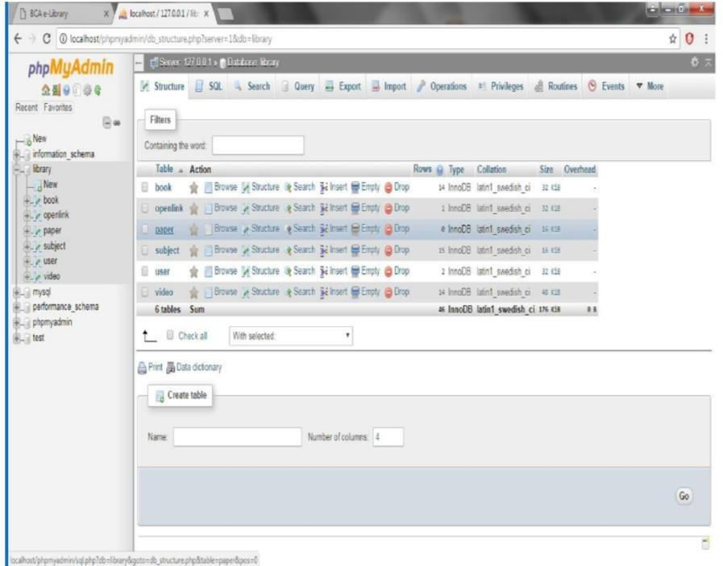
Wikipedia, Google (though not for searches), Facebook, Twitter, Flickr, and
CHAPETR 3 SYSTEM DESIGN
3.1 TABLE DESIGN
VARIOUS TABELS TO MAINTAIN INFORMATION
Library Table from Database
ADMIN TABLE FROM DATABASE

Slide 18
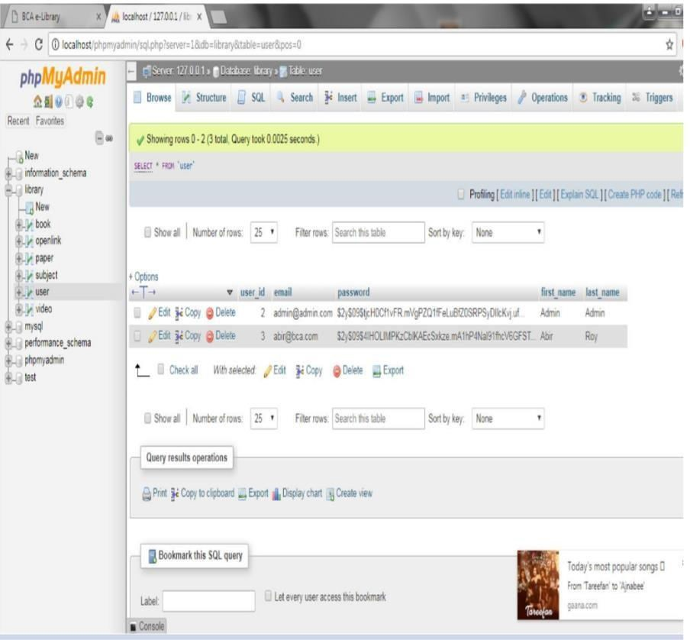
SUBJECT TABLE FROM DATABASE

Slide 19
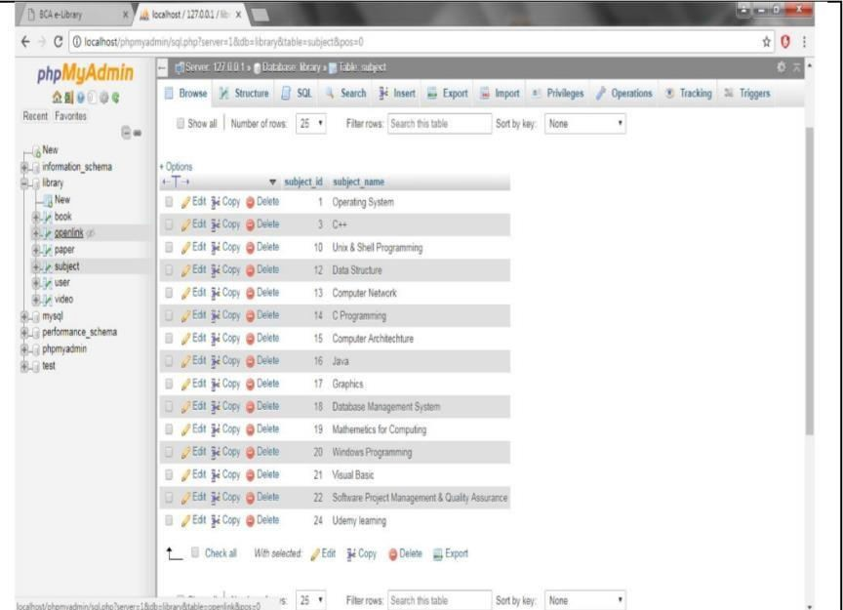
BOOKS TABLE FROM DATABASE BOOKS TABLE FROM DATABSE

Slide 20
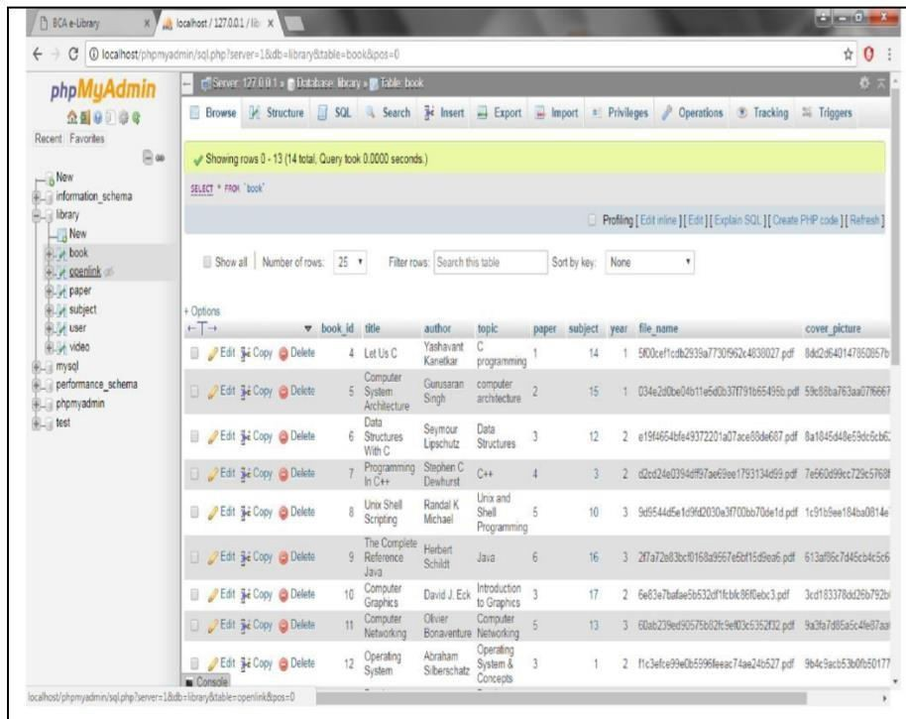
VIDEO TABLE FROM DATABSE
20

Slide 21
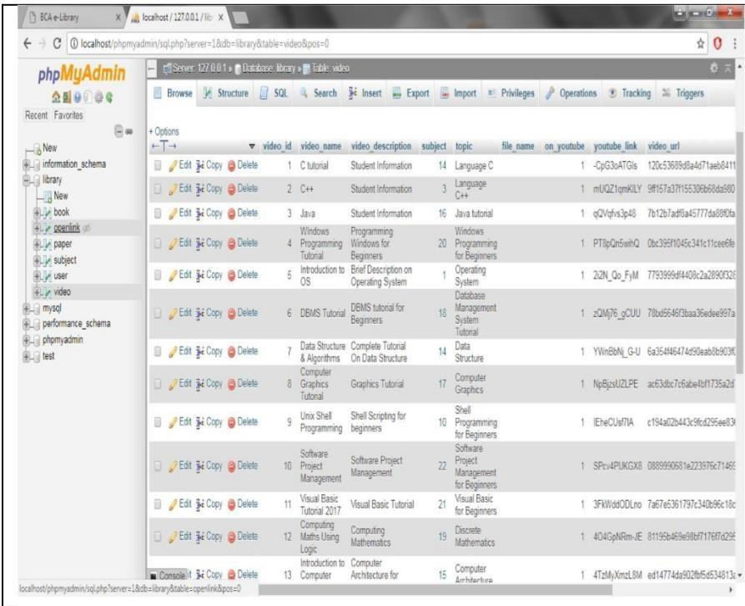
OPEN LINK TABLE FROM DATABASE

Slide 22
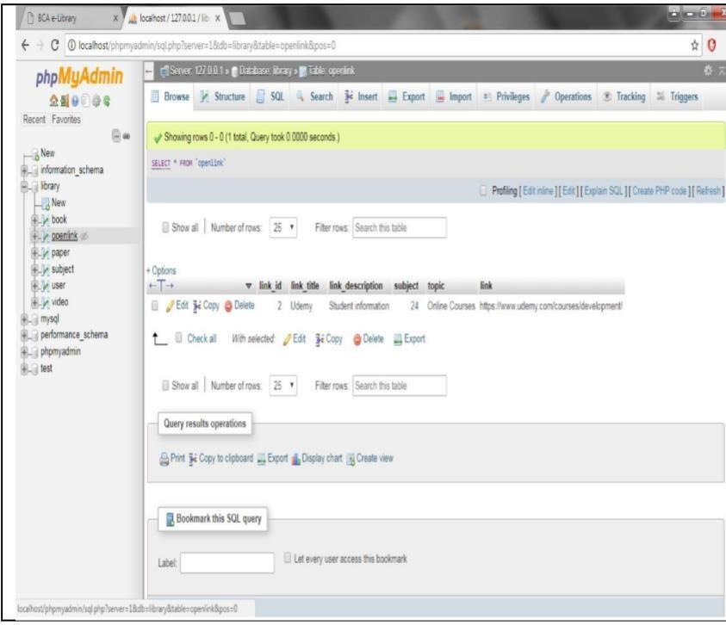
3.2 DATA FLOW DIAGRAM
DATA FLOW DIAGRAM FOR ASMIT LOGIN

Slide 23
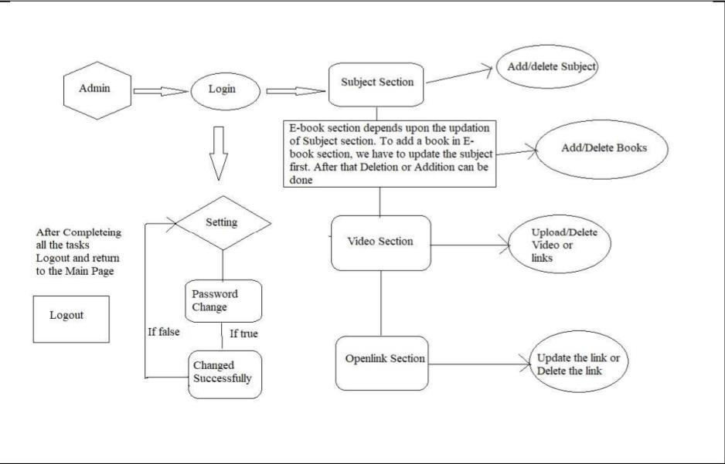
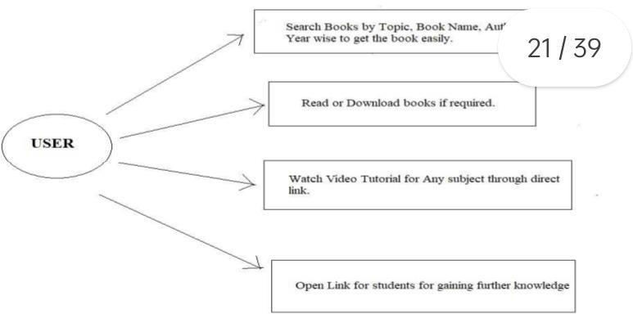
After entering to the home page of the website , Admin can choose the Admin Login option where they are asked to enter username & password , and if he/she is a valid user then a teacher login page will be displayed
USE CASES DIAGRAM FOR USERS

Slide 24
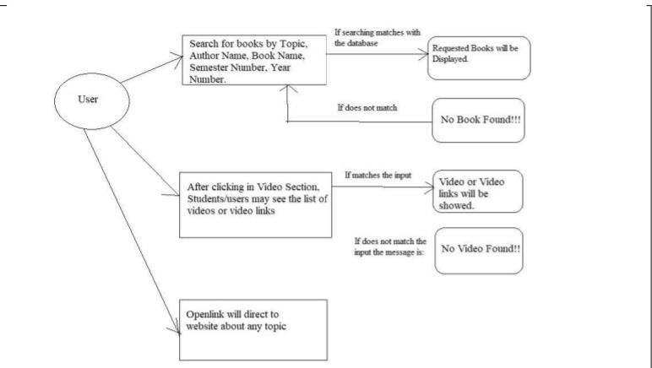
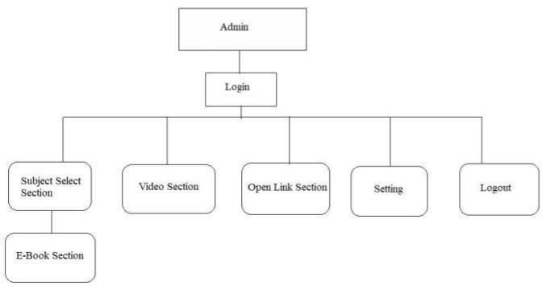
After entering to the home page of the website , student can choose the USER LOGIN option where they are asked to enter username & password , and if he/she is a valid user then a student login page will be displayed.
DATA FLOW DIAGRAM FOR USERS
USERS CASE DIAGRAM FOR ADMIN

Slide 25
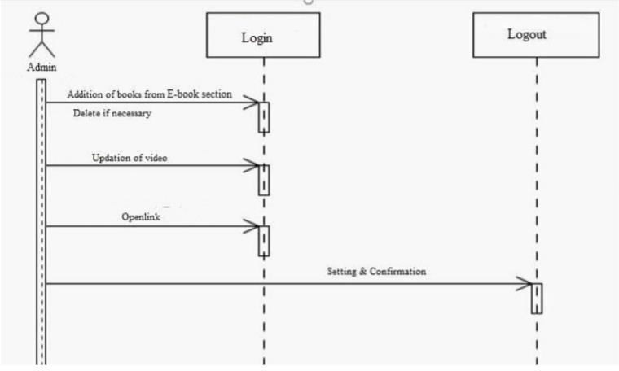
SEQUENCE DIAGRAM

Slide 26
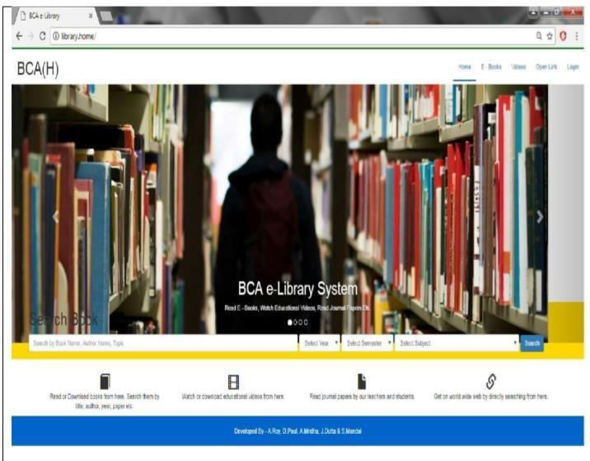
Chapter 4
SYSTEM IMPLEMENTATION
4.2 screenshot of e-books from users.

Slide 27
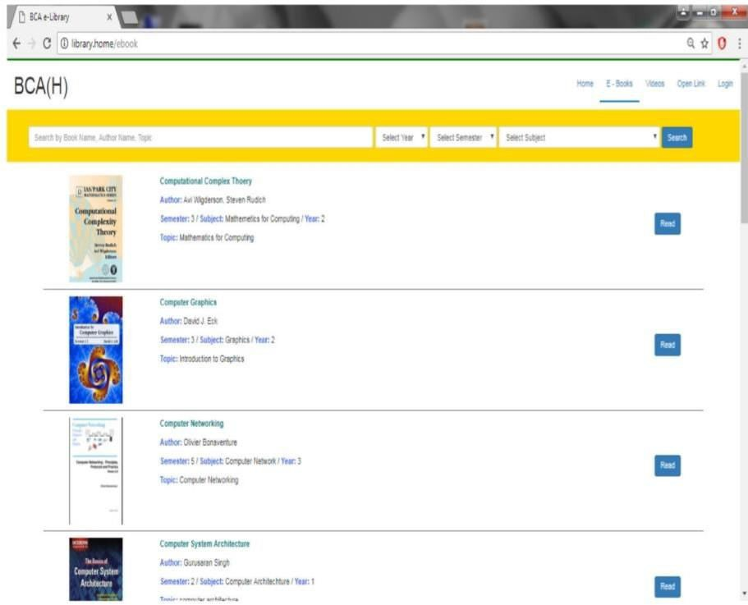
4.3 screenshot of videos from users

Slide 28
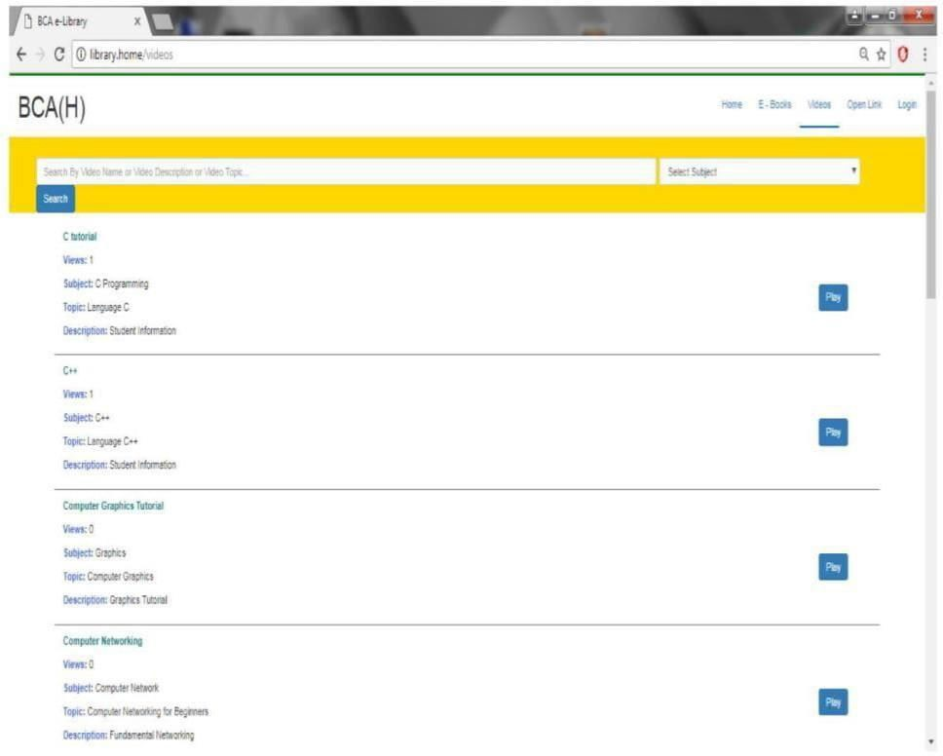
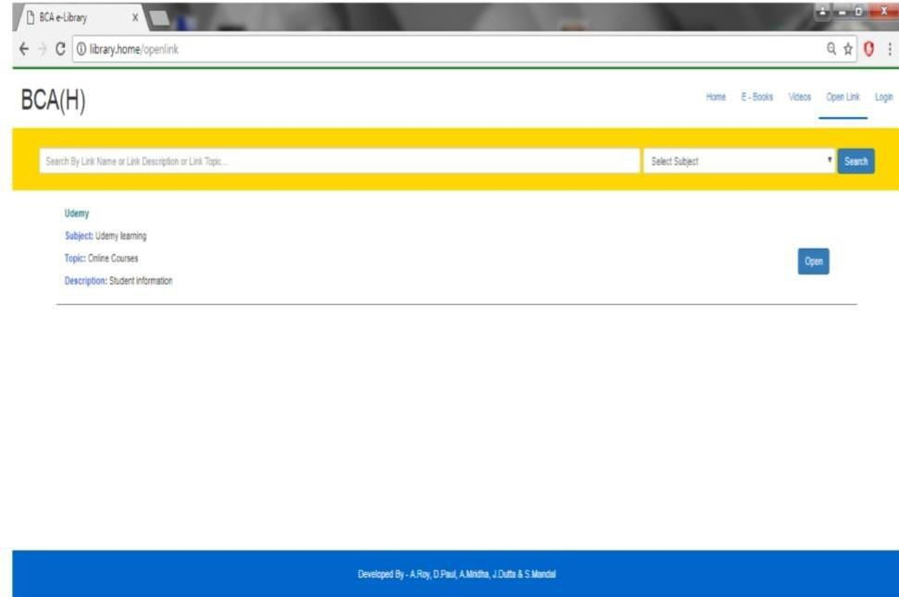
4.4 Screenshot of open from users

Slide 29
4.5 Screenshot of login for admin
  MODULE DESCRIPTION
For Library Management System it is divided into the following Modules:
The aim of the system testing process was to determine all defects in our project .The program was subjected to a set of test inputs and various observations were made and based on these observations it will be decided whether the program behaves as expected or not. Our Project went through two levels of testing
UNIT TESTING
Unit testing is undertaken when a module has been created and succesfully reviewed .In order to test a single module we need to provide a complete environment ie besides the module we would require
    The procedures belonging to other modules that the module under test calls
Non local data structures that module accesses
  A procedure to call the functions of the module under test with appropriate parameters

Slide 30
Unit testing was done on each and every module that is described under module description of chapter
4 1. Test For the admin module
Testing admin login form-This form is used for log in of administrator of the system.In this we enter the username and password if both are correct administration page will open other wise if any of data is wrong it will get redirected back to the login page and again ask for username and password
Student account addition- In this section the admin can verify student details from student academinc info and then only add student details to main library database it contains add and delete buttons if user click add button data will be added to student database and if he clicks delete button the student data will be deleted
Book Addition- Admin can enter details of book and can add the details to the main book table also he can view the books requests .
30

Slide 31
2. Test for Student login module
Test for Student login Form-This form is used for log in of Student .In this we enter thelibraryid, username and password if all these are correct student login page will open other wise if any of data is wrong it will get redirected back to the login page and again ask for libraryid, username and password.
Test for account creation- This form is used for new account creation when student does not fill the form completely it asks again to fill the whole form when he fill the form fully it gets redirected to page which show waiting for conformation message as his data will be only added by administrator after verification.
3. Test for teacher login module
Test for teacher login form- This form is used for logg in of teacher .In this we enter the username and password if all these are correct teacher login page will open other wise if any of data is wrong it will get redirected back to the login page and again ask for username and password.
INTEGRATION TESTING
In this type of testing we test various integration of the project module by providing the input
.The primary objective is to test the module interfaces in order to ensure that no errors are occurring when one module invokes the other module.

Slide 32
CHAPTER 6 REFRENCE
http://www.w3schools.com/htmlintro.asp http://www.udemy.com/css/css http://www.w3schools.com/js/js

