Slide 1

Grocery Store Management
By Sumit Mangalwedhekar

Slide 2

About me
Name: Sumit Mangalwedhekar
Education: B.Tech – Artificial Intelligence & Data Science
College: Vishwakarma University
GitHub: https://github.com/Sumit2308
LinkedIn: https://www.linkedin.com/in/sumit-mangalwedhekar-0a60aa274

Slide 3
Agenda
Objective of the Project
ER Diagram and schema explanation
Key analysis questions (use cases)
SQL query results with summaries
Final business insights and recommendations
Experience/Challenges working on SQL – Data Analysis Project.
Conclusion (Key finding overall)

Slide 4
OBJECTIVE OF THE PROJECT
The main objectives of this project were:
To design and implement a relational database for a grocery store.
To retrieve and manipulate structured data using SQL.
To analyze customer behavior, product performance, and revenue trends.
To apply joins, aggregations, subqueries, filtering, and date functions for business intelligence.
Dataset Summary:
200 Customers
50 Products
300 Orders
5 Suppliers
10 Employees
Total Revenue: ₹551,329.93

Slide 5
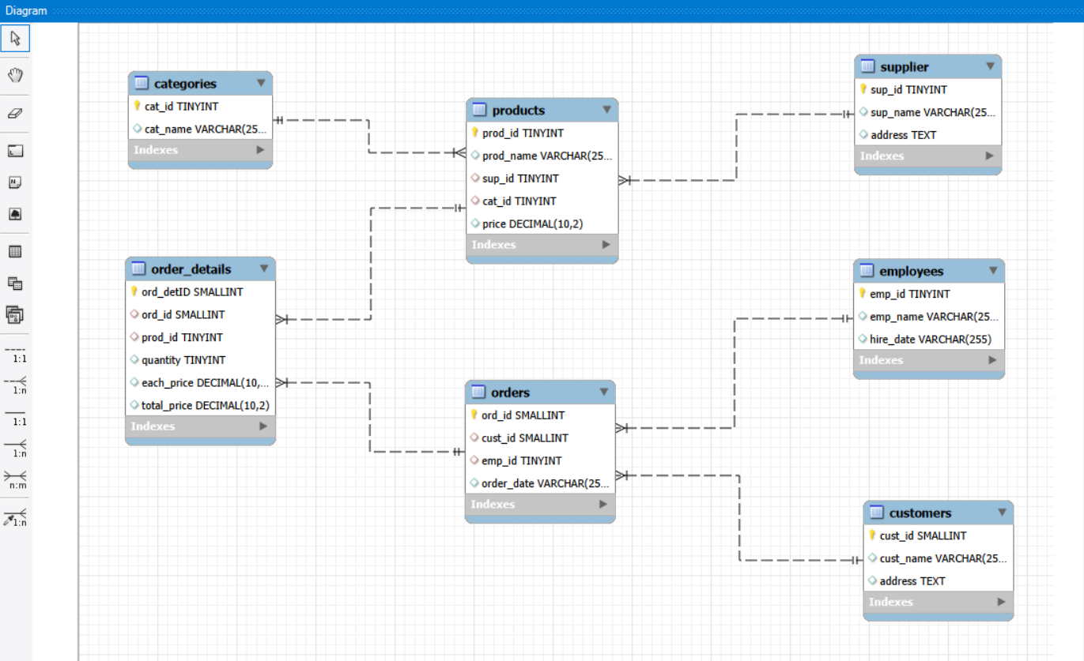
ER DIAGRAM

Slide 6
SCHEMA EXPLANATION:
Database Structure:
Tables Used:
supplier
categories
products
customers
employees
orders
order_details
Relationships:
One Supplier → Many Products
One Customer → Many Orders
One Employee → Many Orders
One Order → Many Order Details
One Category → Many Products

Slide 7
KEY ANALYSIS QUESTIONS (USE CASES)
Customer Insights
Who are the top customers?
What is the average purchase per customer?
Product Performance
Which products sell the most?
Which month generate the highest revenue?
Sales & Trends
What is the total revenue?
What are the monthly revenue patterns?
Supplier Contribution
Which supplier contributes most revenue?
Employee Performance
Which employees process the most sales?

Slide 8
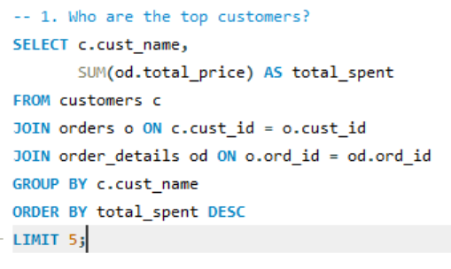
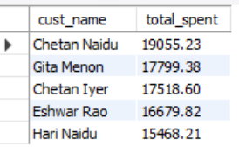
SQL QUERY RESULTS (CUSTOMER INSIGHTS)
Top 5 Customers:
Chetan Naidu – ₹19,055.23
Gita Menon – ₹17,799.38
Chetan Iyer – ₹17,518.60
Eshwar Rao – ₹16,679.82
Hari Naidu – ₹15,468.21
Top 5 customers contribute: ₹86,521.24 → 15.7% of total revenue
Insight: Customer revenue is moderately distributed

Slide 9
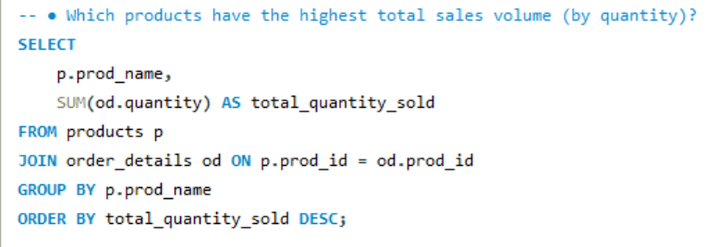
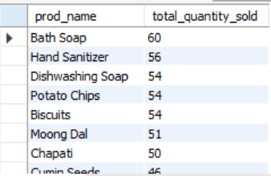
SQL QUERY RESULTS (PRODUCT PERFORMANCE)
Top Selling Products (by quantity):
Bath Soap – 60 units
Hand Sanitizer – 56 units
Dishwashing Soap – 54 units
Biscuits – 54 units
Potato Chips – 54 units
Insight: Essential daily-use products dominate sales.

Slide 10
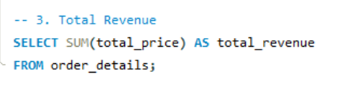

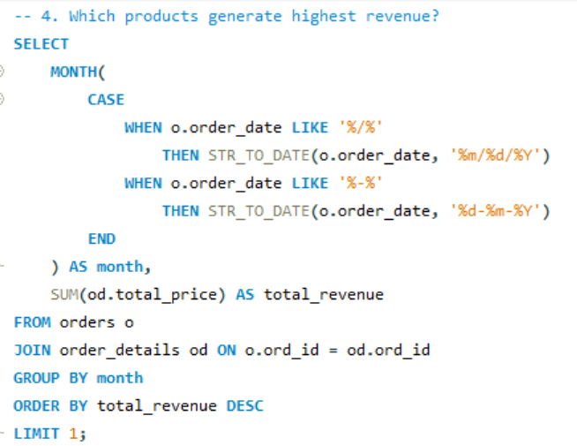

SQL QUERY RESULTS (REVENUE & TRENDS)
Total Revenue: ₹551,329.93
Average Order Value: ₹1,837.77
Highest Revenue Month: October – ₹66,862.80
Lowest Revenue Month: July – ₹32,654.79
Observation: Strong Q4 seasonal spike.

Slide 11
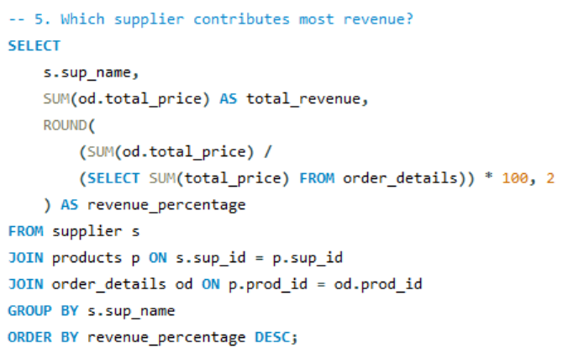
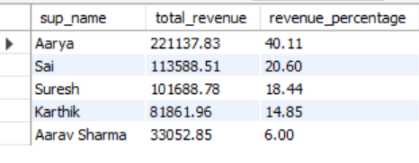
SQL QUERY RESULTS (SUPPLIER CONTRIBUTION)
Supplier Revenue Contribution:
Aarya – 40.1%
Sai – 20.6%
Suresh – 18.4%
Karthik – 14.8%
Aarav Sharma – 6%
Key Finding: High dependency on one supplier (40%).

Slide 12
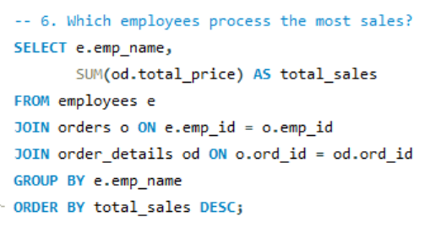
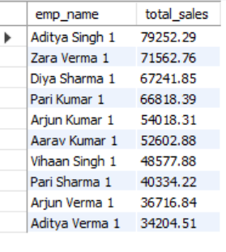
SQL QUERY RESULTS (EMPLOYEE PERFORMANCE)
Revenue Processed by Each Employee
Top Performers:
Aditya Singh – ₹79,252.29
Zara Verma – ₹71,562.76
Diya Sharma – ₹67,241.85
Pari Kumar – ₹66,818.39
Lowest Performer:
Aditya Verma – ₹34,204.51

Slide 13
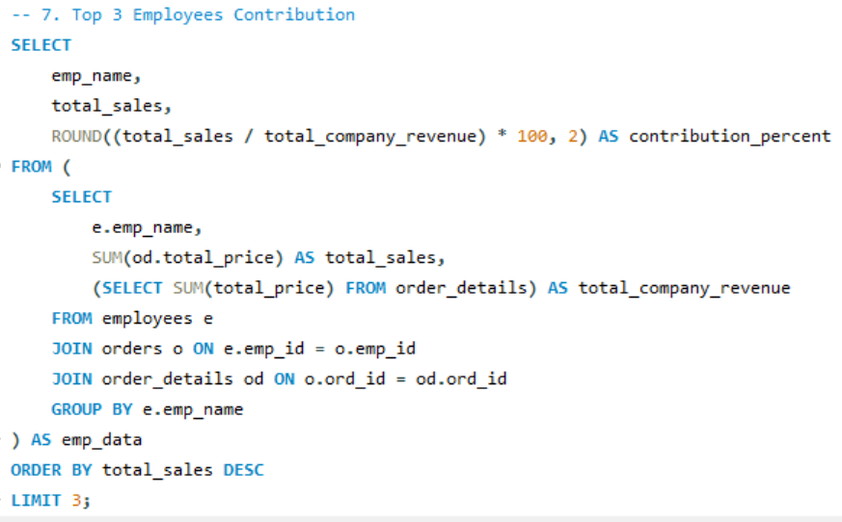
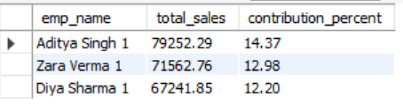
SQL QUERY RESULTS (EMPLOYEE PERFORMANCE)
Key Metrics
Total Employees: 10
Total Revenue: ₹551,329.93
Average Revenue per Employee: ₹55,132
Top Employee Contribution: Aditya Singh contributes ~14.4% of total revenue.
Top 3 Employees Contribution: ₹79,252.29 + ₹71,562.76 + ₹67,241.85 = ₹218,056.90 = 39.5% of total revenue

Slide 14
FINAL BUSINESS INSIGHTS & RECOMMENDATIONS
📊 1. Customer Revenue Distribution
Top 5 customers contribute 15.7% of total revenue.
Revenue is moderately distributed across 200 customers.
🎯 Recommendation:
Introduce loyalty programs for top customers.
Offer targeted promotions to mid-tier customers.
Use customer segmentation (High / Medium / Low spenders).
📦 2. Product Demand Insights
Essential FMCG products dominate sales.
Bath Soap and hygiene products are top sellers.
High repeat purchase behavior observed.
🎯 Recommendation:
Maintain higher inventory for daily essentials.
Bundle high-demand items for promotional offers.
Monitor slow-moving inventory for discounting.
📈 3. Seasonal Revenue Trends
Peak revenue in October (₹66,862.80).
Lowest month: July (₹32,654.79).
Clear Q4 demand spike (Oct–Dec).
🎯 Recommendation:
Increase stock before festive season.
Launch marketing campaigns during low months.
Use monthly revenue trend for demand forecasting.

Slide 15
🏭 4. Supplier Risk Analysis
Aarya contributes 40.1% of total revenue.
Top 3 suppliers contribute nearly 79% revenue.
🎯 Recommendation:
Diversify supplier base.
Negotiate better pricing with top supplier.
Develop backup vendor strategy.
👨‍💼 5. Employee Productivity Insights
Revenue distributed across 10 employees.
Top 3 employees contribute 39.5% revenue.
🎯 Recommendation:
Introduce performance-based incentives.
Share best practices of top performers.
Monitor revenue per employee monthly.
🧠 Overall Strategic View
Data-driven decisions can improve:
Profit margins
Operational efficiency
Inventory planning
Supplier negotiation power

Slide 16
CHALLENGES & EXPERIENCE
Challenges Faced:
Handling inconsistent date formats in orders table.
Writing complex multi-table joins.
Managing foreign key constraints.
Converting raw data into business insights.
Learning Outcome:
Improved advanced SQL skills.
Better understanding of relational database design.
Experience in real-world messy data handling.
Stronger business analytics thinking.

Slide 17
CONCLUSION
This project successfully designed and analyzed a relational grocery store database using SQL.
Key Findings
Total Revenue: ₹551,329.93
Strong seasonal spike in October
Top supplier contributes 40% of revenue
Balanced employee performance
Essential FMCG products dominate sales
Technical Skills Applied
Multi-table JOIN operations
Aggregations (SUM, AVG, COUNT)
Subqueries & filtering
Handling inconsistent date formats
KPI & revenue percentage analysis
Final Takeaway
This project demonstrates how SQL can transform raw transactional data into meaningful business insights and support data-driven decision making.

Slide 18

THANK YOU

