Slide 1
Gantt Charts and Scheduling Logic

Slide 2
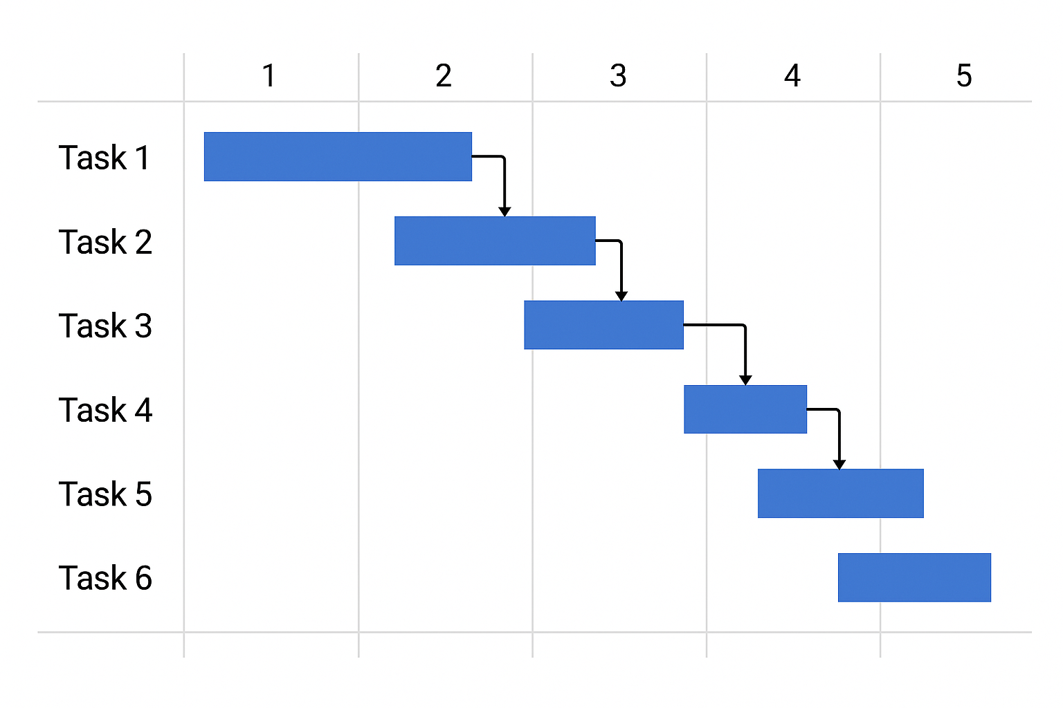
Introduction to Gantt Charts
Definition: A Gantt chart is a bar chart showing project tasks over time.
Developed by Henry L. Gantt (early 1900s).
Common tools: MS Project, Excel, GanttProject.
Used for visualizing project timelines and progress.

Slide 3
Gantt Chart Basics
Time runs horizontally; activities are listed vertically.
Bars represent task duration, start, and finish dates.
Milestones shown as diamonds or markers.
Color or shading can show progress or task status.

Slide 4
Scheduling Logic
Finish-to-Start (FS): Task B begins when Task A finishes (most common).
Start-to-Start (SS): Tasks begin simultaneously.
Finish-to-Finish (FF): Tasks must finish at the same time.
Start-to-Finish (SF): Rare dependency type.

Slide 5
Lag and Lead Time
Lag: intentional delay between tasks.
  Example: wait 3 days after concrete pour before inspection.
Lead: overlap between tasks for efficiency.
  Example: start painting 2 days before drywall completion.
Lag/Lead refine schedule realism and control timing.

Slide 6
Linking AON and Gantt
AON diagrams define task logic and dependencies.
Gantt charts visualize the same relationships over time.
Both use dependency logic, including lag and lead adjustments.
Combining both improves planning accuracy and communication.

Slide 7
Advantages of Gantt Charts
Highly visual and easy to interpret.
Tracks planned versus actual progress.
Shows dependencies, milestones, and lags clearly.
Useful communication tool for non-technical stakeholders.

Slide 8
Limitations of Gantt Charts
Can become cluttered for large projects.
Difficult to show multiple dependencies clearly.
Does not easily show total float or slack.
Less analytical detail than Critical Path Method (CPM).

Slide 9
Summary
Gantt charts visualize project timing and task relationships.
Scheduling logic defines how tasks connect.
Lag and lead provide timing flexibility.
Combining AON and Gantt gives a complete schedule picture.

