Slide 1
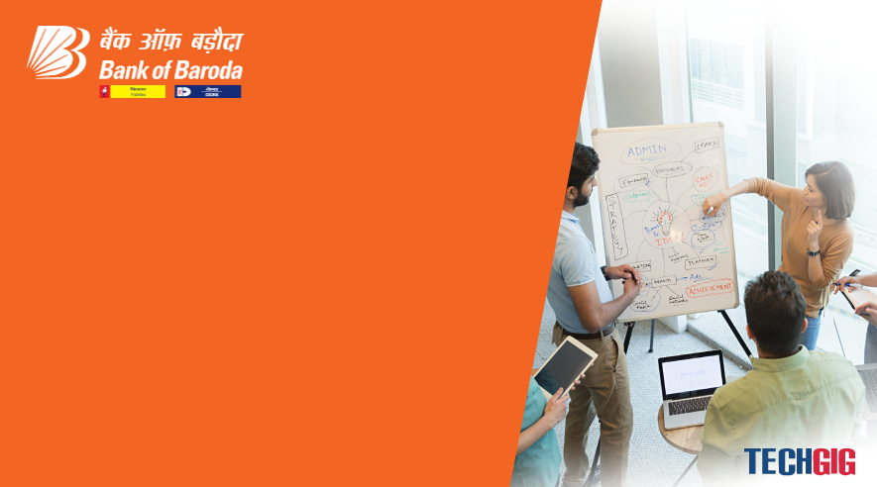

Bank of Baroda Hackathon - 2022
Technology Partner
Your Team Name : The Spartans
Your team bio : A group of tech enthusiasts who are keen to discover the way machine and humans can collaborate to enlighten the society.
Date : 20/09/2022

Slide 2
Video Analytics
One of the most popular technological tools for monitoring is the CCTV. This video can “LATER” be used as the source to address problems in banks, such as ATM theft, etc.
When we took into account the same “LATER” into “NOW” using our Microsoft Azure powered cloud-based analytical software with A.I. capabilities. As a result, we chose this use case to address an important issue that banks confront.

Slide 3
User Segment & Pain Points
Any service-based business regardless of the domain they are operating can be our potential customer. The reason being there common pain points regarding their customer experience. The biggest pain points are:
Unable to understand customer satisfaction.
Lack of technology support to detect the customers next move and the reason behind that.
How fast is there service is in terms of time taken to serve per person.
Hence we are solving all these issues with few more with the advantage to customization in the A.I. to suit all service-based businesses. To get the satisfactory level of customers feedback forms are still in the market which are neither the best way to do nor the efficient way.

Slide 4
Pre-Requisite
Apart from Banks, this model can be used in malls, service centres, brand outlets etc. where the company serve the customer with some products or services.

Slide 5
Azure tools or resources
1. Azure Database for MySQL 2. Azure Cosmos DB 3. API management 4. Application gateway 5. Azure Video Indexer 6. Computer Vision etc.

Slide 6
Key Differentiators & Adoption Plan
The differentiator is, the ease to use, requirement of no extra high-end hardware and the efficiency of solving the problem with human like understanding. To detect the satisfactory level the software not just detects the facial expression like any other deep learning models but it will average out the facial expression for every minute till the time customer stays. Further it will use the tone analyser to understand the tone of the customer at the time of taking the service at the counters.

Slide 7
Thank You
Sumit Sinha
Midhvana Rishi
Kush Mishra

