Slide 1

WORKSHOP ON PYTHON & IMAGE PROCESSING
Dr. Akhilesh Das Gupta Institute of Technology and Management, New Delhi
Organized BY ECE Department
11th -12th February, 2020
Student Coordinators :
Zorawar Singh
Sumneet Kaur
Devjot Singh
Aman Puri
Pranav Gupta
HEAD OF DEPARTMENT: Prof. (Dr.) Rajiv Sharma
EVENT COORDINATOR:
Asstt. Prof. Swati

Slide 2
PYTHON
Easy to Learn and Use
Expressive Language
Interpreted Language
Cross-platform Language
Free and Open Source
Object-Oriented Language

Slide 3
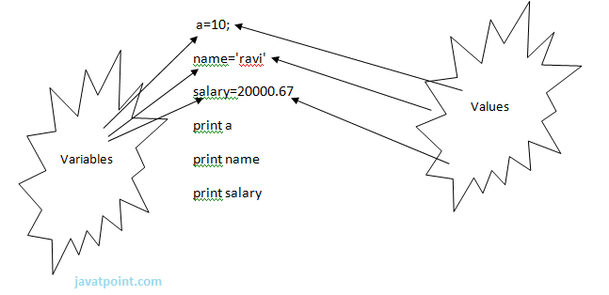
Python Variables
Identifier Naming
Declaring Variable and Assigning Values
Multiple Assignment

Slide 4
Python Data Types
Numbers
String
List
Tuple
Dictionary

Slide 5
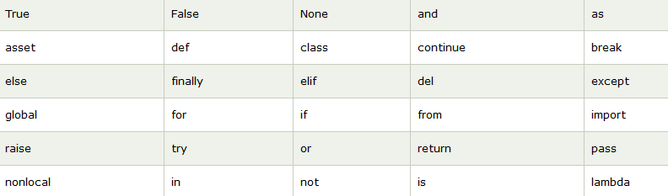
Python Keywords

Slide 6
Python Operators
Arithmetic operators
Comparison operators
Assignment Operators
Logical Operators
Bitwise Operators

Slide 7
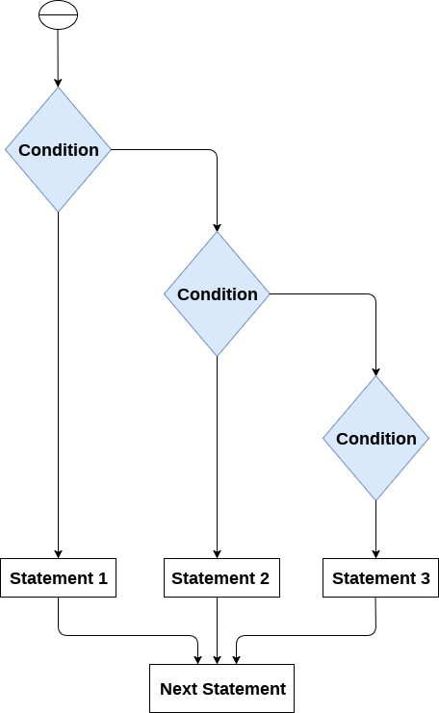
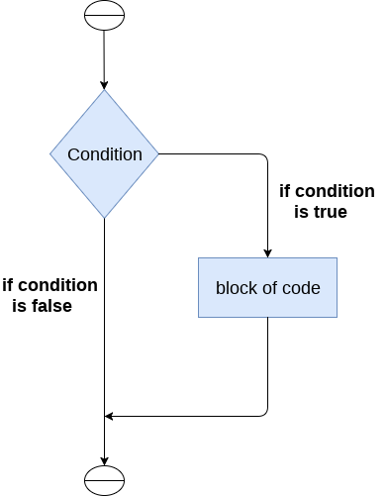
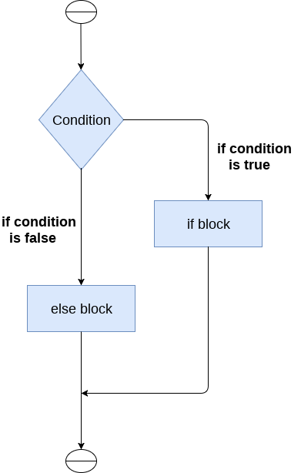
Python If-else statements
The if statement
The if-else statement
The elif statement

Slide 8


Python Loops
Python for loop
Python while loop

Slide 9
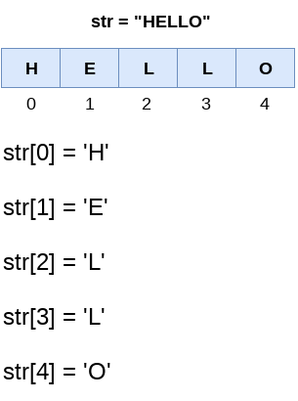
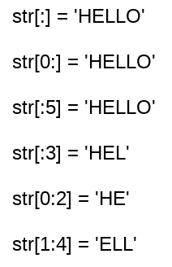
Strings indexing and splitting

Slide 10
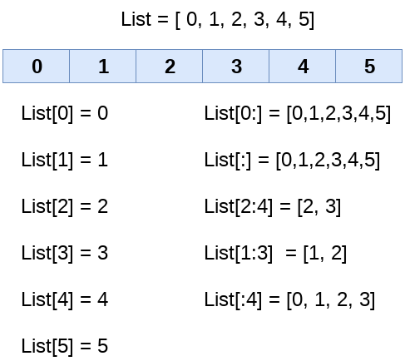
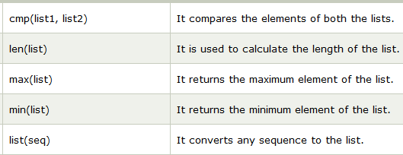
Python List

Slide 11

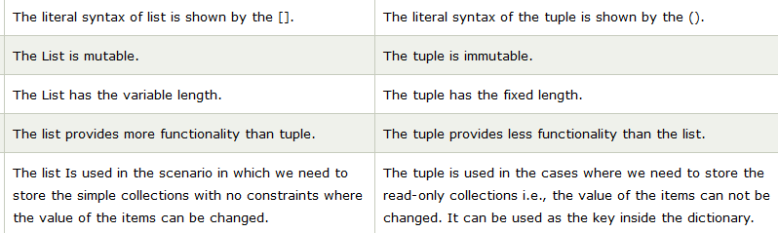
Python Tuple

Slide 12
Python Functions
Advantage of Functions in Python
Creating a function
Function calling
Parameters in function
Call by reference in Python
Types of arguments

Slide 13
DAY 2
IMAGE PROCESSING

Slide 14
What is an image?
A pixel is the smallest unit of an image.
A Pixel represents a fixed value
A 2-D array of pixels forms an image
For ease we will be using UINT8 type images. (?)

Slide 15
Colour Schemes
Colour (BGR)
HSV
Grayscale

Slide 16
Loading and Displaying an image

