Slide 1
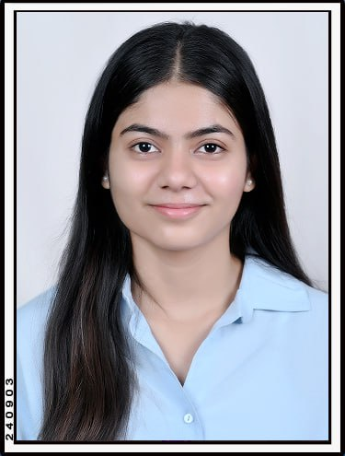
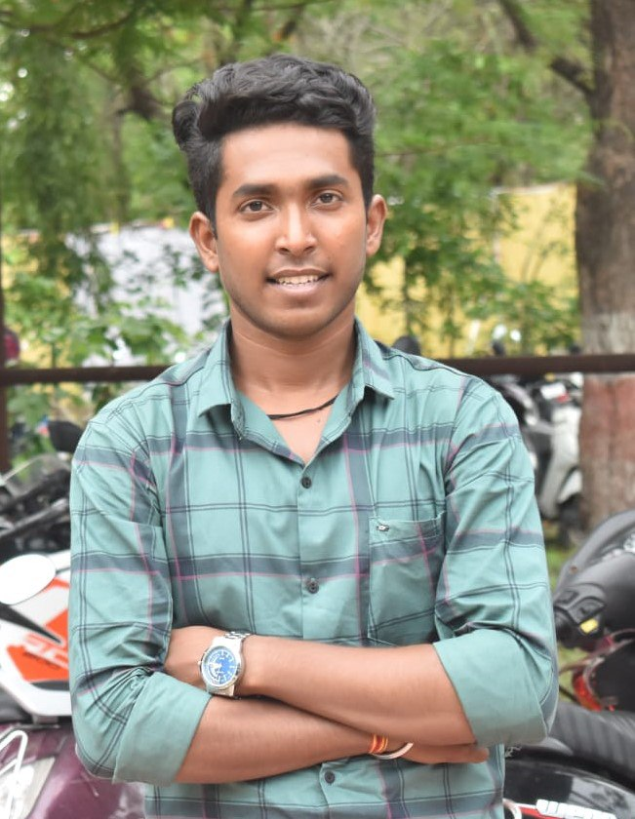
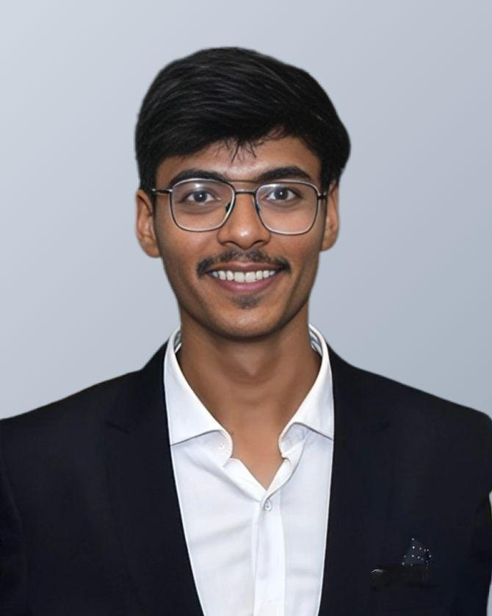
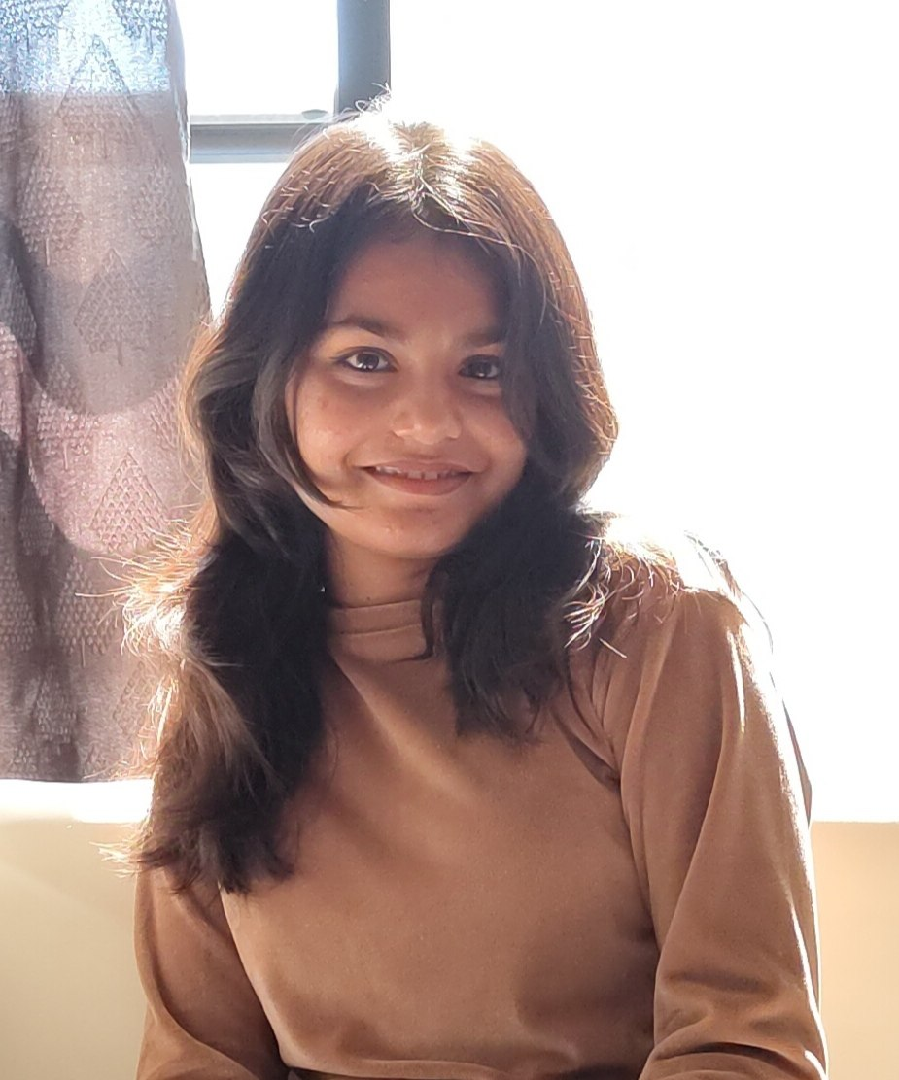
Team details
TEAM NAME: Pose_Fit
Ishwari Kusumbe
Sumit Katwate (Team Leader)
College: Government College of Engineering Amravati
Stream: Information Technology
Year of graduation: 2025
College: Government College of Engineering Amravati
Stream: Information Technology
Year of graduation: 2025
Kshitija Jaminkar
Om Ladole
Photo
College: Government College of Engineering Amravati
Stream: Information Technology
Year of graduation: 2025
College: Government College of Engineering Amravati
Stream: Information Technology
Year of graduation: 2025

Slide 2
Problem Statement:
Develop an AI-based pose estimation model using computer vision and deep learning to assist users in performing exercises with proper form at home, reducing injury risk and enhancing workout efficiency. The model will utilize convolutional neural networks (CNNs) or similar architectures to detect and track key body landmarks such as joints and limbs in real time. By comparing the user’s posture against predefined ideal poses for exercises like squats, push-ups, and lunges, the system will analyze deviations and provide immediate real-time feedback for corrections. The model will also offer continuous posture analysis throughout the exercise, alerting users when they deviate from the correct form and giving suggestions for improvement. This AI-driven solution is designed for home environments, requiring only a camera for real-time monitoring, and can be implemented through mobile or web applications using deep learning frameworks such as TensorFlow, PyTorch, or MediaPipe. By ensuring proper posture during exercises, the system will help users minimize the risk of injury, improve workout effectiveness, and provide a personalized training experience without requiring professional supervision.

Slide 3
Proposed Solution:
To solve the problem of incorrect posture during home exercises, we propose an AI-powered pose estimation model utilizing computer vision and deep learning. This model will detect key body landmarks (e.g., joints and limbs) in real-time using convolutional neural networks (CNNs) or advanced architectures like MediaPipe Pose. These landmarks will be compared against ideal postures for various exercises, such as squats, lunges, or push-ups, to identify deviations. The system will provide real-time feedback to users by highlighting incorrect movements and offering corrections. This feedback will ensure proper exercise form, reduce injury risk, and optimize workout efficiency. Additionally, the model will continuously monitor users throughout their workout, alerting them when they perform exercises incorrectly and guiding them to adjust their posture. This solution is designed to work with a standard camera, making it accessible for home workouts. The AI model can be integrated into mobile or web applications using frameworks like TensorFlow or PyTorch, allowing users to train with real-time guidance. By ensuring correct posture, the system will enable users to improve their form, avoid injuries, and achieve better health outcomes from their workouts without requiring professional supervision.

Slide 4
Video Link: https://drive.google.com/file/d/1pa5tIO0Np9kfD5ostRSpg9Zh8ivJaytv/view?usp=sharing
Research Paper :
https://docs.google.com/document/d/1JYNXsXcHHHsxOL7bVD_Fb5LxvjUNecIk/edit?usp=sharing&ouid=102072925140913108008&rtpof=true&sd=true
Thank You !!!!

