Slide 1

Team Details
Team name – TeamMAGNUS
Team leader name – Sumit Mondal
Problem Statement - Travelers often use multiple disconnected apps for navigation, weather updates, traffic monitoring, accommodation booking, restaurant search, fuel stations, mechanic support, and sightseeing discovery. Existing platforms do not integrate all travel needs into a single intelligent ecosystem, leading to inefficient planning, safety risks, and missed exploration opportunities along travel routes.

Slide 2

Brief about the idea
Our solution is an AI-powered smart travel ecosystem designed for all types of travelers — including bike riders, car travelers, road-trippers, campus groups, and solo explorers.
The platform integrates real-time weather updates, traffic analysis, fuel prediction, nearby stay recommendations, restaurant suggestions based on time of day (breakfast, lunch, evening snacks, dinner), nearby mechanic and fuel stations, safety-based route risk scoring, and dynamic sightseeing discovery along travel routes — all within a single intelligent application.
Unlike traditional navigation apps, our system acts as a complete travel assistant by combining AI-driven optimization with community-powered insights. It ensures safer journeys, smarter budgeting, and enriched exploration of attractions located along the road.
The platform uses AI-driven personalization to learn user preferences such as travel style, budget range, food preferences, safety sensitivity, and sightseeing interests. Based on past trips and behavior patterns, it dynamically recommends optimized routes, suitable restaurants, ideal stay options, and customized sightseeing stops — making every journey uniquely tailored to the traveler.

Slide 3
Opportunities:-
Unlike existing travel apps that focus only on navigation, booking, or food discovery separately, our platform integrates real-time weather, traffic analysis, nearby stays, time-based restaurant suggestions, mechanic support, fuel alerts, and route-based sightseeing discovery into a single AI-powered ecosystem. It provides a complete travel assistant rather than a single-feature application.
The solution reduces travel complexity by combining multiple travel services into one intelligent platform. It optimizes routes, provides safety alerts, suggests nearby essential services, and highlights sightseeing spots along the journey, ensuring safer, smarter, and more enjoyable travel planning without switching between multiple apps.
An all-in-one AI-powered travel intelligence ecosystem that integrates navigation, safety monitoring, service discovery, personalization, and route-based exploration into a unified platform for all types of travelers.

Slide 4
List of features offered by the solution:-
Smart Multi-Mode Route Planner (Bike, Car, Group Travel)
AI-Based Route Optimization (Time, Cost, Safety Balanced)
Real-Time Weather Updates & Alerts
Traffic Congestion Analyzer
Fuel Prediction & Nearby Fuel Station Locator
Nearby Stay Recommendations (Hotels, Hostels, Camping Options)
Time-Based Restaurant Suggestions (Breakfast, Lunch, Evening Snacks, Dinner)
Nearby Mechanic & Emergency Support Locator
Route Risk Scoring System
Dynamic Sightseeing Discovery Along the Travel Route
Personalized Travel Recommendation Engine
Community Reviews & Safety Feedback System
Group & Campus Trip Coordination Tool
Carbon Footprint Tracker
Offline Mode for Remote or Low-Network Areas
Auto Trip Summary & Shareable Report Generator

Slide 5
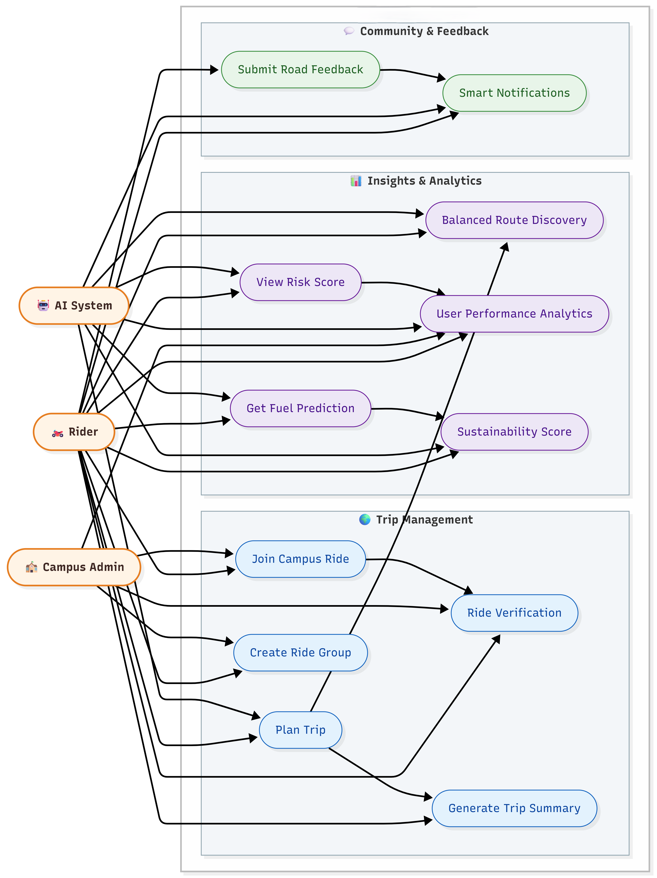
Process flow diagram or Use-case diagram

Slide 6
Wireframes/Mock diagrams of the proposed solution (optional)
Type here

Slide 7
Architecture diagram of the proposed solution

Slide 8
Technologies to be used in the solution
Firebase – Authentication, Cloud Firestore Database, and Real-time Data Sync
Node.js – Backend server and API management
Python – AI/ML models for route optimization, risk scoring, and personalization
Machine Learning Algorithms – Recommendation systems and predictive analytics
RESTful APIs – Integration with external services
Maps API (Google Maps / OpenStreetMap) – Navigation and geolocation services
Weather API Integration – Real-time weather updates and forecasts
Places API – Nearby restaurants, stays, sightseeing spots, mechanic shops
Geospatial Data Processing – Route analysis and point-of-interest detection
Cloud Hosting (Firebase / Cloud Platform) – Scalable deployment
Push Notification Service – Real-time alerts and emergency notifications
Data Analytics Tools – Travel insights and performance monitoring
Offline Data Caching Technology – Support in low-network areas

Slide 9
Usage of AMD Products/Solutions
AMD Ryzen™ Processors – Used for high-performance development, backend processing, and training AI/ML models for route optimization, traffic analysis, and risk scoring.
AMD Radeon™ GPUs – Utilized for accelerating machine learning computations, geospatial data processing, and real-time route analytics.
AMD-Powered Systems for Model Training – Heavy AI workloads such as predictive weather modeling, personalization engines, and traffic data analysis can be optimized using AMD’s multi-core architecture for faster computation.
Parallel Processing with AMD Architecture – Enables efficient handling of large-scale travel datasets, including route mapping, location intelligence, and real-time recommendation systems.
Scalable Deployment & Testing – Application backend and simulation testing can be optimized on AMD-powered cloud or workstation environments for performance efficiency.

Slide 10
Estimated implementation cost (optional)
Type here

Slide 11
Prototype Assets (Optional)
GitHub Public Repository Link:-https://github.com/Sumit648527/AMD
Demo Video Link:-https://drive.google.com/drive/folders/1jiCzmENKc11uaTdsBxFibxbZekCuKcde?usp=sharing

Slide 12
Add as per the requirements of the contest
Our proposed solution aligns with the contest objectives by delivering an AI-driven, scalable, and high-performance travel intelligence platform that integrates real-time mobility analytics, predictive modeling, and personalized recommendation systems. The application leverages advanced computing capabilities for route optimization, weather-risk analysis, traffic modeling, and geospatial data processing.
The system is designed to:
Demonstrate innovation in smart mobility and intelligent travel planning
Utilize AI/ML models accelerated on AMD-powered systems
Showcase scalable cloud-based architecture
Address real-world travel planning challenges with practical implementation
Promote sustainable mobility through carbon tracking and optimized routing
The prototype will include a working mobile interface, integrated APIs, and an AI-based route intelligence engine to demonstrate feasibility and technical depth, ensuring alignment with the technical and innovation benchmarks of the competition.

Slide 13
Our project is an AI-powered Smart Travel Intelligence Ecosystem designed for all types of travelers. Many travelers currently depend on multiple disconnected applications for navigation, weather updates, traffic monitoring, accommodation booking, food discovery, fuel stations, and sightseeing information, which makes planning inefficient and complicated. Our solution integrates all these features into one unified platform. It offers AI-driven route optimization, real-time weather and traffic insights, time-based restaurant suggestions, nearby stay recommendations, mechanic and fuel station locators, and dynamic sightseeing discovery along travel routes. Built on scalable architecture and high-performance computing, the system enhances safety, personalization, convenience, and overall travel efficiency, creating a smarter and more seamless travel experience.

Slide 14


