Slide 1

Team Name : TeamMAGNUS
Team Leader Name : Suraj Ojha
Problem Statement :Millions of semi-literate Indian micro-merchants are excluded from the digital economy because they cannot navigate complex, text-first financial applications to track their daily credit and payments.

Slide 2
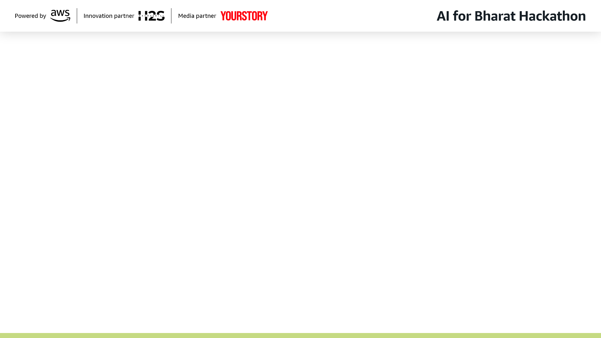
Brief about the Idea:
Bol-Khata: The Voice-First Financial Ledger for Bharat
Bol-Khata is an AI-powered digital ledger designed for India’s 80 million+ street vendors and micro-merchants who struggle with complex, typing-based financial apps due to literacy or language barriers.
Instead of navigating menus or typing names, a vendor simply speaks naturally in their local dialect (e.g., "Ramesh ne 20 rupay udhaar liye"). Our system uses a Hybrid AI Architecture:
Voice AI (Bhashini/Sarvam): Instantly transcribes mixed-language speech (Hinglish/Tanglish) into text.
NLU Engine (Python): Extracts the intent (Credit vs. Payment), customer name, and amount.
Banking Core (Java): Securely logs the transaction and automatically sends a WhatsApp payment reminder to the customer.
Key Innovation: It creates a "Zero-Touch" user interface where the vendor speaks, the app listens, confirms back in audio, and manages the books—making digital record-keeping accessible to the next billion users.

Slide 3
Your solution should be able to explain the following:
1. How different is it from any of the other existing ideas?
While apps like Khatabook, OkCredit, and Paytm for Business exist, they are primarily Visual & Text-First—they require users to navigate menus, type customer names, and manually enter numbers. Bol-Khata is Voice-First. It completely removes the keyboard and screen navigation from the primary workflow. Competitors treat voice as an "add-on" feature (like a search bar). We treat voice as the only interface needed, mimicking how an uneducated vendor naturally speaks ("Ramesh ne 20 rupay udhaar liye"). Unlike standard speech-to-text tools, we utilize Bhashini/Sarvam AI (India's Digital Public Infrastructure) to handle code-mixed "Hinglish" and regional dialects specific to Indian street commerce, which global competitors struggle with.
2. How will it be able to solve the problem?
The core problem is exclusion due to friction. Street vendors stop using digital tools during rush hours because typing is too slow, leading to lost data and financial loss. The vendor simply taps a big button and speaks the transaction in their local dialect. Our Python-based NLU engine extracts the Intent (Credit/Payment), Entity (Customer Name), and Value (Amount) instantly. The app plays back an audio confirmation ("Recorded 20 rupees for Ramesh") so the vendor doesn't even need to look at the screen to verify. It automatically sends a WhatsApp payment link to the customer, ensuring the vendor gets paid on time without awkward face-to-face reminders.
3. USP of the proposed solution
"Zero-Touch Bookkeeping": The first ledger app designed to be used "eyes-free" and "hands-free" during peak business hours.
"Built for Bharat, not just India": Deep integration with Indian dialects (Bhojpuri, Tanglish, etc.) ensuring that language barrier is never a barrier to financial literacy.
"Hybrid Trust Architecture": We combine the cutting-edge speed of AI (Python) with the reliability of a banking-grade backend (Java/Spring Boot), giving users the ease of a chat app with the security of a bank.

Slide 4
List of features offered by the solution:
Voice-First Transaction Logging:
Feature: "Speak-to-Log" interface.
Description: Vendors record transactions naturally (e.g., "Ramesh ne 50 rupay udhaar liye") without typing or navigating menus.
Tech: Powered by Bhashini / Sarvam AI for high-accuracy dialect recognition.
"Eyes-Free" Audio Confirmation:
Feature: Two-way audio feedback loop.
Description: The system talks back to verify the entry (e.g., "Recorded 50 rupees for Ramesh. Is this correct?"), allowing vendors to work without looking at the screen during
rush hour.
Audio Evidence & Dispute Resolution:
Feature: Immutable Audio Audit Trail.
Description: Unlike competitors that just save text, Bol-Khata saves the original voice recording linked to the transaction. If a customer disputes a bill, the vendor can replay the
exact moment the credit was given.
Automated WhatsApp Reminders:
Feature: Smart Payment Alerts.
Description: Automatically sends a professional WhatsApp receipt or payment link to the customer immediately after the transaction is logged, reducing the awkwardness of
asking for money.
3-Tier Intelligent NLU Engine:
Feature: Cost-Optimized Intent Extraction.
Description: A proprietary tiered system (Regex → Keyword Mapping → LLM Fallback) that ensures simple numbers are processed instantly and cheaply, while complex phrases
use advanced AI.
6. Code-Mixed Language Support:
Feature: "Hinglish" & "Tanglish" Native.
Description: Specifically trained to understand the mix of English and regional languages common in Indian street commerce (e.g., "20 rupay paid"), not just pure textbook
language.
Fuzzy Customer MatchingFeature:
Feature: Smart Name Recognition.
Description: Identifies customers even if the vendor pronounces their name slightly differently each time (e.g., matching "Ramesh", "Ramesh-ji", and "Rames" to the same account).
8. Visual Representation Ideas :
Visual 1: The "Zero-Touch" LoopDraw a cycle with 3 icons:Mic Icon (Vendor Speaks) ➡️Brain Icon (AI Processes) ➡️Speaker Icon (App Confirms) Caption: "100% Eyes-Free Workflow.
Visual 2: The Trust LayerDraw a Database Record row: [ Date | Customer | Amount | 🔊 Play Audio Button ] Caption: "The only ledger that keeps the 'Voice of Truth' for every transaction.
Visual 3: The Hybrid StackDraw a split block:Left Side (Python Snake): "Fast AI Brain (NLU)"Right Side (Java Coffee Cup): "Secure Banking Core"Center: "Connected via API" Caption: "Speed of AI + Security
of banking.

Slide 5
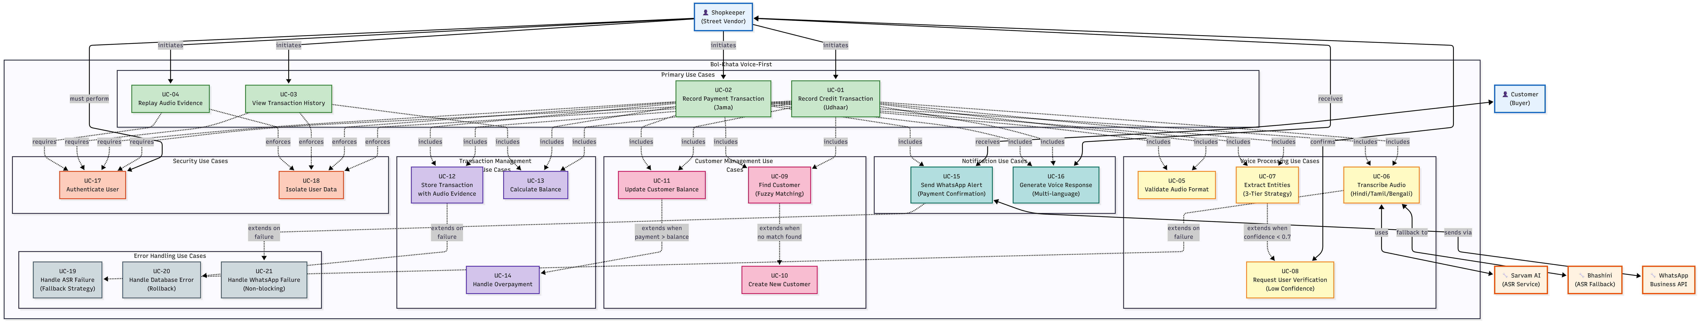
Process flow diagram or Use-case diagram:

Slide 6
Wireframes/Mock diagrams of the proposed solution (optional)

Slide 7
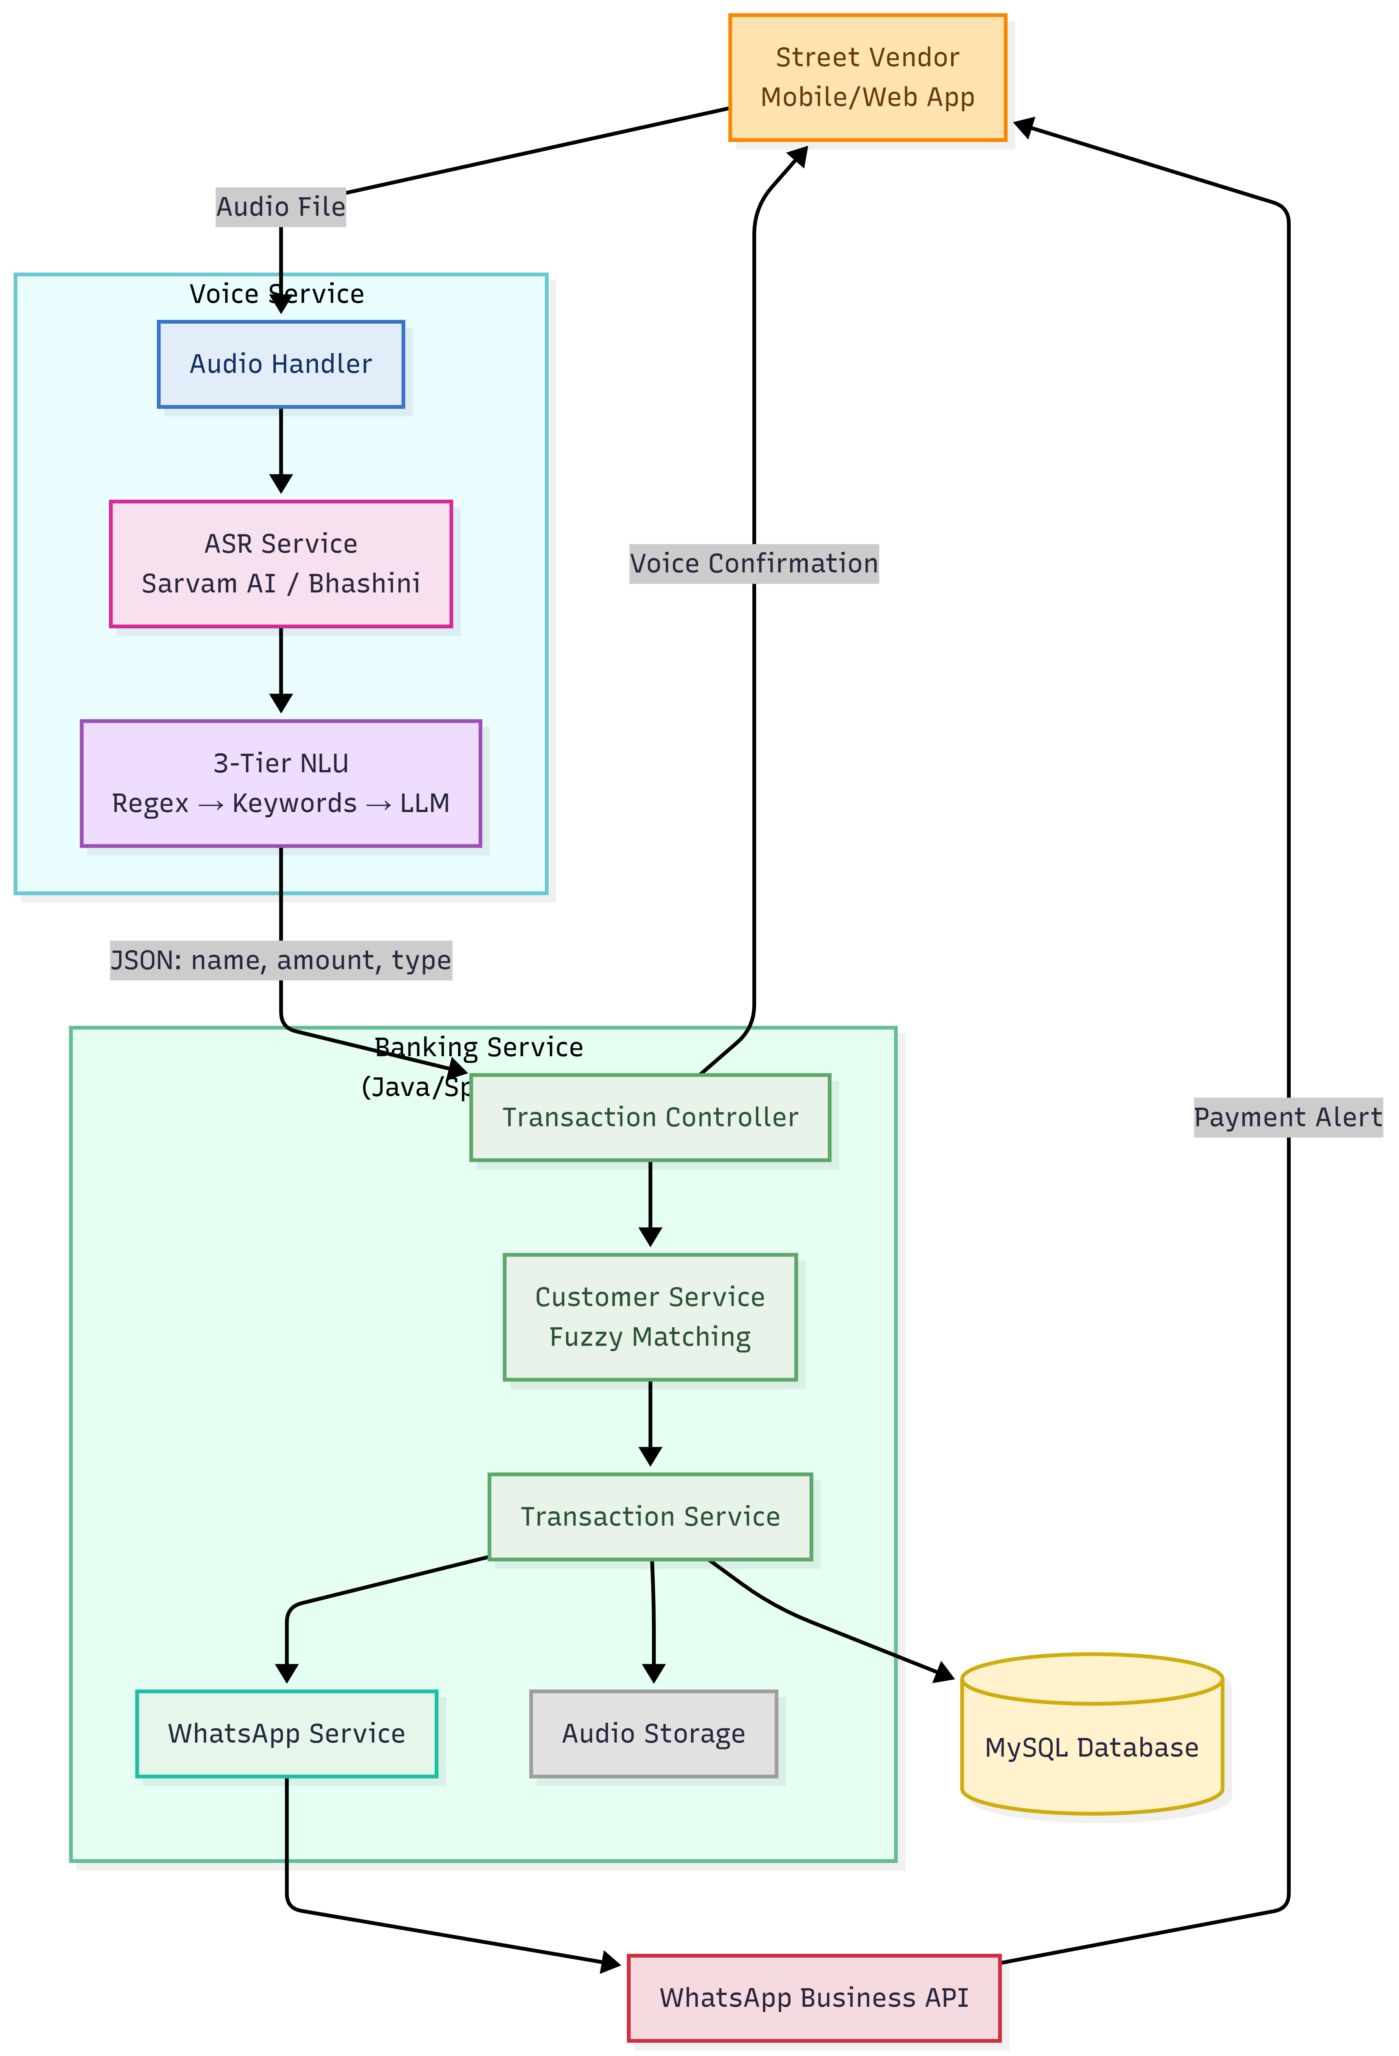
Architecture diagram of the proposed solution:

Slide 8
Technologies to be used in the solution:
Core Backend (Banking Service): Java 17+, Spring Boot 3.x, Spring Data JPA (for robust transaction management).
AI Microservice (Voice Brain): Python 3.10+, FastAPI (for high-performance async processing).
Speech Infrastructure (DPI): Bhashini API (Government of India) & Sarvam AI (for accurate Indian dialect ASR).
Database: MySQL 8.0 (Relational data integrity for financial records).
NLU Engine: Custom 3-Tier stack using Regex (Speed), spaCy (NLP), and LLM (Fallback intelligence).
Integrations: Twilio / WhatsApp Business API (for automated receipts).

Slide 9
Estimated implementation cost (optional):

Slide 10
Add as per the requirements for the hackathon:

Slide 11


