Slide 1
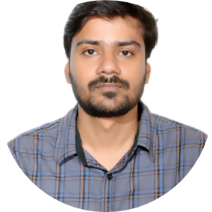

Sumit Sharma
Analyst/Software Engineer
Bachelor of Technology
Computer Science & Engineering : 2018 - 2021
Skills
COBOL
JCL
DB2
Mainframe/ZOS
Python
Database
MySQL
DB2
Web Technologies
HTML5
CSS3
JavaScript
Bootstrap
Add-Ons
GitHub
Additional Details
Peer Learning
Excellent Communication Skills
Team management
Languages
English
Hindi
Pune
sumit.f.sharma@capgemini.com
+91 9559087685
A4
Hands on Experience in Mainframe(Z/OS) with JCL COBOL,VSAM,DB2.
Ready to learn new technologies and implement them to further improve my knowledge.
A team player with good communication skill always ready to work for the enrichment of knowledge.
Eager to work in a team of dedicated people and serve a key role in the enhancement and development of the project.
Has working knowledge on Python and MySQL.
AZ-900: Microsoft Azure Fundamentals
Weather Forecasting
Developed weather forecasting Using Machine learning technology with NumPy, Scikit learn, Pandas etc. library. Predicate the weather based on previous dataset.
Python programming, Coursera
Customer inquiry system
Developed UI using CICS, COBOL and store data into the VSAM file.

