Slide 1
Collectors
Businesses
E-methods
Banks
NBFCs
Forex
NBFCs
Forex

Slide 2

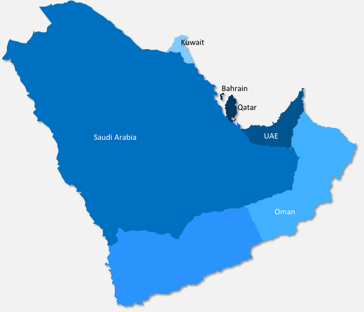





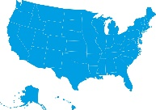
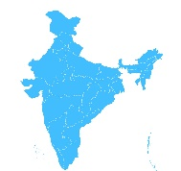







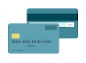
Utilities
Payment
Indian
Wallets
Bank
Banks in
India
Payment Gateway
Virtual card
INR
Cash
Debit
Card

