Slide 1
Excel Charts & Data Presentation
Ch_01_ChartEssentials_test

Slide 2
DataSelection
1 chart(s) in this sheet

Slide 3
DataSelection - Regional Sales_x000D_

Slide 4
ChartData
1 chart(s) in this sheet

Slide 5
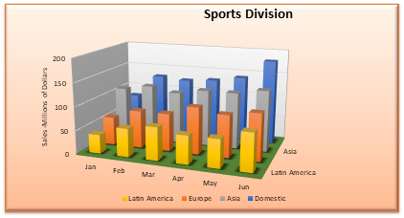
ChartData - Sports Division

Slide 6
ColumnChart
6 chart(s) in this sheet

Slide 7
ColumnChart - Regional Sales_x000D_

Slide 8
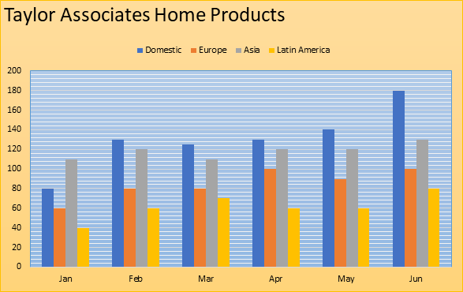
ColumnChart - Taylor Associates Home Products

Slide 9
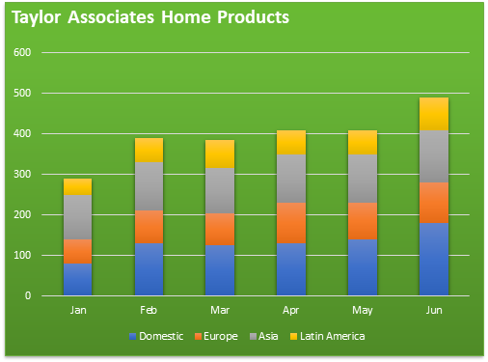
ColumnChart - Taylor Associates Home Products

Slide 10
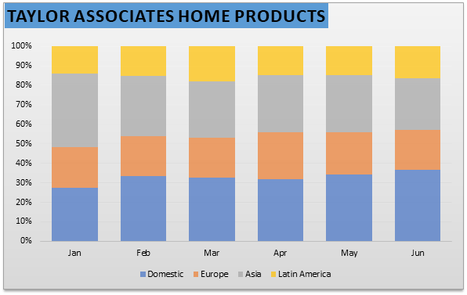
ColumnChart - Taylor Associates Home Products

Slide 11
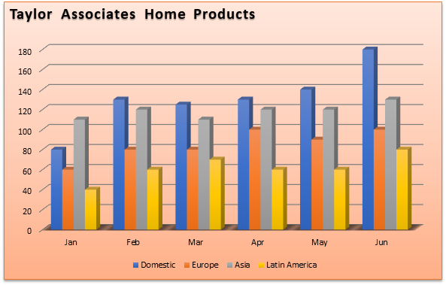
ColumnChart - Taylor Associates Home Products

Slide 12
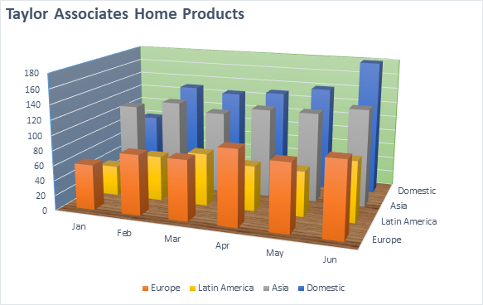
ColumnChart - Taylor Associates Home Products

Slide 13
Line Chart
1 chart(s) in this sheet

Slide 14
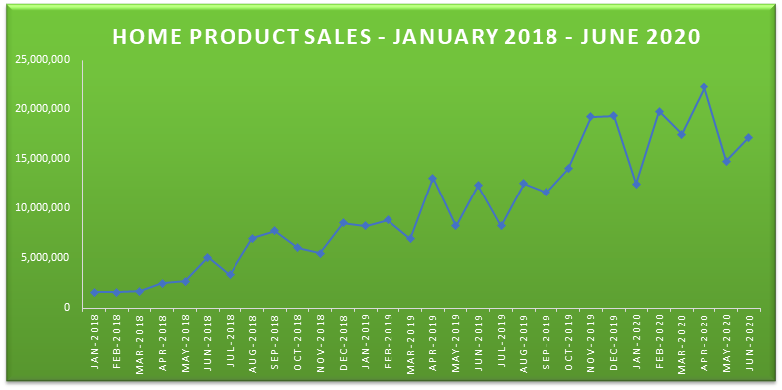
Line Chart - Home Product Sales - January 2018 - June 2020

Slide 15
PieChart
3 chart(s) in this sheet

Slide 16
PieChart - Regional Sales_x000D_

Slide 17
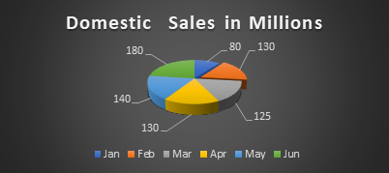
PieChart - Domestic Sales in Millions

Slide 18
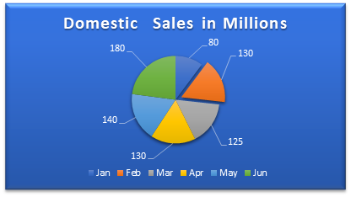
PieChart - Domestic Sales in Millions

Slide 19
BarChart
5 chart(s) in this sheet

Slide 20
BarChart - Regional Sales_x000D_

Slide 21
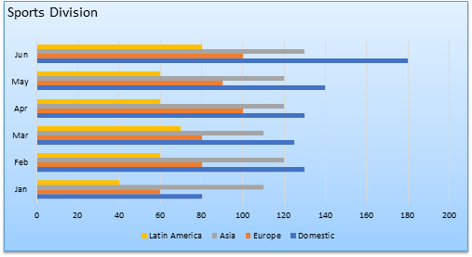
BarChart - Sports Division

Slide 22
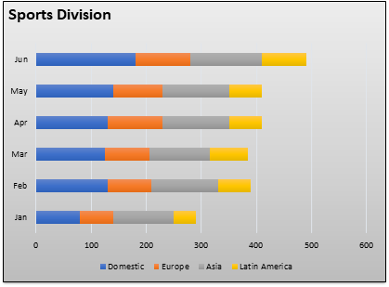
BarChart - Sports Division

Slide 23
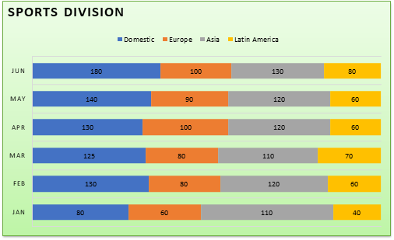
BarChart - Sports Division

Slide 24
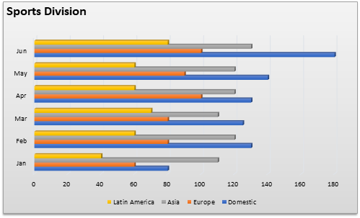
BarChart - Sports Division

Slide 25
AreaChart
1 chart(s) in this sheet

Slide 26
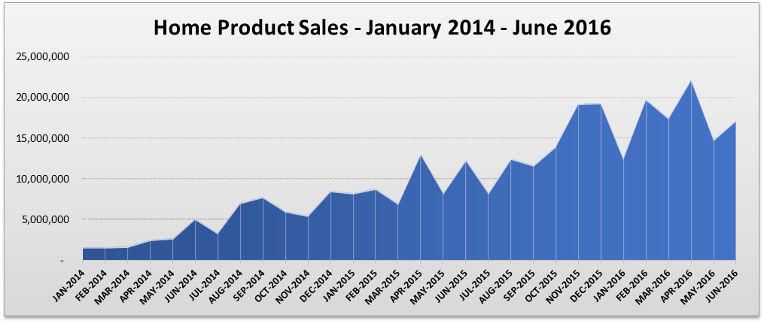
AreaChart - Home Product Sales - January 2014 - June 2016

Slide 27
Scatter Chart
2 chart(s) in this sheet

Slide 28
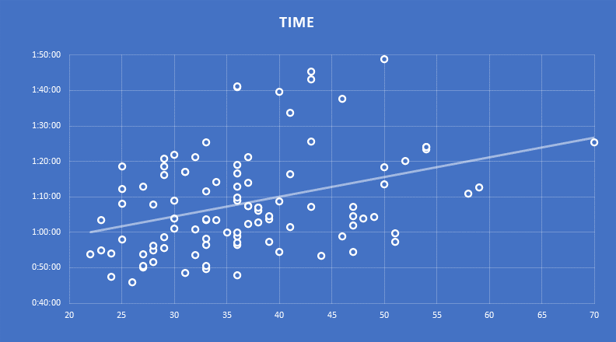
Scatter Chart - Time

Slide 29
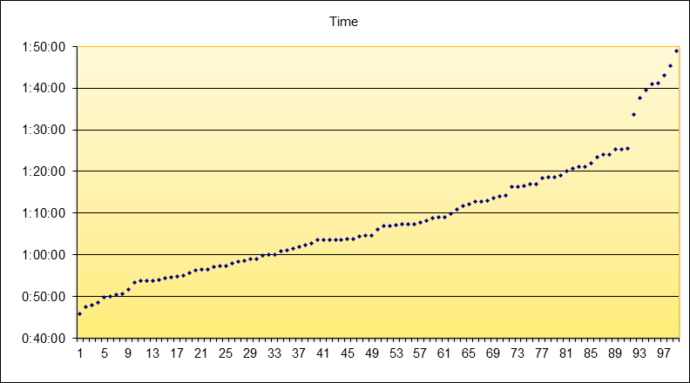
Scatter Chart - Time

Slide 30
Combo
1 chart(s) in this sheet

Slide 31
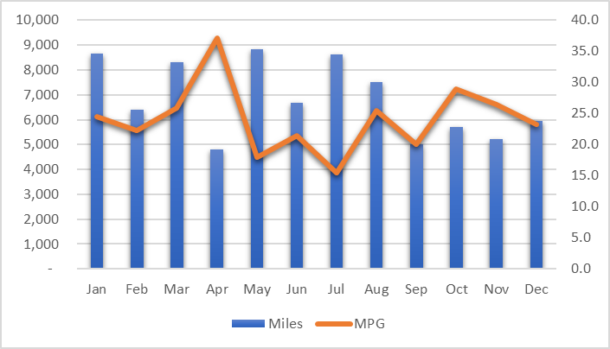
Combo - Chart 1

Slide 32
TreeMap
2 chart(s) in this sheet

Slide 33

TreeMap - Chart Title

Slide 34
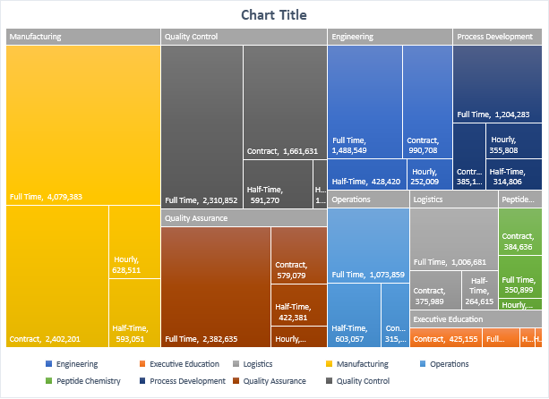
TreeMap - Chart Title

Slide 35
Sunburst
2 chart(s) in this sheet

Slide 36

Sunburst - Chart Title

Slide 37
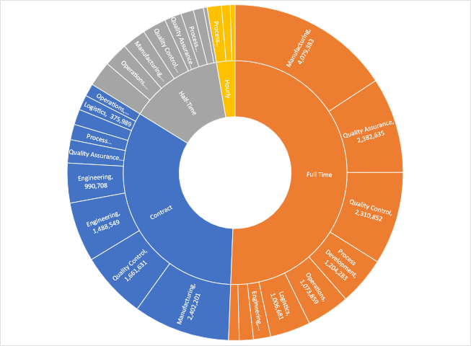
Sunburst - Chart 2

Slide 38
YearData
4 chart(s) in this sheet

Slide 39
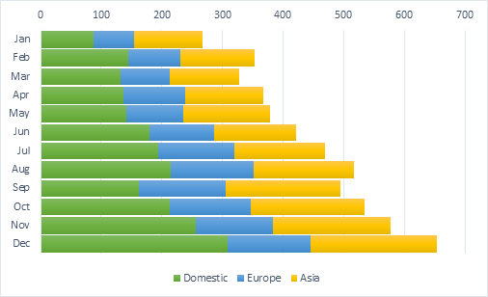
YearData - Chart 1

Slide 40
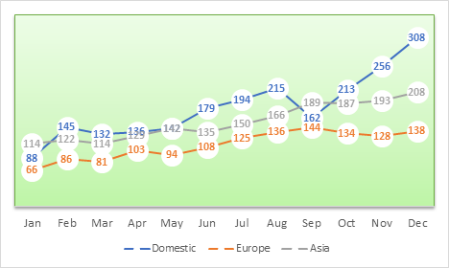
YearData - Chart 2

Slide 41
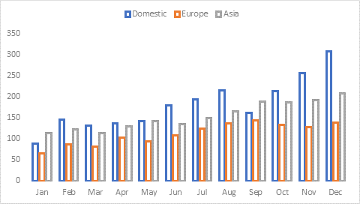
YearData - Chart 3

Slide 42
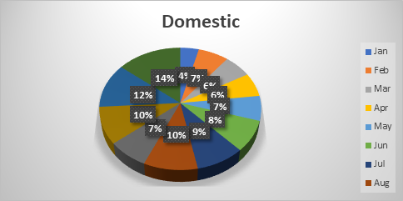
YearData - Domestic

Slide 43
CitySales
1 chart(s) in this sheet

Slide 44
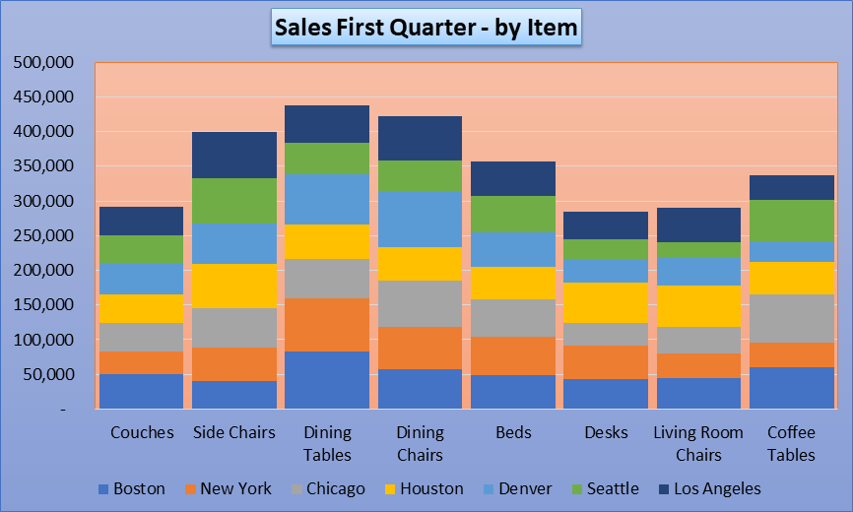
CitySales - Sales First Quarter - by Item

