Slide 1
Chapter Seven
Optimal Risky Portfolios

Slide 2
Chapter Overview
The investment decision:
Capital allocation (risky vs. risk-free)
Asset allocation (construction of the risky portfolio)
Security selection
Optimal risky portfolio
The Markowitz portfolio optimization model
Long- vs. short-term investing

Slide 3
The Investment Decision
Top-down process with 3 steps:
Capital allocation: risky portfolio and risk-free asset
Asset allocation: across broad asset classes
Security selection: individual assets within asset class

Slide 4
Diversification and Portfolio Risk
Market risk
Marketwide risk sources
Remains even after diversification
Also called: Systematic or Nondiversifiable
Firm-specific risk
Risk that can be eliminated by diversification
Also Called: Diversifiable or Nonsystematic

Slide 5
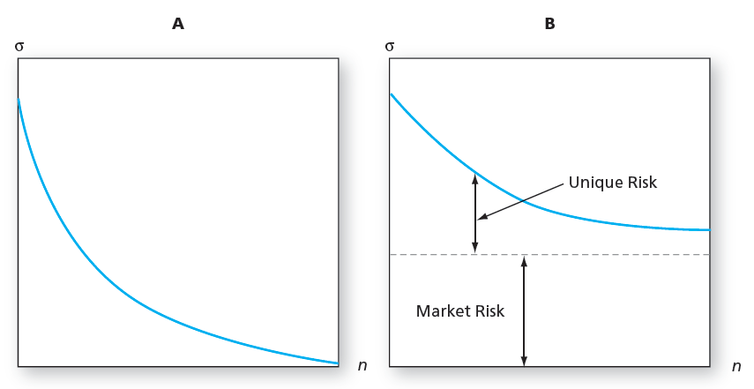
Portfolio Risk and the Number of Stocks in the Portfolio
Panel A: All risk is firm specific Panel B: Some risk is systematic

Slide 6
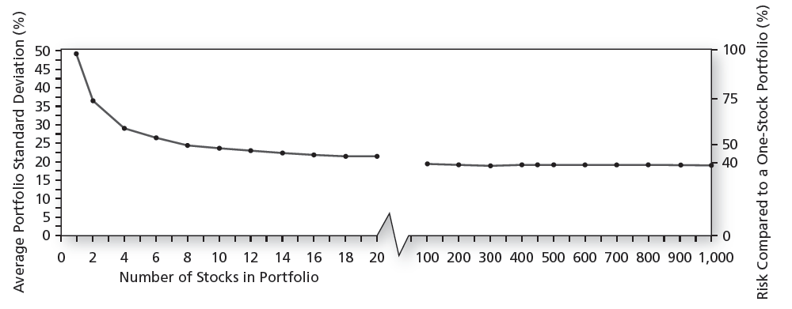
Portfolio Diversification

Slide 7
Portfolios of Two Risky Assets
Expected Return:
Portfolio risk:
Covariance:
Notes:
Expected Return: The expected return on the portfolio is a weighted average of expected returns on the component securities with portfolio proportions as weights: E(rp) = wD E(rD) + wE E(rE)
Portfolio Risk: (variance) depends on the correlation between the returns of the assets in the portfolio
Covariance: a measure of the way returns of two assets move together (covary)

Slide 8
Portfolios of Two Risky Assets: Expected Return
Consider a Portfolio made up of Equity (stocks) and Debt (bonds)
Notes:
Think: Why must we use expected values?

Slide 9
Portfolios of Two Risky Assets: Risk
Portfolio variance:
= Bond variance
= Equity variance
= Covariance of returns for bond and equity

Slide 10
Portfolios of Two Risky Assets: Covariance
Covariance of returns on bond and equity:
ρ_{D,E} = Correlation coefficient of returns
σ_{D} = Standard deviation of bond returns
σ_{E} = Standard deviation of equity returns

Slide 11
Portfolios of Two Risky Assets: Correlation Coefficients (1 of 2)
Range of values for ρ_{1,2}
If ρ = 1.0 → perfectly positively correlated securities
If ρ = 0 → the securities are uncorrelated
If ρ = - 1.0 → perfectly negatively correlated securities

Slide 12
Portfolios of Two Risky Assets: Correlation Coefficients (2 of 2)
When ρ_{DE} = 1, there is no diversification
When ρ_{DE} = -1, a perfect hedge is possible

Slide 13
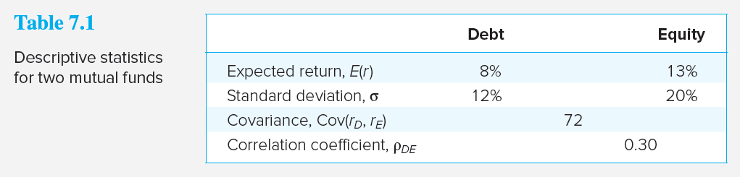
Portfolios of Two Risky Assets: Example — 50%/50% Split
Expected Return:
Variance:

Slide 14
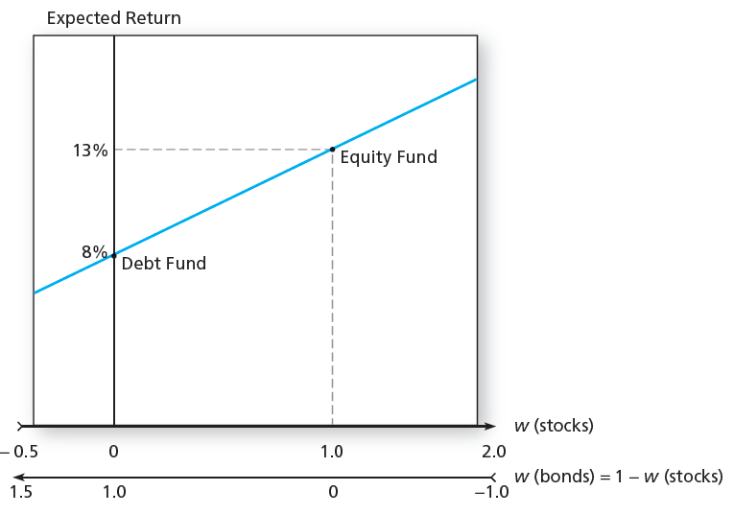
Portfolio Expected Return

Slide 15
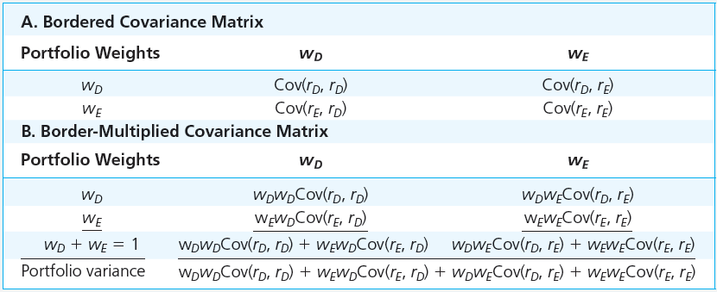
Computation of Portfolio Variance from the Covariance Matrix

Slide 16
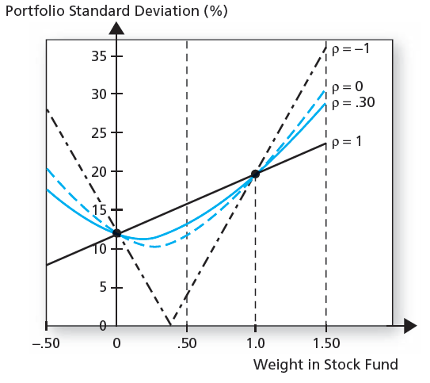
Portfolio Standard Deviation

Slide 17
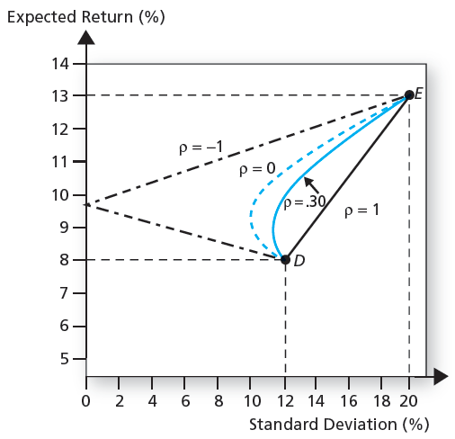
Portfolio Expected Return as a Function of Standard Deviation

Slide 18
The Minimum Variance Portfolio
The minimum variance portfolio: the portfolio composed of risky assets with smallest standard deviation
Risk reduction depends on the correlation:
If ρ = +1.0, no risk reduction is possible
If ρ = 0, σ_{P} may be less than the standard deviation of either component asset
If ρ = -1.0, a riskless hedge is possible

Slide 19
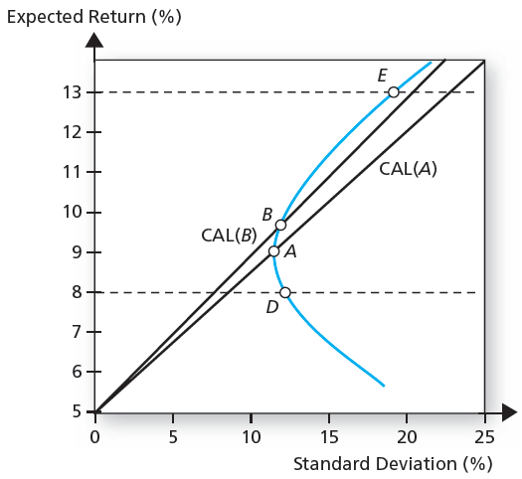
The Opportunity Set of the Debt and Equity Funds and Two Feasible CALs

Slide 20
The Sharpe Ratio
Maximize the slope of the CAL for any possible portfolio, P
The objective function is the slope:

Slide 21
The Sharpe Ratio: Example

Slide 22
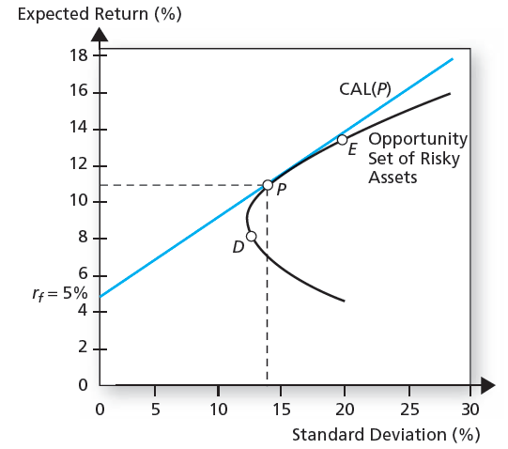
Debt and Equity Funds with the Optimal Risky Portfolio

Slide 23
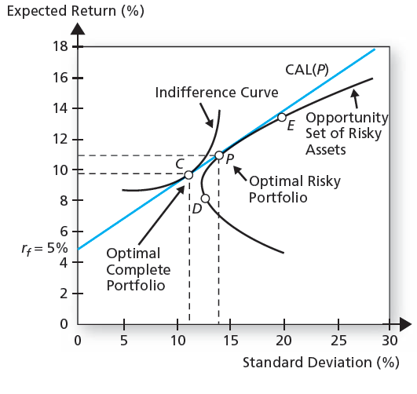
Determination of the Optimal Overall Portfolio
Notes:
Think: what if the indifference curves were more shallow?

Slide 24
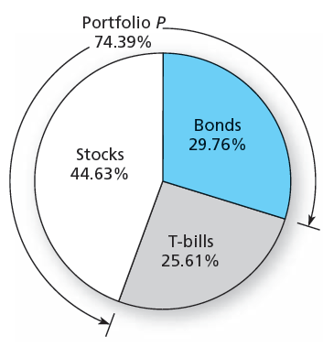
The Proportions of the Optimal Complete Portfolio

Slide 25
Markowitz Portfolio Optimization Model (1 of 6)
Security selection
Step 1: Determine the risk-return opportunities available
All portfolios that lie on the minimum-variance frontier from the global minimum-variance portfolio and upward provide the best risk-return combinations

Slide 26
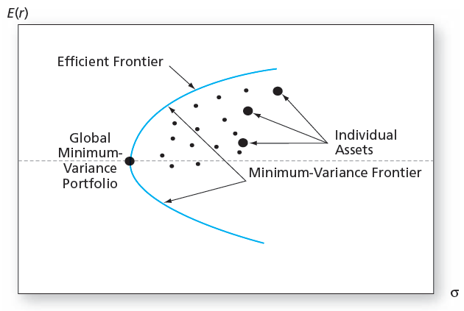
The Minimum-Variance Frontier of Risky Assets

Slide 27
Markowitz Portfolio Optimization Model (2 of 6)
Search for the CAL with the highest reward-to-variability ratio
Everyone invests in P, regardless of their degree of risk aversion
More risk averse investors put less in P
Less risk averse investors put more in P

Slide 28
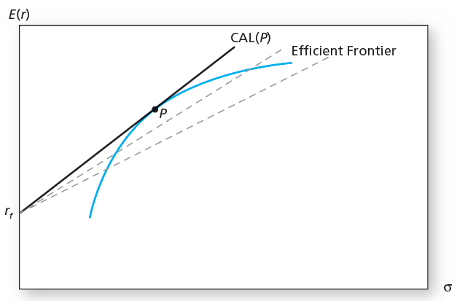
The Efficient Frontier of Risky Assets with the Optimal CAL

Slide 29
Markowitz Portfolio Optimization Model (3 of 6)
Capital Allocation and the Separation Property
Portfolio choice problem may be separated into two independent tasks
Determination of the optimal risky portfolio is purely technical
Allocation of the complete portfolio to risk-free versus the risky portfolio depends on personal preference

Slide 30
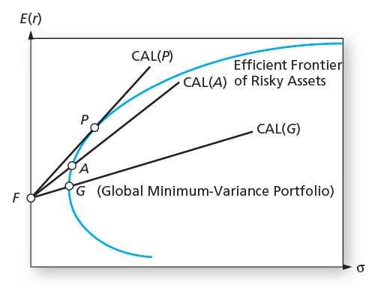
Capital Allocation Lines with Various Portfolios from the Efficient Set

Slide 31
Markowitz Portfolio Optimization Model (4 of 6)
The Power of Diversification
Remember:
If we define the average variance and average covariance of the securities as:

Slide 32
Markowitz Portfolio Optimization Model (5 of 6)
The Power of Diversification
We can then express portfolio variance as
Portfolio variance can be driven to zero if the average covariance is zero
The irreducible risk of a diversified portfolio depends on the covariance of the returns

Slide 33
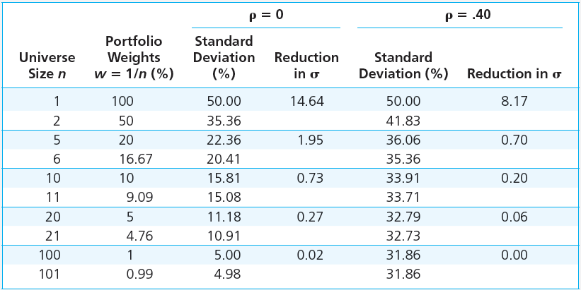
Risk Reduction of Equally Weighted Portfolios

Slide 34
Markowitz Portfolio Optimization Model (6 of 6)
Optimal Portfolios and Nonnormal Returns
Fat-tailed distributions can result in extreme values of VaR and ES → smaller allocations
If other portfolios provide sufficiently better VaR and ES values than the mean-variance efficient portfolio, we may prefer these when faced with fat-tailed distributions

Slide 35
Risk Pooling and the Insurance Principle
Risk pooling
Merging uncorrelated, risky projects as a means to reduce risk
It increases the scale of the risky investment by adding additional uncorrelated assets
The insurance principle
Risk increases less than proportionally to the number of policies when the policies are uncorrelated
Sharpe ratio increases

Slide 36
Risk Sharing
As risky assets are added, a portion of the pool is sold to maintain a risky portfolio of fixed size
Risk sharing combined with risk pooling is the key to the insurance industry
True diversification means spreading a portfolio of fixed size across many assets, not merely adding more risky bets

Slide 37
Investment for the Long Run
Long-Term Strategy
Short-Term Strategy
Invest in the risky portfolio for 2 years
Long-term strategy is riskier
Risk can be reduced by selling some of the risky assets in year 2
“Time diversification” is not true diversification
Invest in the risky portfolio for 1 year and in the risk-free asset for the second year

