Slide 1
Chapter Eight
Index Models

Slide 2
Chapter Overview
Advantages of a single-factor model
Risk decomposition
Systematic vs. firm-specific
Single-index model and its estimation
Optimal risky portfolio in the index model
Index model vs. Markowitz procedure

Slide 3
A Single-Factor Market
Advantages
Reduces the number of inputs for diversification
Easier for security analysts to specialize
Model
β_{i} =
m =
e_{i} =
Notes:
β_{i} = response of an individual security’s return to the common factor, m
m = a common macroeconomic factor (systematic risk)
e_{i} = firm-specific surprises

Slide 4
Single-Index Model (1 of 3)
Regression equation:
Expected return-beta relationship:

Slide 5
Single-Index Model (2 of 3)
Variance = Systematic risk + Firm-specific risk:
Covariance = Product of betas × Market risk:

Slide 6
Single-Index Model (3 of 3)
Correlation =
Notes:
Correlation = Product of individual correlations with the market index

Slide 7
Index Model and Diversification
Variance of the equally-weighted portfolio of firm-specific components:
When n gets large, σ²(e_{p}) → 0 negligible
Firm specific risk is diversified away

Slide 8
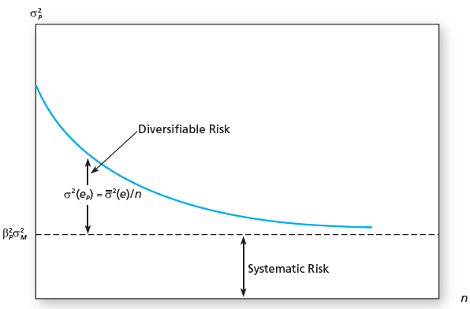
The Variance of an Equally Weighted Portfolio with Risk Coefficient β_{p}

Slide 9
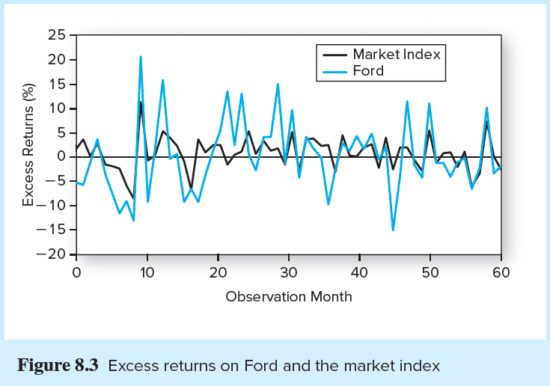
Excess Returns on Ford and S&P 500

Slide 10
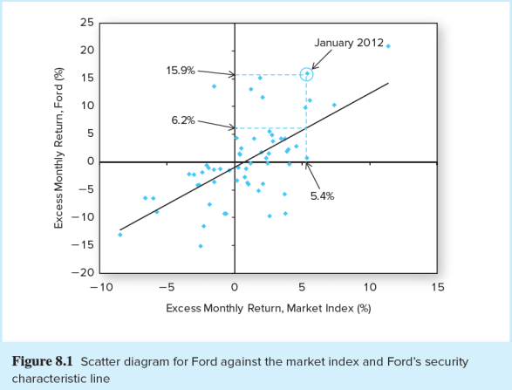
Scatter Diagram of Ford, the S&P 500, and Ford’s SCL

Slide 11
Index Model Regression Equation
Excess return of security i
Expected excess return when the market excess return is zero
Zero-mean, firm-specific surprise in security i‘s return in month t.
(the residual)
Sensitivity of security i‘s return to changes in the return of the market
Expected excess return of the market

Slide 12
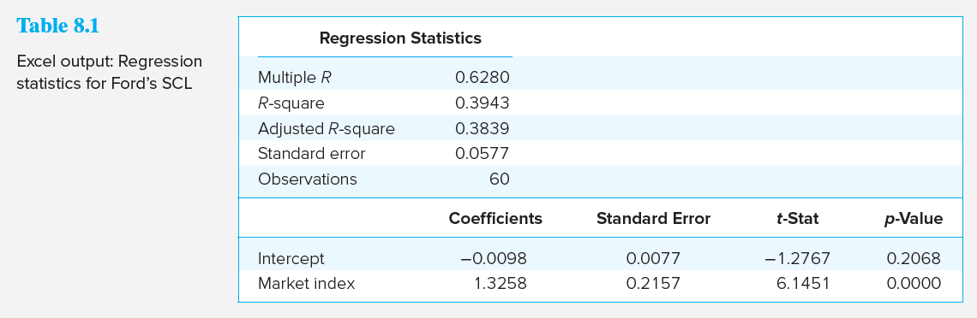
Excel Output: Regression Statistics for the SCL of Ford

Slide 13
Interpreting the Output
Correlation of Ford with the S&P 500 is 0.6280
The model explains about 38% of the variation in Ford
Ford's alpha is -0.98% per month, but not statistically significant
Ford's beta is 1.3258, but the 95% confidence interval is 0.90 to 1.75

Slide 14
Portfolio Construction and the Single-Index Model (1 of 3)
Alpha and Security Analysis
Macroeconomic analysis estimates the risk premium and market risk
Statistical analysis estimates the beta coefficients and residual variances, σ₂(e_{i}), of all securities
Establish the expected return of each security absent any contribution from security analysis
Use security analysis to develop private forecasts of the expected returns for each security

Slide 15
Portfolio Construction and the Single-Index Model (2 of 3)
Single-Index Model Input List
Risk premium on the S&P 500 portfolio
Estimate of the SD of the S&P 500 portfolio
n sets of estimates of
Beta coefficient
Stock residual variances
Alpha values

Slide 16
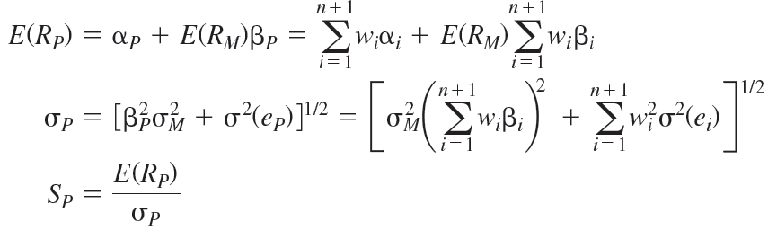
Portfolio Construction and the Single-Index Model (3 of 3)
Optimal risky portfolio in the single-index model
Expected return, SD, and Sharpe ratio:

Slide 17
Portfolio Construction: The Process
Optimal risky portfolio in the single-index model is a combination of
Active portfolio, denoted by A
Passive portfolio, denoted by M
See Spreadsheet 8.1 for a detailed example of the following procedure

Slide 18
Summary of Optimization Procedure (1 of 4)
Compute the initial position of each security:
Scale those positions:
Compute the alpha of the active portfolio:

Slide 19
Summary of Optimization Procedure (2 of 4)
Compute the residual variance of A:
Compute the initial position in A:
Compute the beta of A:

Slide 20
Summary of Optimization Procedure (3 of 4)
Adjust the initial position in A:

Slide 21
Summary of Optimization Procedure (4 of 4)
Optimal Risky Portfolio now has weights:
Calculate the risk premium of P (Optimal Risky Portfolio):
Compute the variance of P:

Slide 22
Optimal Risky Portfolio: Information Ratio
The Information Ratio
The contribution of the active portfolio depends on the ratio of its alpha to its residual standard deviation (Step 5):
The information ratio measures the extra return we can obtain from security analysis
Information Ratio of A

Slide 23
Optimal Risky Portfolio: Sharpe Ratio
The Sharpe ratio of an optimally constructed risky portfolio will exceed that of the index portfolio:

Slide 24
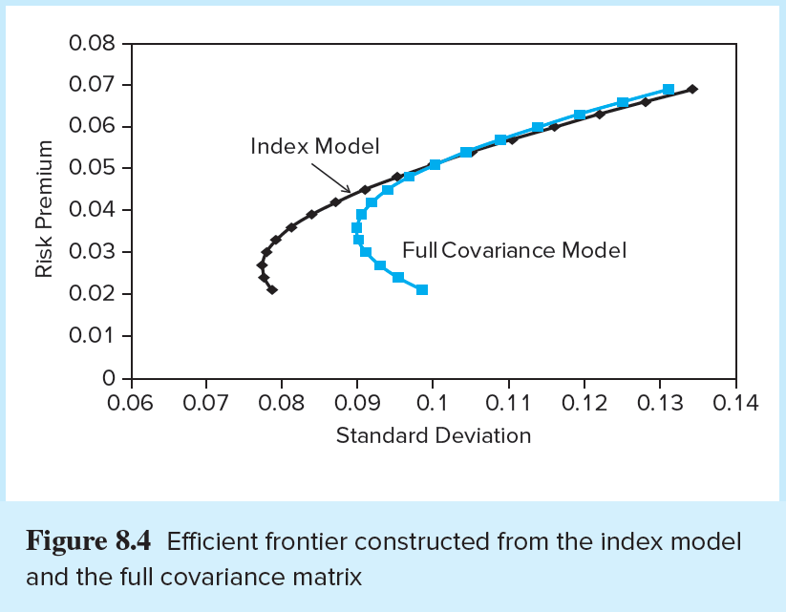
Efficient Frontiers of Index Model vs. Full-Covariance Matrix

Slide 25
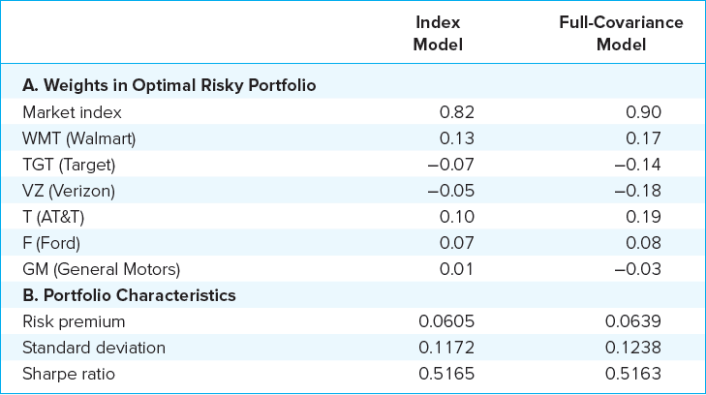
Portfolios from the Single-Index and Full-Covariance Models

Slide 26
Is the Index Model Inferior to the Full-Covariance Model?
Full Markowitz model is better in principle, but
The full-covariance matrix invokes estimation risk of thousands of terms
Cumulative errors may result in a portfolio that is actually inferior
The single-index model is practical and decentralizes macro and security analysis

