Slide 1
Chapter Nine
The Capital Asset Pricing Model

Slide 2
Capital Asset Pricing Model (CAPM)
It is the equilibrium model that underlies all modern financial theory
Derived using principles of diversification with simplified assumptions
Markowitz, Sharpe, Lintner and Mossin are researchers credited with its development
Notes:
2

Slide 3
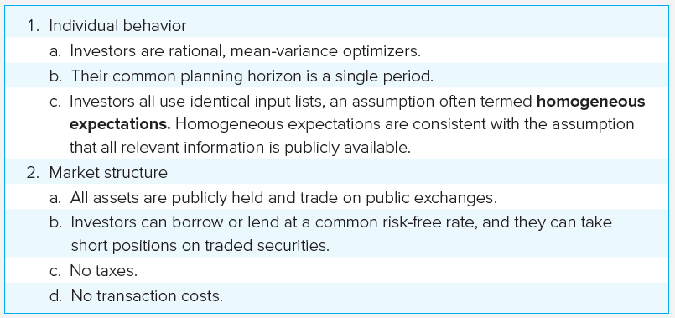
Assumptions

Slide 4
Resulting Equilibrium Conditions
All investors will hold the same portfolio for risky assets — market portfolio
Market portfolio contains all securities and the proportion of each security is its market value as a percentage of total market value

Slide 5
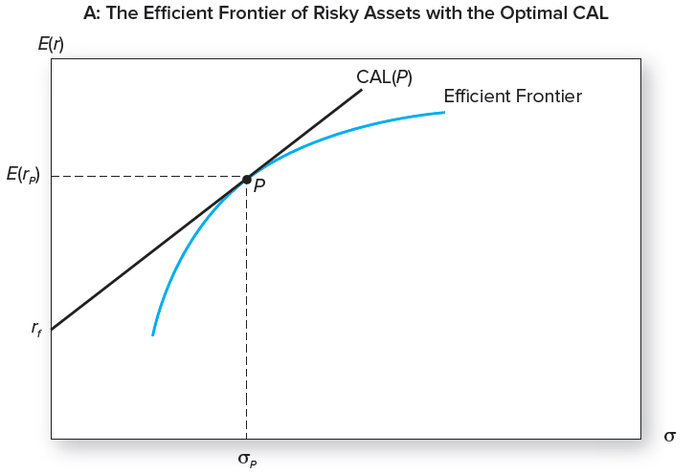
The Efficient Frontier and the Capital Allocation Line

Slide 6
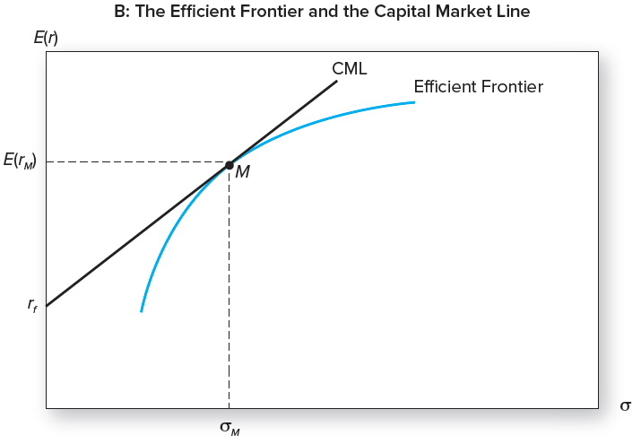
The Efficient Frontier and the Capital Market Line

Slide 7
Market Risk Premium
The risk premium on the market portfolio is proportional to its risk and the degree of risk aversion:
Where
Notes:
σ²_{M :} the variance of the market portfolio
Ᾱ: is the average degree of risk aversion across investors

Slide 8
Return and Risk For Individual Securities
An individual security’s risk premium is a function of:
Its contribution to the risk of the market portfolio
The covariance of returns with the assets that make up the market portfolio

Slide 9
Individual Securities: Example
Covariance of GE return with the market portfolio:
The reward-to-risk ratio for GE would be:

Slide 10
GE Example (1 of 2)
Reward-to-risk ratio for investment in market portfolio:
These ratios should equal:

Slide 11
GE Example (2 of 2)
The risk premium for GE:
Restating, we obtain:

Slide 12
Expected Return-Beta Relationship
CAPM holds for the overall portfolio because:
This also holds for the market portfolio:

Slide 13
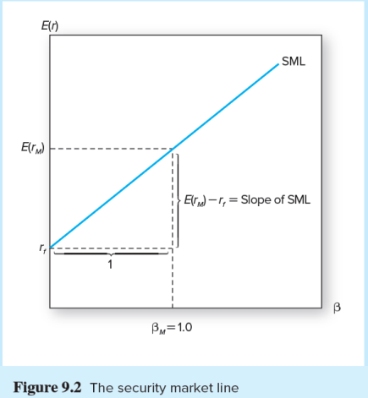
The Security Market Line

Slide 14
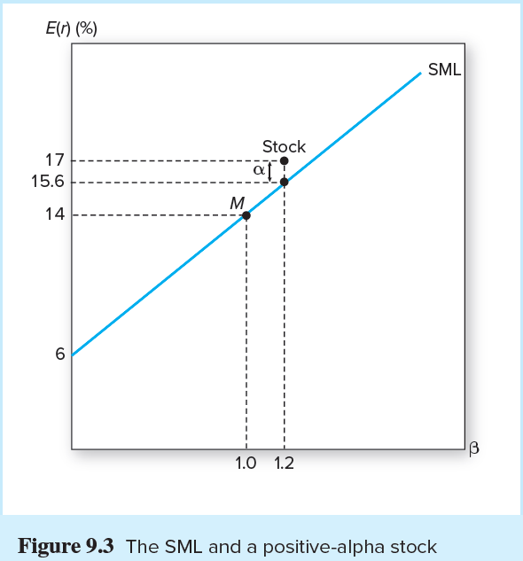
The SML and a Positive-Alpha Stock

Slide 15
Single-Index Model and Realized Returns
To move from expected to realized returns, use the index model in excess return form:
The index model beta coefficient is the same as the beta of the CAPM expected return-beta relationship

Slide 16
Extensions of the CAPM (1 of 2)
Zero-Beta Model
Helps to explain positive alphas on low beta stocks and negative alphas on high beta stocks
Consideration of labor income and nontraded assets

Slide 17
Extensions of the CAPM (2 of 2)
Merton’s Multi-period Model and hedge portfolios
Incorporation of the effects of changes in the real rate of interest and inflation
Consumption-based CAPM
Rubinstein, Lucas, and Breeden
Investors allocate wealth between consumption today and investment for the future

Slide 18
Liquidity and the CAPM
Liquidity:
Illiquidity Premium:
Measured partly by bid-asked spread
Trading costs and illiquidity discount are positively related
Notes:
Liquidity: The ease and speed with which an asset can be sold at fair market value
Illiquidity Premium: Discount from fair market value the seller must accept to obtain a quick sale

Slide 19
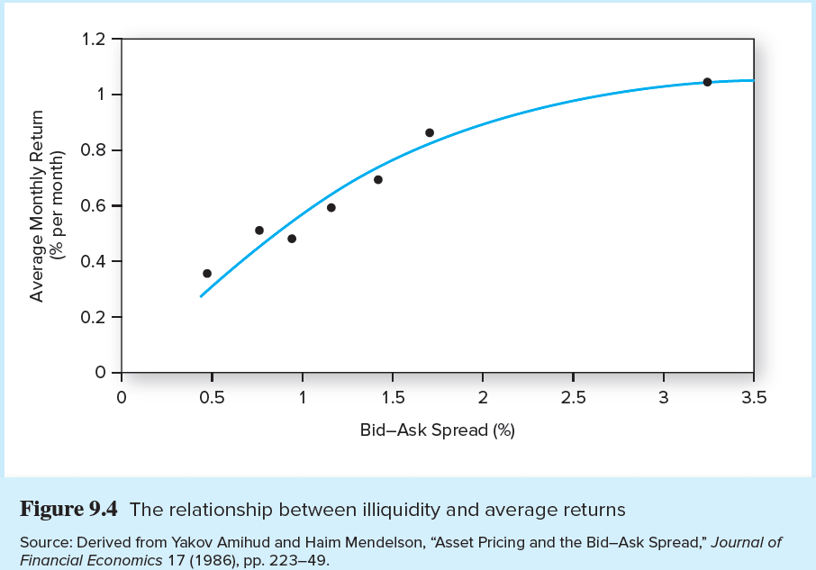
The Relationship Between Illiquidity and Average Returns

Slide 20
Liquidity Risk
In a financial crisis, liquidity can unexpectedly dry up
When liquidity in one stock decreases, it concurrently decreases the liquidity in other stocks
Investors demand compensation for liquidity risk
Liquidity betas

Slide 21
CAPM and Academia
Academic World
Cannot observe all tradable assets
Impossible to pin down market portfolio
Attempts to validate using regression analysis

Slide 22
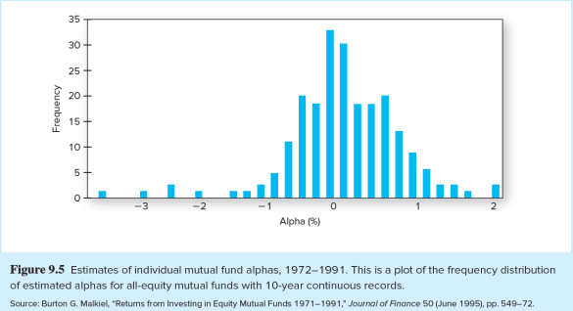
CAPM and Investment Industry
Investment Industry
Relies on the single-index CAPM model
Most investors don’t beat the index portfolio

