Slide 1
Chapter Ten
Arbitrage Pricing Theory and Multifactor Models of Risk and Return

Slide 2
Single Factor Model (1 of 2)
Returns on a security come from two sources:
Common macro-economic factor
Firm specific events
Possible common macro-economic factors
Gross Domestic Product growth
Interest rates

Slide 3
Single Factor Model (2 of 2)
R_{i} =
β_{i}=
F =
e_{i} =
Notes:
R_{i} = Excess return on security
β_{i}= Factor sensitivity or factor loading or factor beta
F = Surprise in macro-economic factor
(F could be positive or negative but has expected value of zero)
e_{i} = Firm specific events (zero expected value)

Slide 4
Multifactor Models
Use more than one factor:
Examples: Market Return, GDP, Expected Inflation, Interest Rates
Estimate a beta or factor loading for each factor using multiple regression

Slide 5
Multifactor Model Equation
R_{i} =
β_{GDP} =
β_{IR} =
e_{i} =
Notes:
R_{i} = Excess return for security i
β_{GDP} = Factor sensitivity for GDP
β_{IR} = Factor sensitivity for Interest Rate
e_{i} = Firm specific events

Slide 6
Interpretation
The expected return on a security is the sum of:
The risk-free rate
The sensitivity to GDP times the GDP risk premium
The sensitivity to interest rate risk times the interest rate risk premium

Slide 7
Arbitrage Pricing Theory
Arbitrage occurs if there is a zero investment portfolio with a sure profit
No investment → investors create large positions to obtain large profits
All investors will want an infinite position in the risk-free arbitrage portfolio
In efficient markets, profitable arbitrage opportunities will quickly disappear

Slide 8
Law of One Price
The Law of One Price:
Enforced by arbitrageurs: If they observe a violation they will engage in arbitrage activity
This bids up (down) the price where it is low (high) until the arbitrage opportunity is eliminated
Notes:
The Law of One Price: states that if two assets are equivalent in all economically relevant respects, then they should have the same market price

Slide 9
APT and Well-Diversified Portfolios
For a well-diversified portfolio,
e_{P} → 0 as the number of securities increases
and their associated weights decrease

Slide 10
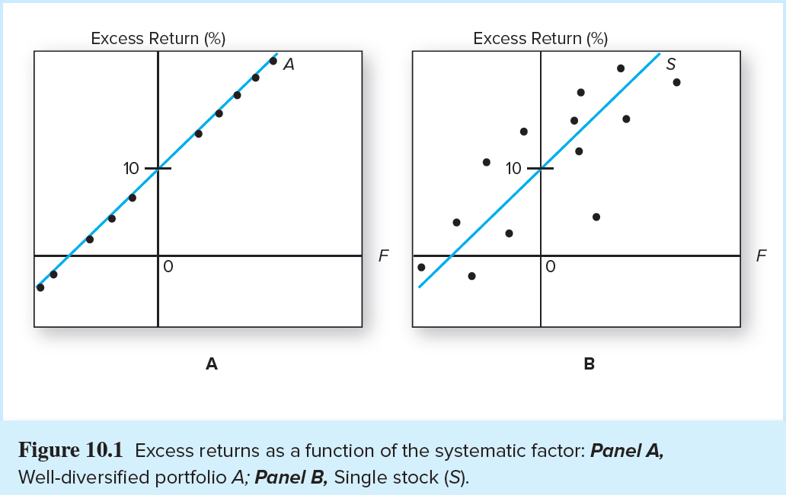
Returns as a Function of the Systematic Factor

Slide 11
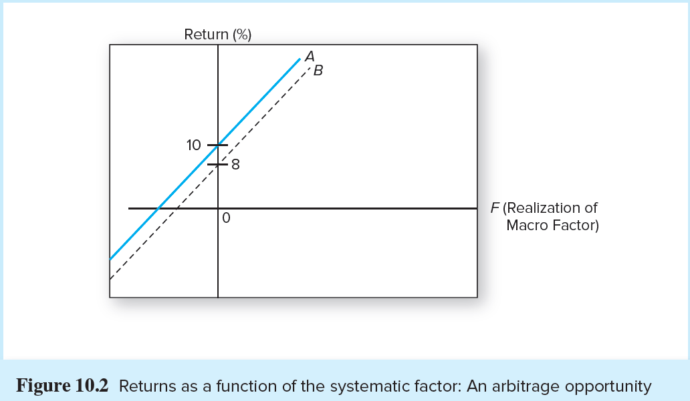
Returns as a Function of the Systematic Factor: An Arbitrage Opportunity

Slide 12
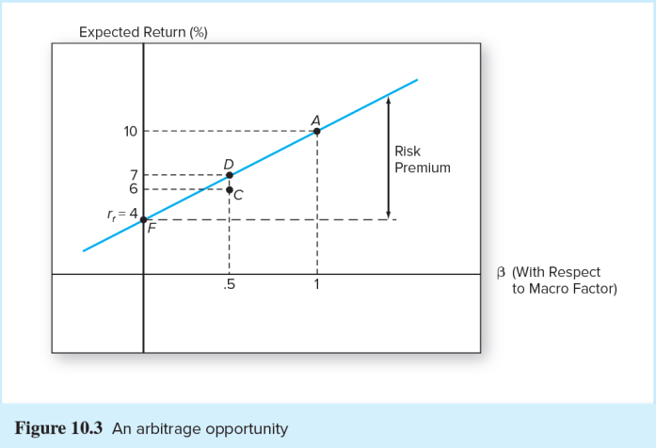
An Arbitrage Opportunity

Slide 13
No-Arbitrage Equation of APT
Applies to well-diversified portfolios
Establishes that the SML of CAPM applies to well-diversified portfolios

Slide 14
APT and CAPM
APT
CAPM
Assumes a well-diversified portfolio, but residual risk is still a factor
Does not assume investors are mean-variance optimizers
Uses an observable market index
Reveals arbitrage opportunities
Model is based on an inherently unobservable “market” portfolio
Rests on mean-variance efficiency. The actions of many small investors restore CAPM equilibrium

Slide 15
Multifactor APT
Use of more than a single systematic factor
Requires formation of factor portfolios
What factors?
Factors that are important to performance of the general economy
What about firm characteristics?

Slide 16
Two-Factor Model (1 of 2)
The multifactor APT is similar to the one-factor case

Slide 17
Two-Factor Model (2 of 2)
Track with diversified factor portfolios:
β=1 for one of the factors and 0 for all other factors
The factor portfolios track a particular source of macroeconomic risk, but are uncorrelated with other sources of risk

Slide 18
Fama-French Three-Factor Model
SMB =
HML =
Are these firm characteristics correlated with actual systematic risk factors?
Notes:
SMB = Small Minus Big (firm size)
HML = High Minus Low (book-to-market ratio)

Slide 19
The Multifactor CAPM and the APT
A multi-index CAPM inherits its risk factors from sources that a broad group of investors deem important enough to hedge
The APT is largely silent on where to look for priced sources of risk

