Slide 1
Chapter Eleven
The Efficient Market Hypothesis

Slide 2
Efficient Market Hypothesis (EMH) (1 of 3)
Maurice Kendall (1953) found no predictable pattern in stock price changes
Prices are as likely to go up as to go down on any particular day
How do we explain random stock price changes?

Slide 3
Efficient Market Hypothesis (EMH) (2 of 3)
EMH:
A forecast about favorable future performance →
Market participants trade on new information→
Generates favorable current performance →
Prices change until expected returns are commensurate with risk
Notes:
EMH: says stock prices already reflect all available information

Slide 4
Efficient Market Hypothesis (EMH) (3 of 3)
New information is unpredictable
Stock prices that change in response to new (unpredictable) information also must move unpredictably
Stock price changes follow a random walk

Slide 5
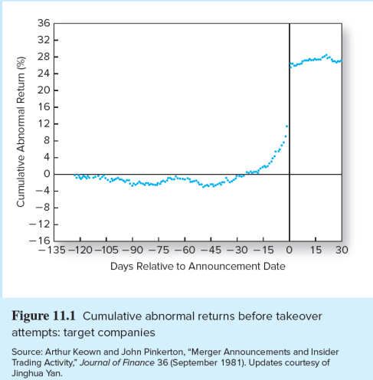
Cumulative Abnormal Returns Before Takeover Attempts

Slide 6
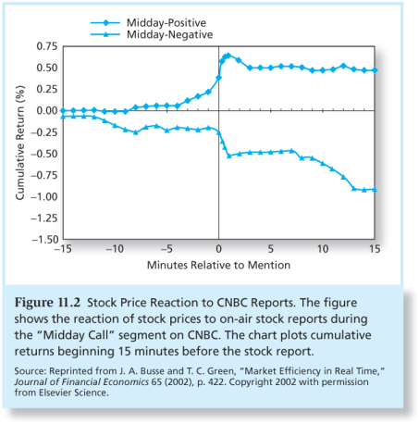
Stock Price Reaction to CNBC Reports

Slide 7
EMH and Competition
Information:
The most precious financial commodity
Strong competition assures prices reflect information
Higher investment returns motivates information-gathering
Diminutive marginal returns on research activity suggest only managers of the largest portfolios will find it useful pursuing

Slide 8
Versions of the EMH
Weak:
Semi-strong:
Strong:
All versions assert that prices should reflect available information
Notes:
The weak-form hypothesis asserts that stock prices already reflect all information that can be derived by examining market trading data such as the history of past prices, trading volume, or short interest.
The semistrong-form hypothesis states that all publicly available information regarding the prospects of a firm must be reflected already in the stock price. Such information includes, in addition to past prices, fundamental data on the firm’s product line, quality of management, balance sheet composition, patents held, earnings forecasts, and accounting practices.
The strong-form version of the efficient market hypothesis states that stock prices reflect all information relevant to the firm, even including information available only to company insiders.

Slide 9
Implications of the EMH
Technical Analysis:
Success depends on a sluggish response of stock prices to supply-and-demand factors
Weak-form efficiency
Relative strength
Resistance levels
Notes:
Technical Analysis - using prices and volume information to predict future prices

Slide 10
Types of Stock Analysis
Fundamental Analysis:
Seek firms that are mispriced
Find poorly run firms that are not as bad as the market thinks
Semistrong form efficiency and fundamental analysis
Notes:
Fundamental Analysis - using economic and accounting information to predict stock prices

Slide 11
Active versus Passive Management
Active Management
An expensive strategy
Suitable for very large portfolios
Passive Management:
No attempt to outsmart the market
Accept EMH
Index Funds and ETFs
Very low cost

Slide 12
Market Efficiency and Portfolio Management
Even if the market is efficient a role exists for portfolio management:
Diversification
Appropriate risk level
Tax considerations

Slide 13
Resource Allocation
Inefficient markets → systematic resource misallocation
Overvalued securities can raise capital too cheaply
Undervalued securities may pass up profitable opportunities because cost of capital is too high
Efficient market ≠ perfect foresight market

Slide 14
Event Studies
Financial research can assess the impact of an event on a firm’s stock price
The abnormal return due to the event is the difference between the stock’s actual return and a proxy for the stock’s return in the absence of the event

Slide 15
How Tests Are Structured
Returns are adjusted to determine if they are abnormal
Market Model approach:
a. Expected Return:
b. Abnormal Return:

Slide 16
Are Markets Efficient?
Magnitude Issue:
Selection Bias Issue:
Lucky Event Issue:
Notes:
Magnitude Issue: Only managers of large portfolios can earn enough trading profits to make the exploitation of minor mispricing worth the effort.
Selection Bias Issue: Only unsuccessful investment schemes are made public; good schemes remain private.
Lucky Event Issue: For every big winner, there may be many big losers, but we never hear of these managers. The winners, though, turn up in The Wall Street Journal as the latest stock market gurus; then they can make a fortune publishing market newsletters.

Slide 17
Weak-Form Tests: Momentum Effect
Returns over the Short Horizon
Momentum Effect:
Notes:
Momentum: good or bad recent performance continues over short to intermediate time horizons

Slide 18
Weak-Form Tests: Reversal Effect
Returns over Long Horizons
Reversal Effect:
Notes:
Reversal effect: in which losers rebound and winners fade back, suggests that the stock market overreacts to relevant news

Slide 19
Predictors of Broad Market Returns
Fama and French
Aggregate returns are higher with higher dividend ratios
Campbell and Shiller
Earnings yield can predict market returns
Keim and Stambaugh
Bond spreads can predict market returns

Slide 20
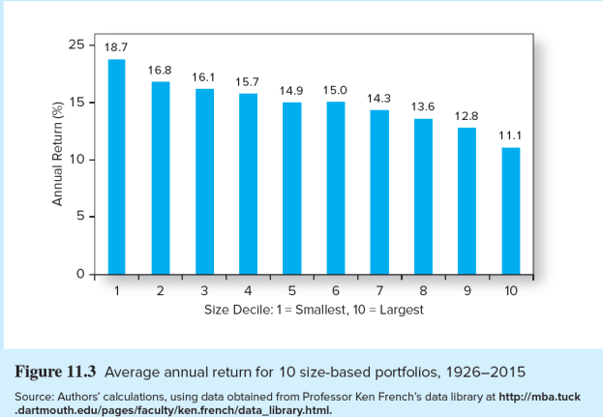
Semistrong Tests: Small Firm Anomaly
Small Firm Effect:

Slide 21
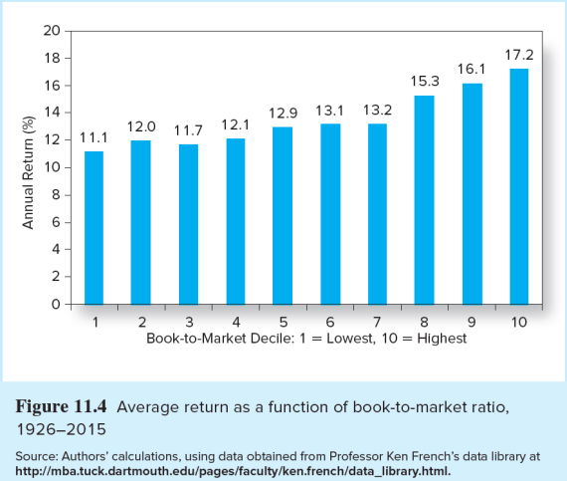
Semistrong Tests: Book to Market Anomaly
Book-to-Market Ratios:

Slide 22
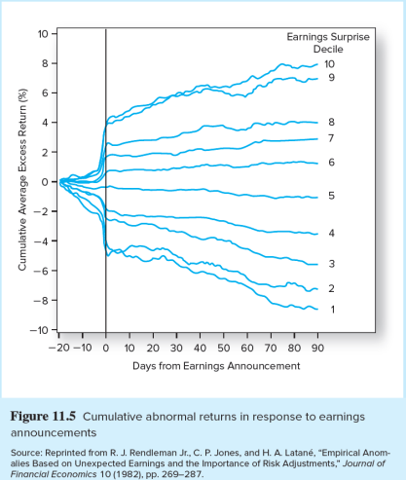
Semistrong Tests: Drift Anomaly
Post-Earnings-Announcement Price Drift:

Slide 23
Semistrong Tests: Anomalies
P/E Effect:
Neglected Firm Effect and Liquidity Effects:

Slide 24
Strong-Form Tests: Inside Information
The ability of insiders to trade profitability in their own stock has been documented in studies by Jaffe, Seyhun, Givoly, and Palmon
SEC requires all insiders to register their trading activity

Slide 25
Interpreting the Anomalies
The most puzzling anomalies are price-earnings, small-firm, market-to-book, momentum, and long-term reversal
Fama and French argue that these effects can be explained by risk premiums
Lakonishok, Shleifer, and Vishny argue that these effects are evidence of inefficient markets

Slide 26
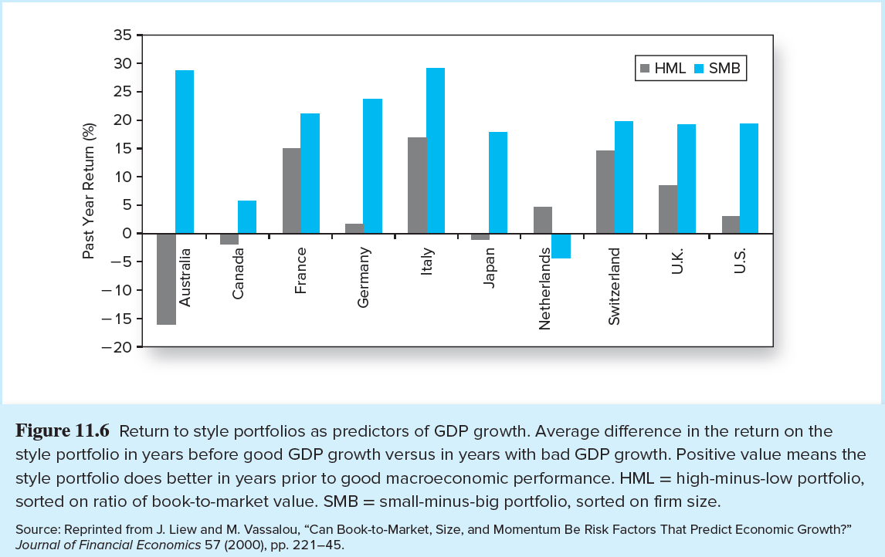
Predictors of GDP Growth

Slide 27
Interpreting the Evidence (1 of 2)
Anomalies or data mining?
Some anomalies have disappeared
Book-to-market, size, and momentum may be real anomalies
Anomalies over time
Exploiting them eliminates abnormal profits
Chordia, Subrahmanyam, and Tong study found attenuating

Slide 28
Interpreting the Evidence (2 of 2)
Bubbles and market efficiency
Prices appear to differ from intrinsic values
Rapid run up followed by crash
Bubbles are difficult to predict and exploit

Slide 29
Stock Market Analysts
Some analysts may add value, but:
Difficult to separate effects of new information from changes in investor demand
Findings may lead to investing strategies that are too expensive to exploit

Slide 30
Mutual Fund Performance (1 of 2)
The conventional performance benchmark today is a four-factor model:
The three Fama-French factors
Plus a momentum factor
Notes:
The three Fama-French factors: the return on the market index, and returns to portfolios based on size, and book-to-market ratio
Momentum factor: a portfolio constructed based on prior-year stock return

Slide 31
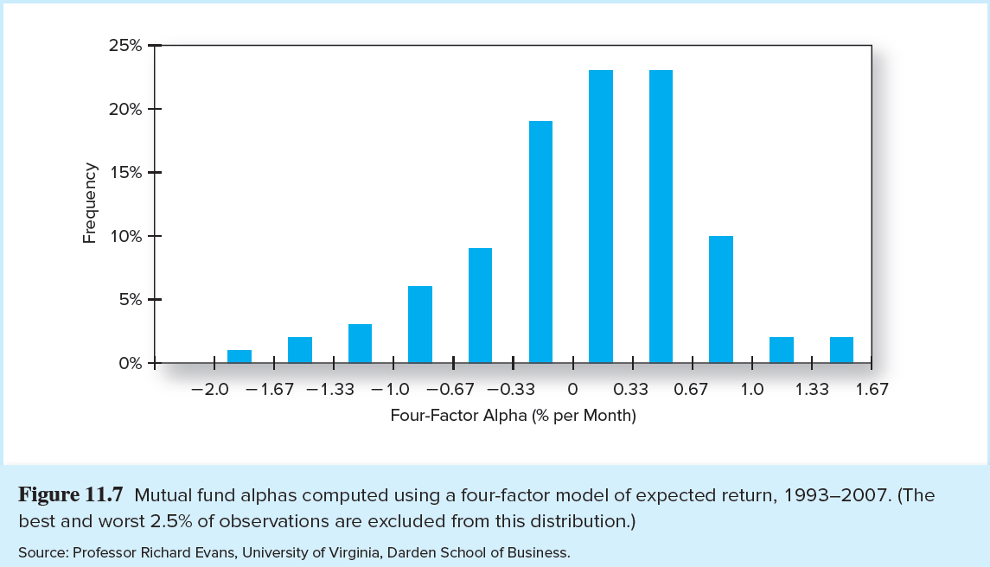
Estimates of Individual Mutual Fund Alphas

Slide 32
Mutual Fund Performance (2 of 2)
Consistency
Carhart — alphas positive before fees, negative after
Bollen and Busse — support for performance persistence over short time horizons
Berk and Green — skilled managers will attract new funds until the costs of managing those extra funds drive alphas down to zero

Slide 33
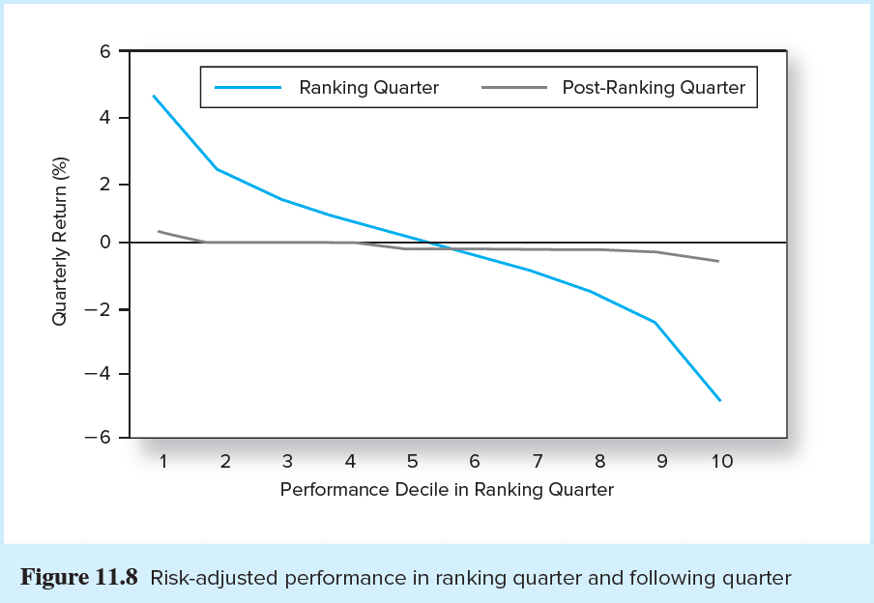
Risk-adjusted Performance in Ranking Quarter and Following Quarter

Slide 34
So, Are Markets Efficient?
Professional manager performance is broadly consistent with market efficiency
Most managers do not do better than the passive strategy
There are, however, some notable superstars:
Peter Lynch, Warren Buffett, John Templeton, Mario Gabelli

