Slide 1
Chapter Twelve
Behavioral Finance and Technical Analysis

Slide 2
Chapter Overview
Conventional vs. behavioral finance
Information processing and behavioral irrationalities
Limits to arbitrage and bubbles in behavioral economics
Technical analysis and strategies

Slide 3
Behavioral Finance
Conventional Finance
Behavioral Finance
Prices are correct and equal to intrinsic value
Resources are allocated efficiently
Consistent with EMH
What if investors don’t behave rationally?

Slide 4
The Behavioral Critique
Two categories of irrationalities:
Investors do not always process information correctly
Result: Incorrect probability distributions of future returns
Even when given a probability distribution of returns, investors may make inconsistent or suboptimal decisions
Result: They have behavioral biases

Slide 5
Errors in Information Processing
Forecasting Errors:
Overconfidence:
Conservatism:
Sample Size Neglect and Representativeness:
Notes:
Forecasting Errors: Too much weight is placed on recent experiences
Overconfidence: Investors overestimate their abilities and the precision of their forecasts
Conservatism: Investors are slow to update their beliefs and underreact to new information
Sample Size Neglect and Representativeness: Investors are too quick to infer a pattern or trend from a small sample

Slide 6
Behavioral Biases: Examples
Framing
How the risk is described, “risky losses” vs. “risky gains” can affect investor decisions
Mental Accounting
Investors may segregate accounts or monies and take risks with their gains that they would not take with their principal
Regret Avoidance
Investors blame themselves more when an unconventional or risky bet turns out badly

Slide 7
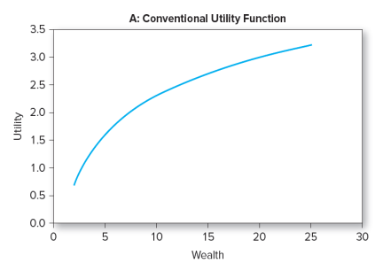
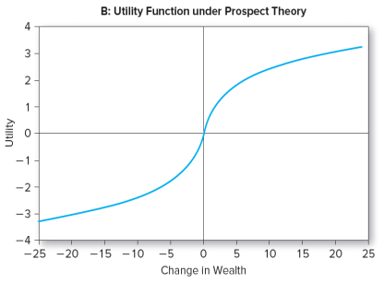
Behavioral Biases: Prospect Theory
Prospect Theory
Conventional view: Utility depends on level of wealth
Behavioral view: Utility depends on changes in current wealth

Slide 8
Limits to Arbitrage (1 of 2)
Behavioral biases would not matter if rational arbitrageurs could fully exploit the mistakes of behavioral investors
Fundamental Risk:
“Markets can remain irrational longer than you can remain solvent”
Intrinsic value and market value may take too long to converge

Slide 9
Limits to Arbitrage (2 of 2)
Implementation Costs:
Transactions costs and restrictions on short selling can limit arbitrage activity
Model Risk:
What if you have a bad model and the market value is actually correct?

Slide 10
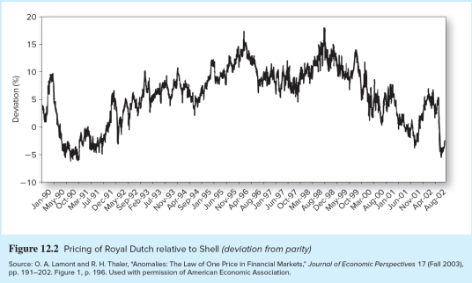
Limits to Arbitrage and the Law of One Price (1 of 2)
Siamese Twin Companies
Royal Dutch should sell for 1.5 times Shell
Deviated from parity ratio for extended periods
Example of fundamental risk

Slide 11
Limits to Arbitrage and the Law of One Price (2 of 2)
Equity Carve-outs
3Com and Palm
Arbitrage limited by availability of shares for shorting
Closed-End Funds
May sell at premium or discount to NAV
Can also be explained by rational return expectations

Slide 12
Bubbles and Behavioral Economics (1 of 2)
Bubbles are easier to spot after they end
Dot-com bubble
Housing bubble

Slide 13
Bubbles and Behavioral Economics (2 of 2)
Rational explanation for stock market bubble using the dividend discount model:
S&P 500 is worth $12,883 million if dividend growth rate is 8% (close to actual value in 2000)
S&P 500 is worth $8,589 million if dividend growth rate is 7.4% (close to actual value in 2002)

Slide 14
Technical Analysis and Behavioral Finance
Technical analysis attempts to exploit recurring and predictable patterns in stock prices
Prices adjust gradually to a new equilibrium
Market values and intrinsic values converge slowly
Disposition effect:
Demand for shares depends on price history
Can lead to momentum in stock prices
Notes:
Disposition effect: The tendency of investors to hold on to losing investments

Slide 15
Technical Analysis: Trends and Corrections
Momentum and moving averages
The moving average is the average level of prices over a given time interval, interval updates as time passes
Bullish signal:
Bearish signal:
Notes:
Bullish signal: Market price breaks through the moving average line from below, it is time to buy
Bearish signal: When prices fall below the moving average, it is time to sell

Slide 16
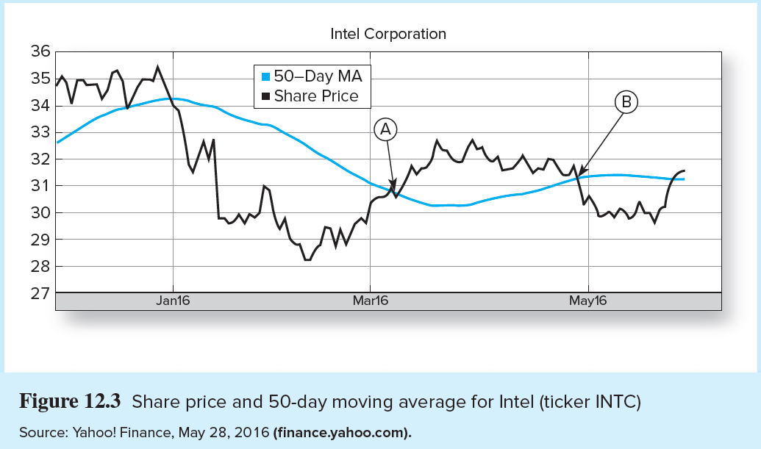
Moving Average for INTC

Slide 17
Technical Analysis: Relative Strength (1 of 2)
Relative strength
Measures if a security has out- or underperformed either the market or its particular industry
Pricing ratio implies outperformance

Slide 18
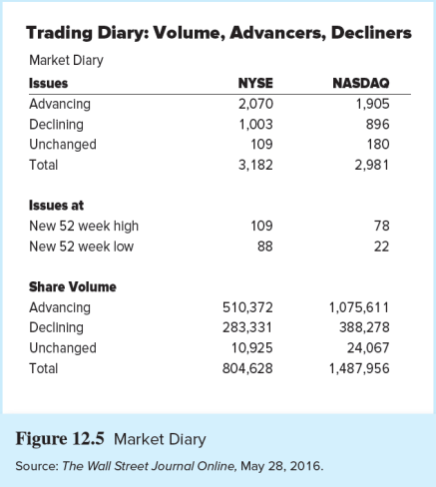
Technical Analysis: Relative Strength (2 of 2)
Breadth
Often measured as the spread between the number of stocks that advance and decline in price

Slide 19
Technical Analysis: Sentiment Indicators (1 of 3)
Trin Statistic
Ratios above 1.0 are bearish

Slide 20
Technical Analysis: Sentiment Indicators (2 of 3)
Confidence Index
The ratio of the average yield on 10 top-rated corporate bonds divided by the average yield on 10 intermediate-grade corporate bonds
Higher values are bullish

Slide 21
Technical Analysis: Sentiment Indicators (3 of 3)
Put/Call Ratio
Calls are the right to buy
A way to bet on rising prices
Puts are the right to sell
A way to bet on falling prices
A rising ratio may signal investor pessimism and a coming market decline
Contrarian investors see a rising ratio as a buying opportunity

Slide 22
Technical Analysis: A Warning
It is possible to perceive patterns that really don’t exist
Figure 12.6A is based on the real data
The graph in panel B was generated using “returns” created by a random-number generator
Figure 12.7 shows obvious randomness in the weekly price changes behind the two panels in Figure 12.6

Slide 23
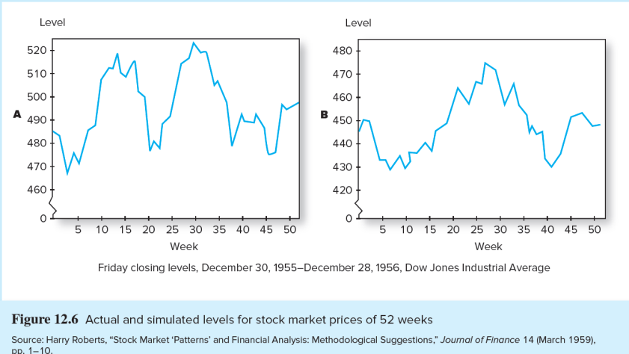
Actual and Simulated Levels for Stock Market Prices of 52 Weeks

Slide 24
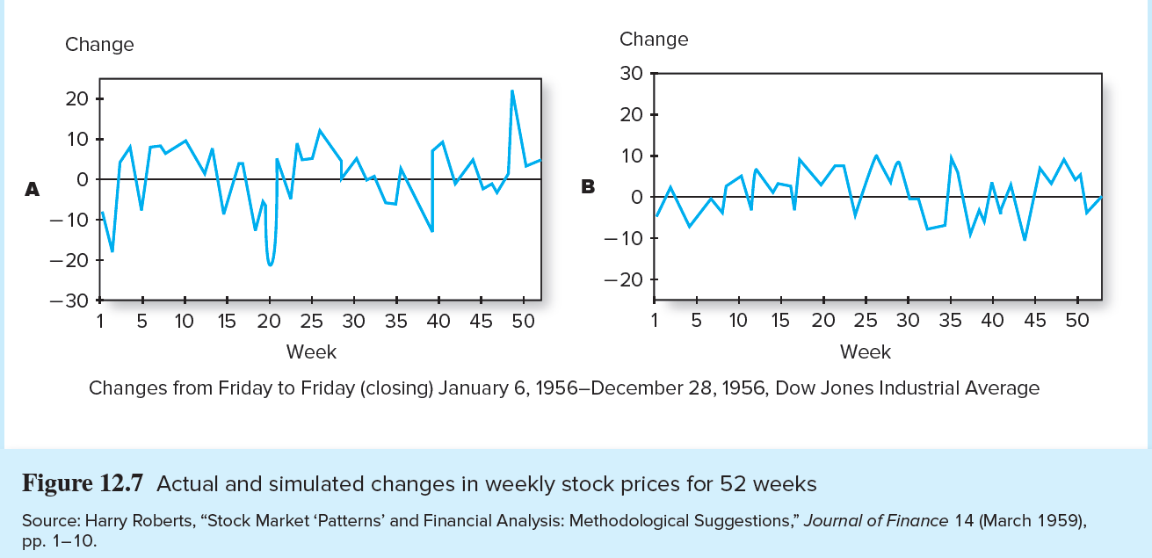
Actual and Simulated Changes in Stock Prices for 52 Weeks

