Slide 1
Chapter Twenty Four
Portfolio Performance Evaluation

Slide 2
Introduction
If markets are efficient, investors must be able to measure asset management performance
Two common ways to measure average portfolio return:
Time-weighted returns
Dollar-weighted returns
Returns must be adjusted for risk

Slide 3
Dollar- and Time-Weighted Returns (1 of 2)
Time-weighted returns
The geometric average is a time-weighted average
Each period’s return has equal weight

Slide 4
Dollar- and Time-Weighted Returns (2 of 2)
Dollar-weighted returns
Internal rate of return considering the cash flow from or to investment
Returns are weighted by the amount invested in each period:

Slide 5
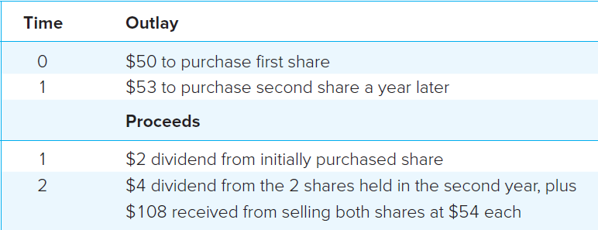
Example of Multiperiod Returns

Slide 6
Dollar-Weighted Return (1 of 2)
$4 + $108
$2
-$50
-$53
Dollar-weighted Return (IRR):

Slide 7
Time-Weighted Return
r_{G} = [ (1.10)×(1.0566) ]^{1/2} – 1 = 7.81%
The dollar-weighted average is less than the time-weighted average in this example because more money is invested in year two, when the return was lower

Slide 8
Dollar-Weighted Return (2 of 2)
Households should maintain a spreadsheet of time-dated cash flows (in and out) to determine the effective rate of return for any given period
Examples include:
IRA, 401(k), 529

Slide 9
Adjusting Returns for Risk
The simplest way to adjust for risk is to compare the portfolio’s return with the returns of a comparison universe
The comparison universe is called the benchmark
It is composed of a group of funds or portfolios with similar risk characteristics

Slide 10
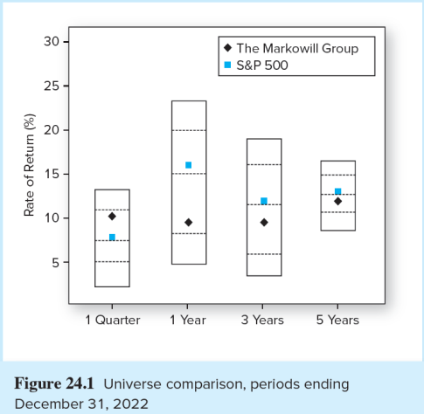
Universe Comparison

Slide 11
Risk Adjusted Performance: Sharpe
Sharpe Index
r_{p} = Average return on the portfolio
r_{f} = Average risk free rate
σ
= Standard deviation of portfolio return
p

Slide 12
Risk Adjusted Performance: Treynor
Treynor Measure
r_{p} = Average return on the portfolio
r_{f} = Average risk free rate
ß_{p} = Weighted average beta for portfolio

Slide 13
Risk Adjusted Performance: Jensen
Jensen’s Measure
α
= Alpha for the portfolio
p
r_{p} = Average return on the portfolio
ß_{p} = Weighted average Beta
r_{f} = Average risk free rate
r_{m} = Average return on market index portfolio

Slide 14
Information Ratio
Information Ratio
The information ratio divides the alpha of the portfolio by the nonsystematic risk
Nonsystematic risk could, in theory, be eliminated by diversification

Slide 15
M² Measure
Developed by Modigliani and Modigliani
Create an adjusted portfolio P* that combines P with Treasury Bills
Set P* to have the same standard deviation as the market index
Now compare market and P* returns:

Slide 16
M² Measure: Example
Managed Portfolio P: r_{P} = 35% σ_{P} = 42%
Market Portfolio: r_{M} = 28% σ_{M} = 30%
T-bill return = 6%
P* Portfolio: 30/42 = .714 in P and .286 in T-bills
r_{P*} = (.714)×(.35) + (.286)×(.06) = 26.7%
r_{P*}< r_{M} → the managed portfolio underperformed

Slide 17
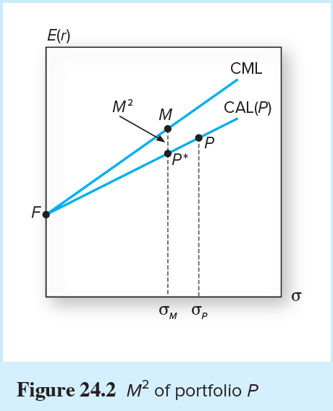
M² of Portfolio P

Slide 18
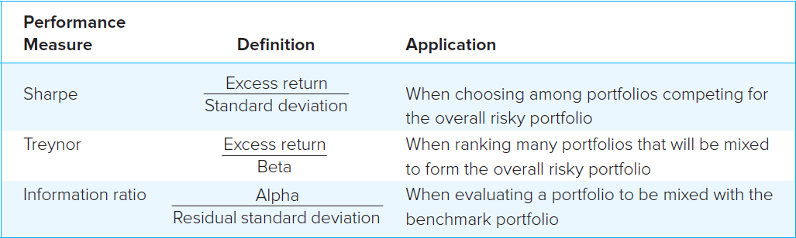
Which Measure is Appropriate?
It depends on investment assumptions
If P is not diversified, then use the Sharpe measure as it measures reward to risk
If the P is diversified, nonsystematic risk is negligible and the appropriate metric is Treynor’s, measuring excess return to beta

Slide 19
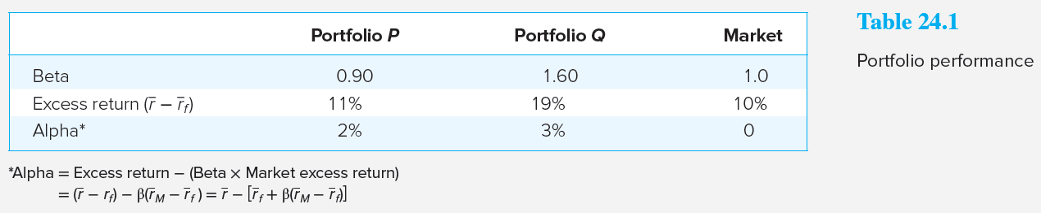
Portfolio Performance
Is Q better than P?

Slide 20
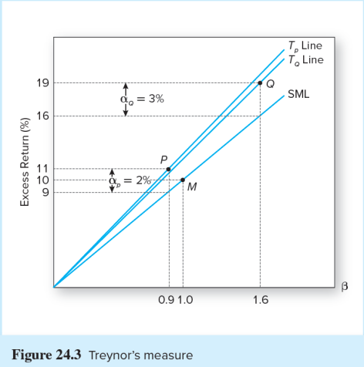
Treynor’s Measure

Slide 21
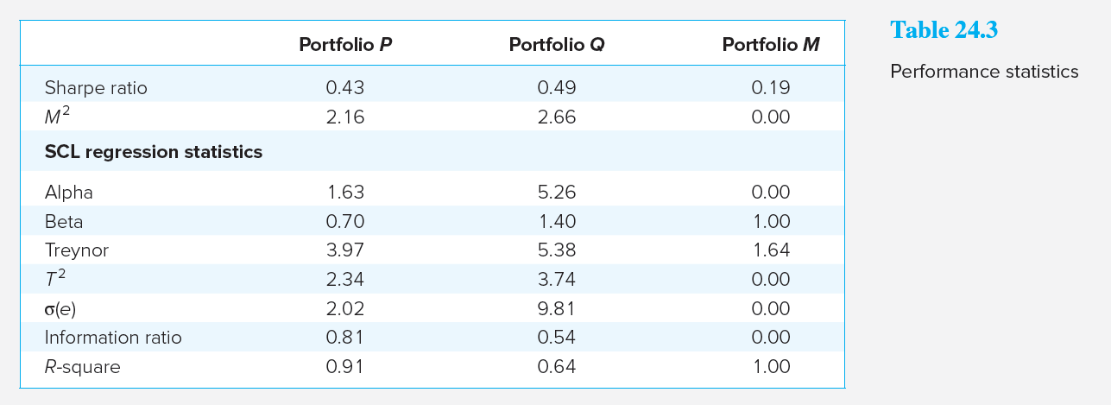
Performance Statistics

Slide 22
Interpretation of Performance Statistics
If P or Q represents the entire investment, Q is better because of its higher Sharpe measure and better M²
If P and Q are competing for a role as one of a number of subportfolios, Q also dominates because its Treynor measure is higher
If we seek an active portfolio to mix with an index portfolio, P is better due to its higher information ratio

Slide 23
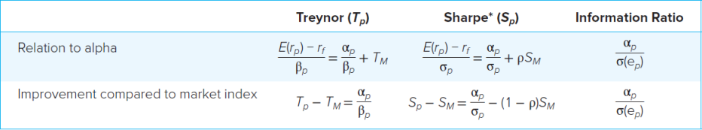
The Role of Alpha in Performance Measures

Slide 24
Performance Measurement for Hedge Funds
When the hedge fund is optimally combined with the baseline portfolio, the improvement in the Sharpe measure will be determined by its information ratio:

Slide 25
Performance Measurement with Changing Portfolio Composition
We need a very long observation period to measure performance with any precision, even if the return distribution is stable with a constant mean and variance
What if the mean and variance are not constant? We need to keep track of portfolio changes

Slide 26
Style Analysis
Introduced by William Sharpe
Regress fund returns on indexes representing a range of asset classes
The regression coefficient on each index measures the fund’s implicit allocation to that “style”
R-square measures return variability due to style or asset allocation
The remainder is due either to security selection or to market timing

Slide 27
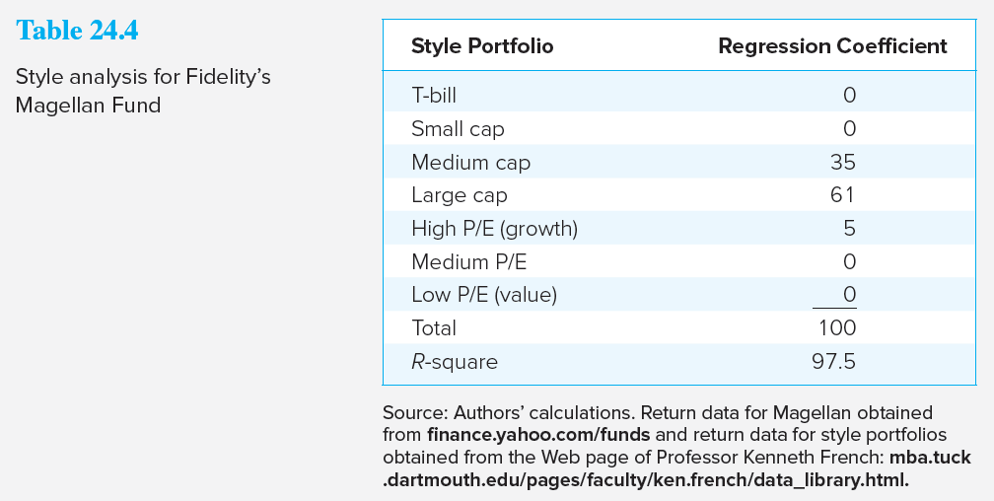
Style Analysis for Fidelity’s Magellan Fund

Slide 28
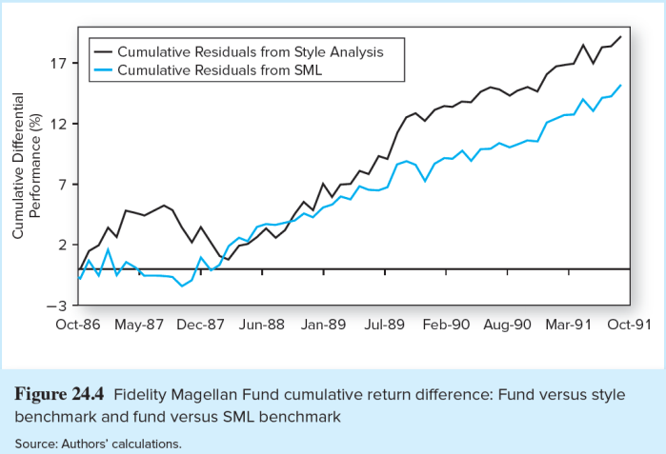
Fidelity Magellan Fund Cumulative Return Difference

Slide 29
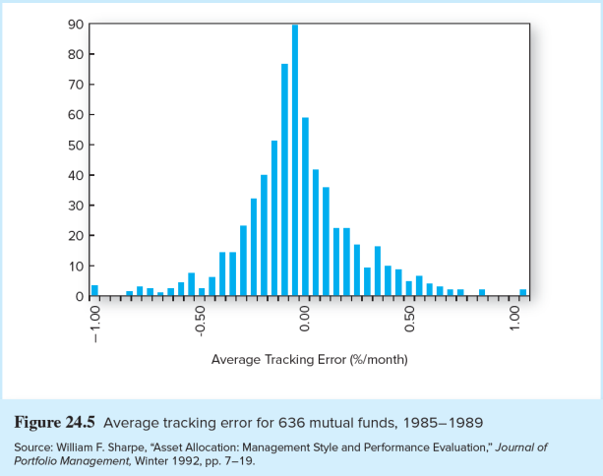
Average Tracking Error for 636 Mutual Funds, 1985-1989

Slide 30
Performance Manipulation and the MRAR
Assumption: Rates of return are independent and drawn from same distribution
Managers may employ strategies to improve performance at the loss of investors
Ingersoll, Spiegel, Goetzmann, and Welch study leads to MPPM
Using leverage to increase potential returns
MRAR fulfills requirements of the MPPM

Slide 31
Morningstar Risk Adjusted Return

Slide 32
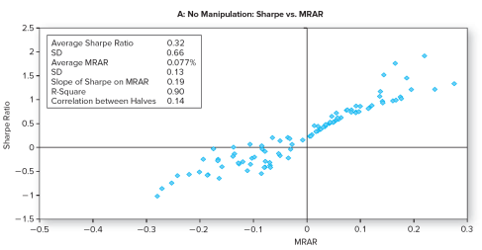
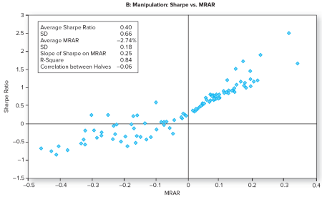
MRAR Scores with and without Manipulation

Slide 33
Market Timing
In its pure form, market timing involves shifting funds between a market-index portfolio and a safe asset
Treynor and Mazuy:
Henriksson and Merton:

Slide 34
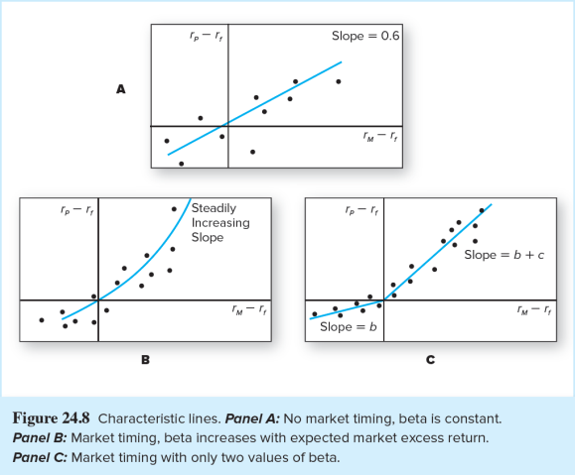
Market Timing — Characteristic Lines

Slide 35
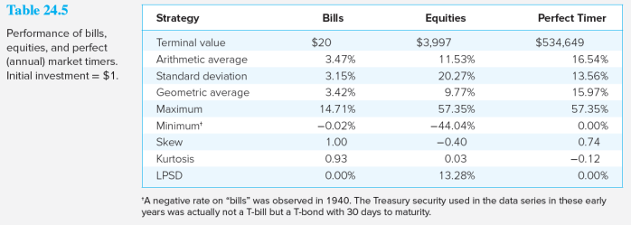
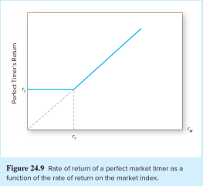
Rate of Return of a Perfect Market Timer

Slide 36
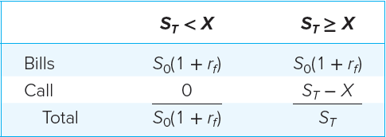
Valuing Market Timing as a Call Option

Slide 37
Performance Attribution Procedures (1 of 3)
A common attribution system decomposes performance into three components:
Allocation choices across broad asset classes
Industry or sector choice within each market
Security choice within each sector

Slide 38
Performance Attribution Procedures (2 of 3)
Set up a ‘Benchmark’ or ‘Bogey’ portfolio:
Select a benchmark index portfolio for each asset class
Choose weights based on market expectations
Choose a portfolio of securities within each class by security analysis

Slide 39
Performance Attribution Procedures (3 of 3)
Calculate the return on the ‘Bogey’ and on the managed portfolio
Explain the difference in return based on component weights or selection
Summarize the performance differences into appropriate categories

Slide 40
Formulas for Attribution
Where B is the bogey portfolio and p is the managed portfolio

Slide 41
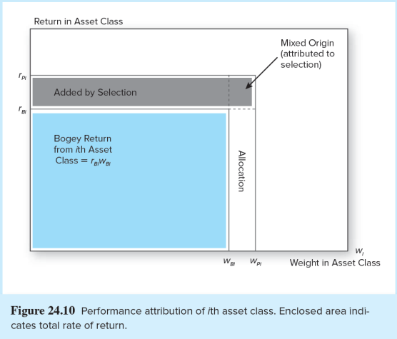
Performance Attribution of ith Asset Class

Slide 42
Performance Attribution
Superior performance is achieved by:
Overweighting assets in markets that perform well
Underweighting assets in poorly performing markets

Slide 43
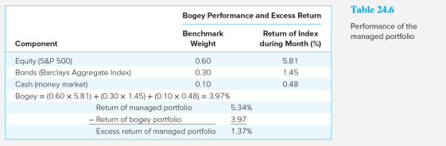
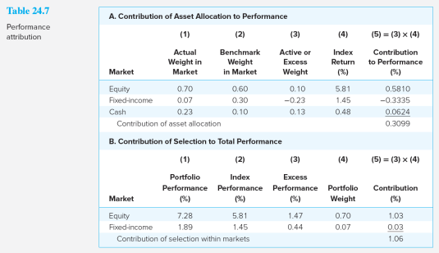
Performance Attribution: Example

Slide 44
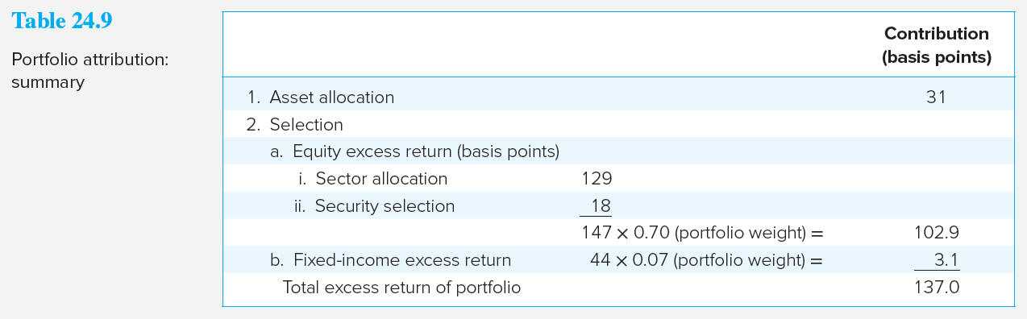
Performance Attribution Summary
Good performance (a positive contribution) derives from overweighting high-performing sectors
Good performance also derives from underweighting poorly performing sectors

