Slide 1
Chapter Twenty Six
Hedge Funds

Slide 2
Chapter Overview
Hedge funds vs. mutual funds
Hedge fund strategies
Portable alpha and pure play
Performance measurement for hedge funds
Exposure to omitted risk factors
Fee structure in hedge funds
High water marks
Funds of funds

Slide 3
Hedge Funds versus Mutual Funds (1 of 3)
Hedge Fund
Mutual Fund
Transparency: LLP with minimal disclosure of strategy and portfolio composition
Investors: No more than 100 “sophisticated” and wealthy investors
Transparency: Regulations require public disclosure of strategy and portfolio composition
Investors: Number is not limited

Slide 4
Hedge Funds versus Mutual Funds (2 of 3)
Hedge Fund
Mutual Fund
Investment Strategies: Very flexible, funds can act opportunistically; make a wide range of investments
Often use shorting, leverage, options
Investment Strategies: Predictable, stable strategies, stated in prospectus
Limited use of shorting, leverage, options

Slide 5
Hedge Funds versus Mutual Funds (3 of 3)
Hedge Fund
Mutual Fund
Liquidity: Have lock-up periods, require advance redemption notices
Compensation structure: Management fee of 1-2% of assets and an incentive fee of 20% of profits
Liquidity: Investments can be moved more easily into and out of a fund
Compensation structure: Fees are usually a fixed percentage of assets, typically 0.5% to 1.25%

Slide 6
Hedge Fund Strategies (1 of 2)
Directional
Bets that one sector or another will outperform other sectors
Nondirectional
Exploit temporary misalignments in relative valuation across sectors
Buy one type of security and sell another
Strives to be market neutral

Slide 7
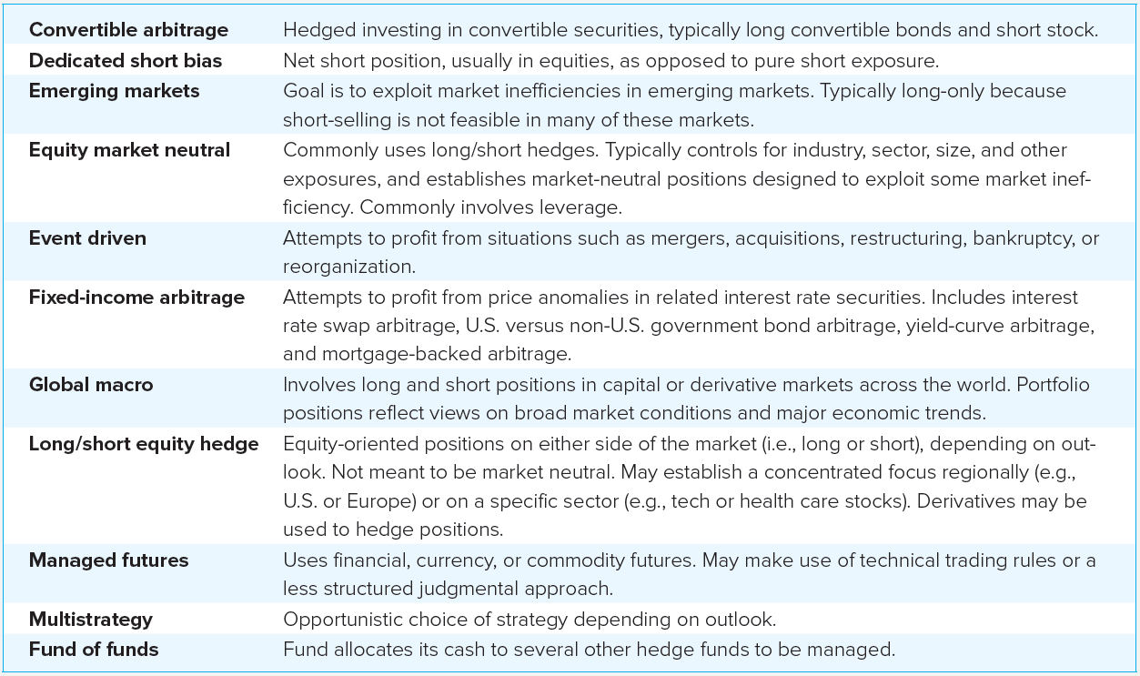
Hedge Fund Styles

Slide 8
Hedge Fund Strategies (2 of 2)
Statistical Arbitrage
Quantitative systems seek out many temporary and modest misalignments in prices
Trades in hundreds of securities a day with short holding periods
Pairs trading: Pair similar companies with highly correlated returns where one is priced more aggressively
Data mining: Uncovers systematic pricing patterns

Slide 9
Portable Alpha (1 of 5)
Invest wherever you can find alpha
Hedge systematic risk of the investment → isolates its alpha
Establish exposure to desired market sectors by using passive products such as indexed mutual funds, ETFs, or index futures
Transfer alpha from the sector where you find it to the asset class in which you ultimately establish exposure

Slide 10
Portable Alpha (2 of 5)
Pure Play Example
$2.1 million portfolio
You believe alpha > 0 and that the market is about to fall, < 0
So you establish a pure play on the mispricing
The return on your portfolio is

Slide 11
Portable Alpha (3 of 5)
Pure Play Example (continued)
Suppose
Beta = 1.2
Alpha = 2%
Risk-free rate = 1%
S&P 500 (S₀) = 2,016
You want to capture the 2% alpha per month, but you don’t want the positive beta of the stock because of an expected market decline

Slide 12
Portable Alpha (4 of 5)
Pure Play Example (continued)
Hedge your exposure by selling S&P 500 futures contracts (S&P multiplier = $50)
After 1 month, the value of your portfolio will be:

Slide 13
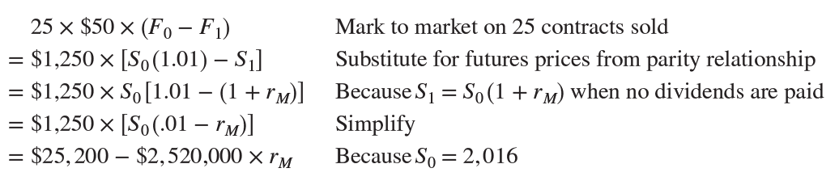
Portable Alpha (5 of 5)
Pure Play Example (continued)
The dollar proceeds from your futures position
Hedged proceeds = $2,163,000 + $2,100,000 × e
Beta is zero and your monthly return is 3%

Slide 14
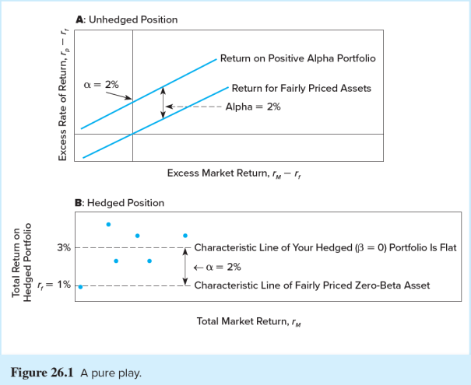
A Pure Play

Slide 15
Style Analysis for Hedge Funds
The equity market-neutral funds
Have low and insignificant betas
Dedicated short bias funds
Have substantial negative betas on the S&P index
Distressed-firm funds
Have significant exposure to credit conditions
Global macro funds
Show negative exposure to a stronger U.S. dollar

Slide 16
Performance Measurement for Hedge Funds (1 of 2)
Standard index model estimates
Period: October 2011– September 2016
S&P 500 as a market benchmark
Below average performance results
Average alpha was slightly negative
Average Sharpe ratio was less than S&P 500

Slide 17
Performance Measurement for Hedge Funds (2 of 2)
In earlier periods (particularly before 2010) hedge funds generally substantially outperformed passive indexes.
Regardless of this variability in outcome, several factors make hedge fund performance difficult to evaluate.

Slide 18
Liquidity and Hedge Fund Performance (1 of 2)
Hedge funds tend to hold more illiquid assets than other institutional investors
Aragon: Typical alpha may actually be an equilibrium liquidity premium rather than a sign of stock-picking ability
Hasanhodzic and Lo: Hedge fund returns have serial correlation → liquidity problems, which explains the upward bias in the Sharpe ratios

Slide 19
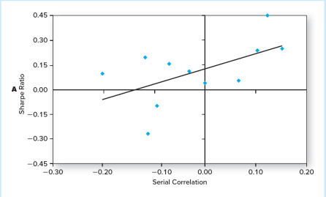
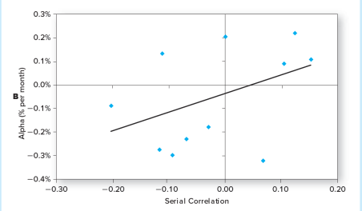

Hedge Funds with Higher Serial Correlation in Returns

Slide 20
Liquidity and Hedge Fund Performance (2 of 2)
Sadka: Unexpected declines in market liquidity are an important determinant of average hedge fund returns
Santa effect: Hedge funds report average returns in December that are substantially greater than their average returns in other months
The December spike in returns is stronger for lower-liquidity funds, suggesting that illiquid assets are more generously valued in December

Slide 21
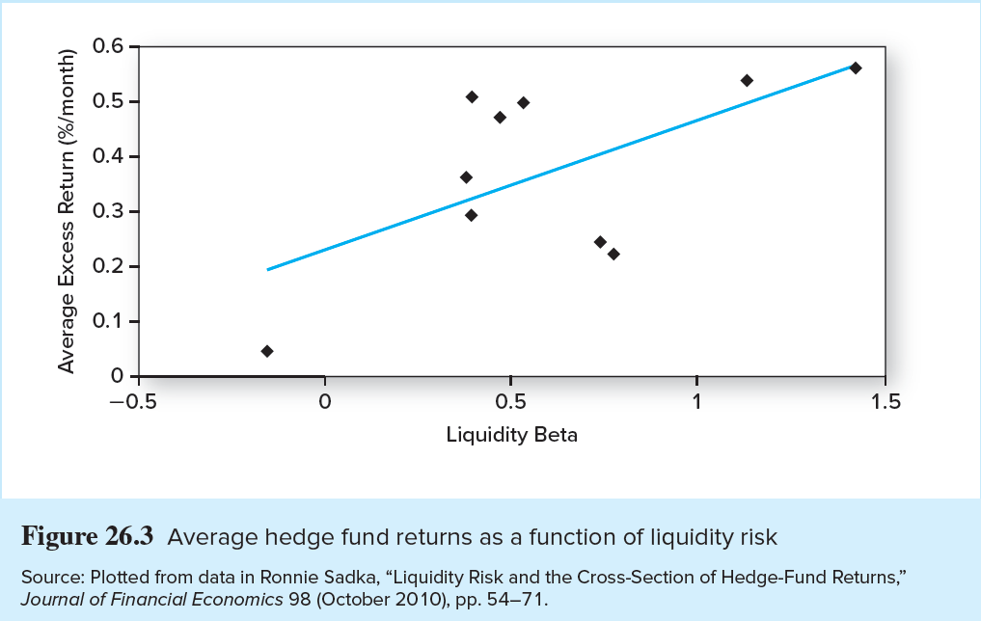
Average Hedge Fund Returns as a Function of Liquidity Risk

Slide 22
Hedge Fund Performance and Survivorship Bias
Backfill bias:
Hedge funds report returns only if they choose to
They may do so only when prior performance is good
Survivorship bias:
Failed funds drop out of the database
Hedge fund attrition rates are more than double those for mutual funds

Slide 23
Hedge Fund Performance and Changing Factor Loadings
Hedge funds are opportunistic and may frequently change their risk profiles
If risk is not constant, alphas will be biased in the standard linear index model
Conclusions
Perfect market timing → nonlinear characteristic line and hence greater sensitivity to the bull market
Funds that write options have greater sensitivity to the market when it is falling than when it is rising
Nonlinear characteristic lines suggest many hedge funds are implicit option writers

Slide 24
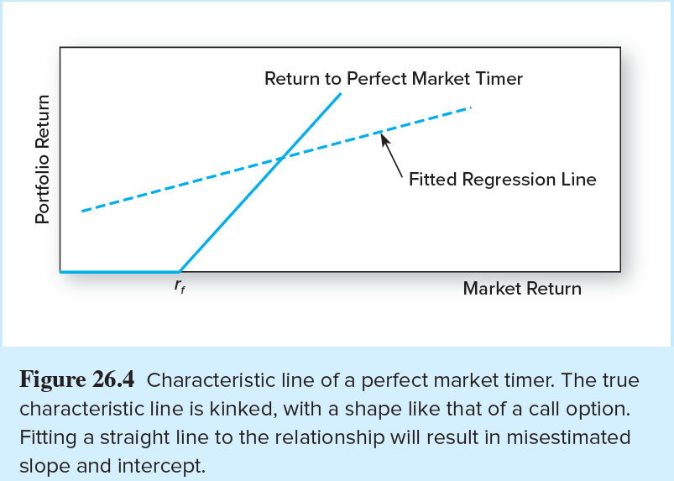
Characteristic Line of a Perfect Market Timer

Slide 25
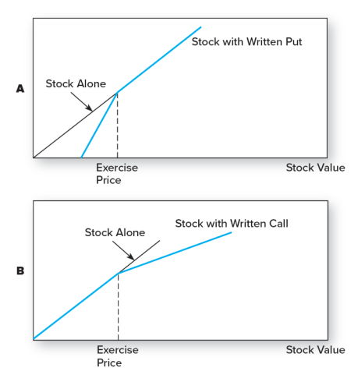
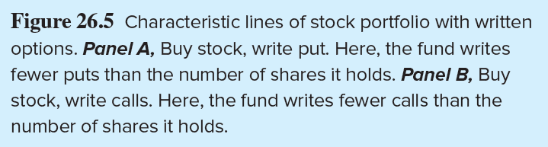
Characteristic Lines of Stock Portfolio with Written Options

Slide 26
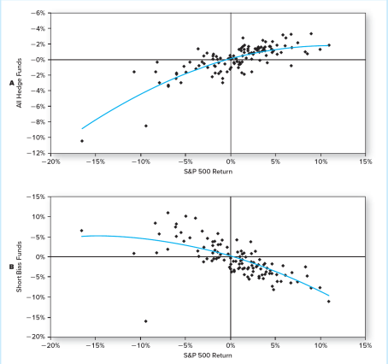
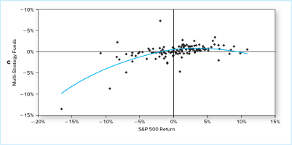

Monthly Return on Hedge Fund Indexes versus Return on the S&P 500

Slide 27
Tail Events and Hedge Fund Performance
Nassim Taleb:
Many hedge funds rack up fame through strategies that make money most of the time, but expose investors to rare but extreme losses
Examples:
The October 1987 crash
Long term capital management

Slide 28
Fee Structure in Hedge Funds
2% of assets plus an incentive fee equal to 20% of investment profits
Incentive fees are effectively call options on the portfolio with:
X = (Portfolio value) × (1 + Benchmark return)
The manager gets the fee if the portfolio value rises sufficiently, but loses nothing if it falls

Slide 29
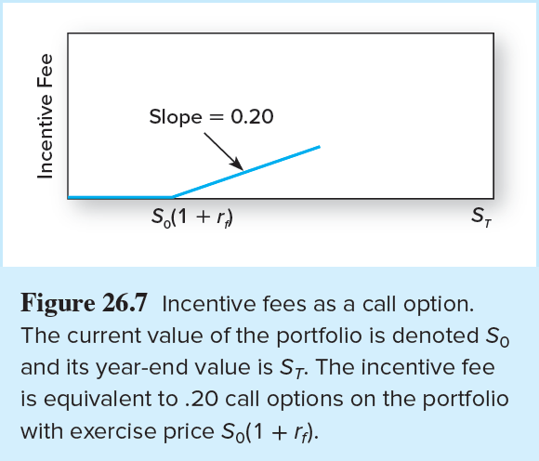
Incentive Fees as a Call Option

Slide 30
Fee Structure in Hedge Funds (1 of 3)
High water mark
The fee structure can give incentives to shut down a poorly performing fund
If a fund experiences losses, no incentive fee until it recovers its previous higher value
With deep losses, this may be too difficult so the fund closes

Slide 31
Fee Structure in Hedge Funds (2 of 3)
Funds of funds (feeder funds)
Hedge funds that invest in one or more other funds → diversify across hedge funds
Supposed to provide due diligence in screening funds for investment worthiness
Madoff scandal showed that these advantages are not always realized in practice

Slide 32
Fee Structure in Hedge Funds (3 of 3)
Funds of funds
Pay an incentive fee to each underlying fund that outperforms its benchmark even if the aggregate performance is poor
Diversification can hurt the investor in this case
Spread risk across several different funds, but operate with considerable leverage
If the various hedge funds in which these funds of funds invest have similar investment styles, diversification may be an illusion

Slide 33
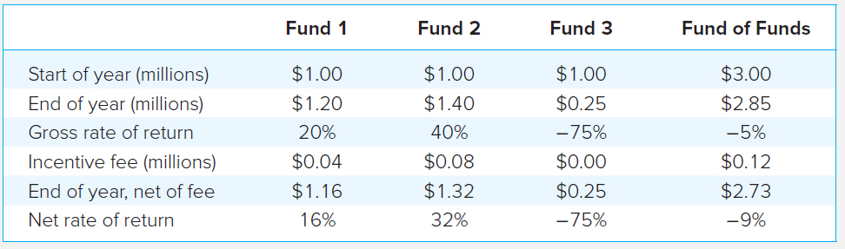
Incentive Fees in Funds of Funds
A fund of funds has $1 million invested in three hedge funds
Hurdle rate for the incentive fee is a zero return
Each fund charges an incentive fee of 20%
The aggregate portfolio of the fund of funds is -5%
Still pays incentive fees of $.12 for every $3 invested

