Slide 1
Chapter Twenty Seven
The Theory of Active Portfolio Management

Slide 2
Overview
Treynor-Black model
The optimization uses analysts’ forecasts of superior performance
The model is adjusted for tracking error and for analyst forecast error
Black-Litterman model
Quantify complex forecasts
Apply these views to portfolio construction

Slide 3
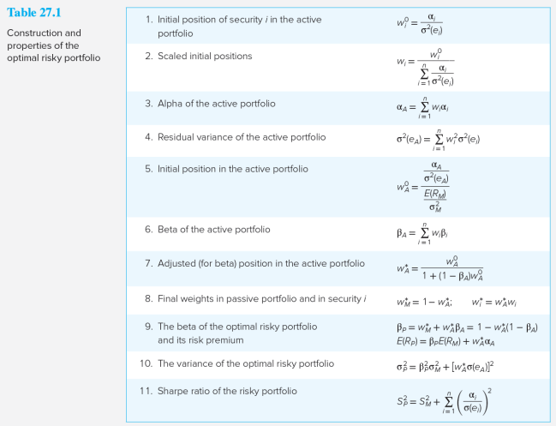
Construction and Properties of the Optimal Risky Portfolio

Slide 4
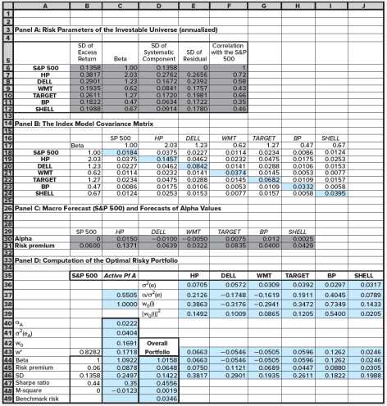

Active Portfolio Management
An active portfolio of six stocks is added to the passive market index portfolio
Panel D shows:
Performance increases are very modest
M-square increases by only 19 basis points

Slide 5
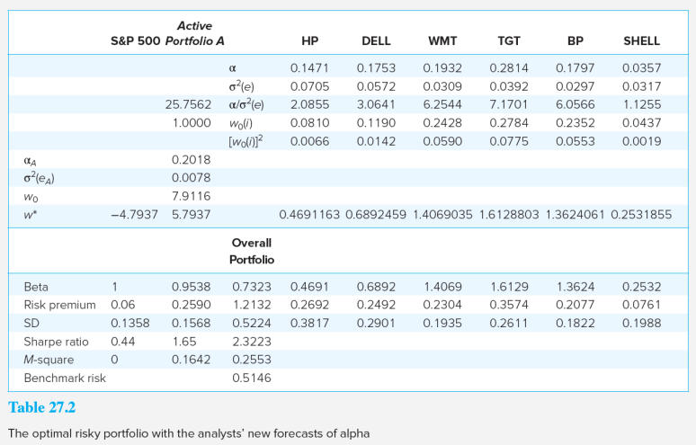
The Optimal Risky Portfolio

Slide 6
The Optimal Risky Portfolio Results
The Sharpe ratio increases to 2.32, a huge risk-adjusted return advantage
M-square increases to 25.53%

Slide 7
Results: Problems
Problems:
The optimal portfolio calls for extreme long/short positions that may not be feasible for a real-world portfolio manager
The portfolio is too risky and most of the risk is nonsystematic risk
A solution: Restrict extreme positions
This results in a lack of diversification

Slide 8
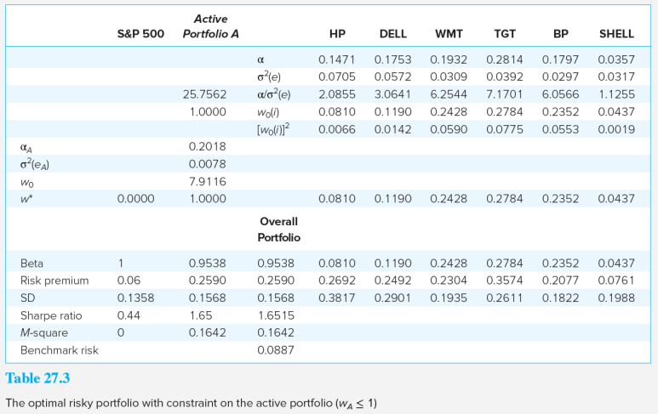
The Optimal Risky Portfolio, Constrained (w_{A} ≤1)

Slide 9
The Optimal Risky Portfolio, Constrained (w_{A} ≤1) Results
The Sharpe ratio falls from 2.32 to 1.65
M-square is now .1642

Slide 10
Tracking Error (1 of 2)
Most investment managers are judged on performance relative to a benchmark portfolio
Such commitment raises the importance of tracking error

Slide 11
Tracking Error (2 of 2)

Slide 12
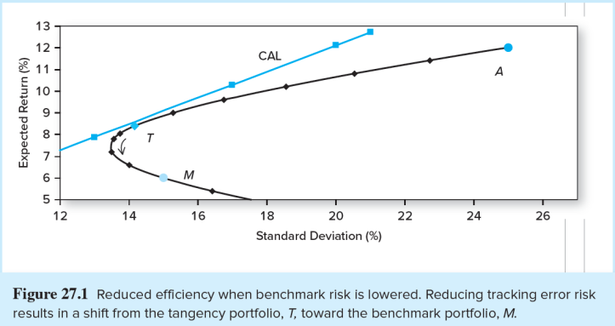
Reduced Efficiency when Benchmark Risk is Lowered
Benchmark risk is the standard deviation of the tracking error, T_{E} = R_{P} - R_{M.} Control it by restricting W_{A}

Slide 13
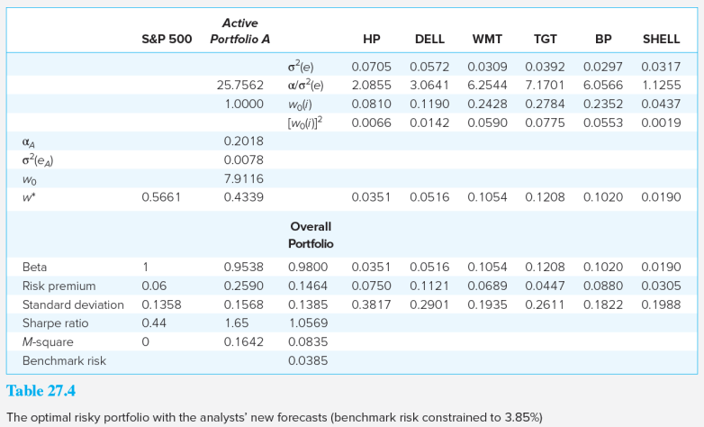
The Optimal Risky Portfolio with the Analysts’ New Forecasts

Slide 14
The Optimal Risky Portfolio with the Analysts’ New Forecasts Results
The Sharpe ratio falls from 1.65 to 1.06
M-square is now .0835

Slide 15
Adjusting Forecasts for the Precision of Alpha
How accurate is your forecast?
Regress forecast alphas on actual, realized alphas to adjust alpha for the accuracy of the analysts’ previous forecasts

Slide 16
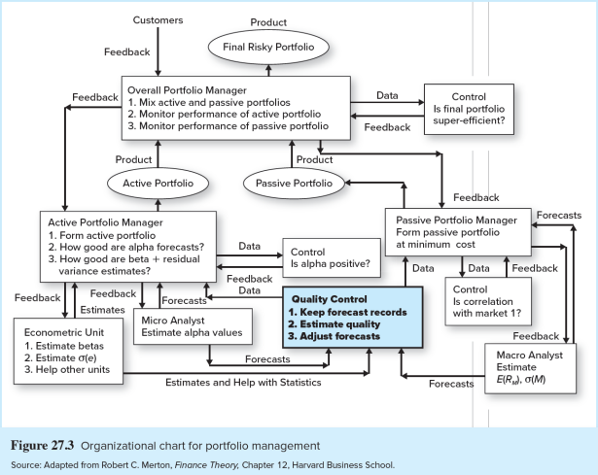
Organizational Chart for Portfolio Management

Slide 17
The Black-Litterman (BL) Model
The BL model allows portfolio managers to incorporate complex forecasts into the portfolio construction process
Data hails from two sources: history and forecasts, called views
Historical sample is used to estimate covariance matrix and asset allocation to make baseline forecasts
Views represent departure from the baseline, establishing new alpha forecasts and an optimal risky P

Slide 18
Steps in the BL Model
Estimate the covariance matrix from recent historical data
Determine a baseline forecast
Integrate the manager’s private views
Develop revised (posterior) expectations
Apply portfolio optimization

Slide 19
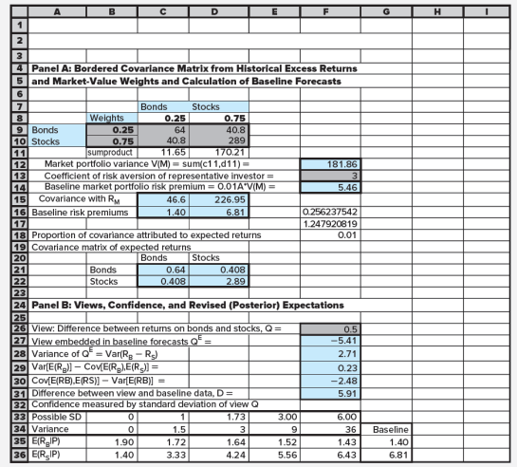

Sensitivity of Black-Litterman Portfolio Performance to Confidence Level (1 of 2)

Slide 20
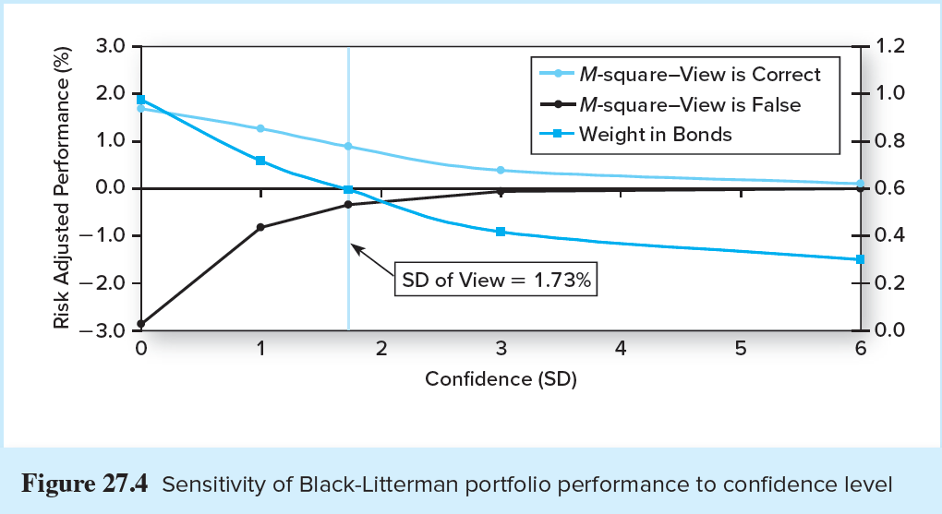
Sensitivity of Black-Litterman Portfolio Performance to Confidence Level (2 of 2)

Slide 21
BL Conclusions
The BL model and the Black-Treynor (TB) model are complements
The models are identical with respect to the optimization process and will chose identical portfolios given identical inputs
The BL model is a generalization of the TB model that allows you to have views about relative performance that cannot be used in the TB model

Slide 22
BL versus TB (1 of 2)
Black-Litterman Model
Treynor-Black Model
Optimal portfolio weights and performance are highly sensitive to the degree of confidence in the views
The validity of the BL model rests largely upon the way in which the confidence about views is developed
TB model is not applied in the field because it results in “wild” portfolio weights
The extreme weights are a consequence of failing to adjust alpha values to reflect forecast precision

Slide 23
BL versus TB (2 of 2)
Black-Litterman Model
Treynor-Black Model
Use the BL model for asset allocation
Views about relative performance are useful even when the degree of confidence is inaccurately estimated
Use the TB model for the management of security analysis with proper adjustment of alpha forecasts

Slide 24
Value of Active Management
Kane, Marcus, and Trippi show that active management fees depend on:
The coefficient of risk aversion
The distribution of the squared information ratio in the universe of securities
The precision of the security analysts

Slide 25
Concluding Remarks
The gap between theory and practice has been narrowing in recent years
The CFA Institute has worked to transfer investment theory to the asset management industry
The TB and BL models are not yet widely used in industry, perhaps because of the issues in adjusting for analysts’ forecast errors

