Slide 1

Discussing the Equity Risk Premium

Slide 2
Learning Objectives:
Understanding
The role of a fixed income research group within a large financial institution
The importance of ERP in asset allocation decisions for investment managers (understanding bond vs. equity allocation)
Basics of portfolio mathematics
How to estimate ERP using historical date, the Gordon Growth Model, and the PE ratio
The strengths and weaknesses of the techniques used to estimate ERP

Slide 3
Discussion Points:
What are the current issues confronting Deutsche Bank?
Why would the fixed income group concentrate on the ERP?
What is the basic asset allocation problem depicted in the case?
How to estimate the ERP?
Compare and contrast various techniques to estimate the ERP

Slide 4
Analyzing the Asset Allocation Problem:
Definitions:
$$\begin{matrix}\begin{aligned}W \\ R_{e}\end{aligned} \\ R_{f} \\ R_{ERP} \\ R_{P} \\ \left.E(R\right) \\ \begin{aligned}\left.Var(R\right) \\ y\end{aligned}\end{matrix}$$
= the proportion of money invested, i.e, portfolio weight, in stocks
= the realized return on stocks
= the guaranteed return on the risk free bond
= the realized return on stocks over the risk free bond
= the realized return on the portfolio of stocks and bonds
= the expected return
= the variance of the return
= investor’s risk aversion parameter

Slide 5
Defining the Portfolio, Expected Return, and Variance
Portfolio Return:
$$R_{p}=(1−w)R_{f}+wR_{e}=R_{f}+w(R_{e}−R_{f})=R_{f}+wR_{erp}$$
Expected Return:
Variance:
$$\left.E(R_{p})=R_{f}+wE(R_{erp}\right)$$
$$\left.Var(R_{p})=w^{2}Var(R_{erp}\right)$$

Slide 6
Setting Up and Solving the Basic Asset Allocation Problem:
In order to determine the allocation of stocks vs. bonds, we must define the investor’s preferences:
$\left.E(R_{p})−yVar(R_{p}\right)$ Investors prefer more money relative to less Objective function money and less risk relative to more risk
$$\left.\max_{w} E(R_{p})−yVar(R_{p}\right)$$
The investor wants to choose the proportion of money invested in stocks that maximizes his/her preferences

Slide 7
Setting Up and Solving the Basic Asset Allocation Problem:
Substituting in the expression for portfolio expected return and variance derived earlier, we get a function that is defined over the proportion of money invested in stocks, w.
$$\left.\max_{w}{ R}_{f}+wE(R_{erp})−yw^{2}Var(R_{erp}\right)$$
$$\frac{∂}{∂w} [R_{f}+wE(R_{erp})−yw^{2}Var(R_{erp})]=E(R_{erp})−2ywVar(R_{erp})=0$$
In order to solve for the proportion of money invested in stocks, w, that maximizes investor preferences, we must take the derivative of the objective function with respect to w and set the equation to zero

Slide 8
Setting Up and Solving the Basic Asset Allocation Problem:
Solving for the optimal portfolio weight in stocks w, we obtain:
$$w=\frac{\left.E(R_{erp}\right)}{\left.2yVar(R_{erp}\right)}$$
How does this relate to the ERP? Why is understanding it important?

Slide 9
Equity Risk Premium - Definitions
$$\begin{matrix}D \\ E \\ g_{o} \\ g_{E} \\ P \\ D/P \\ \left.E(R_{e}\right) \\ R_{ERP} \\ \left.E(R_{ERP}\right) \\ \left.E(R_{ERP∗}\right)\end{matrix}$$
= dividend paid on stocks (equities) next period
= Earnings next period
= the growth rate in dividends
= the growth rate in earnings
= the price or value of stocks
= the dividend yield
= the expected return on stocks
= the realized return on stocks over the risk free bond
= the expected return on stocks over the risk free bond
= the estimate of the expected return on stocks over the rf bond

Slide 10
Equity Risk Premium: Three Ways to Estimate
Using Historical Data:
Strengths/Weaknesses of using this method?
$$E(R_{ERP∗})\frac{\sum_{t=1}^{T}{R_{ERP,t}}}{T}$$

Slide 11
Equity Risk Premium: Three Ways to Estimate
2. Gordon Growth Model:
Solving for expected return on stocks, we obtain:
Strengths/Weaknesses of of using this method?
$$P=\sum_{t=o}^{∞}{\left(\frac{D{\left(1+g_{d}\right)}^{t}}{{\left(1+E(R_{e})\right)}^{t+1}}\right.})=\frac{D}{\left.1+E(R_{E}\right)}\sum_{t=0}^{∞}{{\left(\frac{1+g_{d}}{\left.1+E(R_{e}\right)}\right)}^{t}}=\frac{D}{E(R_{e})−g_{d}}$$
$$E(R_{e})=\frac{D}{P}+g_{d}$$

Slide 12
Equity Risk Premium: Three Ways to Estimate
3. Using the Price to Earnings Ratio:
Solving for the expected return on stocks, we obtain:
Strengths/Weaknesses of of using this method?
$$P=\sum_{t=o}^{∞}{\left(\frac{E{\left(1+g_{E}\right)}^{t}}{{\left(1+E(R_{e})\right)}^{t+1}}\right.})=\frac{E}{\left.1+E (R_{e}\right)}\sum_{t=0}^{∞}{{\left(\frac{1+g_{E}}{\left.1+E(R_{e}\right)}\right)}^{t}}=\frac{E}{E(R_{e})−g_{E}}$$
$$E(R_{e})=\frac{E}{P}+g_{E}$$

Slide 13
Fundamental Stock Analysis: Models of Equity Valuation
Basic Types of Models
Discounted Cash Flow Models
Balance Sheet Models
BV, MV, LV, RC
Dividend Discount Models
Ratio Models
P/E

Slide 14
General Model
∞
D
∑
t
V
=
o
(
1
+
k
)
t
t
=
1
V₀ = Value of Stock
D_{t} = Dividend
k = Required return (e.g. CAPM derived)

Slide 15
No Growth Model
D
V
=
o
k
Stocks that have earnings and dividends that are expected to remain constant
Preferred Stock

Slide 16
No Growth Model: Example
D
V
=
o
k
E₁ = D₁ = $5.00
k = .15
V₀ = $5.00 / .15 = $33.33

Slide 17
Constant Growth Model
D
(
1
+
g
)
Vo
=
o
k
−
g
g = constant perpetual growth rate

Slide 18
Constant Growth Model: Example
D
(
1
+
g
)
Vo
=
o
k
−
g
E₁ = $5.00 b = 40% k = 15%
(1-b) = 60% D₁ = $3.00 g = 8%
V₀ = 3.00 / (.15 - .08) = $42.86

Slide 19
Stock Prices and Investment Opportunities
g
=
ROE
×
b
g = growth rate in dividends
ROE = Return on Equity for the firm
b = plowback or retention percentage rate
(1- dividend payout percentage rate)

Slide 20
g = ROE * b
Cash Cow Ltd | Growth Prospects Inc
E(e) $5/share | E(e) $5/share
b=0 | b=0
k=12.5% D1/k=$40 | k=12.5% D1/k=$40
Assets | L & OE
PPE $100m | Equity $100
$100 million | $100 million
Now assume Growth Prospects: projects with ROE 15%
Decide: b=0.6 → 60% of earnings reinvested at 15%
Dividend then: down to $2 (40% of $5)
With ROE of 15% → $15million earnings
60% of $15million reinvested
Value of firm will grow at 9% p.a.
Assuming same payout ratio: Dividends will
grow at 9% p.a. as well
Therefore: g = ROE * b
9% = 15% * 0.6
New share price: DIV1 / (k – g)
$2 / (.125 - .09) = $57.14 > $40

Slide 21
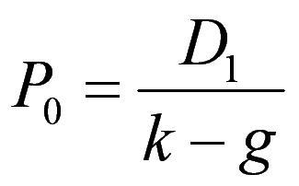
PV of Growth Opportunities
If the stock price equals its IV, growth rate is sustained, the stock should sell at:
If all earnings paid out as dividends, price should be lower (assuming growth opportunities exist)

Slide 22
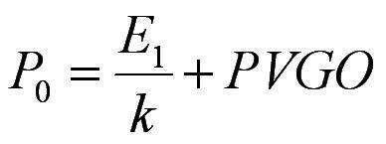
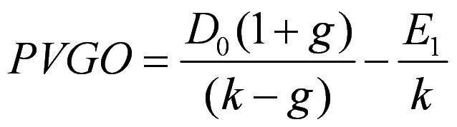
Present Value of Growth Opportunities (cont.)
Price = No-growth value per share + PVGO (present value of growth opportunities)
Where:
E₁ = Earnings Per Share for period 1 and

Slide 23
Partitioning Value: Example
ROE = 20% d = 60% b = 40%
E₁ = $5.00 D₁ = $3.00 k = 15%
g = .20 x .40 = .08 or 8%

Slide 24
Partitioning Value: Example (cont.)
3
P
=
=
$42
.
86
o
(.
15
−
.
08
)
5
NGV
=
=
$33
.
33
o
.
15
PVGO
=
$42
.
86
−
$33
.
33
=
$9
.
52
P_{o} = price with growth
NGV_{o} = no growth component value
PVGO = Present Value of Growth Opportunities

Slide 25
Life Cycles and Multistage Growth Models
T
(
1
+
g
)
t
D
(
1
+
g
)
∑
T
P
=
D
₁
+
2
o
o
(
1
+
k
)
t
(
k
−
g
)
(
1
+
k
)
T
t
=
1
2
g₁ = first growth rate
g₂ = second growth rate
T = number of periods of growth at g₁

Slide 26
Multistage Growth Rate Model: Example
D0 = $2.00 g1 = 20% g2 = 5%
k = 15% T = 3 D1 = 2.40
D2 = 2.88 D3 = 3.46 D4 = 3.63
V0 = D1/(1.15) + D2/(1.15)2 + D3/(1.15)3 +
D4 / (.15 - .05) ( (1.15)3
V0 = 2.09 + 2.18 + 2.27 + 23.86 = $30.40

Slide 27
SECURITY ANALYSIS
Equity Valuation
Price-Earnings Ratio

Slide 28
P/E Ratio and Growth Opportunities
P/E Ratios are a function of two factors
Required Rates of Return (k)
Expected growth in Dividends
Uses
Relative valuation
Extensive use in industry

Slide 29
Recap
Price = No growth value per share + PVGO
Re-arrange
When PVGO is zero
Price stock = E1/k
P/E = 1/k
When PVGO dominates
High P/E
Growth stocks

Slide 30
P/E Ratio: No expected growth
E
P
=
1
0
k
P
1
0
=
E
k
1
E₁ - expected earnings for next year
E₁ is equal to D₁ under no growth
k - required rate of return

Slide 31
P/E Ratio: Constant Growth
D
E
(
1
−
b
)
P
=
1
=
1
0
−
−
×
k
g
k
(
b
ROE
)
P
1
−
b
0
=
E
k
−
(
b
×
ROE
)
1
b = retention ratio
ROE = Return on Equity

Slide 32
Numerical Example: No Growth
E₀ = $2.50 g = 0 k = 12.5%
P₀ = D/k = $2.50/.125 = $20.00
P/E = 1/k = 1/.125 = 8

Slide 33
Numerical Example with Growth
b = 60% ROE = 15% (1-b) = 40%
E₁ = $2.50 (1 + (.6)(.15)) = $2.73
D₁ = $2.73 (1-.6) = $1.09
k = 12.5% g = 9%
P₀ = 1.09/(.125-.09) = $31.14
P/E = 31.14/2.73 = 11.4
P/E = (1 - .60) / (.125 - .09) = 11.4

Slide 34
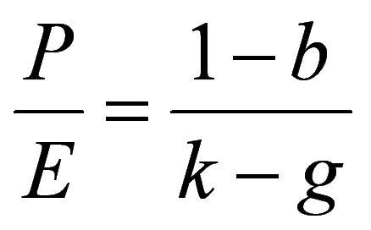
P/E Ratios and Stock Risk
Riskier stocks will have lower P/E multiples
Riskier firms will have higher required rates of return (higher values of k)

Slide 35
Pitfalls in Using P/E Ratios
Flexibility in reporting makes choice of earnings difficult
Pro forma earnings may give a better measure of operating earnings
Problem of too much flexibility

Slide 36
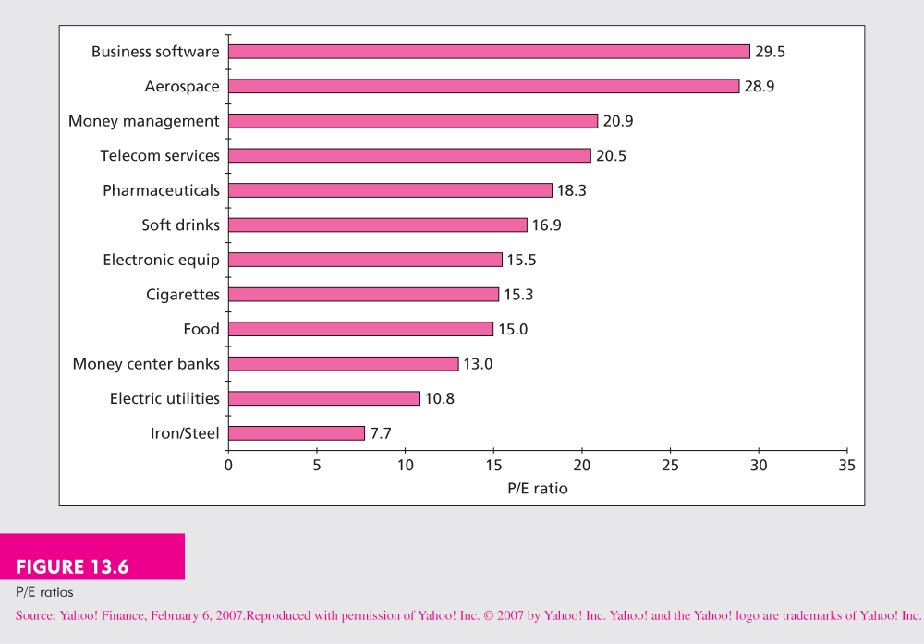
P/E Ratios

Slide 37
Comparing the Valuation Models
Free cash flow approach should provide same estimate of IV as the dividend growth model
In practice the two approaches may differ substantially
Simplifying assumptions are used

