Slide 1
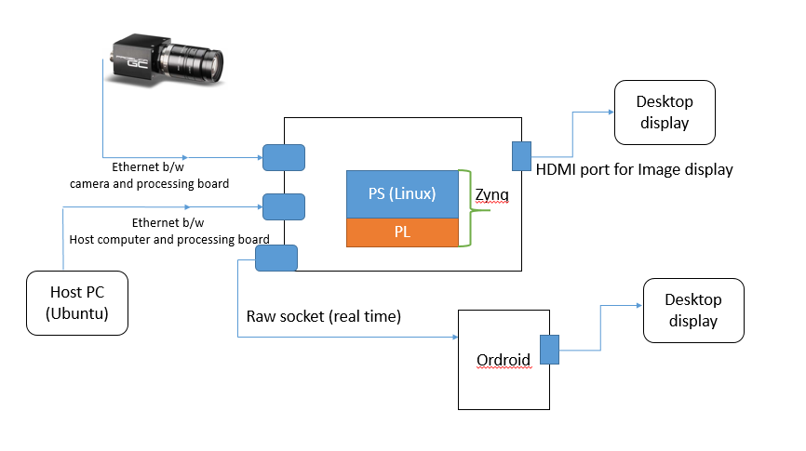
Project (Sumit Chouhan)
A] Sobel Filter implementation in the FPGA Zynq.
Approach to design a sobel filter in fpga block with read/write operations from the DDR memory. [ Hardware design ]
Writing/Reading the captured data from camera to the DDR memory. [PS side on Linux
B] Sending data to Odroid Board

Slide 2
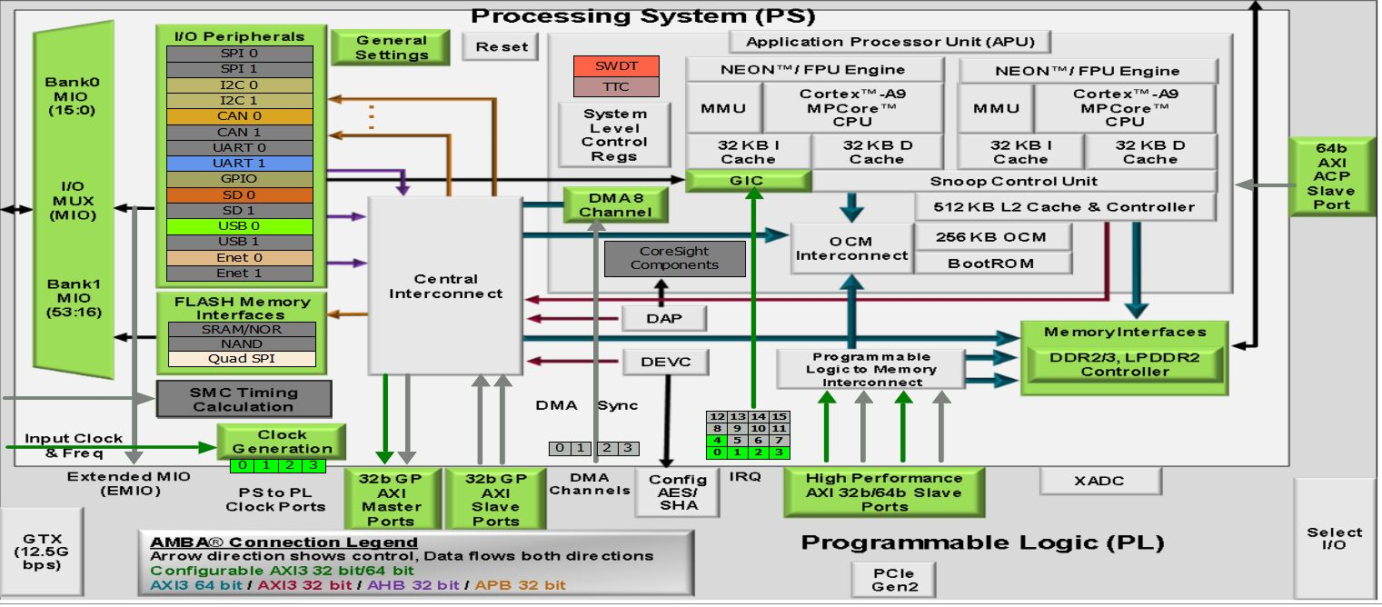
Zynq PS and PL
Some Brief details about different blocks.
Processor System Components
application processing unit (Apu)
I/O peripherals (Iop)
multiplexed I/O (Mio), extended multiplexed I/O (Emio)
memory interfaces
PS interconnect
Dma
timers
general interrupt controller Gic
on-chip memory (Ocm): Ram
debug controller: CoreSight
The PS can “Master” peripherals in the PL
Using the GP_Master_AXI_0
PL Devices can access the resources of PS
Through the two slave ports
GP_slave_AXI_0
HP_slave_AXI_0/1/2/3 (High performance)
Memory map
The cortex-A9 processor uses 32-bit addressing
All the PS and PL peripherals are memory mapped to processor cores

Slide 3
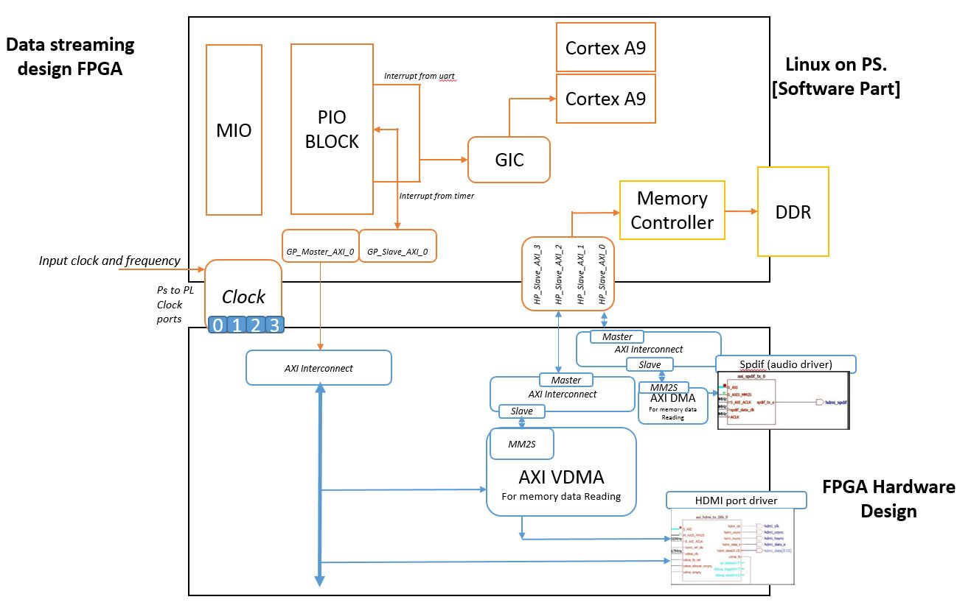
A] 1. Hardware Design part (Hardware Driver part)
What is already done:
Using this The Cortex-A9
processor writes and reads
all AXI4-Lite slave registers in
the design for control and status
information.
AXI_INTERCONNECT_GP0_MASTER
Xilinx provide AXI VDMA for video read/write
capabilities from AXI4 memory mapped
domain to AXI4stream
AXI4-Lite
AXI4-Lite

Slide 4
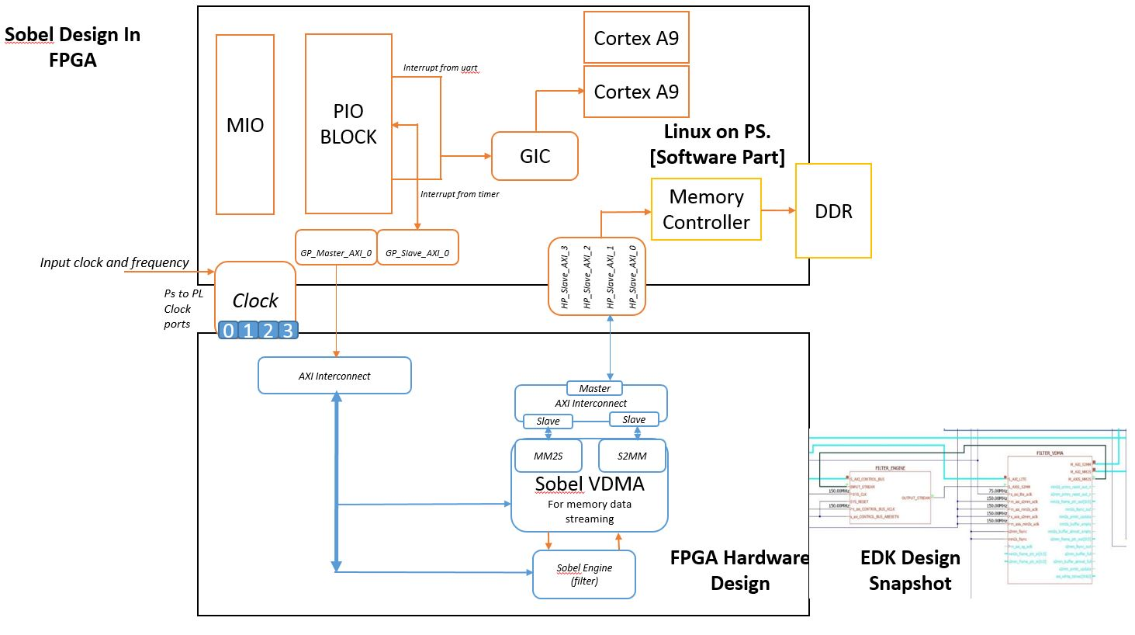
Sobel filter part
Zynq PS-PL
A. 1.

Slide 5
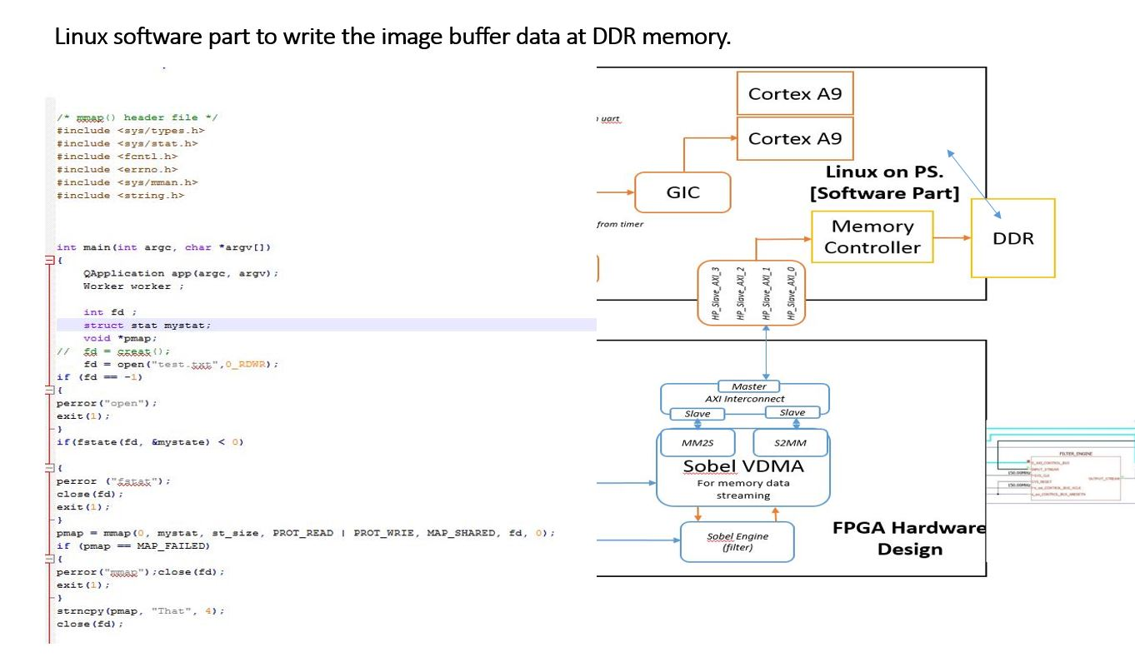
A. 2.
Virtual memory

Slide 6
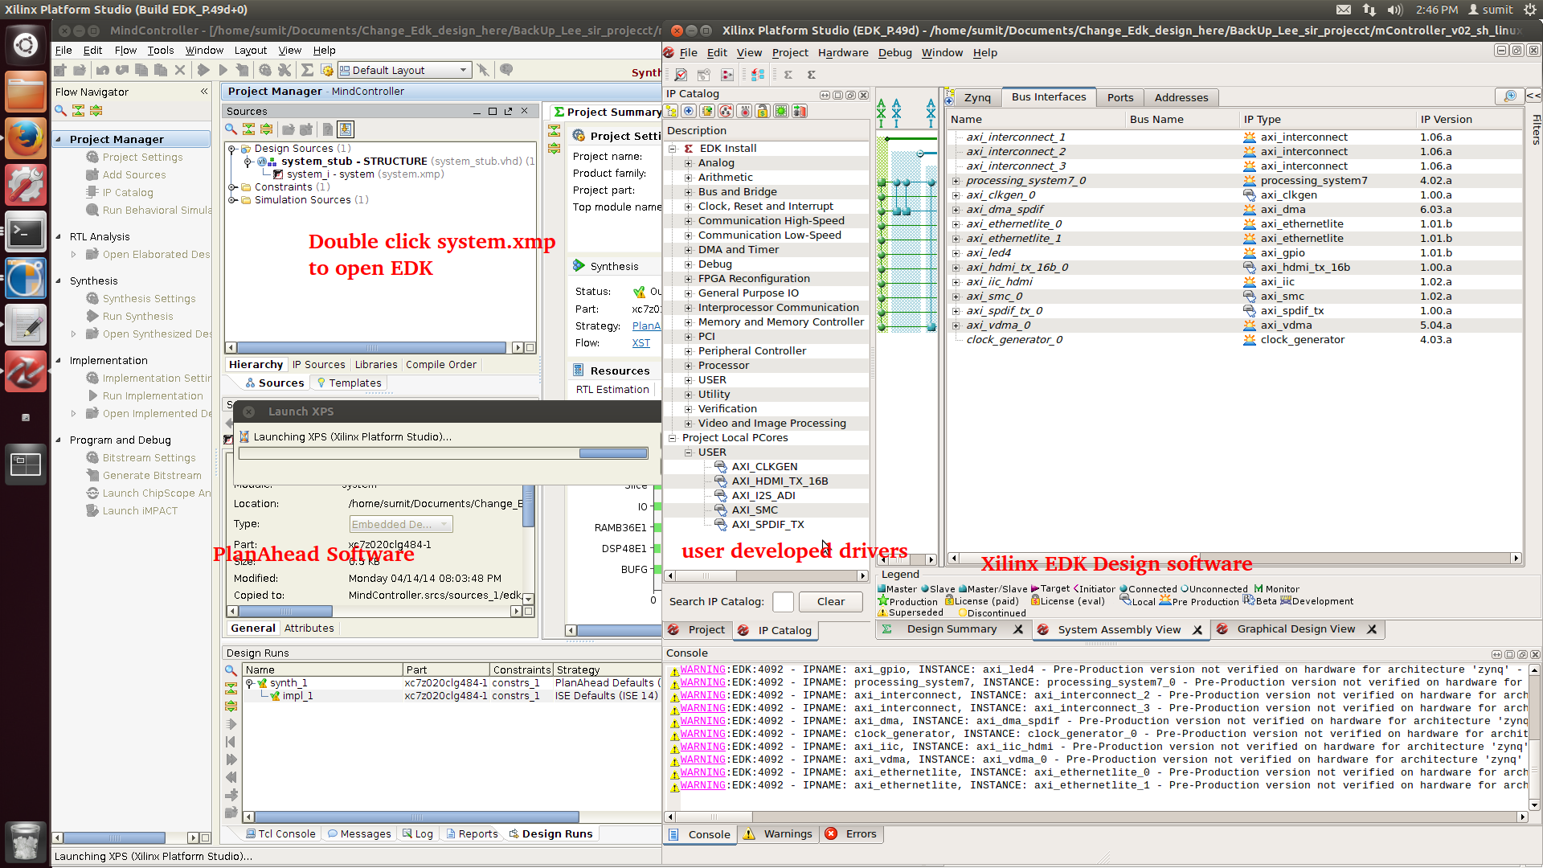
Steps followed for building fpga (PL) side of project
A. 1. part Steps
Open PlanAhead Software -> EDK Design

Slide 7
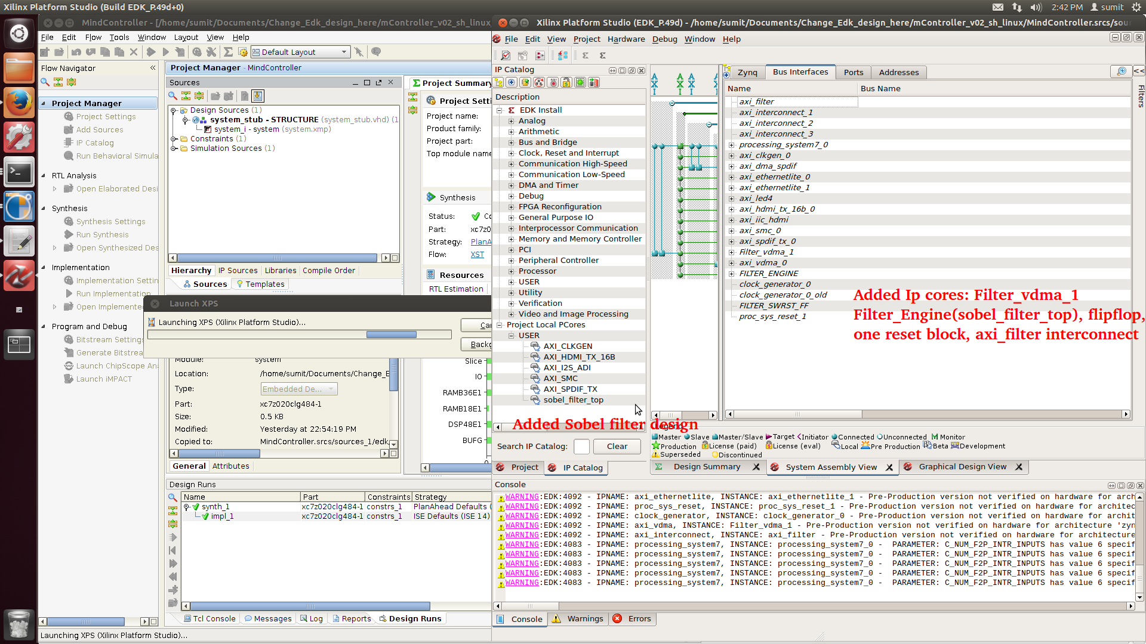
ADD Extra design drivers (Sobel filter and VDMA)

Slide 8
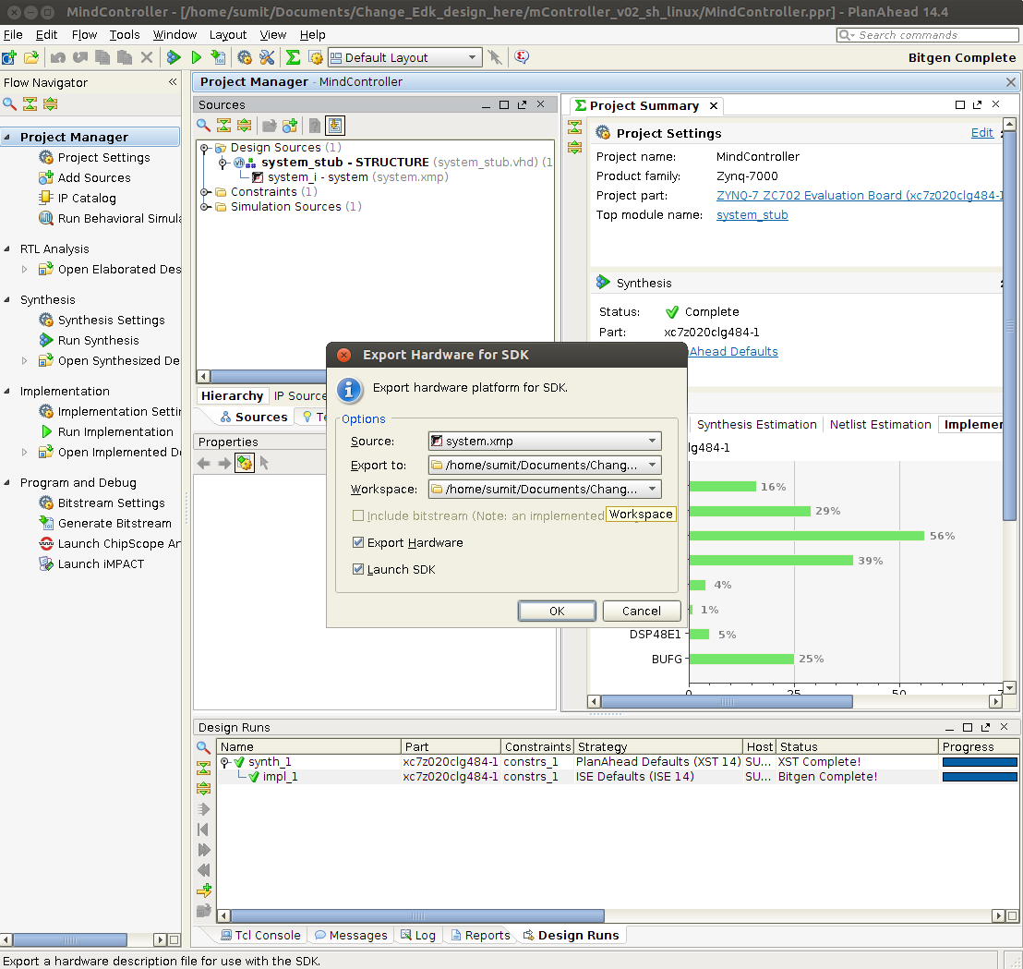
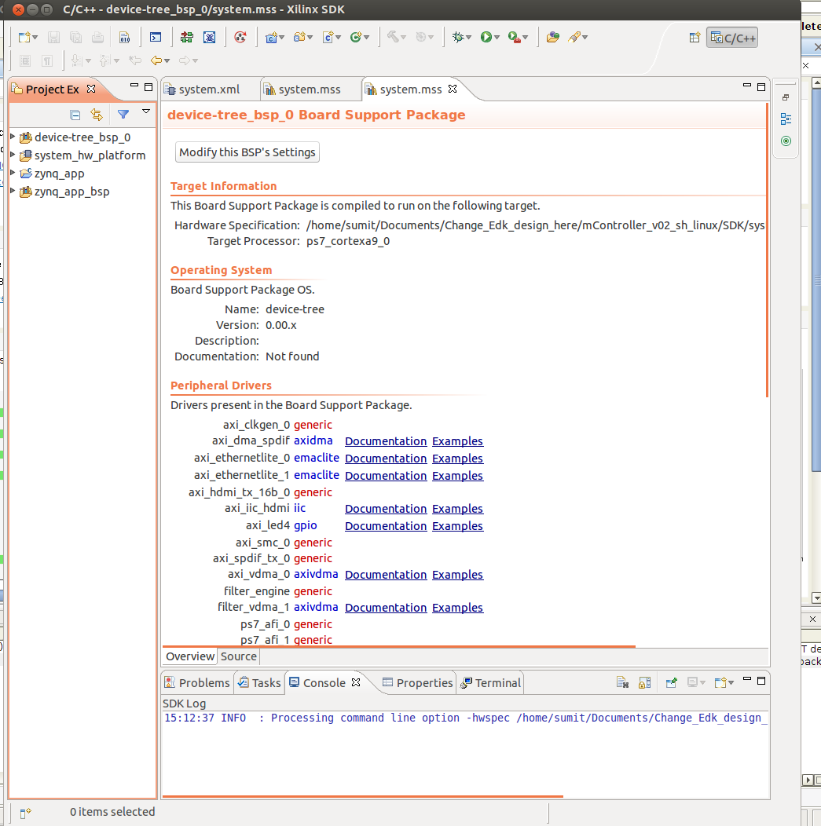
Close the EDK Design tool and Export the Hardware design to SDK

Slide 9
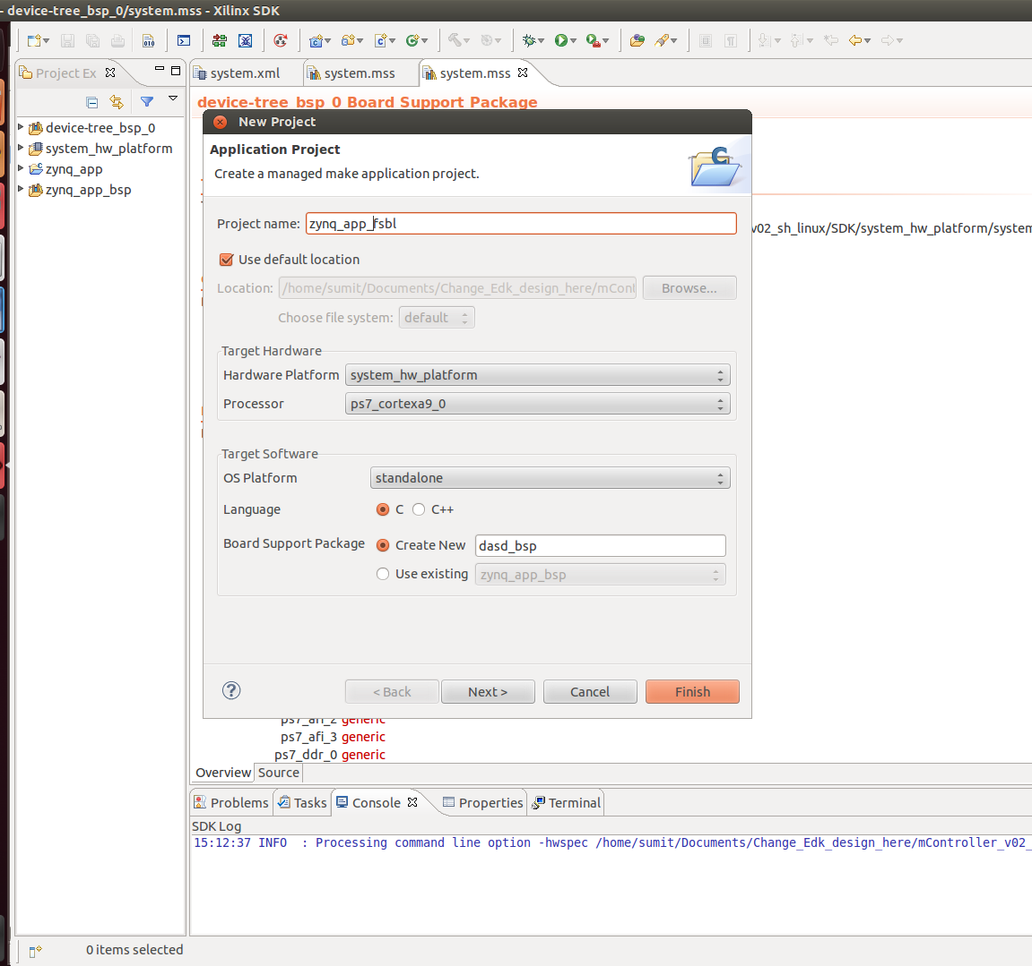
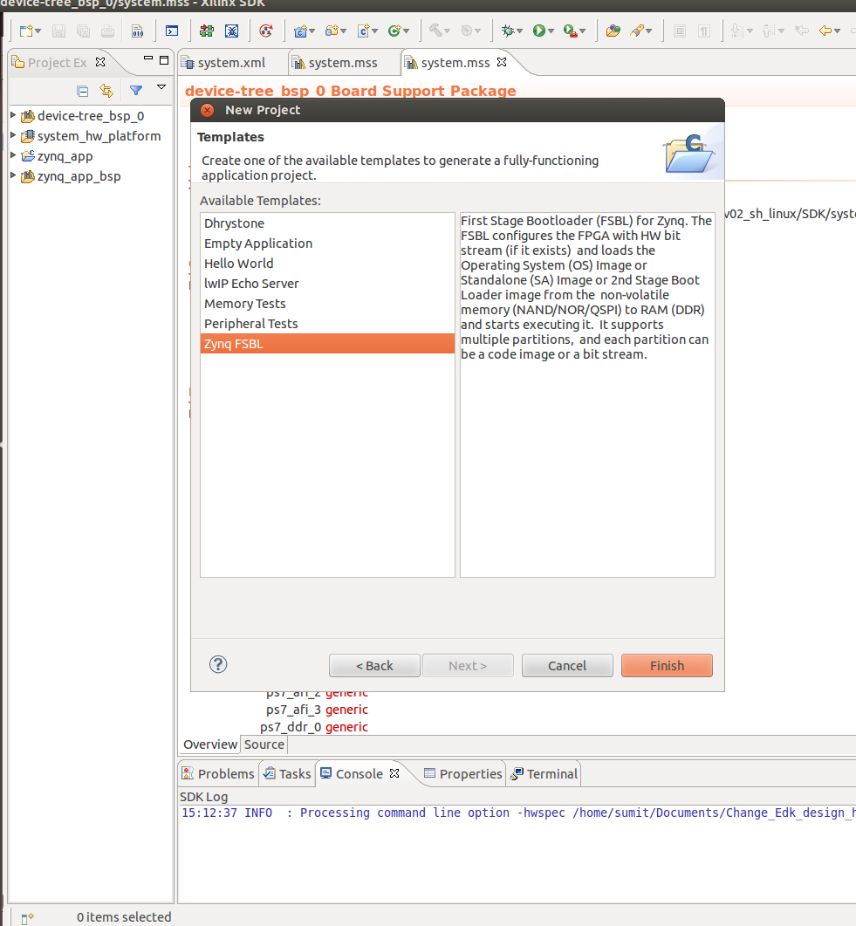
Make a New Application Project: FSBL Project in SDK

Slide 10
Now Steps to generate the DeviceTree of the new Hardware design using SDK
First The Device Tree Generator Git repository needs to be cloned from the Xilinx. Using the following command on linux.
Now the cloned BSP repository should be added to SDK.
SDK Menu: Xilinx Tools > Repositories > New... (<bsp repo>) > OK
git clone git://github.com/Xilinx/device-tree.git bsp/device-tree_v0_00_x

Slide 11
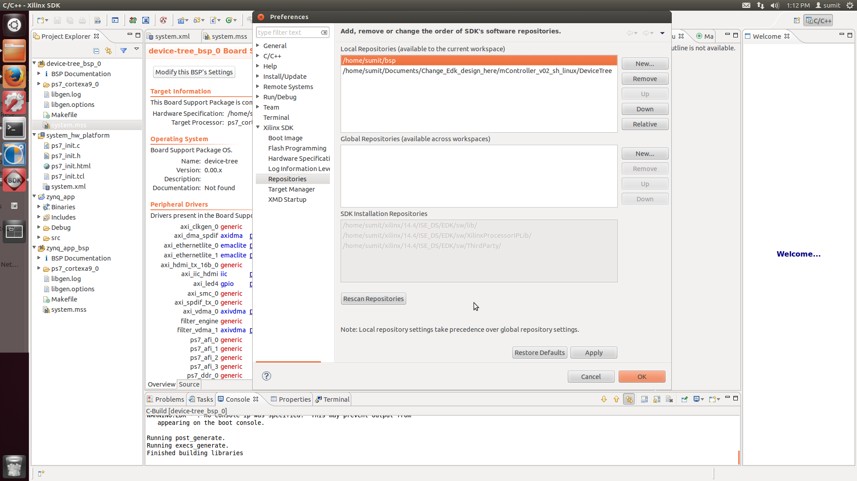
In the Local Repositories, New->Add the BSP repository ->OK

Slide 12
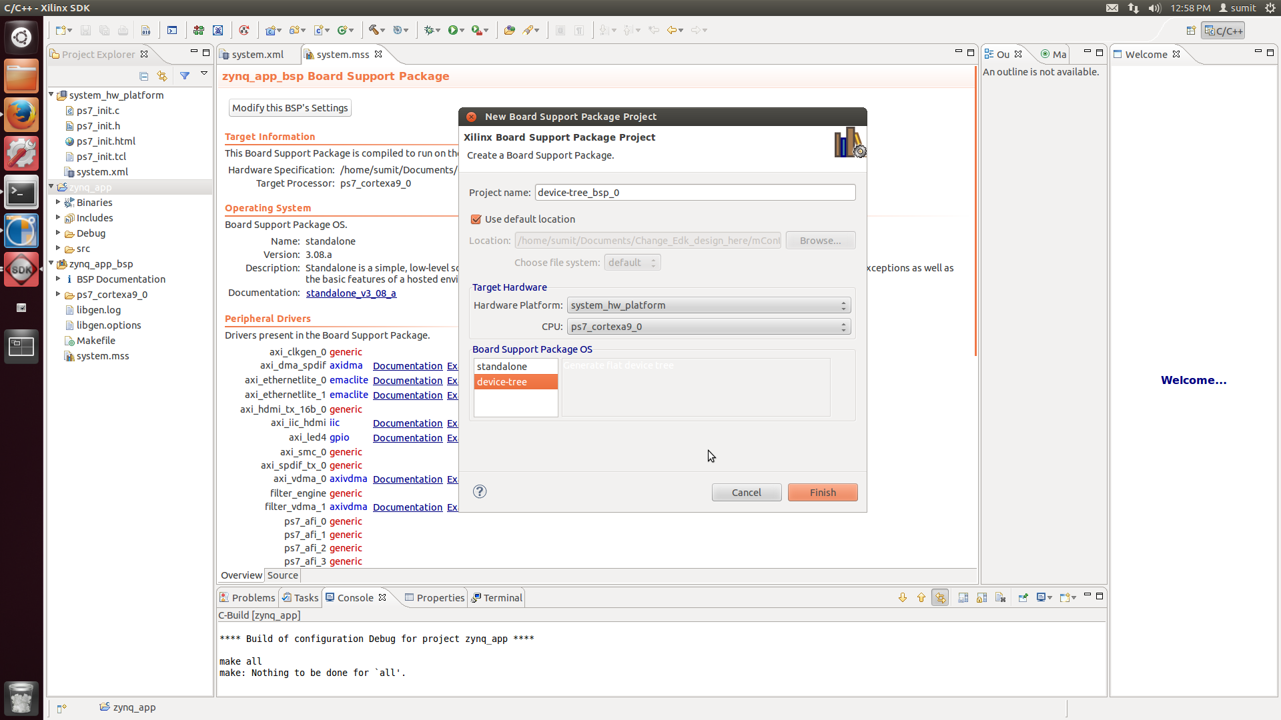
Create a Device Tree Board Support Package (BSP):
SDK Menu: File > New > Board Support Package > Board Support Package OS: device-tree > Finish

Slide 13
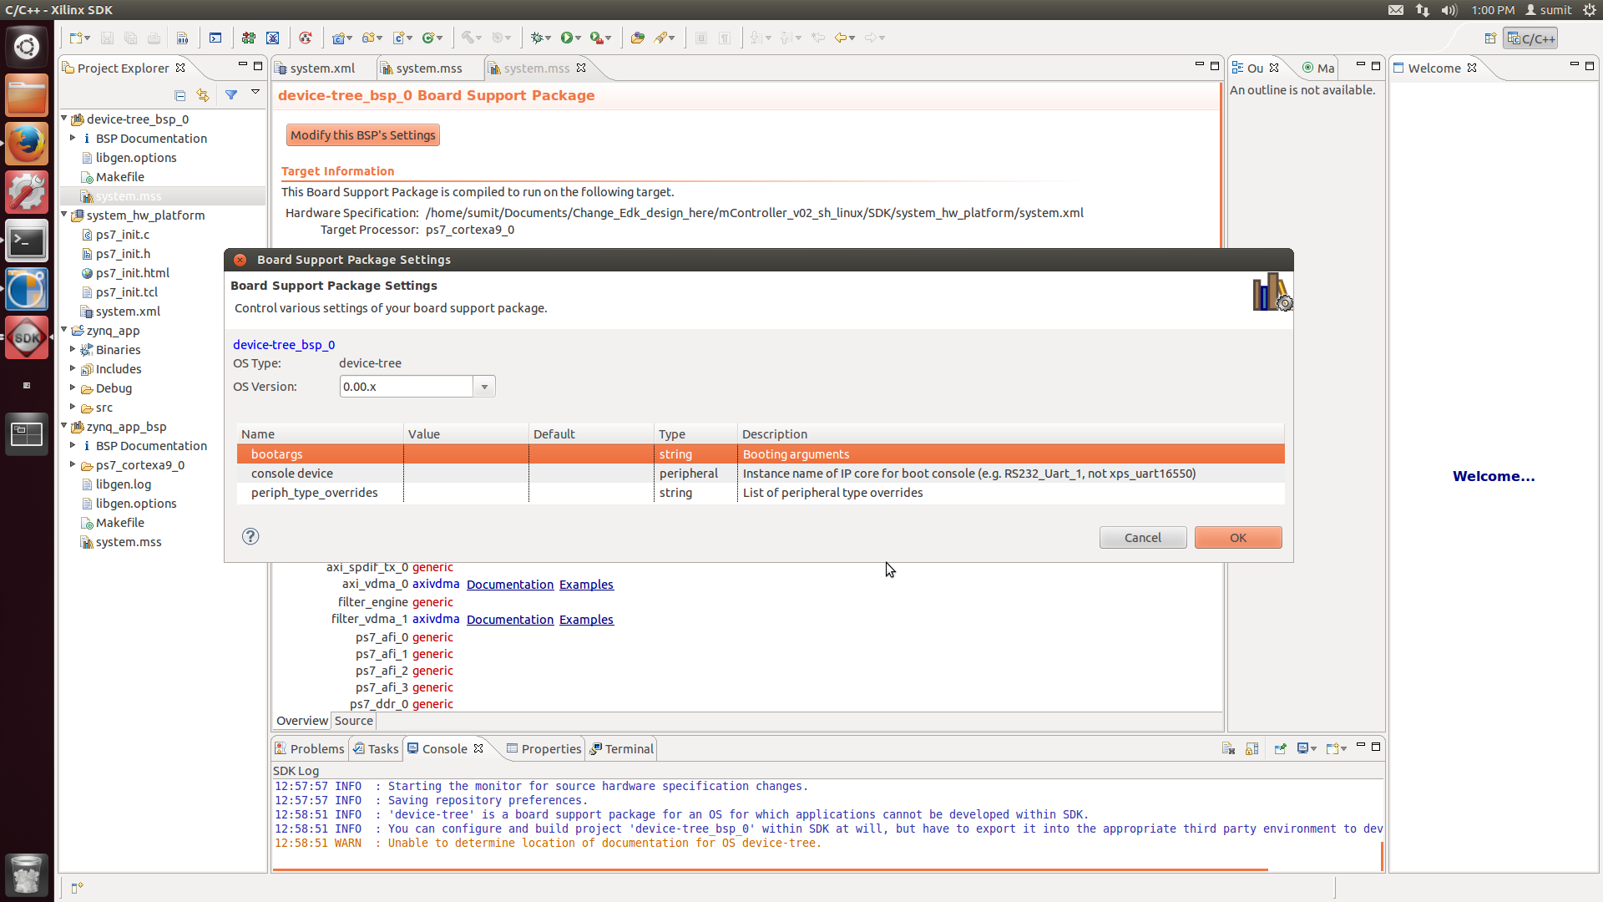
A BSP settings window will appear.
Fill in the values as appropriate:
The 'bootargs' parameter specifies the arguments passed to the kernel at boot time (kernel command line). ***
The 'console device' parameter specifies which serial output device will be used. Select a value from the drop-down.
Generally Default options are preferred and works in most cases.
Click Ok -> This will create a devicetree (.dts format) at the location : <SDK workspace>/<device-tree bsp name>/<processor name>/libsrc/device-tree_v0_00_x/xilinx.dts.

Slide 14
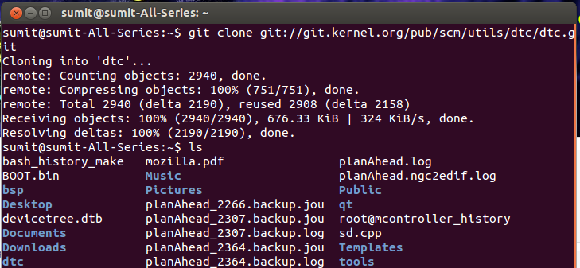
Now Generated Devicetree is in .dts format, In order to be used it needs to be converted to .dtb format
The Device Tree Compiler (DTC) is the toolchain for building device tree source files (*.dts) into the binary format (*.dtb).
The source code of the DTC should be cloned from a git repository on git.kernel.org. This can be done using following command.
git clone git://git.kernel.org/pub/scm/utils/dtc/dtc.git

Slide 15
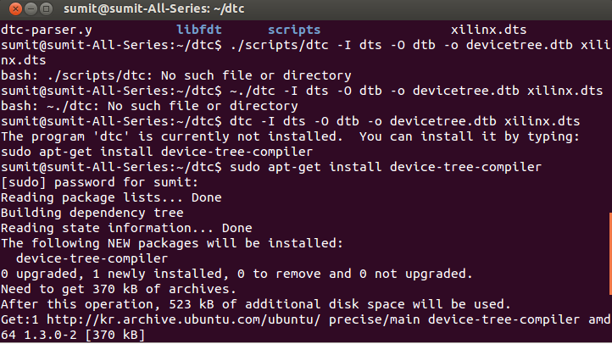
Now the Device Tree compiler should be installed
sudo apt-get install device-tree-complier (Command to install DTC)

Slide 16
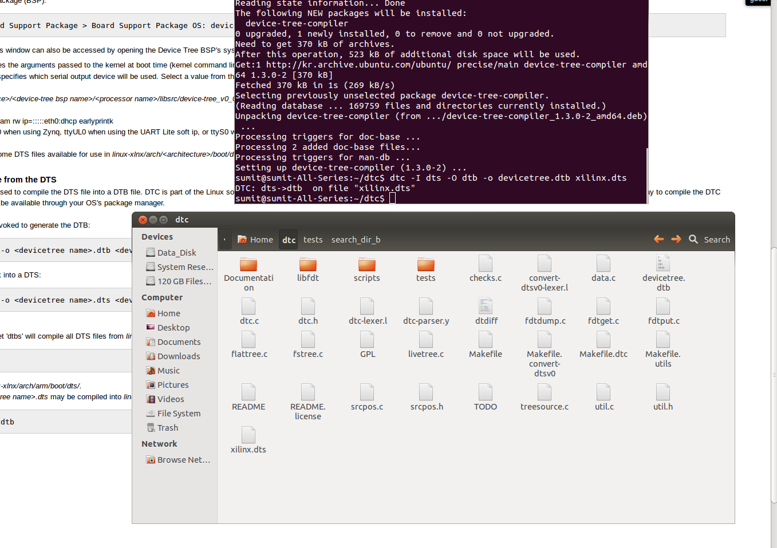
Now the dts file can be converted to the dtb
Command: dtc -I dts -O dtb -o devicetree.dtb Xilinx.dts
It will generate a dtb formate devicetree.

Slide 17
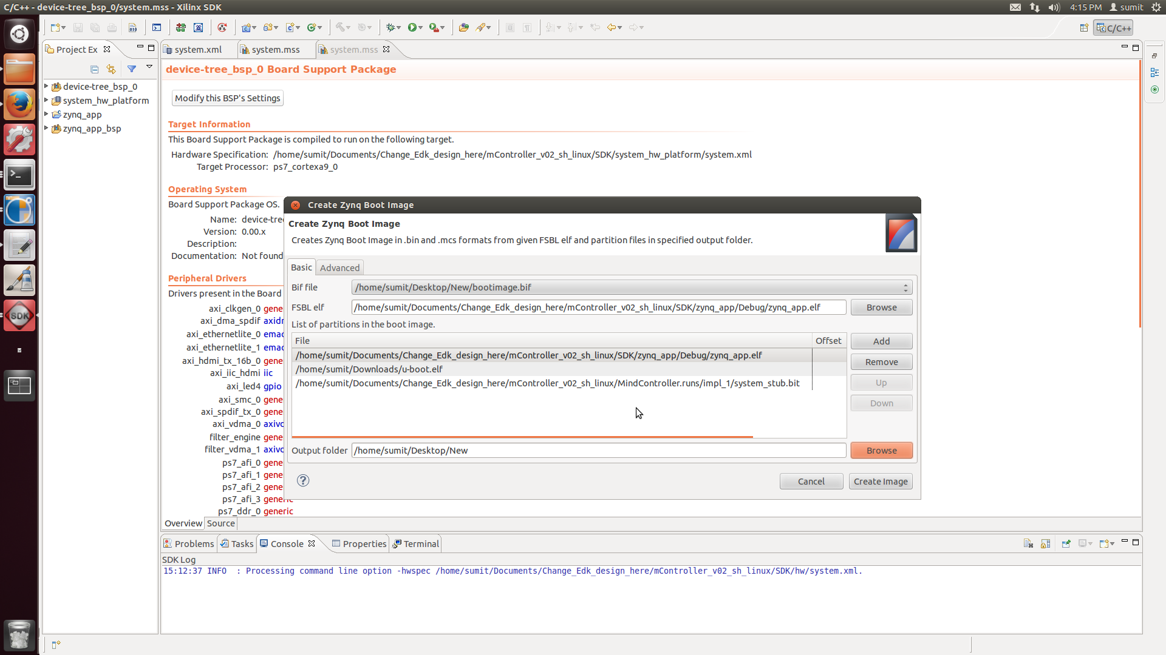
After generating the devicetree.dtb, We need to make the BOOT.bin file using SDK.
Go to Xilinx tools -> Creat Zynq Boot Image
Select the location of output folder and create image
This will create u-boot.bin, remane it as BOOT.bin

Slide 18
The SD card Boot partition files
zImage (Kernel Image is downloaded from the Xilinx site)
BOOT.bin and devicetree.dtb are made.
These three files should be put in the boot partition of sd card.
After powering up Linux will automatically gets booted on the zynq device.

Slide 19
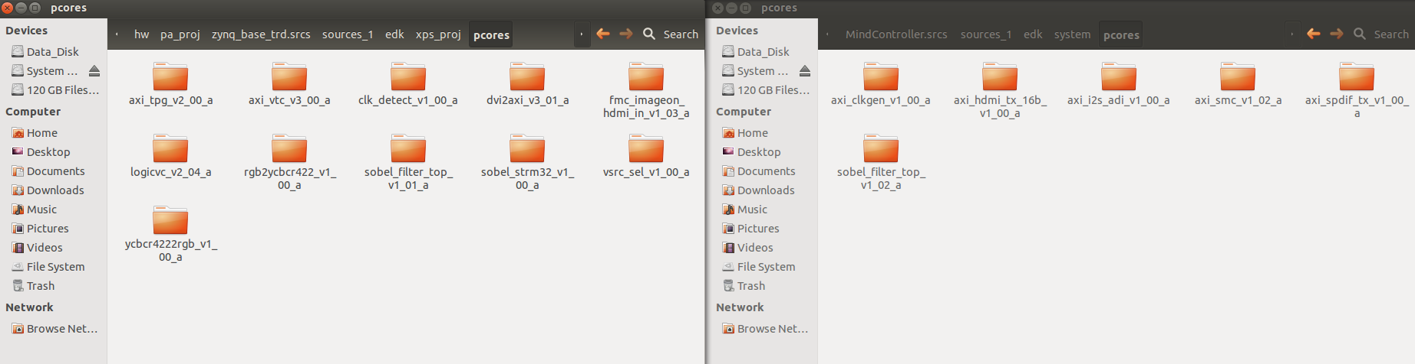
Hardware Design
Add Sobel filter
Go to
http://www.wiki.xilinx.com/Zynq+Base+TRD+14.1
Download
Zynq Base TDR package
Go to
Hardware Design (hw)
In the Pcores directory
Sobel filter is there Copy the
Folder in the project pCores directory
Then it can be added in the
EDK design

Slide 22
After Linux installation
A. 2.

