Slide 1
Customer Churn Business Analysis
Week 8 Capstone
End-to-end analytics → insights → action

Slide 2
Business Problem
Identify churn drivers.
Validate evidence statistically.
Prioritize risk and recommend retention actions.

Slide 3
Dataset & Quality
500 customers; 9 original fields.
0 missing values; 0 duplicates.
Target: Churn.

Slide 4
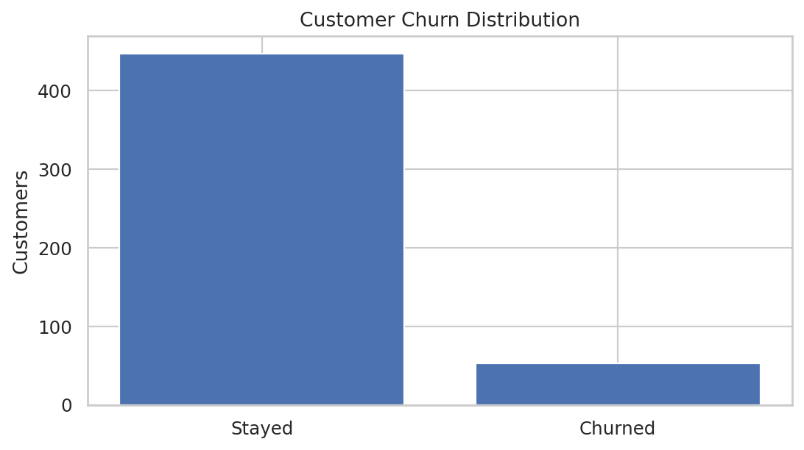
Overall Churn
Overall churn: 10.6%
Segment analysis identifies where retention resources should focus.

Slide 5
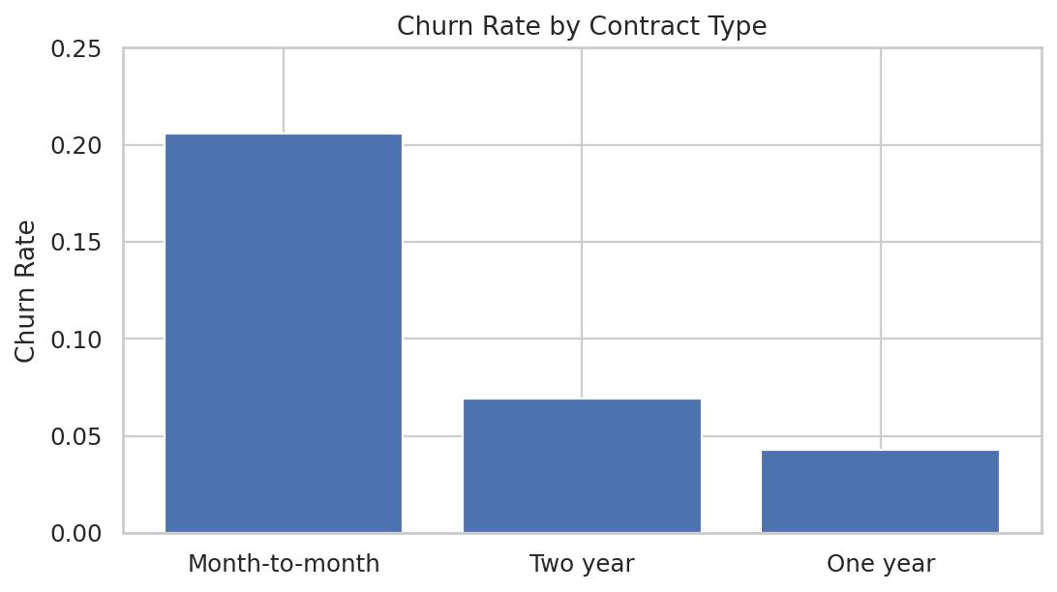
Contract Segment
Month-to-month: 20.6%
One year: 4.3%
Two year: 6.9%
Statistically significant association.

Slide 6
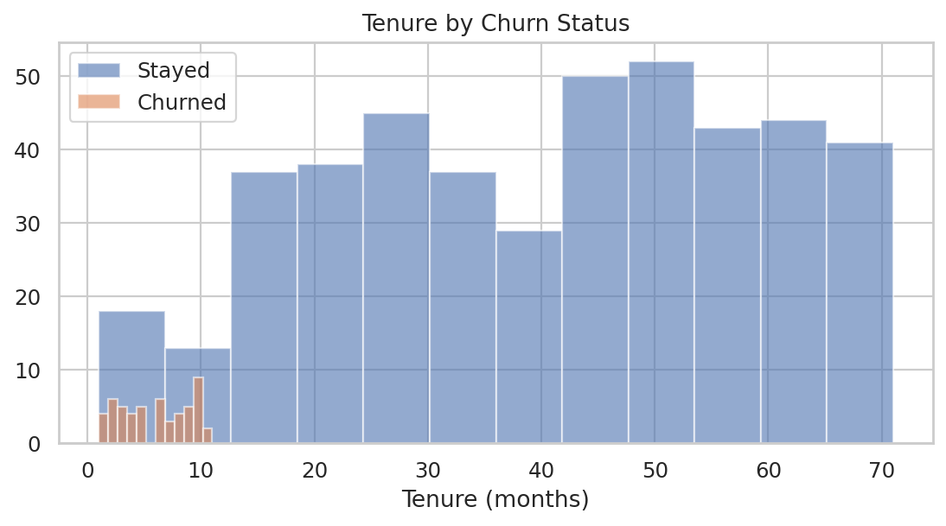
Tenure Signal
Churned customers have significantly lower tenure.
Welch t-test p < 0.001.
Use early-life support as a retention lever.

Slide 7
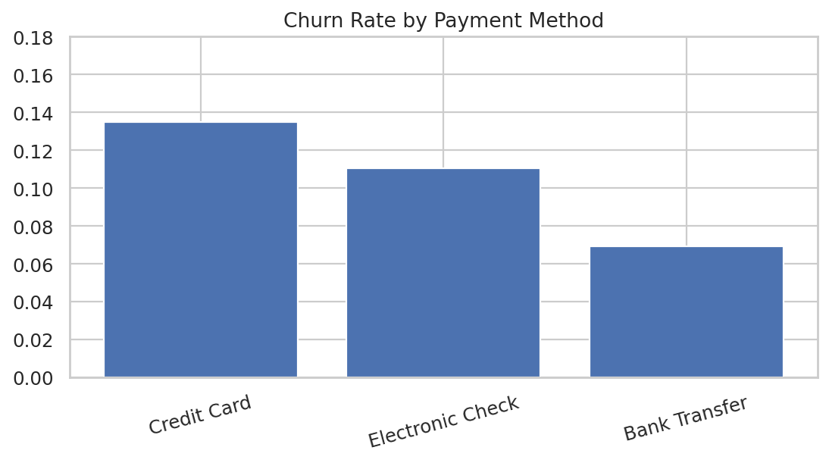
Payment Method
Secondary segmentation signal.
Use for targeted experiments, not assumptions of causality.

Slide 8
Statistical Validation
Chi-square: Contract × Churn.
Welch t-test: Tenure.
Welch t-test: Monthly Charges.
All provide complementary evidence.

Slide 9
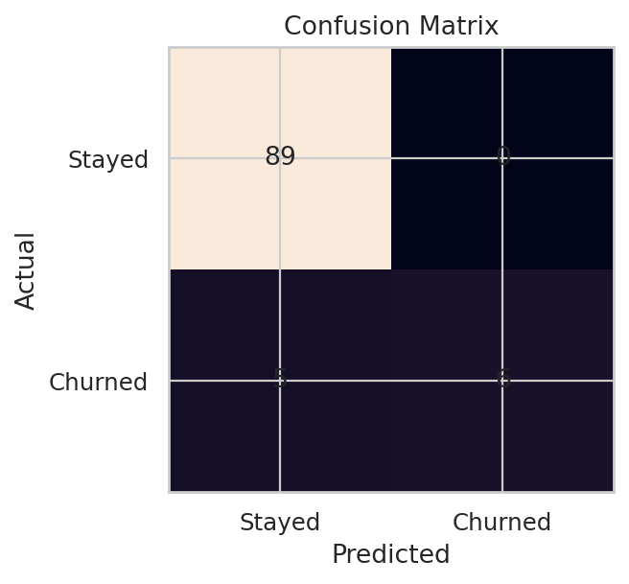
Predictive Model
Logistic regression with encoded categorical + standardized numeric variables.
Accuracy 95.0% | Precision 100.0% | Recall 54.5% | F1 70.6% | ROC-AUC 0.981

Slide 10
Recommendations
Contract conversion
First-year onboarding/support
Billing/payment assistance
Risk-prioritized outreach
A/B testing

Slide 11
90-Day Implementation
0–30: baseline + pilot
31–60: controlled experiments
61–90: scale winners + model validation
Primary KPI: incremental churn reduction

Slide 12
Conclusion
Focus retention on the highest-risk segments.
Turn statistical findings into controlled business actions.
Measure results against a control group.

