Slide 1
Predicting Customer Churn
Data Science Capstone: from raw data to a working web app
Sumit Gupta | Week 12 Final Project
Notes:
Introduce yourself. One sentence: I built a model that finds customers about to leave, and a web app to use it.

Slide 2
Losing customers is expensive
10.6%
5x
82,536
of customers churned (53 of 500)
typical cost of winning a new customer vs keeping one
yearly revenue carried by the customers who left
Goal: flag at-risk customers early so the retention team can act
Success: ROC-AUC 0.90 or higher, recall 80% or higher, and a campaign that pays for itself
The 5x figure is a commonly quoted industry rule of thumb, not from this dataset.
Notes:
53 of 500 customers left. Keeping a customer costs much less than winning a new one, so the question is who will leave and what we can do before they go.

Slide 3
The approach
1
2
3
4
5
6
Data & quality
Explore (EDA)
Features
Model & tune
Evaluate
Deploy
Clean, tested Python modules (src/) feed a notebook, a web app and 16 automated tests
Everything is on GitHub with a README so anyone can re-run it
Notes:
We followed the full workflow, from data to deployment to business recommendations.

Slide 4
The data: 500 customers, 9 columns
Column | Meaning
Tenure | Months with the company (1 to 71)
MonthlyCharges | Amount billed per month (20 to 199)
TotalCharges | Total billed so far
Contract | Month-to-month, One year, Two year
PaymentMethod | Bank Transfer, Credit Card, Electronic Check
PaperlessBilling / SeniorCitizen | Yes/No and 0/1
Churn (target) | 1 = customer left
0
missing values or duplicates
89 / 11
% stayed vs churned: imbalanced
Notes:
Quality checks passed: no missing values, no duplicates, no negative numbers. The data looks simulated because TotalCharges is not exactly tenure times monthly charges.

Slide 5
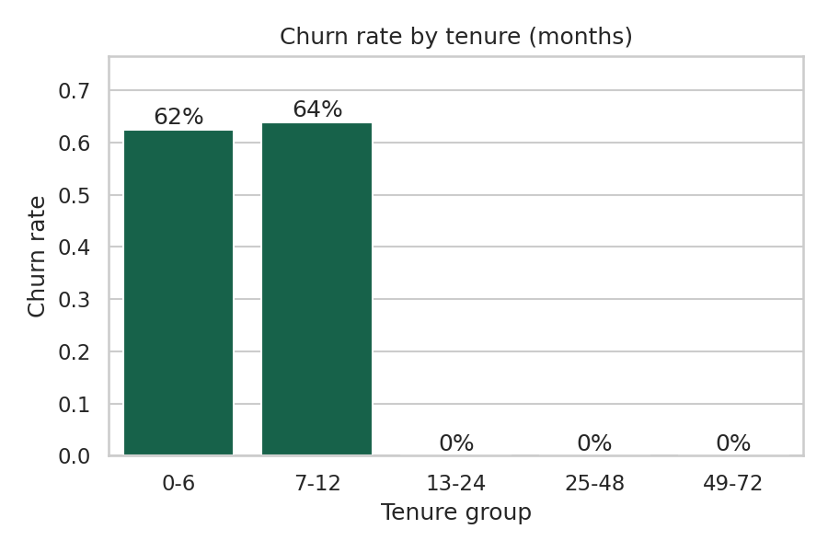
All churn happens in the first year
63%
churn in months 1 to 12 (53 of 84)
0%
churn after month 12 (0 of 416)
Notes:
Of 84 customers in their first 12 months, 53 left. Of the 416 who passed month 12, none left. This is the single most important finding.

Slide 6
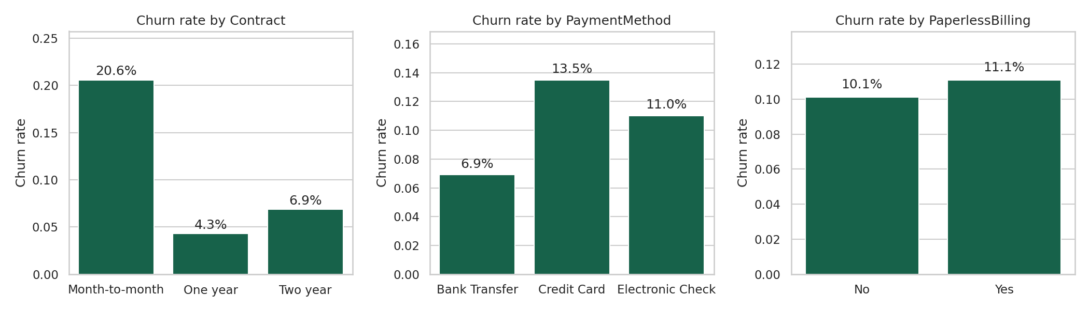
Contract type and price drive risk
Month-to-month: 20.6% churn vs 4.3% (one year) and 6.9% (two year)
New customers paying over 100 a month: 79% churn vs 38% on cheaper plans
Notes:
Month-to-month customers churn 20.6 percent versus 4.3 percent for one-year contracts. New customers paying over 100 a month churn at 79 percent.

Slide 7
Three models, one clear signal
Chosen: Random Forest, tuned with grid search (27 settings)
Best: depth 3, 300 trees, min leaf 5
Class imbalance handled with balanced class weights
Tuned CV AUC: 0.993
Notes:
All three models score about 0.99 AUC, so the signal in this data is strong. We chose Random Forest because it is robust and easy to explain, then tuned it.

Slide 8
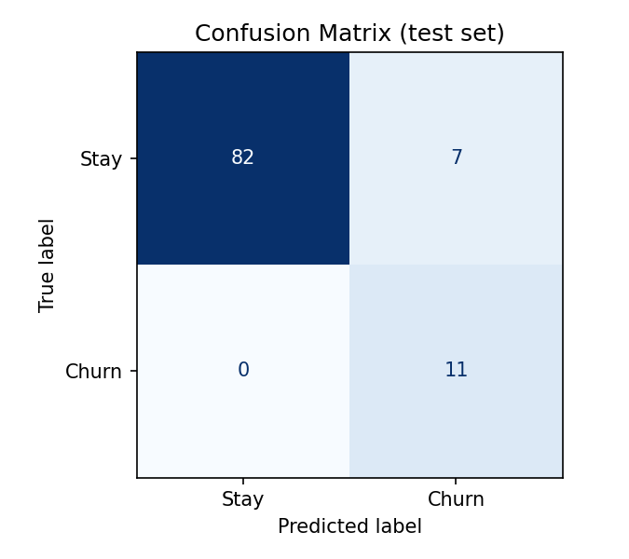
Results on unseen data
0.997
100%
ROC-AUC
recall: no churner missed
61%
93%
precision
accuracy
100 test customers: 82 correct stays, 11 caught churners, 7 false alarms, 0 missed.
Notes:
The model found all 11 churners in the test set. 7 of the 18 customers it flagged would have stayed, which is the price of not missing anyone. The test set is small, so we also rely on cross-validation.

Slide 9
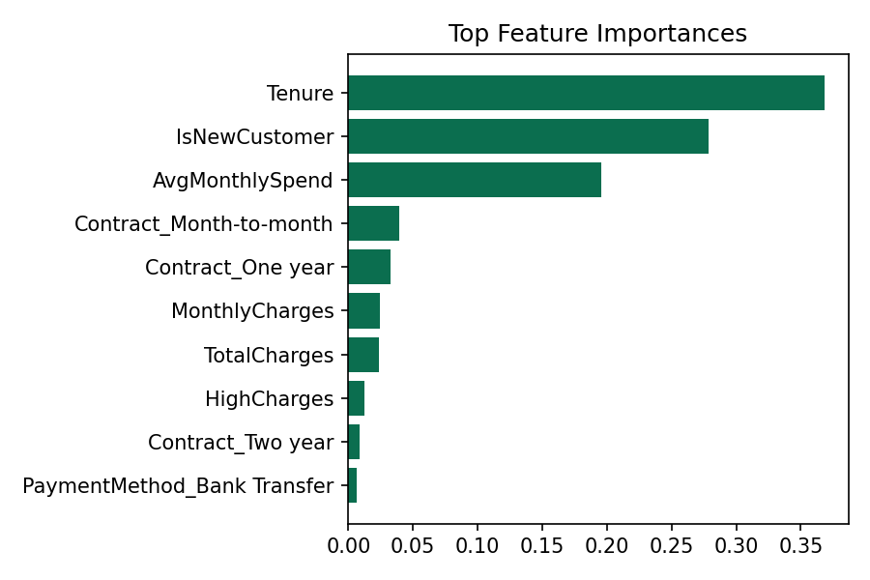
What the model relies on
Tenure and new-customer flag: about 65% of importance together
Average monthly spend and contract type come next
Matches what the charts showed, so the model learned real patterns
Notes:
Tenure and the new-customer flag dominate, which matches the EDA. That agreement is a good sanity check.

Slide 10
A retention campaign pays for itself
+13,316
net benefit on 500 customers
81 customers contacted, 53 real churners reached
Annual revenue at risk: 82,536
Notes:
Assumptions: an offer costs 10 percent of annual revenue and 30 percent of contacted churners stay. Break-even is about a 14 percent save rate, so the downside is limited. All numbers are in the currency of the dataset.

Slide 11
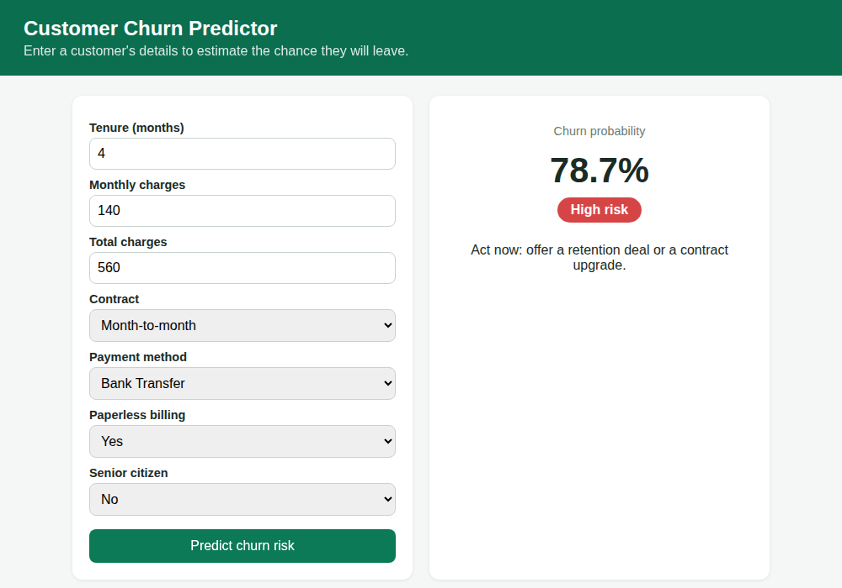
The model as a working web app
Flask app: web form plus JSON API (POST /predict)
Returns probability and Low / Medium / High risk
Validates every input and returns clear errors
Tested with 5 API tests; Dockerfile included
Notes:
Show the live demo here: enter a new month-to-month customer and the app returns a high-risk score with advice. Bad input returns a clear error.

Slide 12
What the business should do
1
Focus on months 1 to 12
Onboarding calls and check-ins at months 1, 3 and 6
2
Move people off month-to-month
Offer a small discount for a one-year plan
3
Review pricing for new high-bill customers
Over 100 a month: 79% churn
4
Run a weekly watch-list
Send the High-risk list to the retention team
5
Measure and improve
Track saves, replace assumptions with real numbers
Notes:
Each recommendation links to a finding. Offer to pilot the watch-list on a live customer group first.

Slide 13
Limits and next steps
Data is small (500 rows) and simulated, so real scores will be lower
Pilot on a live customer group, then add support and usage data
Retrain every quarter and monitor results
Thank you. Questions?
Notes:
Be honest about the limitations: simulated data and a small test set. Then take questions.

