Slide 1
Marketing Analytics Project
By : Sumit Koshti

Slide 2
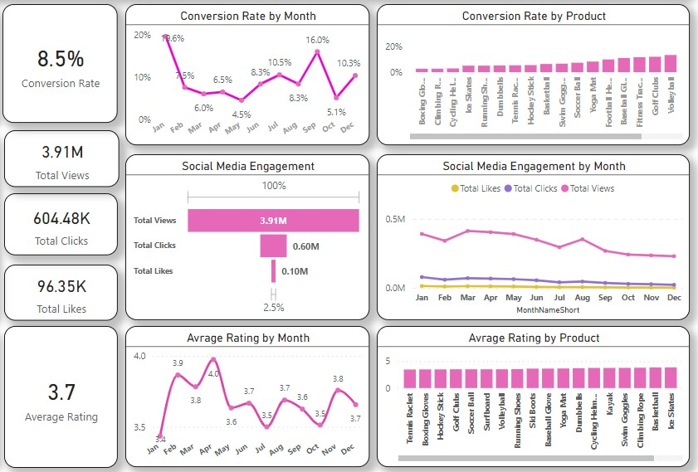
Overview
Declined Conversion Rates: Significant rebound to 10.3% in December, recovering from a low of 5.1% in October.
Social Media Engagement: Overall views declined throughout the year. Click-through rate remains strong at 15.37%, indicating effective engagement among active users.
Customer Feedback Analysis: Ratings are steady, averaging 3.7, but below the target of 4.0. Products rated below 3.5 require targeted improvement to enhance customer satisfaction.

Slide 3
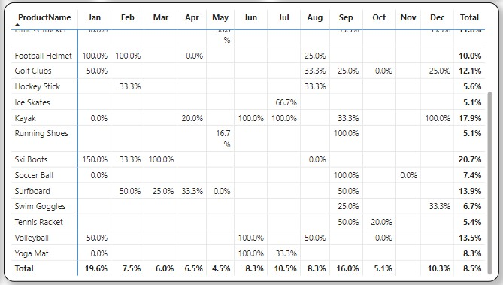
Decreased Conversion Rates
General Conversion Trend:
Conversion rates fluctuated throughout the year, with peaks in July and September.
Seasonal products drove higher conversions, presenting an opportunity to target underperforming months.
Lowest Conversion Month:
May saw the lowest conversion rate at 4.5%, with no standout product performance.
Suggests a need for improved marketing strategies or promotions during this time.
Highest Conversion Rates:
January achieved the highest conversion rate at 19.6%, led by Ski Boots with an exceptional 150% conversion.
Indicates strong seasonal demand and effective marketing efforts at the start of the year.

Slide 4
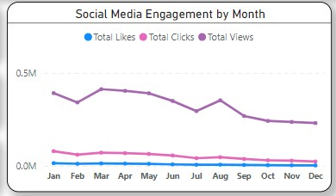
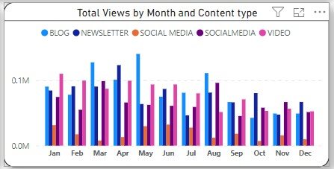
Reduced Customer Engagement
Audience Engagement Trend: Views reached their highest in March and April but steadily declined from August onward, highlighting reduced engagement in the latter half of the year.
Low Interaction Rates: Clicks and likes were consistently low relative to views, indicating a need for more compelling content or stronger calls to action.
Content Type Performance: The highest number of views came from blog content, particularly in March and May, while social media and video content generated consistent but somewhat lower engagement.

Slide 5
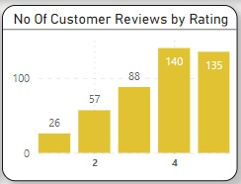
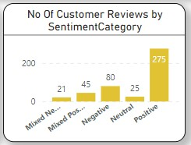
Customer Feedback Analysis
Customer Ratings Distribution: Most customer reviews are positive, with 140 reviews at 4 stars and 135 at 5 stars, Indicating overall positive feedback. While lower ratings (1-2 stars) make up a smaller share, with 26 reviews at 1 star and 57 at 2 stars.
Sentiment Analysis: Positive sentiment prevails in 275 reviews, indicating overall customer satisfaction, while negative sentiment is seen in 80 reviews, with a few mixed and neutral sentiments, pointing to areas for improvement but strong overall approval.
Opportunity for Improvement: The mixed positive and negative sentiments highlight opportunities to turn these experiences into more clearly positive ones, potentially improving overall ratings. Addressing the concerns in mixed reviews could enhance customer satisfaction.

Slide 6
Goals & Actions
Goals
Actions
Increase Conversion Rates :
Goal: Identify factors impacting the conversion rate and recommend improvements.
Insight: Analyze key stages where visitors drop off and suggest optimizations to enhance the conversion funnel.
Enhance Customer Engagement :
Goal: Determine which content types drive the highest engagement.
Insight: Analyze interactions with different marketing content to refine content strategies and boost engagement.
Improve Customer Feedback Scores :
Goal: Understand recurring themes in customer reviews and provide actionable insights.
Insight: Identify common positive and negative feedback to guide improvements in products and services.
Increase Conversion Rates:
Target High-Performing Product Categories: Focus marketing on products with high conversion rates, like Kayaks, Ski Boots, and Baseball Gloves. Launch seasonal promotions or personalized campaigns during peak months (e.g., January and September) to maximize trends.
Enhance Customer Engagement:
Revitalize Content Strategy: Improve declining views and interaction rates by experimenting with engaging formats like interactive videos or user-generated content. Optimize call-to-action placement in social media and blog posts, especially during low-engagement months (September-December).
Improve Customer Feedback Scores:
Address Mixed and Negative Feedback: Create a feedback loop to analyze mixed and negative reviews for recurring issues. Develop action plans to resolve these concerns, follow up with dissatisfied customers to address their issues, and encourage re-rating to help raise the average rating closer to the 4.0 target.

