Slide 1

POWER BI ANALYTICS
Power BI Data Analytics Dashboard
Business Performance & Data Insights
This presentation delivers a comprehensive analysis of retail business performance using Power BI — an industry-leading data visualization and business intelligence platform. The dashboard tracks key metrics across three product categories (Clothing, Electronics, and Furniture), 19 Indian states, and 25 cities, covering all 12 months of the fiscal year. With 17 sub-categories and 5 payment modes analyzed, this report provides actionable insights to support strategic business decisions.

Slide 2
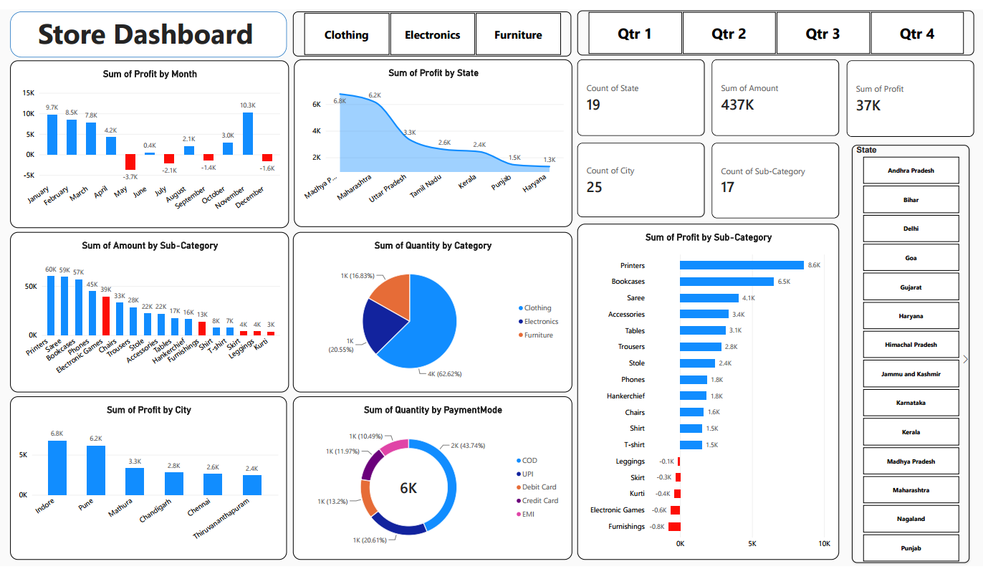

Slide 3
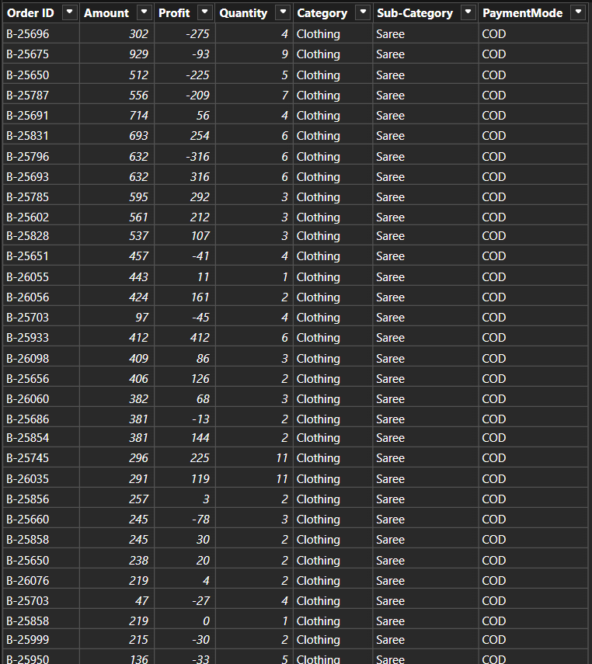
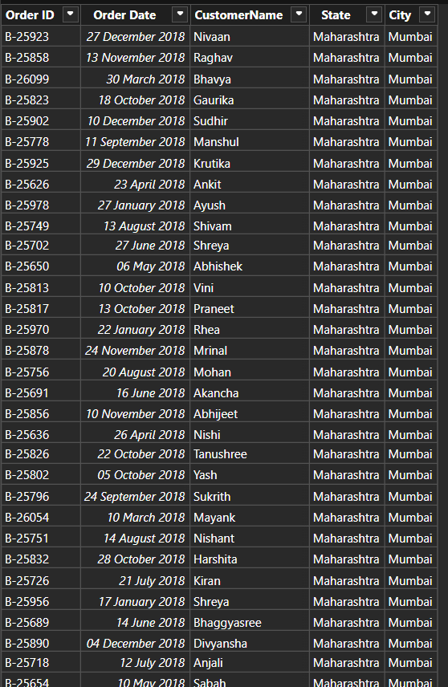
Detail Table
Order Table

Slide 4
Dashboard Overview & Key Performance Indicators
These KPIs represent the core performance metrics from the Power BI dashboard, covering sales volume, profitability, geographic reach, and product diversity across the full fiscal year.
437K
37K
Total Sales Amount
Total Profit
Combined revenue across all categories, states, and cities for the full fiscal year.
Net profit generated across all product categories and regions. Profit margin: ~8.5%.
6K+
19
Total Quantity Sold
States Covered
Units sold across all categories — Clothing leads with 62.62% of total volume.
Geographic reach across Indian states, with Madhya Pradesh and Maharashtra as top contributors.
25
17
Cities Tracked
Sub-Categories
Urban markets monitored, led by Indore (6.8K profit) and Pune (6.2K profit).
Product sub-categories tracked, including Printers, Saree, Bookcases, and Phones.

Slide 5
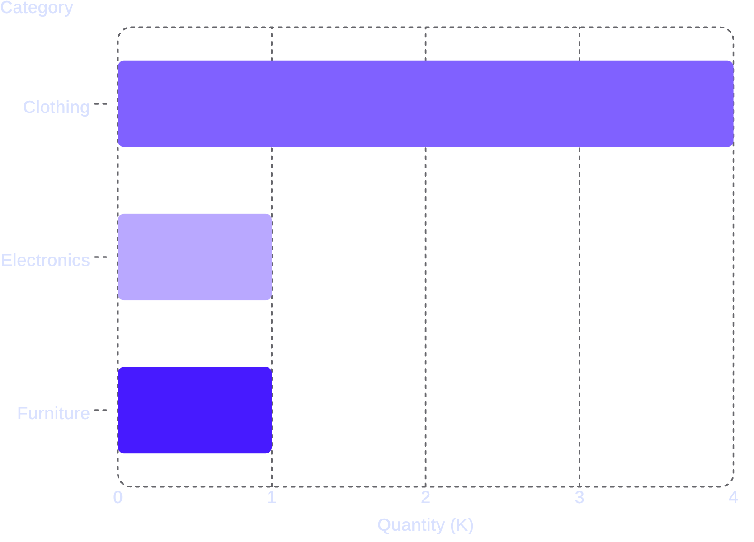
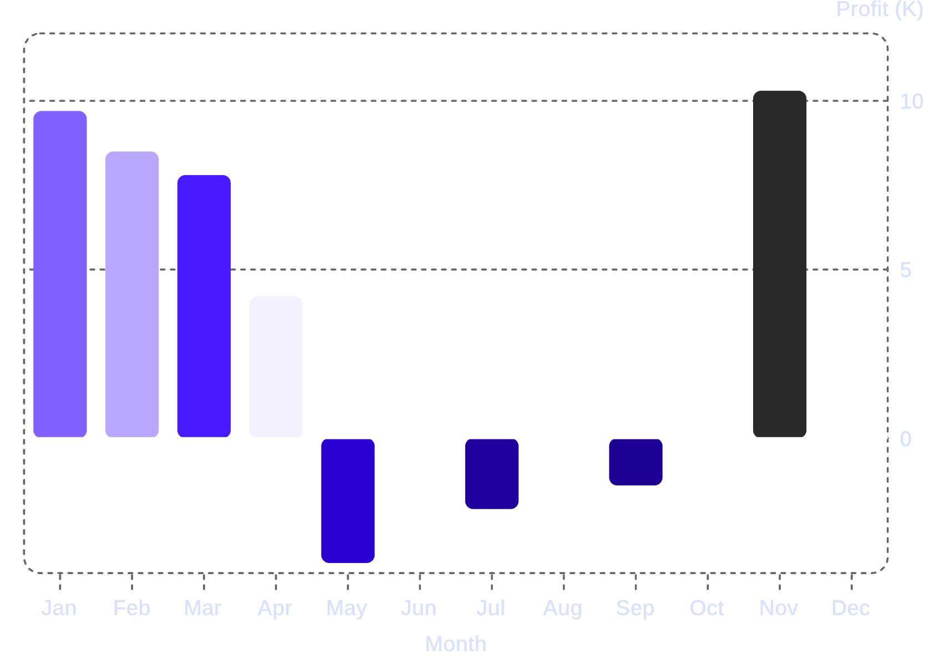
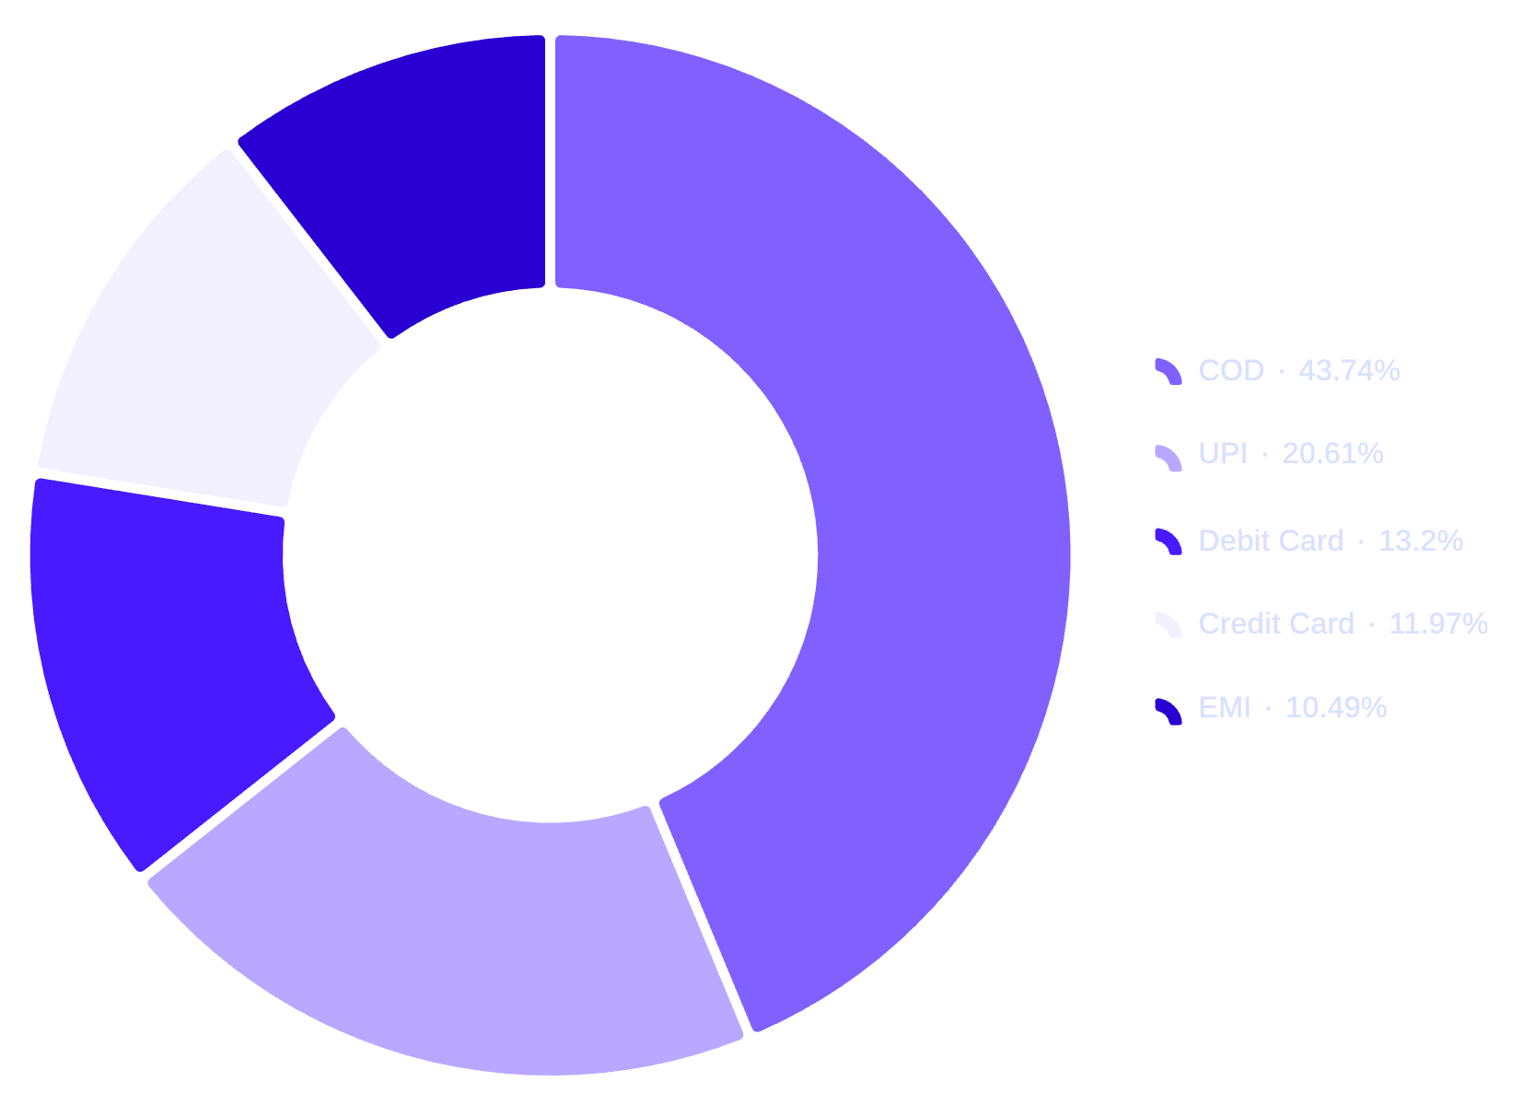
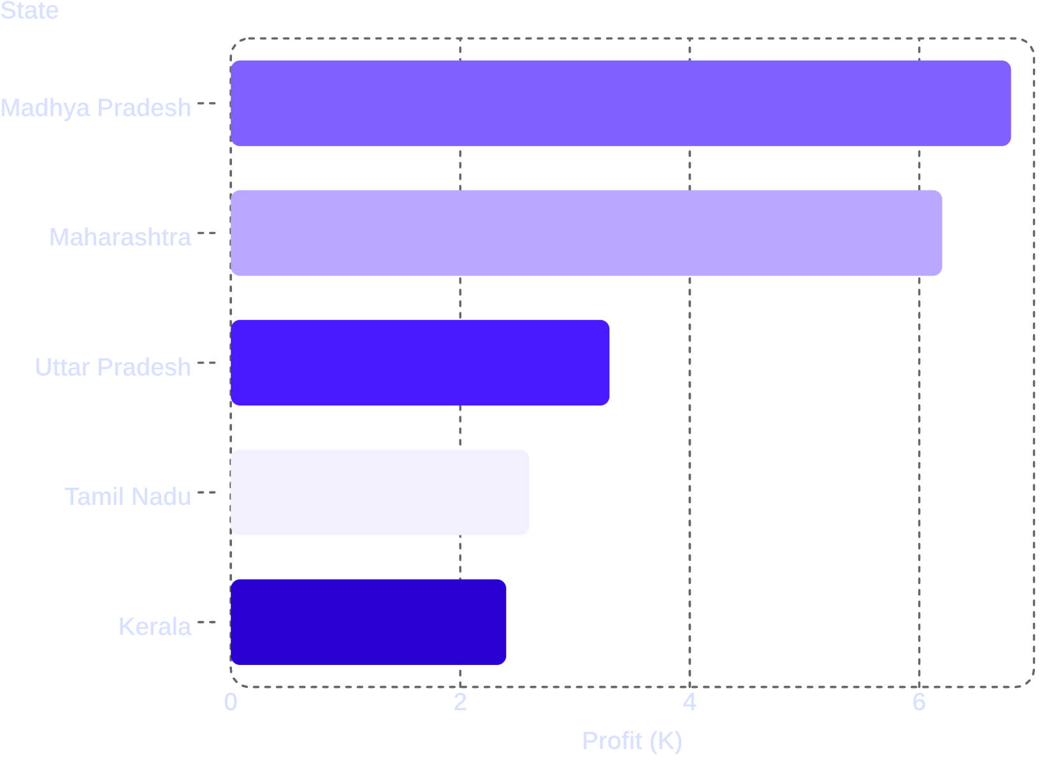
Data Analysis & Visualizations
Quantity by Category
Key charts reveal seasonal profit patterns, regional performance, category distribution, and payment behavior across the business.
Monthly Profit Trend (K)
Strong start (Jan: 9.7K) and peak in November (10.3K). May, July, September, and December posted losses.
Clothing dominates with 62.62% of units sold. Electronics (20.55%) and Furniture (16.83%) trail significantly.
Payment Mode Distribution
Top States by Profit (K)
COD leads at 43.74%, signaling strong cash-preference. UPI (20.61%) is the top digital method.
Top two states account for ~35% of total profit. Central and western India drive strongest returns.

Slide 6
Key Business Insights
These insights are drawn directly from the Power BI dashboard data, highlighting top performers, underperformers, and critical trends across categories, regions, and time periods.
Printers Lead in Revenue & Profit
Four Sub-Categories at a Loss
Printers top both revenue (60K) and profit (8.6K). Bookcases follow closely (57K amount, 6.5K profit). These are the strongest sub-categories.
Furnishings (-0.8K), Electronic Games (-0.6K), Kurti (-0.4K), and Skirt (-0.3K) posted negative profits — immediate review needed.
Strong Seasonal Profit Pattern
Central & Western India Dominate
January (9.7K) and November (10.3K) are peak months. Four months posted losses, suggesting strong seasonality and festival-driven demand.
Madhya Pradesh (6.8K) and Maharashtra (6.2K) lead state profits. Indore and Pune are top-performing cities, each contributing over 6K in profit.
Cash on Delivery Dominates Payments
Clothing Drives Volume, Not Always Profit
COD accounts for 43.74% of transactions — nearly double UPI (20.61%). Card and EMI modes each hold 10–13% share.
Clothing leads quantity (62.62%) and revenue (Saree: 59K), but several sub-categories like Kurti and Skirt are unprofitable despite high volume.

Slide 7

Conclusion & Recommendations
The Power BI dashboard reveals a business with strong revenue potential but uneven profitability. Strategic focus on high-performing products, loss-making sub-categories, and seasonal planning can significantly improve overall margins.
1
Prioritize High-Profit Sub-Categories
Increase inventory and marketing for Printers and Bookcases — the top profit drivers. Consider bundling strategies to boost their sales further.
2
Audit or Discontinue Loss-Making Products
Review Furnishings, Electronic Games, Kurti, and Skirt for cost reduction, repricing, or discontinuation to eliminate negative profit contributions.
3
Strengthen Q2–Q3 Performance
May, July, September, and December posted losses. Launch targeted promotions or seasonal campaigns to stabilize profitability during these weak months.
4
Expand in Top-Performing Regions
Deepen market presence in Madhya Pradesh, Maharashtra, Indore, and Pune. These regions show the strongest profit contribution and growth potential.
5
Incentivize Digital Payments
COD dominates at 43.74%. Offer discounts for UPI and card payments to reduce cash-handling costs and improve transaction efficiency.
Power BI in Decision-Making: This dashboard transforms raw retail data into clear visual insights — enabling faster, data-driven decisions across product, regional, and financial dimensions.
Thank You
This analysis was created using Power BI — demonstrating how modern data visualization tools empower businesses to understand performance, identify opportunities, and drive growth.

Slide 8
Thank You…..

