Slide 1

Amritsar College of Engineering & Technology, Amritsar, Punjab, INDIA NAAC - A grade, NBA accredited courses(2009-12, 2016-18), UGC Autonomous College
SUBJECT: OOPS (ACCS-16302)
UNIT-II
Er. Neha Chadha
Assistant Professor
Department of Computer Science and Engineering

Slide 2
Introduction to Array
C++ provides a data structure, the array, which stores a fixed-size sequential collection of elements of the same type.
An array is used to store a collection of data, but it is often more useful to think of an array as a collection of variables of the same type.
Instead of declaring individual variables, such as number0, number1, ..., and number99, you declare one array variable such as numbers and use numbers[0], numbers[1], and ..., numbers[99] to represent individual variables. A specific element in an array is accessed by an index.

Slide 3
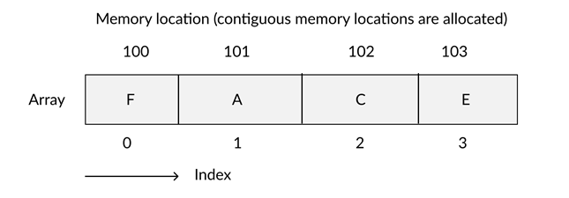
Memory Location
All arrays consist of contiguous memory locations. The lowest address corresponds to the first element and the highest address to the last element.

Slide 4
Declaration
Arrays are declared by the given syntax:
Datatype array_name [dimensions] ;
example : int array[20];
The above code creates an array with a name array which can hold 20 elements of int type.

Slide 5
Types of Array
1. One dimensional (1-D) arrays or Linear arrays
2. Multi dimensional arrays (Two dimensional (2-D) arrays or Matrix arrays)

Slide 6
Array Initialization
An array may be initialized at the time of its declaration, which means to give initial values to an array. Initialization of an array may take the following form:
example:
int id[7] = {1, 2, 3, 4, 5, 6, 7};
float x[5] = {5.6, 5.7, 5.8, 5.9, 6.1};
int a[2][2]={10,20,30,40}

Slide 7
2D array Example-I
#include<iostream.h>
#include<conio.h>
void main()
{
clrscr();
int a[2][2]={1,2,3,4}; or int a[2][2]={{1,2},{3,4}};
for(int i=0;i<2;i++)
{
for(int j=0;j<2;j++)
{cout<<a[i][j];
}
cout<<'\n'; }
getch();
}

Slide 8
2D array Example-II
#include<iostream.h>
#include<conio.h>
void main()
{
clrscr();
int a[][2]={10,20,30,40};
for(int i=0;i<2;i++)
{
for(int j=0;j<2;j++)
{cout<<a[i][j];
}
cout<<'\n'; }
getch();
}

Slide 9
2D array Example-III
#include<iostream.h>
#include<conio.h>
void main()
{
clrscr();
int a[2][3]={{10,20,30},{40,50,60}};
for(int i=0;i<2;i++)
{
for(int j=0;j<3;j++)
{cout<<a[i][j];
}
cout<<'\n'; }
getch();
}

Slide 10
Advantages of Array
Arrays represent multiple data items of the same type using a single name.
In arrays, the elements can be accessed randomly by using the index number.
Arrays allocate memory in contiguous memory locations for all its elements. Hence there is no chance of extra memory being allocated in case of arrays. This avoids memory overflow or shortage of memory in arrays.
Using arrays, other data structures like linked lists, stacks, queues, trees, graphs etc can be implemented.
Two-dimensional arrays are used to represent matrices.

Slide 11
Disadvantages of Array
The number of elements to be stored in an array should be known in advance.
Insertion and deletion are quite difficult in an array as the elements are stored in consecutive memory locations and the shifting operation is costly.
Allocating more memory than the requirement leads to wastage of memory space and less allocation of memory also leads to a problem.

Slide 12
Increment /decrement pointer
void main ()
{
clrscr();
int a = 20;
int *ip;
ip=&a;
cout<<ip<<endl;
*ip++;
cout<<ip;
*ip--;
cout<<ip;
getch();
}

