Slide 1

Amritsar College of Engineering & Technology, Amritsar, Punjab, INDIA NAAC - A grade, NBA accredited courses(2009-12, 2016-18), UGC Autonomous College
SUBJECT: OOPS (ACCS-16302)
UNIT-I
Er. Neha Chadha
Assistant Professor
Department of Computer Science and Engineering

Slide 2
Content
Basic Concepts of OOPS
Compiling and Linking
Types of Errors
Introduction to IDE
Structure of C++ Program
Concept of I/O Stream

Slide 3
Basic Concepts of OOPS
Object
Class
Abstraction
Encapsulation
Inheritance
Polymorphism
Dynamic Binding
Message Passing

Slide 4
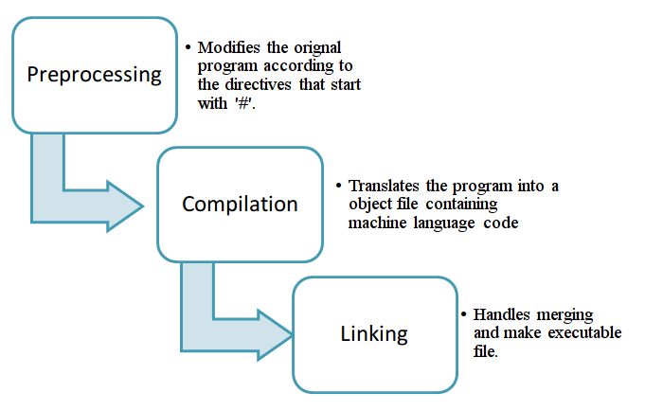
Compiling and Linking

Slide 5
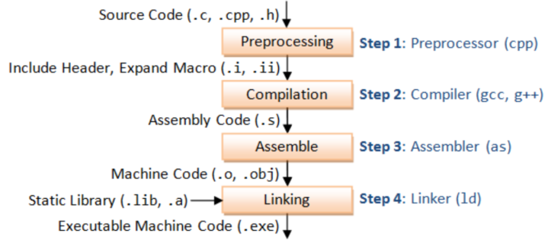
Compiling and Linking Contd..

Slide 6
Types of Errors
Syntax error
For example, cin<<a; // instead of extraction operator insertion operator is used.
Run time Error
For example – a=n/0; // division by zero
Logical Error
For example: remainder = a+b // instead of using % operator + operator is used.

Slide 7
Integrated Development Environment (IDE)
An integrated development environment (IDE) is a software application that provides comprehensive facilities to computer programmers for software development.
An IDE normally consists of a source code editor, build automation tools and a debugger.

Slide 8
Structure of C++ Program
Documentation Section //optional
Link Section
Define Section //optional
Global declaration Section //optional
Main Function Section
Local Variable Declaration Section
Executable Statement Section

Slide 9
Documentation Section //optional
We can give comments about the program, creation or modified date, author name etc in this section.
The characters or words or anything which are given in documentation section won’t be considered by C++ compiler for compilation process.
Single Line Eg. //
Multiline Eg. /*…….
……..
……..*/

Slide 10
Link Section
Header files that are required to execute a C++ program are included in this section
Eg #include<iostream.h>

Slide 11
Define Section
In this section, variables are define and values are set to these variables.
#define pie 3.14

Slide 12
Global Declaration Section
Global variables are defined in this section. When a variable is to be used throughout the program, can be defined in this section.

Slide 13
Main Section
It is the place from where the program execution begins. Every C++ program always begin from the “main” function.

Slide 14
Local Declaration Section
Local Variable is always defined inside a function or block. It is accessible only in the function or block

Slide 15
Executable Statement(s) Section
It Includes the input and output statements.

Slide 16
Concepts of I/O Stream
In the iostream.h library of C++, cin, and cout are the two data streams that are used for input and output respectively.
cout is normally directed to the screen and cin is assigned to the keyboard.

Slide 17
cin
“cin” (extraction operator): By using overloaded operator >> with cin stream, C++ handles the standard input.
int age; cin>>age;
As shown in the above example, an integer variable ‘age’ is declared and then it waits for cin (keyboard) to enter the data. “cin” processes the input only when the RETURN key is pressed.

Slide 18
cout
“cout” (insertion operator): This is used in conjunction with the overloaded << operator. It directs the data that followed it into the cout stream.
cout<<”Hello World”;

