Slide 1

Amritsar College of Engineering & Technology, Amritsar, Punjab, INDIA NAAC - A grade, NBA accredited courses(2009-12, 2016-18), UGC Autonomous College
SUBJECT: OOPS (ACCS-16302)
UNIT-I
Er. Neha Chadha
Assistant Professor
Department of Computer Science and Engineering

Slide 2
Content
Token
Operator Precedence & Associativity
Data Types
Control Structures
Conditional Statements

Slide 3
Token
A token is the smallest element of a C++ program that is meaningful to the compiler.
Keywords
Constant
Variable
Identifiers
Special Symbol
Character Set
Operators

Slide 4
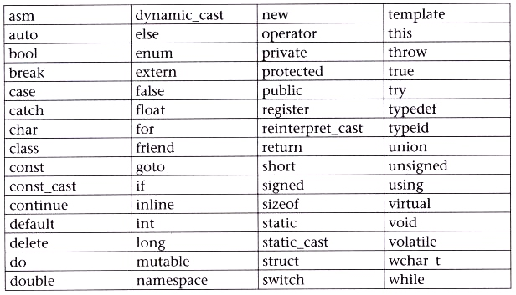
Keywords
Keywords in C++ refer to the pre-existing, reserved words, each holding its own position and power and has a specific function associated with it.

Slide 5
Constants
Type of Constants:
Integer constant
Floating constant
Character constant
String constant
Octal constant
Hexadecimal constant

Slide 6
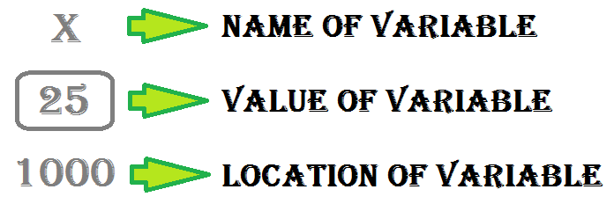
Variable
A variable provides us with named storage that our programs can manipulate.
Definition : datatype var_name=12;
Declaration : datatype var_name;

Slide 7
Identifier
C++ allows the programmer to assign names of his own choice to the variable arrays, functions, structures, classes, and various other data structures called identifiers.

Slide 8
Rules of C++ Identifier
First character
No special characters
No keywords
No white spaces
Word limit
Case sensitive

Slide 9
Special Symbol
Apart from letters and digits, there are some special characters in C++ which help you manipulate or perform data operations.
Each special symbol has a specific meaning to the C++ compiler.

Slide 10

Special Character | Trivial Name | Function
[ ] | Square brackets | The opening and closing brackets of an array symbolize single and multidimensional subscripts.
() | Simple brackets | The opening and closing brackets represent function declaration and calls, used in print statements.
{ } | Curly braces | The opening and closing curly brackets to denote the start and end of a particular fragment of code which may be functions, loops or conditional statements
, | Comma | We use commas to separate more than one statements, like in the declaration of different variable names
# | Hash / Pound / Preprocessor | The hash symbol represents a preprocessor directive used for denoting the use of a header file
* | Asterisk | We use the asterisk symbol in various respects such as to declare pointers, used as an operand for multiplication
~ | Tilde | We use the tilde symbol as a destructor to free memory
. | Period / dot | The use the dot operator to access a member of a class

Slide 11
Character set
Character set is basically a set of valid characters that convey a specific connotation to the compiler. We use characters to represent letters, digits, special symbols, white spaces, and other characters.
The C++ character set consists of 3 main elements. They are:
Letters: These are alphabets ranging from A-Z and a-z (both uppercase and lowercase characters convey different meanings)
Digits: All the digits from 0 – 9 are valid in C++.
Special symbols: There are a variety of special symbols available in C++ like mathematical, logical and relational operators like +,-, *, /, \, ^, %, !, @, #, ^, &, (, ), [, ], ; and many more.

Slide 12
Operators
Operators are tools or symbols which are used to perform a specific operation on data. Operations are performed on operands. Operators can be classified into three broad categories according to the number of operands used.
Unary
Binary
Ternary

Slide 13
Unary operator
It involves the use of one a single operand.
For instance, ’!’ is an unary operator which operates on a single variable,
!c which denotes its negation or complement.

Slide 14
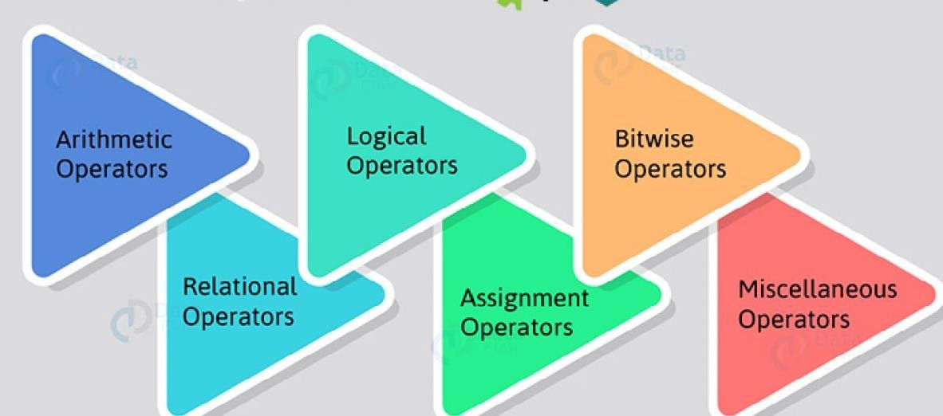
Binary operator
It involves the use of 2 operands. They are further classified as:

Slide 15
Ternary operator
It involves the use of 3 operands.
For instance, ?: is used to in place of if-else conditions.

Slide 16
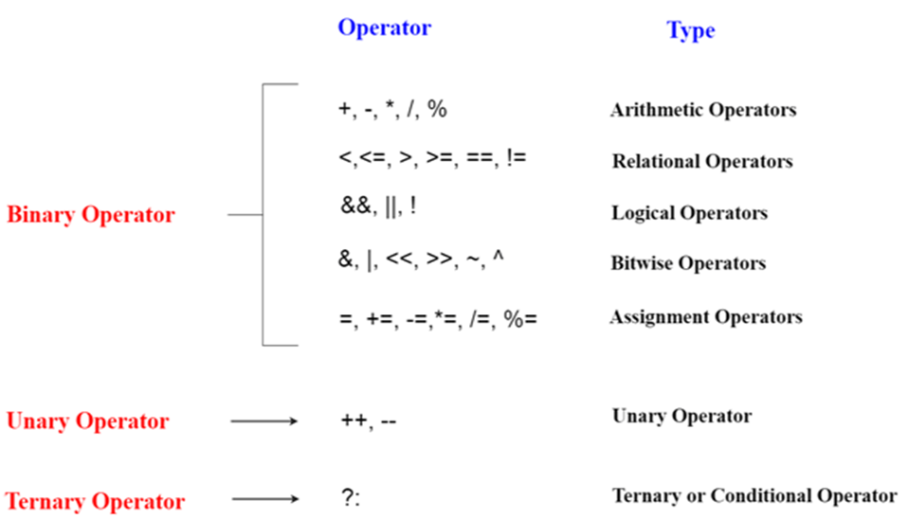
Operator Contd..

Slide 17
Miscellaneous Operator
Stream input output operator(<<,>>)
Scope resolution operator(::)
Memory allocation operator(new)
Memory deallocation operator(delete)
Pointer to member operator(.*,->*)
Line feed operator(endl)
Field width operator(setw)

Slide 18
Associativity
When precedence of operators are same and we need to decide which operator will be evaluated first
example
10 / 2 *5 (Division and multiplication has same precedence so associativity is considered)
Left to Right (10/2) *5 =25
Right to Left 10 / (2*5) =1

Slide 19
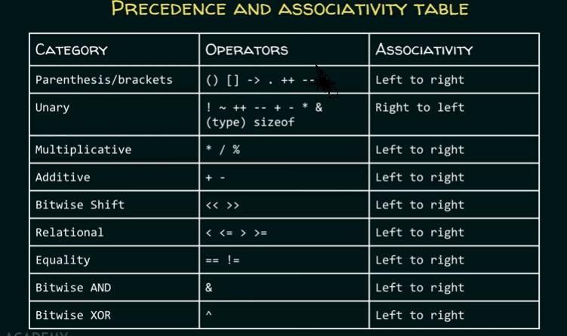
Operator Precedence & Associativity

Slide 20
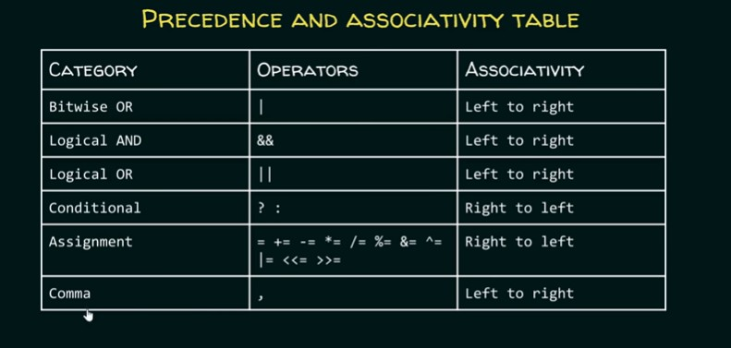
Operator Precedence & Associativity Contd..

Slide 21
Data Types
Data type is a keyword used to identify type of data
It is used for storing the input of the program into the main memory(RAM) of the computer by allocating sufficient memory space in the main memory of the computer.

Slide 22
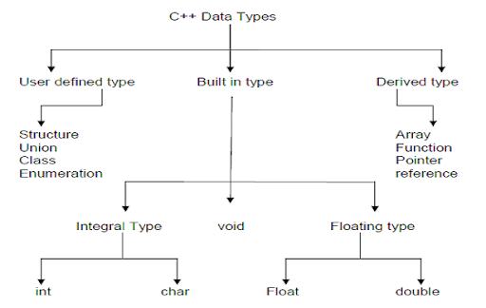

Slide 23
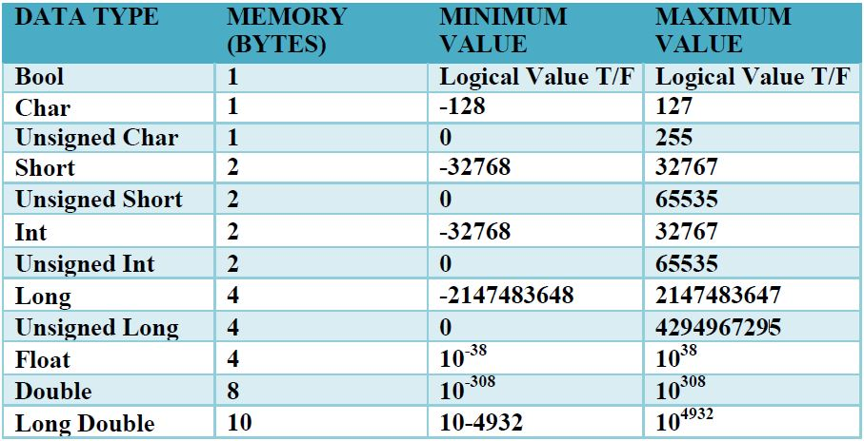

Slide 24
Data Type Ranking
Long double
Double
Float
Unsigned long
Long
Unsigned int
Int
Char

Slide 25
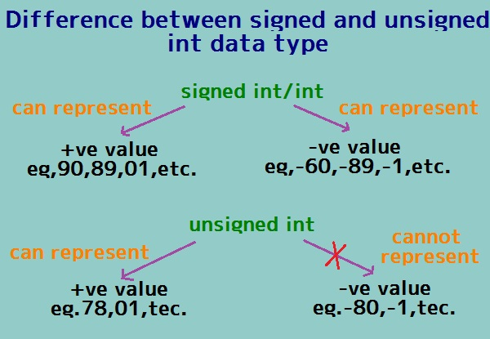

Slide 26
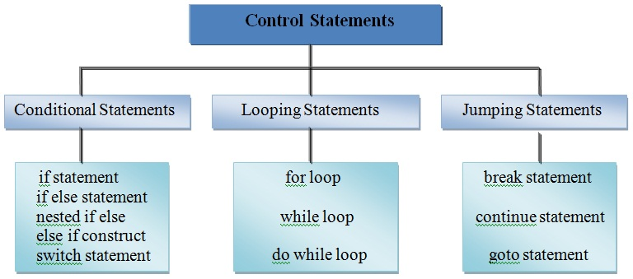
Control Statements
Control statements enable us to specify the flow of program control; i.e. the order in which the instructions in a program must be executed

Slide 27
Compound Statement
A compound statement is a grouping of statements in which each individual statement ends with a semi-colon. The group of statements is called block.
Compound statements are enclosed between the pair of braces ( { } ). The opening brace ({ ) signifies the beginning and closing brace ( } ) signifies the end of the block.

Slide 28
Conditional Statement
Sometimes the program needs to be executed depending upon a particular condition. C++ provides the following statements for implementing the selection control structure.
1. ‘if ’ statement
2. ‘if else’ statement
3. ‘nested if’ statement
4. ‘nested else if’ statement
5. ‘switch’ statement

