Slide 1
Vendor
Performance
Analysis
From raw transactions to vendor-level decisions

Slide 2
02
31.6M
31.6 million records became one vendor-level view
records across purchase pricing, purchases, vendor invoices, and sales
Goal: connect vendor performance to purchasing, profitability, inventory, and cost decisions.
Four raw CSV files, one connected analysis layer.

Slide 3
03
01
02
Load
Aggregate
The workflow moved from raw transactions to business decisions
Load the large CSV files into a database through ingestion_db.py and monitor the process with ingestion_db.log.
Aggregate transaction-level data with get_vendor_summary.py and get_vendor_summary.log.
03
04
Analyze
Decide
Analyze vendor performance and explore patterns in vendor_performance_analysis.ipynb and exploratory_analysis.ipynb.
Translate the results into SQL, Python, and Power BI outputs.

Slide 4
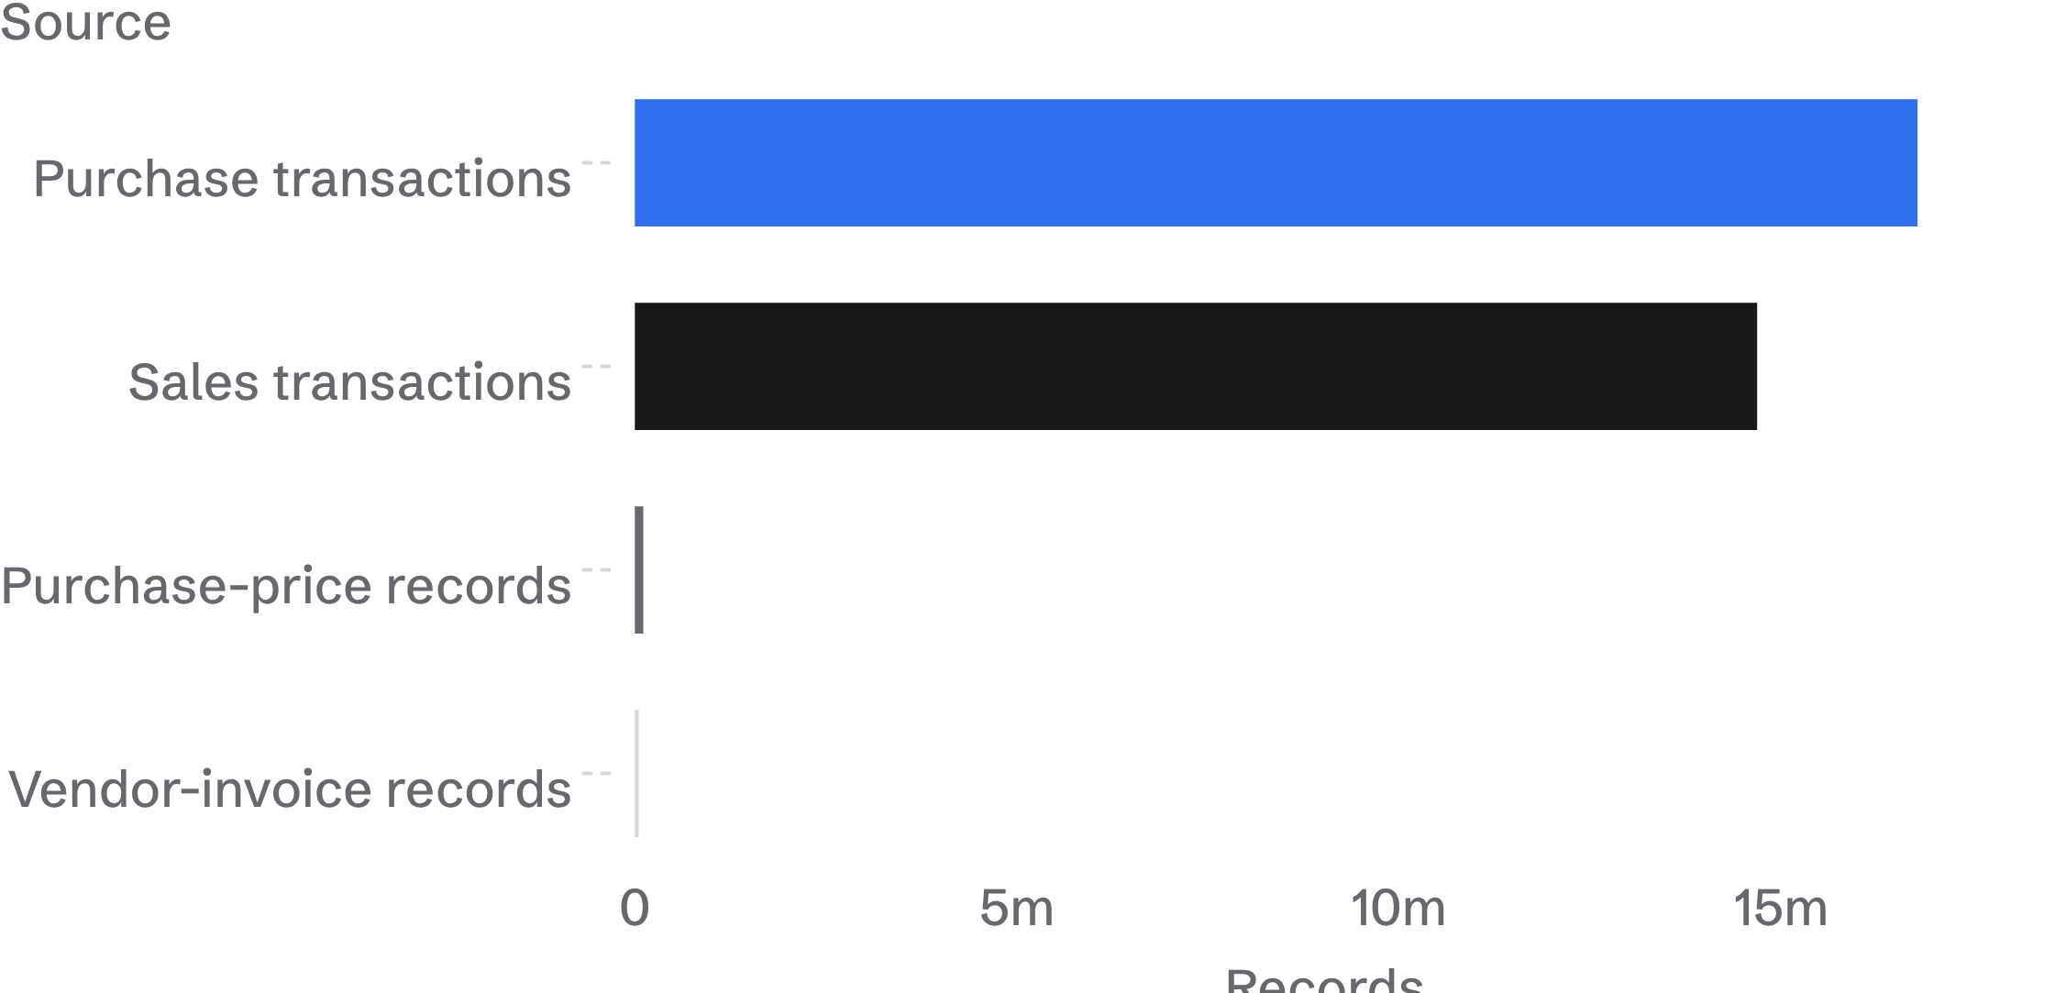
04
The database made millions of rows usable
The source files were large; the analysis became queryable.
A database made it easier to store data systematically, query specific information, aggregate transaction-level data, and work at vendor level.

Slide 5
05
10,692
Compact business metrics
Total sales · total purchases · gross profit · profit margin
Freight cost · stock turnover · sales-to-purchase ratio
vendor-level records
10,692 vendor records created a practical analysis layer
Large transaction tables became a compact set of metrics for vendor analysis.
The summary size is not the raw dataset size.

Slide 6
06
Supplier concentration creates a real dependency risk
65.69%
of total purchases came from the top 10 vendors
A concentrated supplier base increases exposure to vendor unavailability or pricing changes.
Decision implication: maintain alternative suppliers for critical products.

Slide 7
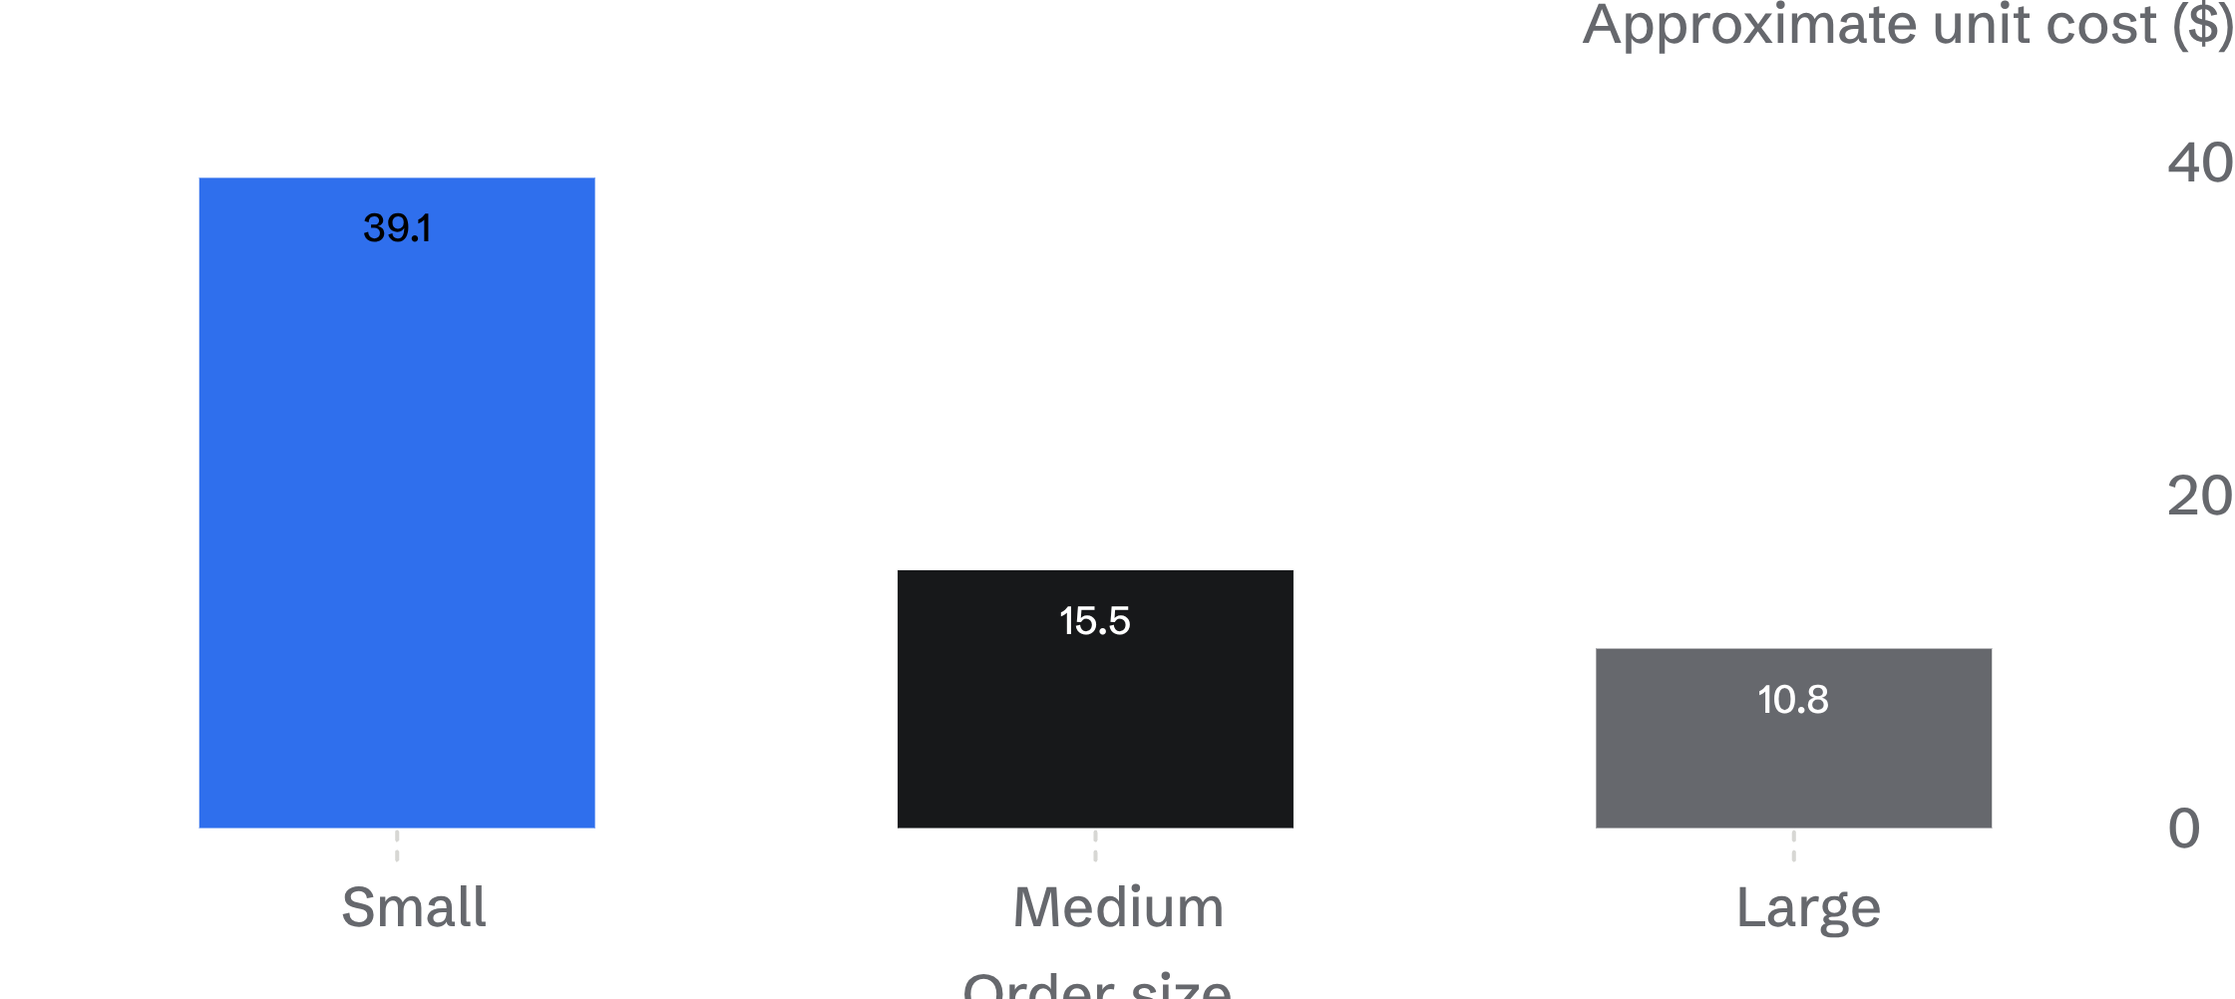
07
Inventory and purchasing decisions are tied together
$2.71M of unsold inventory indicates capital tied up in slow-moving products.
Large orders delivered approximately 72% lower unit cost than small orders, but should be reserved for products with predictable demand.

Slide 8
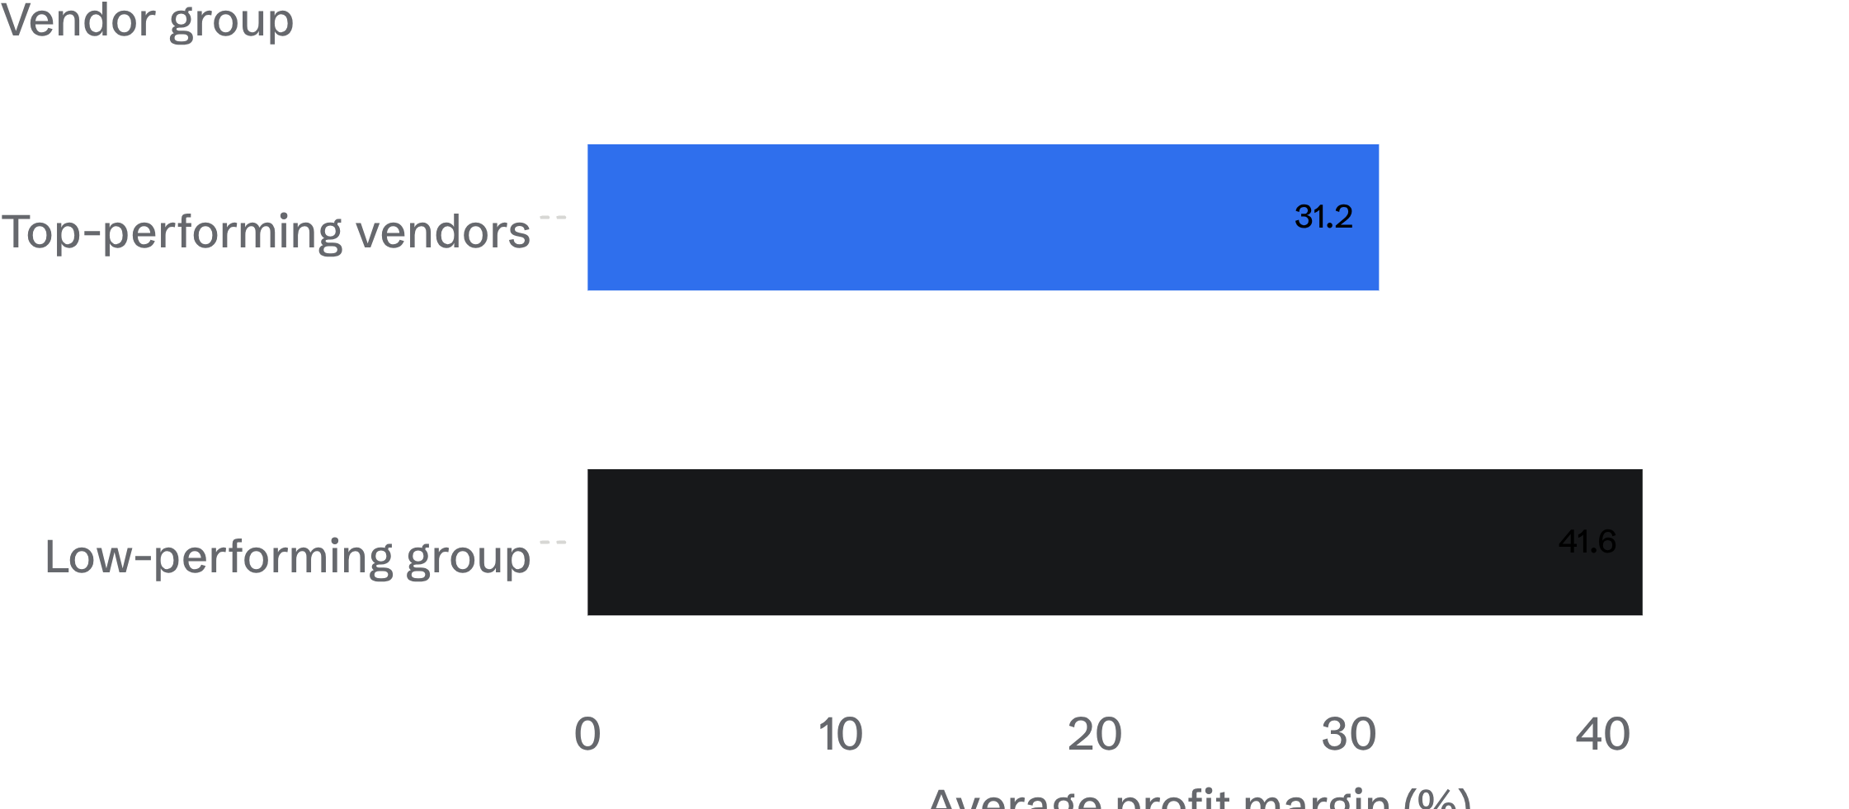
08
Margin alone can misread vendor performance
Higher margin did not necessarily mean stronger overall contribution.
Evaluate vendors across sales, profit, margin, purchase contribution, inventory, and costs.

Slide 9
09
Reduce vendor dependency with qualified alternatives for important products.
01
Improve inventory planning by isolating slow-moving products and avoiding excess purchases where demand is uncertain.
02
Turn the analysis into five operating moves
Use bulk purchasing selectively where demand is predictable.
03
Activate high-margin, low-sales products through better marketing, distribution, or pricing.
04
Keep vendor reviews multi-metric rather than margin-only.
05

Slide 10
10
Build the next decision from the same chain of evidence
Raw CSV data → database → data ingestion → vendor summary → SQL/Python analysis → exploratory analysis → business insights → Power BI dashboard.
01
02
Source
Structure
Raw CSV data
Database → data ingestion
03
04
The value of the project is not only the calculations; it is the connection between data, purchasing, inventory, vendor management, and profitability.
Summarize
Decide
Vendor summary → SQL/Python analysis
Exploratory analysis → business insights → Power BI dashboard

