Slide 1
RAPTOR: RECURSIVE ABSTRACTIVE PROCESSING FOR TREE-ORGANIZED RETRIEVAL
Parth Sarthi, Salman Abdullah, Aditi Tuli, Shubh Khanna, Anna Goldie, Christopher D. Manning Stanford University
Presentation by Sagnick Bhar
https://arxiv.org/pdf/2401.18059

Slide 2
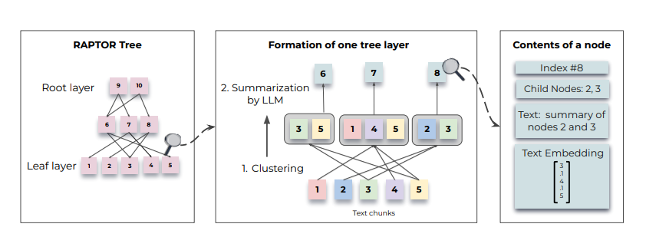
Method
To group similar text chunks, employed a soft clustering algorithm (GMMs).
Once clustered, a Language Model is used to summarize the grouped texts
These summarized texts are then re-embedded, and the cycle of embedding, clustering, and summarization continues until further clustering becomes infeasible
SBERT embeddings

Slide 3
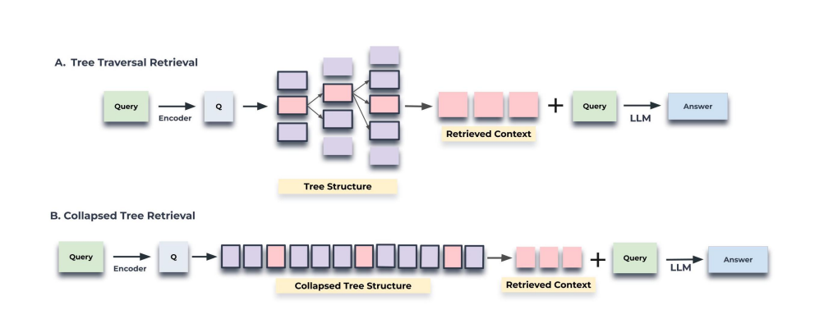
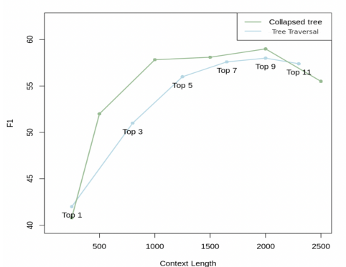
Tree Traversal Methods
At each level, it retrieves the top-k node(s) from the child nodes of the previous layer’s top-k

Slide 4
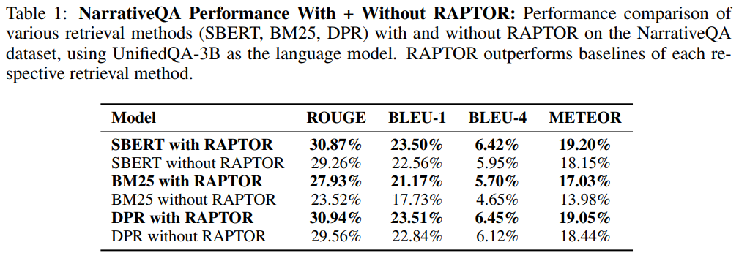
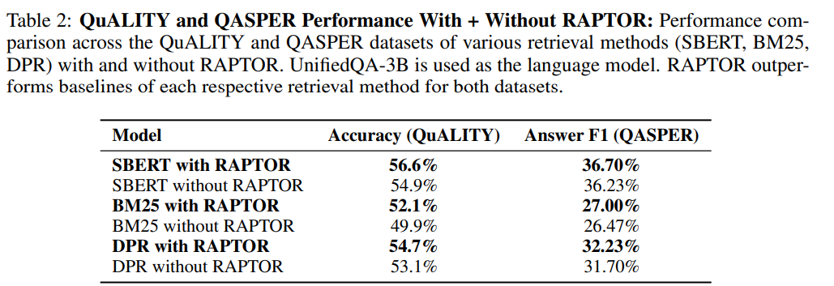
Results
Across retrieval methods, RAPTOR performed the best.

Slide 5
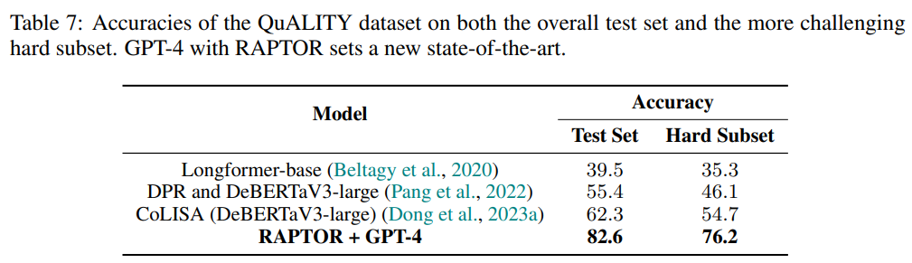
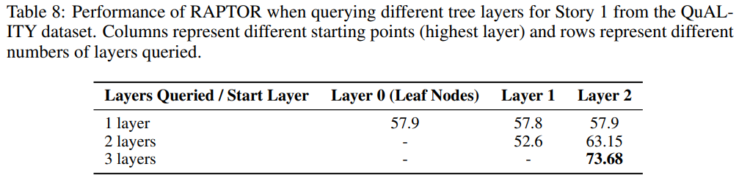
Results
They conduct an ablation study across all three datasets and across three different retrievers with RAPTOR to see what layers the retrieved nodes come from. We observe that from 18.5% to 57% of the retrieved nodes are non-leaf nodes (abstractive summaries).

Slide 6
Benefits
Long context models might solve need of RAG but use of long contexts is expensive and slow.
General RAG Benefit: If the required context is unavailable to user(and not ingrained in model weights), RAG enabled external knowledge access is anyways required.
Usual contiguous segmentation techniques might not capture the complete semantic depth of the text & may still overlook distant interdependencies within the text
RAPTOR groups text dynamically based on semantic meaning, ensuring conceptually complete retrieval.

Slide 7
Problems
4% of the summaries contained minor hallucinations (Is 4 percent hallucination considered standard? What amount of hallucination have other LLM-based summarization systems experienced? Ans: Depends from dataset to dataset (GPT 3.5: 3% to 26%))
Summary Quality and Node size (summary and child node are almost the same size. Shouldn’t there be loss of info? As per author: For All Datasets: avg tokens: non-leaf=131, leaf=85.6)
Can use a better clustering method (Amongst the documents with soft clustering, 38.1% of the summary nodes contain soft clustered child nodes.)
Possibility of redundant tokens, leading to higher computational cost.
Sequential information is lost while clustering.

Slide 8
THANK YOU

