Slide 1
ColBERT: Efficient and Effective Passage Search
A Presentation on Contextualized Late Interaction over BERT
By Sumit Prakash
Under the Guidance of Dr Manish Shrivastava

Slide 2
Introduction
Recent advances in Natural Language Understanding (NLU) have improved Information Retrieval (IR), but with high computational cost.
ColBERT introduces an efficient method for passage search using BERT while maintaining effectiveness.

Slide 3
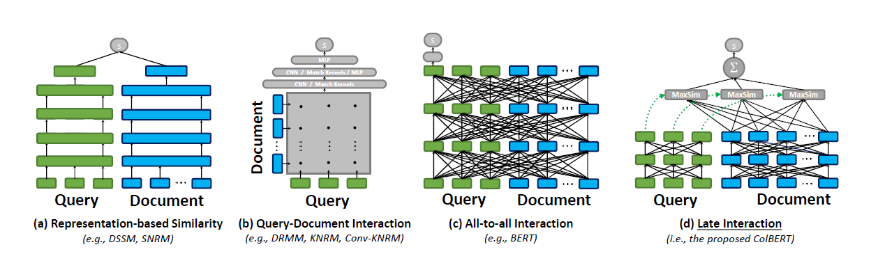
Problem Statement
Traditional ranking models using deep language models (BERT) are computationally expensive.
Each query-document pair needs to pass through a large neural network, leading to inefficiencies.

Slide 4
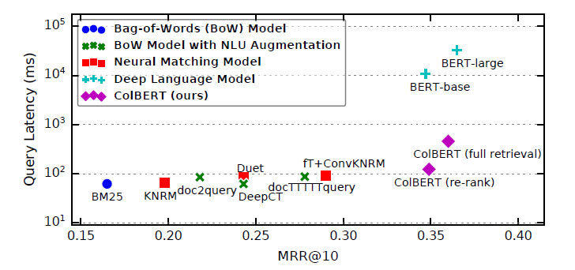
ColBERT - Key Idea
ColBERT introduces a Late Interaction Mechanism where queries and documents are encoded separately.
It enables efficient pre-computation while retaining fine-grained similarity comparison.
It is a much less burden for the encoder to encode meaning at the level of tokens than entire document.

Slide 5
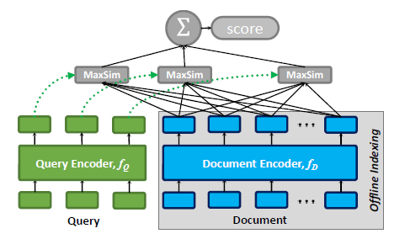
ColBERT Architecture
Query and Document Encoders: Use BERT to encode independently.
Late Interaction: Maximum similarity (MaxSim) computation across query-document embeddings.
Offline Indexing: Pre-computation of document representations speeds up retrieval.

Slide 6
Experimental Evaluation
Datasets: MS MARCO(Bing Search query passages) and TREC CAR(based on Wikipedia Articles) for benchmarking.
Metrics: MRR@10 for effectiveness, query latency for efficiency. Mean Reciprocal Rank(MRR) computes how early the first relevant document appears in the ranked list of top 10 retrieved results.
ColBERT achieves state-of-the-art performance with significant speedup (170x faster than BERT).

Slide 7


Key Advantages of ColBERT
Efficiency: Processes queries in milliseconds while maintaining high ranking accuracy.
Scalability: Supports large document retrieval through vector search.
Practicality: Can be deployed with reasonable hardware requirements.

Slide 8
Conclusion
ColBERT bridges the gap between efficiency and effectiveness in IR using BERT.
It enables practical deployment of neural ranking models by reducing computational overhead while preserving retrieval quality.
It utilizes Indexing(precomputing and storing document embeddings) and retrieval(Embedding query and retrieve top-k document using MaxSim.

Slide 9
Thank You!

