Slide 1


SEO KEYWORD ANALYZER

Slide 2
Team Member’s
Project Manager : Rakesh
Back End Developer : Abhinav
Algorithm : Akshay
Front End Developer : Sumit, Mounika
Documentation: Suchitha

Slide 3
Introduction
In today's dynamic digital landscape, SEO stands as the cornerstone of online success. Our project, the "SEO Keyword Tracker and Analyzer," embodies our commitment to leveraging intricate algorithms such as Rabin-Karp, Suffix Tree, and more, to craft a tool that not only tracks keywords but also provides actionable insights for website optimization. With Python Flask powering the backend and React driving the frontend, our endeavor is to empower website owners and marketers with a transformative SEO solution, poised to elevate their online presence.

Slide 4
Development Step’s
Keyword Selection
Data Gathering from Various Sources
Data Preprocessing Techniques
Integration of Analytical Algorithms:
Rabin-Karp Algorithm: Utilized for efficient string searching, particularly effective in large text datasets.
Suffix Tree and Suffix Array: Powerful tools for substring searching, aiding in comprehensive keyword analysis.
Naive String Matching: Provides a baseline algorithm for comparison, contributing to algorithmic diversity.
KMP Algorithm: Enhances string searching efficiency through pattern preprocessing, ideal for optimizing keyword tracking.

Slide 5
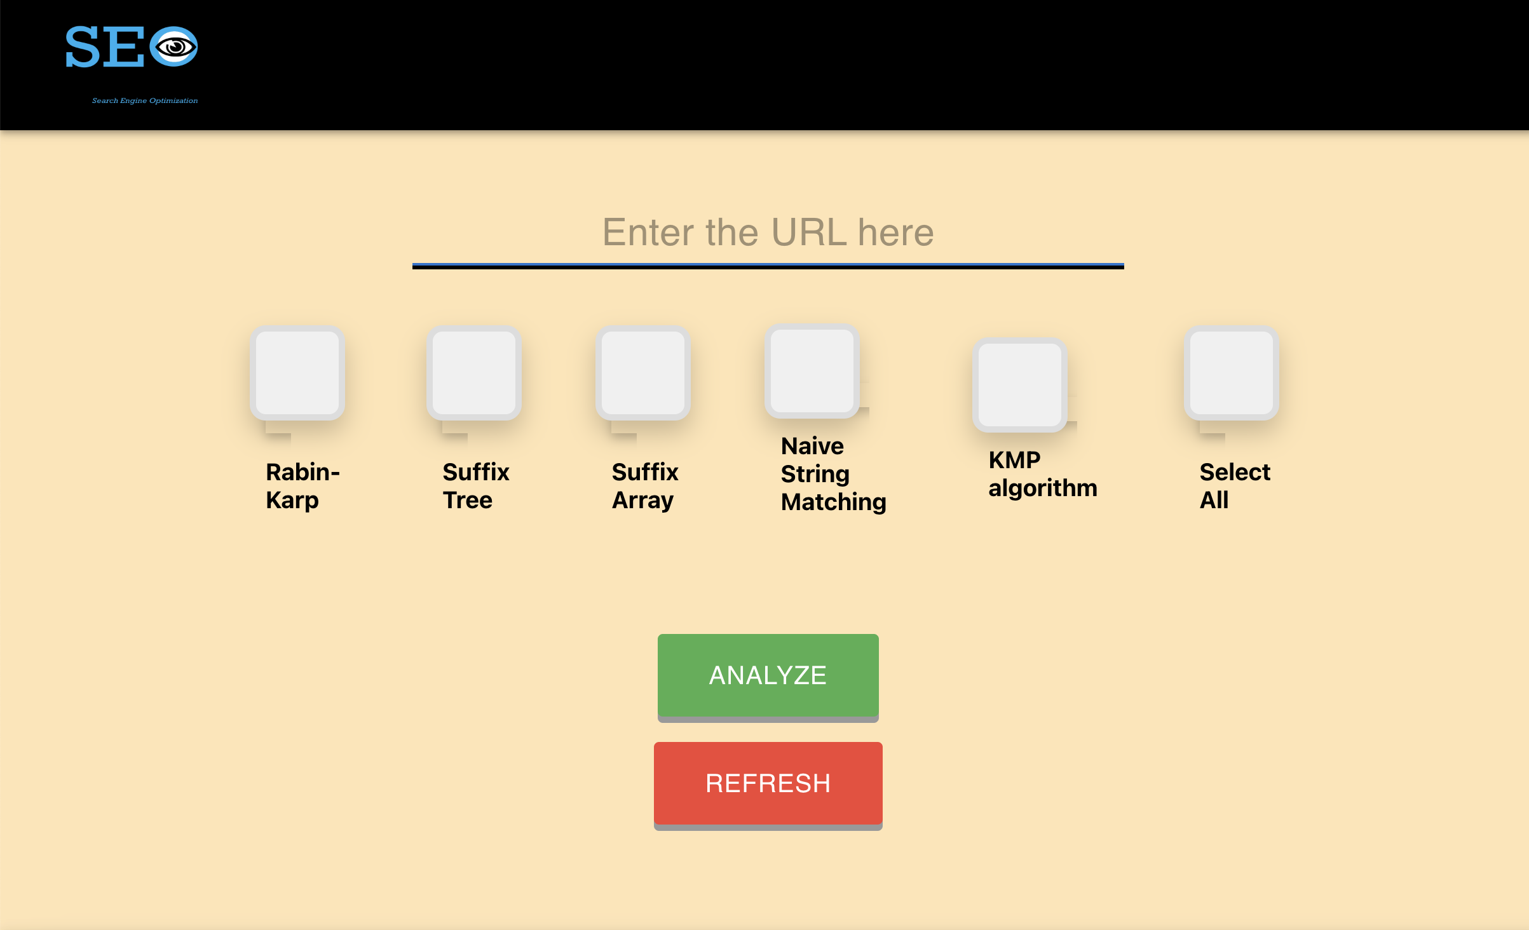
UI Design and User Interaction
React.js for Dynamic UI Development
Component Modularity and Scalability
Streamlined User Experience
Visual Data Representation with Word Clouds

Slide 6
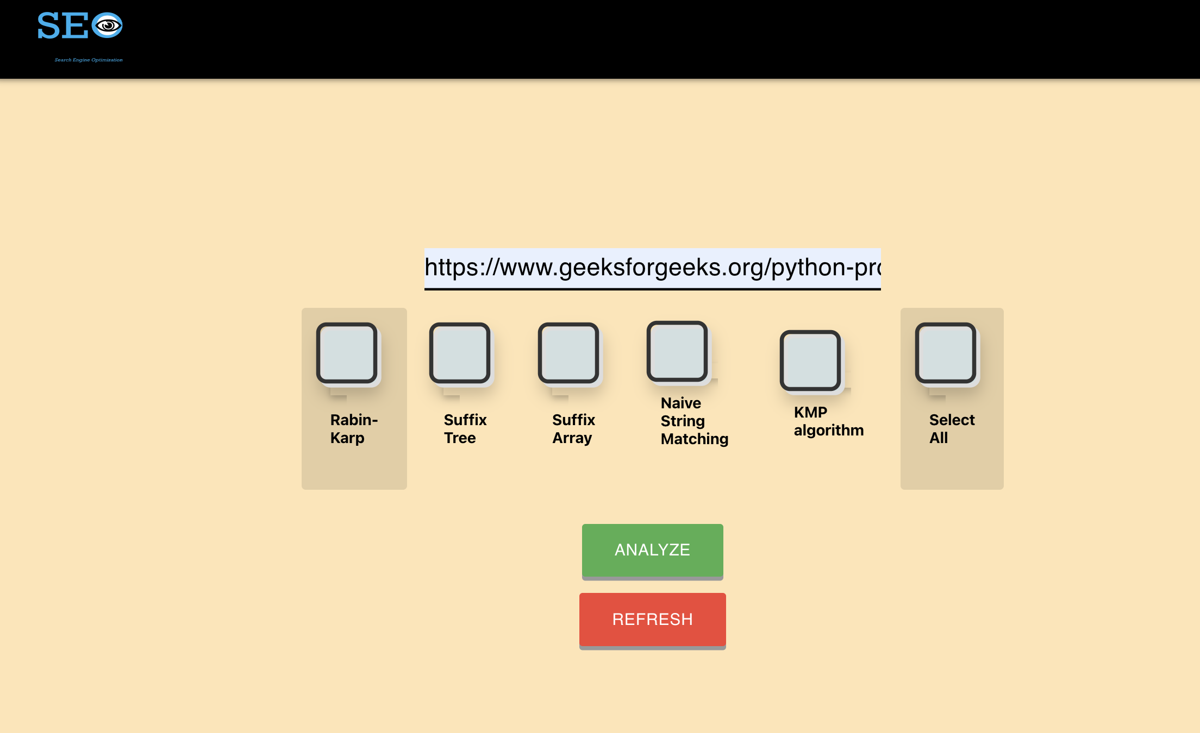
Tool Functionality with Real-World Website Example

Slide 7
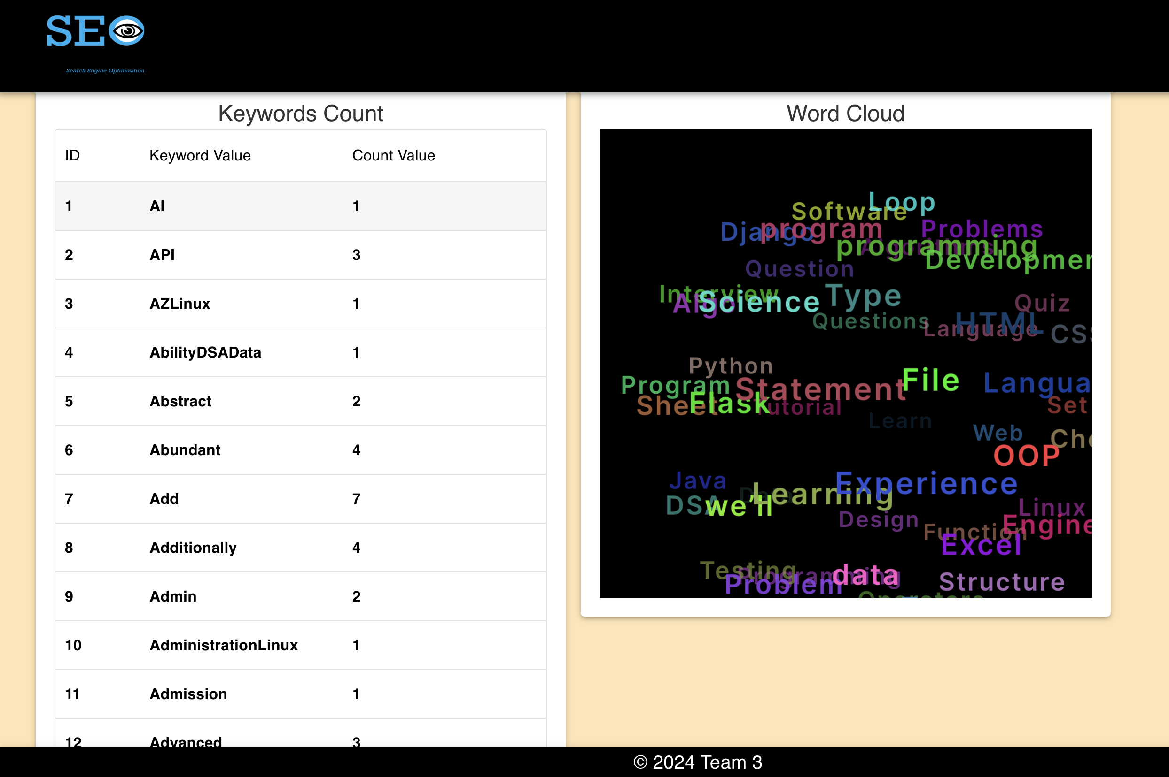
SEO Analyzer

Slide 8
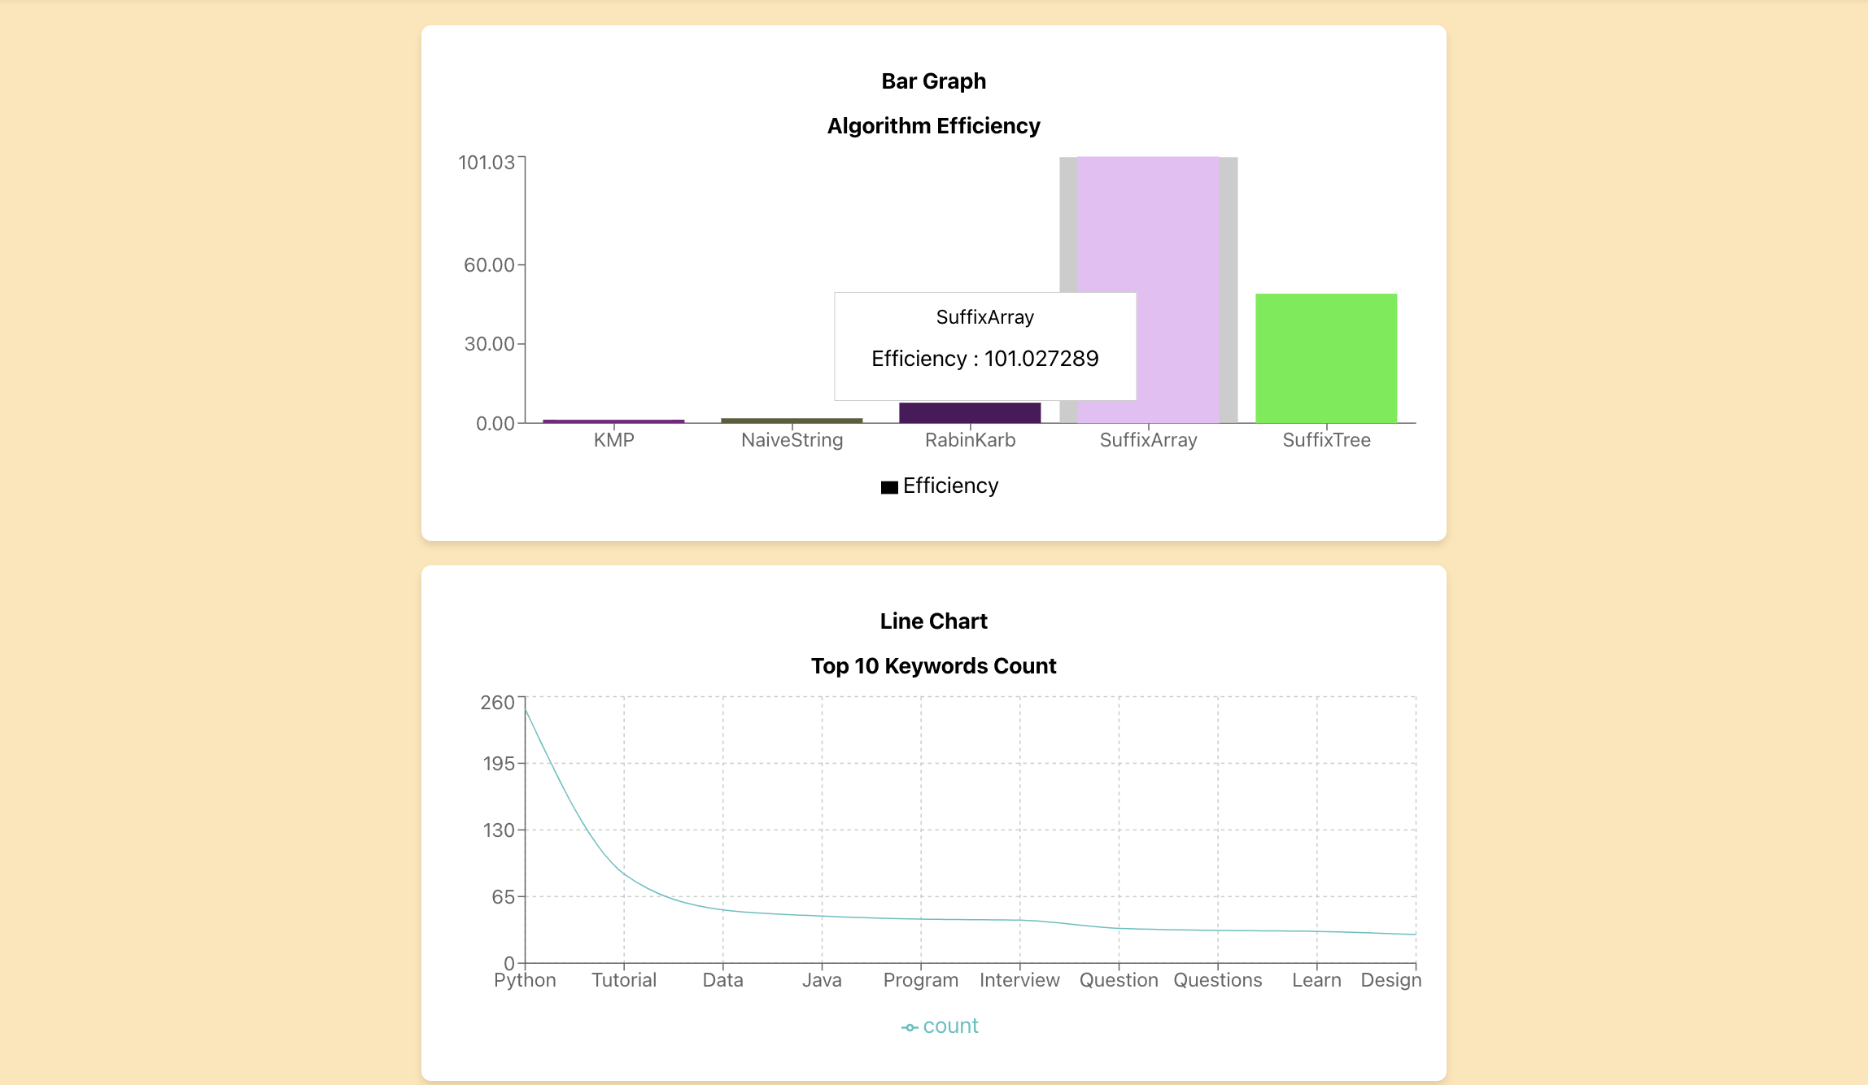
Visualization

Slide 9
Real world Applications and Relevance
Content Creation Guidance: Our tool assists content creators and marketers in optimizing their content strategy by identifying high-performing keywords and trending topics within their niche or industry.
Our "SEO Keyword Tracker and Analyzer" offers comprehensive keyword analysis, allowing e- commerce businesses to identify high-performing keywords and integrate them into product listings effectively.
Product Visibility Enhancement: In the competitive e-commerce landscape, visibility is crucial for driving sales. Our tool enables businesses to optimize product listings on platforms like Amazon or Shopify by analyzing and incorporating relevant keywords. By enhancing product visibility through strategic keyword optimization, businesses can increase their chances of appearing in search results and attracting potential customers.
By offering insights into keyword performance and search trends, our tool empowers businesses to refine their content strategy, produce targeted content that resonates with their audience, and improve overall SEO performance.

Slide 10
Demo

Slide 11
Challenges & Takeaways
Challenges:
Integrating complex algorithms like Rabin-Karp, Suffix Tree, and others posed challenges in implementation and optimization.
The challenge in implementing the recommendation feature arose from our team's limited familiarity with the subject matter. However, we're determined to cultivate our skills and refine the feature in upcoming versions of the tool..
Ensuring seamless communication between the backend APIs developed with Python Flask and the frontend built with React presented integration challenges.
Takeaways:
Through rigorous testing and validation, we gained valuable insights into algorithmic efficiency and performance optimization.

Slide 12
Thank You

