Slide 1

Benchmarking Retrieval-Augmented Generation Pipelines
A Comparative Study of Chunking Strategies, Embedding Models, and Large Language Models
Project Guide: [Guide Name, Designation]
Team (Group No. 125): Sumit Chauhan • Ankit Yadav • Shikhar Saxena • Tejas Kumar Sahu • Tanuj Vatsa
Department of Computer Science and Engineering, VIT Bhopal University | Project Exhibition
Notes:
1

Slide 2
Introduction
  The problem LLMs lack access to private or current knowledge and hallucinate on specialized topics
  RAG retrieves relevant passages from an external knowledge base and grounds the answer in them
  Pipeline chunk → embed → index → retrieve top-k → generate → evaluate
  Why chunking matters it defines the retrieval unit; bad boundaries split ideas or add noise
  This project benchmarks 5 chunking strategies with a fixed embedding model and LLM
Group 125 | Dept. of CSE, VIT Bhopal University
2
Notes:
2

Slide 3
Existing Work and Limitations
Existing work
Limitations
  RAG introduced as parametric + non-parametric memory [1]
  Surveys describe RAG as a multi-stage pipeline [2]
  RAGAS gives automated retrieval and generation metrics [3]
  EvaRAG benchmarks retrievers, indexes and metrics [4]
  Settings tuned by heuristic trial-and-error
  Several components changed together, so causes are unclear
  Chunking rarely isolated as a variable
  Latency often ignored next to quality
  Often built on closed-source APIs
Group 125 | Dept. of CSE, VIT Bhopal University
3
Notes:
3

Slide 4
Proposed Work and Methodology
Normalize
text
Chunk
(1 of 5)
Embed
qwen3
Retrieve
top-k
Generate
gemma4
Evaluate
RAGAS
  Controlled design only chunking varies; embedding, LLM, questions, prompt, temperature and top-p are fixed
  Factorial matrix 5 × 1 × 1 = 5 configurations (C01–C05)
  Metrics Context Recall, Context Precision, Faithfulness, Answer Relevancy, end-to-end latency
  Selection composite score S(c) = (Recall + Precision + Faithfulness) / 3, with Pareto analysis
Group 125 | Dept. of CSE, VIT Bhopal University
4
Notes:
4

Slide 5
Novelty of the Project
Isolated variable
Open-weight stack
Five strategies
  Chunking is the only factor changed, so effects are attributable
  qwen3-embedding with gemma4:31b-cloud instead of legacy closed APIs
  Includes semantic and LLM-driven agentic chunking
Quality + speed
Reusable engine
  Composite score and Pareto frontier weigh accuracy against latency
  Configuration-driven, modular benchmark with a reproducibility checklist
Group 125 | Dept. of CSE, VIT Bhopal University
5
Notes:
5

Slide 6
Real-Time Usage
  Enterprise document Q&A policies, manuals and internal wikis
  Customer support assistants grounded answers from product documentation
  Legal, medical and technical search precise retrieval from dense, domain documents
  Academic and research assistants question answering over papers and PDFs
  Production tuning choose a chunker by latency budget, e.g. fixed-size for speed, agentic for precision
Group 125 | Dept. of CSE, VIT Bhopal University
6
Notes:
6

Slide 7
Hardware and Software Requirements
Software
Hardware
  Python 3 environment
  Ollama runtime: qwen3-embedding:latest and gemma4:31b-cloud
  RAGAS evaluation framework
  Local vector store with cosine similarity
  PDF text extraction and tokenizer libraries
  Plotting library for charts
  Laptop or desktop PC (multi-core CPU)
  16 GB RAM recommended
  Stable internet (cloud-hosted LLM)
  Few GB free disk for models and vector index
  GPU optional for local embedding speed-up
Group 125 | Dept. of CSE, VIT Bhopal University
7
Notes:
7

Slide 8
Overall System Architecture
Indexing phase (offline)
Documents
(PDF)
Preprocess
& normalize
Chunker
Fixed | Recursive | Semantic | Token | Agentic
qwen3-embedding
(chunk vectors)
Vector store
(index)
Query phase (online)
User
query
qwen3-embedding
(query vector)
Similarity
search top-k
Context
construction
gemma4:31b-cloud
(answer)
RAGAS evaluation (Recall, Precision, Faithfulness, Relevancy) + latency logger
Group 125 | Dept. of CSE, VIT Bhopal University
8
Notes:
8

Slide 9
Literature Review
Gap: no controlled study isolating chunking strategy on an open-weight embedding + LLM stack.
Group 125 | Dept. of CSE, VIT Bhopal University
9
Notes:
9

Slide 10
Module Description
1. Ingestion
2. Chunk generation
3. Embedding & indexing
  Parse PDF, clean Unicode and whitespace, produce uniform text
  Run one of five chunkers chosen by configuration
  Embed chunks with qwen3-embedding; store vectors with metadata
4. Retrieval
5. Answer generation
6. Evaluation & logging
  Embed query; cosine similarity search for top-k chunks
  Build fixed prompt and context; gemma4:31b-cloud answers
  RAGAS scores plus timestamps per stage
Group 125 | Dept. of CSE, VIT Bhopal University
10
Notes:
10

Slide 11
Module Workflow Explanation
PDF
Clean text
Chunks
Vectors
Top-k chunks
Prompt
Answer
Scores
  Step 1 ingestion normalizes the PDF into one text stream shared by all chunkers
  Step 2 the active config splits text (fixed window, delimiters, similarity shifts, token budget, or LLM proposition)
  Step 3 each chunk is embedded and stored with source, offsets and chunk ID
  Step 4 each question is embedded and matched by cosine similarity to get top-k context
  Step 5 context and question fill a constant prompt; gemma4:31b-cloud writes the answer
  Step 6 contexts, answers and timings are logged; RAGAS scores them per configuration
Group 125 | Dept. of CSE, VIT Bhopal University
11
Notes:
11

Slide 12
Implementation and Coding
  Design one module per stage, driven by a config manifest
  Constant prompt, temperature, top-p, questions, embedding model
  Chunkers fixed, recursive, semantic, token, agentic
  Logged retrieved contexts, answers, stage timestamps, RAGAS scores
  Note replace with your actual code or screenshots
# Core pipeline (simplified pseudocode)
cfg = load_config(chunker, k, temp, top_p)
text = normalize(read_pdf(path))
chunks = CHUNKERS[cfg.chunker](text)
vecs = embed("qwen3-embedding", chunks)
index.add(vecs, chunks, metadata)
for q in questions:
ctx = index.search(embed(q), k=cfg.k)
ans = llm("gemma4:31b-cloud",
prompt(q, ctx))
log(ctx, ans, timings)
scores = ragas.evaluate(logs)
Group 125 | Dept. of CSE, VIT Bhopal University
12
Notes:
12

Slide 13
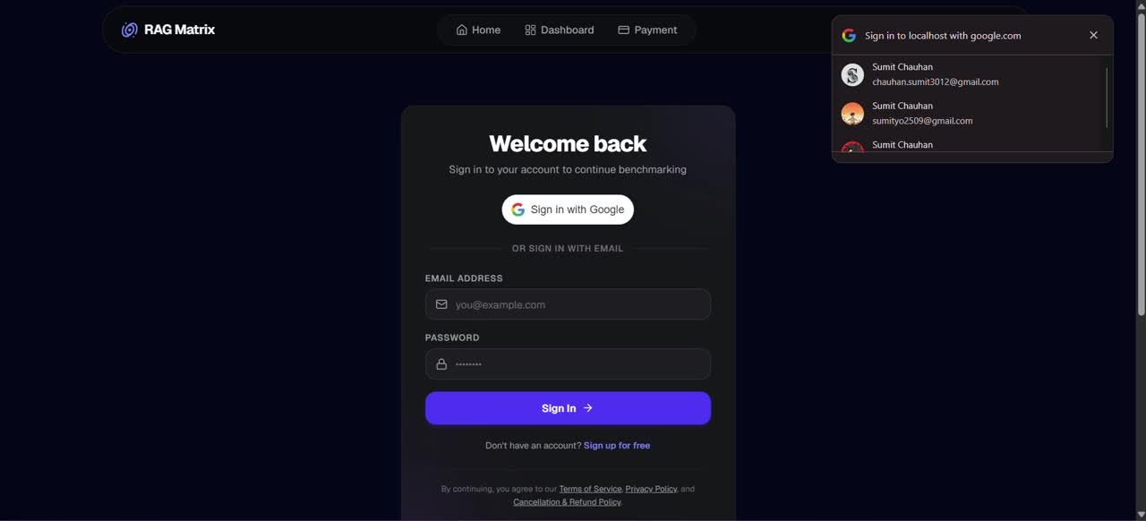
Demo Video
Insert demo video here
(Insert ▸ Video ▸ This Device)
Group 125 | Dept. of CSE, VIT Bhopal University
13
Notes:
13

Slide 14
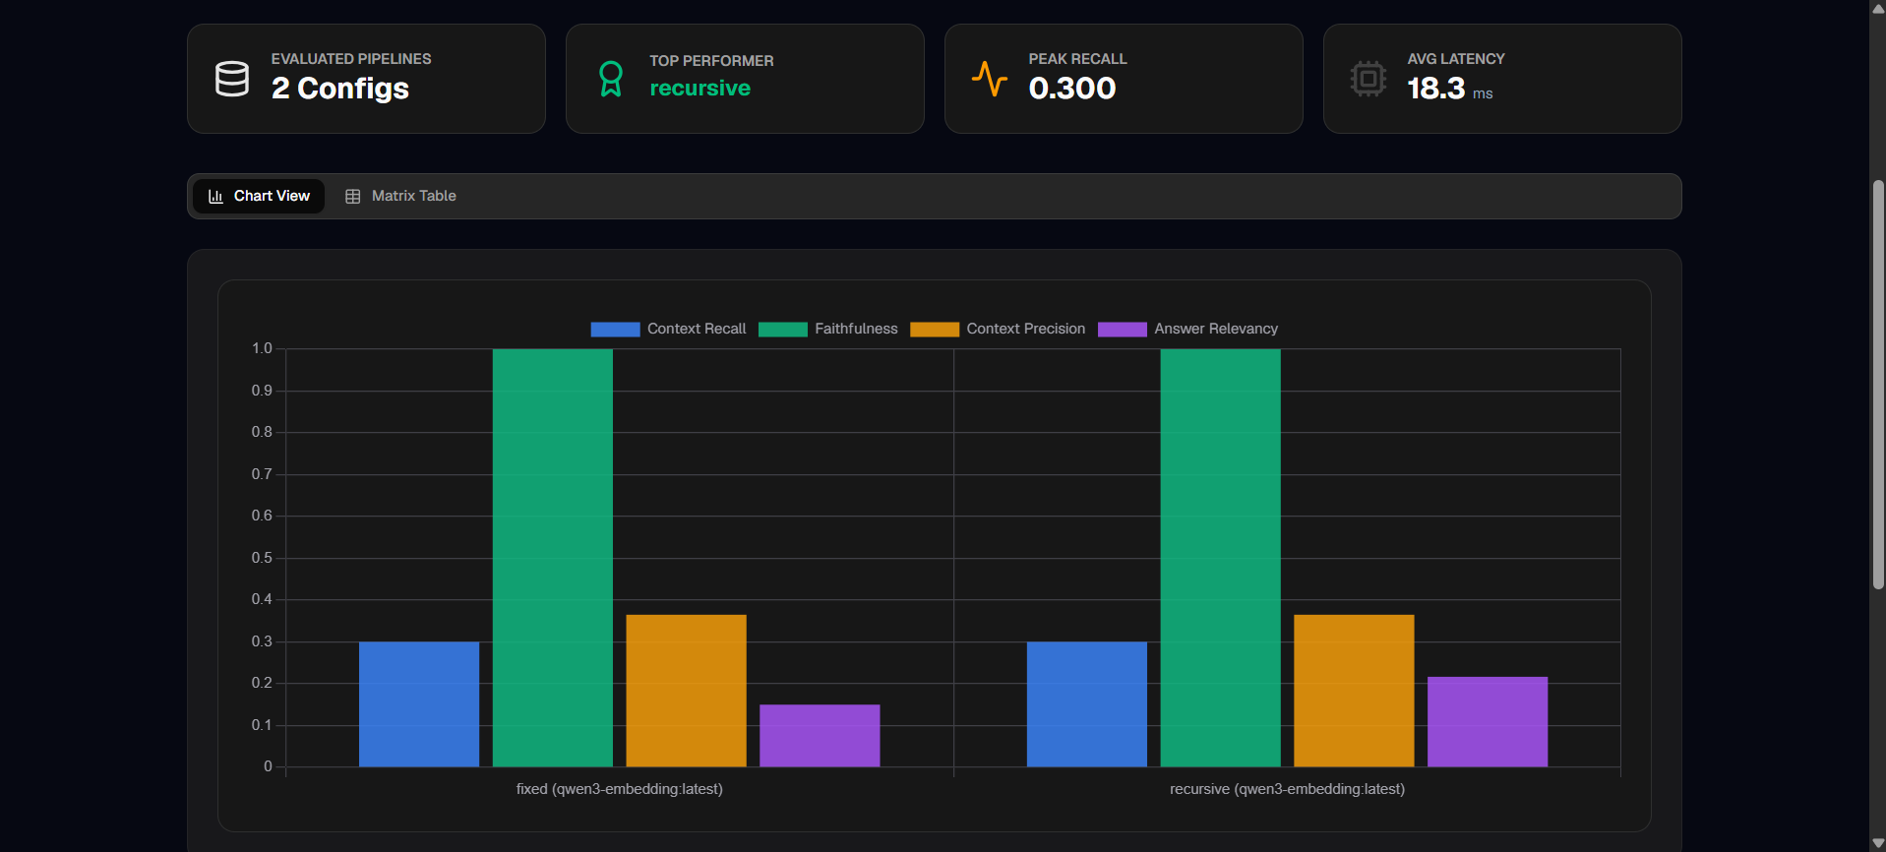
Snapshots of the Project
Group 125 | Dept. of CSE, VIT Bhopal University
14
Notes:
14

Slide 15
Testing
Test setup
Metrics captured
  Corpus: evaluation PDF (~350 KB)
  5 configurations C01–C05 on the same questions
  Same prompt, temperature, top-p and top-k
  Latency timed with identical boundaries
  Outputs stored for inspection
  Context Recall, Context Precision
  Faithfulness, Answer Relevancy
  Latency: indexing, retrieval, generation, total
  Composite score S(c) and tie-breaks
Each configuration uses qwen3-embedding:latest + gemma4:31b-cloud. Results come from single runs.
Group 125 | Dept. of CSE, VIT Bhopal University
15
Notes:
15

Slide 16
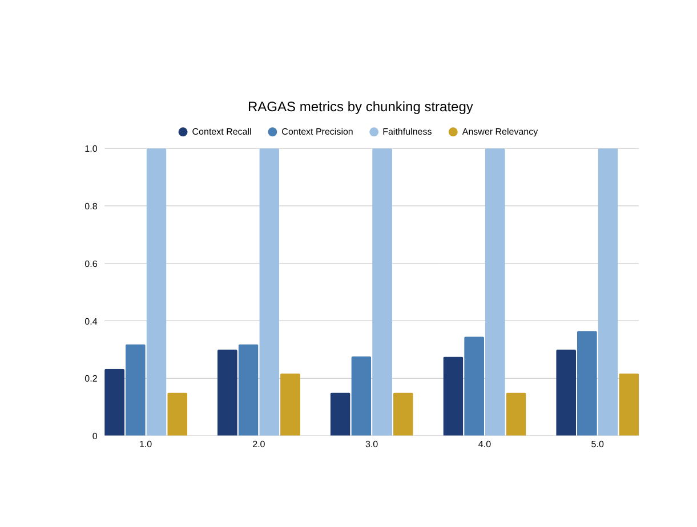
Result and Discussion: Input and Output
Input: PDF corpus + question set + chunking config Output: answer, retrieved context, scores, latency
Values are single-run benchmark figures; replace with final experiment logs if they differ.
Group 125 | Dept. of CSE, VIT Bhopal University
16
Notes:
16

Slide 17
Result Discussion
  Agentic (C05) best S(c) = 0.555 and highest Precision (0.365) at 7.28 s
  Fixed (C02) S(c) = 0.539 at 4.90 s, the best speed–quality balance
  Semantic (C03) fastest (3.54 s) but weakest retrieval (Recall 0.150)
  Token (C04) strong Precision (0.345) but slowest at 11.82 s
  Faithfulness is 1.000 everywhere differences come from retrieval, not generation
  Pareto frontier C03, C02 and C05; C01 and C04 are dominated
Group 125 | Dept. of CSE, VIT Bhopal University
17
Notes:
17

Slide 18
Conclusion
  Summary treated RAG as modular components and isolated the effect of chunking on retrieval, generation and latency
  Findings agentic chunking led on quality; fixed-size chunking gave the best efficiency; semantic chunking was fastest but least effective here
  Takeaway the best configuration depends on workload and latency budget
  Future work reranking and hybrid retrieval, hyperparameter grid search, more domains, human evaluation and repeated trials
Group 125 | Dept. of CSE, VIT Bhopal University
18
Notes:
18

