Slide 1

Sales & Revenue Strategy

Slide 2
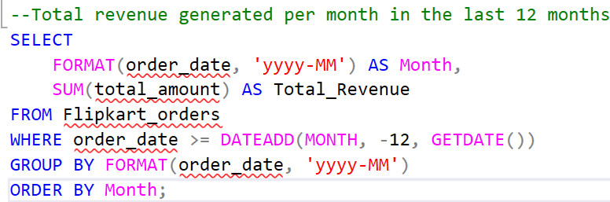
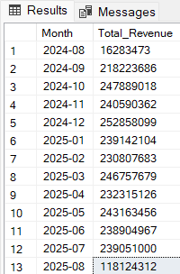
1.Total revenue generated per month in the last 12 months
Explanation:
Uses FORMAT to group by year-month.
Sums revenue in Orders.total_amount.
Filters only last 12 months.
Recommendation:
Track this as a KPI. If certain months show dips, align promotions or campaigns accordingly.

Slide 3
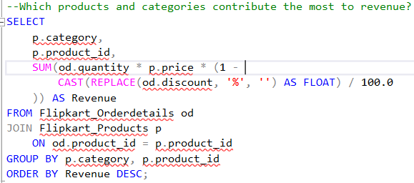
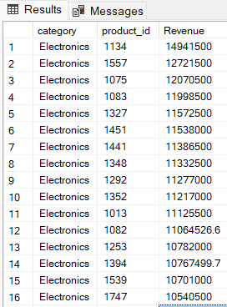
2.Which products and categories contribute the most to revenue?
Explanation:
Revenue = quantity × price × (1 – discount). Groups by category + product.
Recommendation: Focus marketing efforts on top contributors; review underperforming categories.

Slide 4
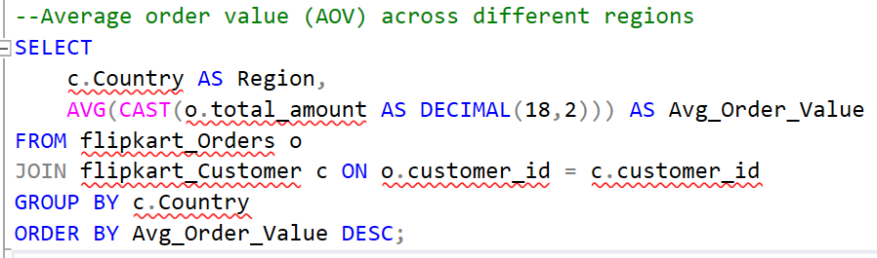
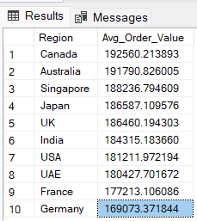
3.Average order value (AOV) across different regions
Explanation:
This query calculates AOV (average revenue per order) for each region by joining customers with orders.
Recommendation:
Focus upselling in regions with low AOV.
For high AOV regions, expand premium product lines.

Slide 5
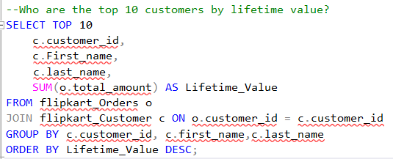
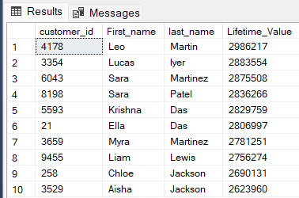
4.Who are the top 10 customers by lifetime value?
Explanation:
Identifies the top spenders by summing up their order history.
Recommendation:
Retain these VIP customers via loyalty programs.
Offer early access, exclusive discounts.

Slide 6
Customer Insights

Slide 7
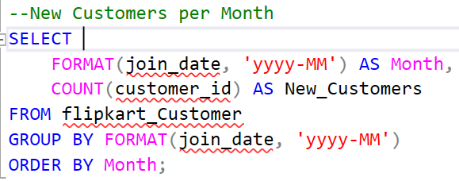
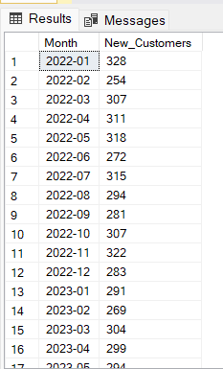
5.New Customers per Month
Explanation:
Counts customers based on their first join date per month.
Recommendation:
Track acquisition trends.
Double down on campaigns in months with high sign-ups.

Slide 8
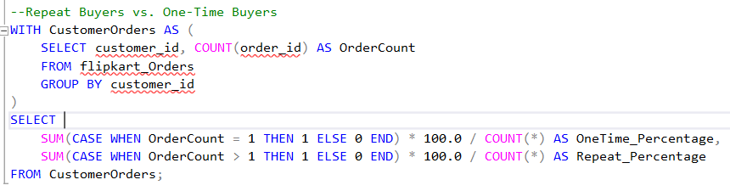

6.Repeat Buyers vs. One-Time Buyers
Explanation:
Calculates percentage of one-time vs repeat customers.
Recommendation:
Improve retention with email marketing, memberships, cashback offers.

Slide 9
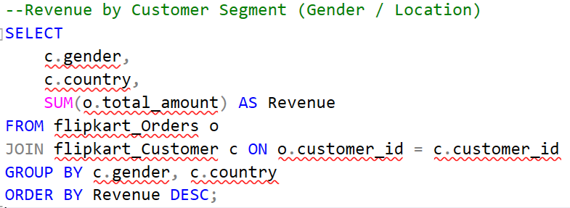
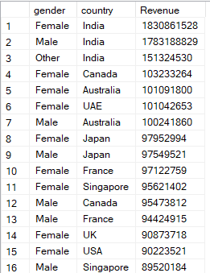
7.Revenue by Customer Segment (Gender / Location)
Explanation:
Groups total revenue by gender + location.
Recommendation:
Target marketing by segment performance.
Run localized campaigns where customers spend more.

Slide 10
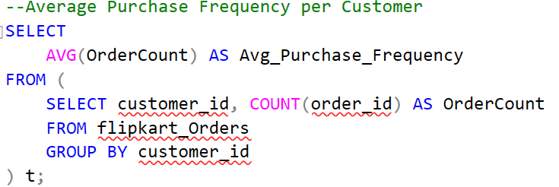

8.Average Purchase Frequency per Customer
Explanation: Measures how often an average customer places an order.
Recommendation:
If frequency is low, introduce subscriptions, flash sales, and re-order reminders.

Slide 11
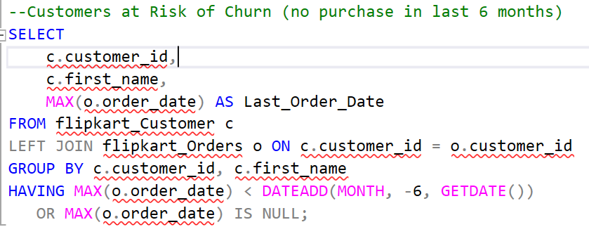
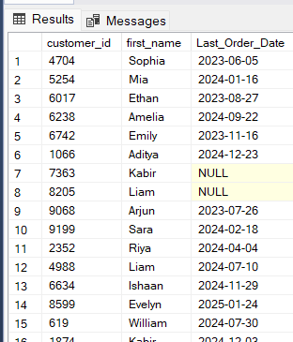
9.Customers at Risk of Churn (no purchase in last 6 months)
Explanation:
Identifies customers who haven’t purchased in 6+ months.
Recommendation:
Run win-back campaigns (discount coupons, special offers).
Personalized emails to re-engage them.

Slide 12
Product & Inventory Insights

Slide 13
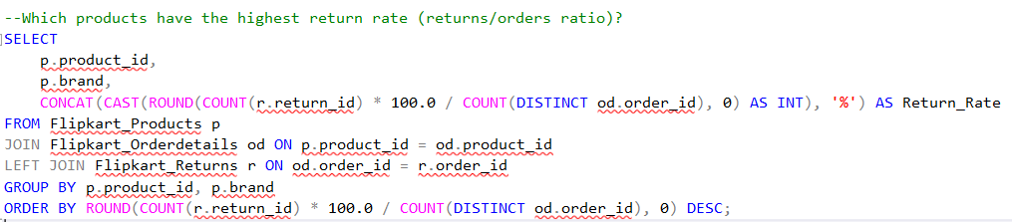
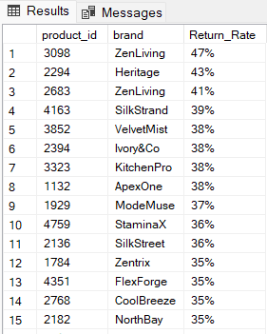
10.Which products have the highest return rate (returns/orders ratio)?
Explanation:
We join Orderdetails with Returns and calculate returns ÷ orders per product.
Recommendation:
Products with a high return rate should be reviewed for quality issues, wrong product descriptions, or packaging problems.

Slide 14
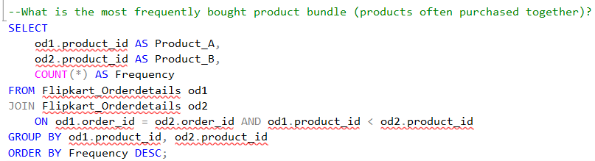
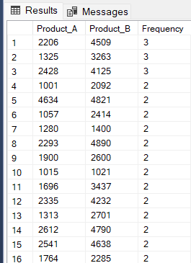
11.What is the most frequently bought product bundle (products often purchased together)?
Explanation:
We self-join Orderdetails on the same order_id to find pairs of products bought together.
Recommendation:
Use these bundles for cross-sell offers and combo discounts.

Slide 15
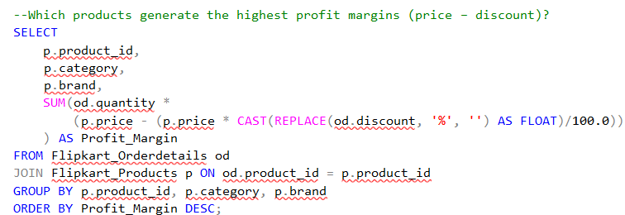
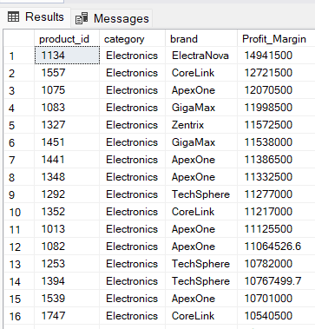
12.Which products generate the highest profit margins (price – discount)?
Explanation:
Profit margin is calculated as price – discount, multiplied by quantity.
Recommendation:
Focus marketing and visibility on high-margin products to maximize profitability.

Slide 16
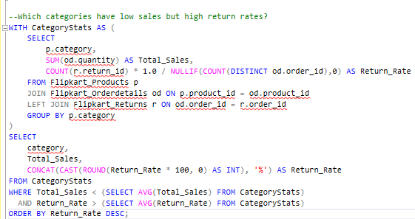

13.Which categories have low sales but high return rates?
Explanation:
Filters categories with below-average sales but above-average returns.
Recommendation:
Either fix quality issues or consider discontinuing these categories.

Slide 17
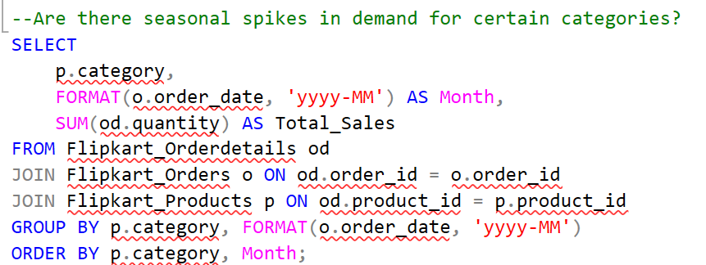
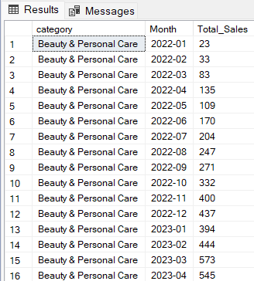
14.Are there seasonal spikes in demand for certain categories?
Explanation:
Groups sales by category & month to detect seasonal demand trends.
Recommendation:
Use this to align inventory & marketing campaigns with demand spikes.

Slide 18
Returns & Reasons

Slide 19
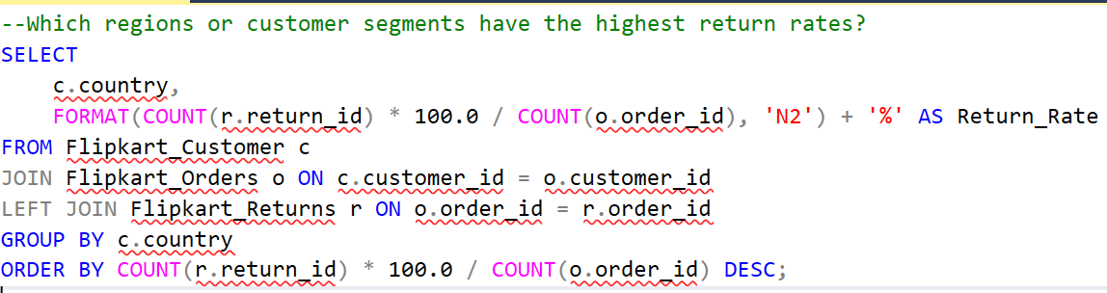
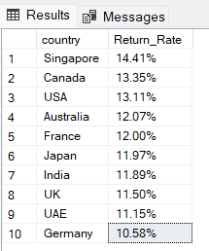
15.Which regions or customer segments have the highest return rates?
Explanation:
Groups by region (country) and calculates return rate.
Recommendation:
For high-return regions, check for logistics, delivery delays, or cultural buying patterns.

Slide 20
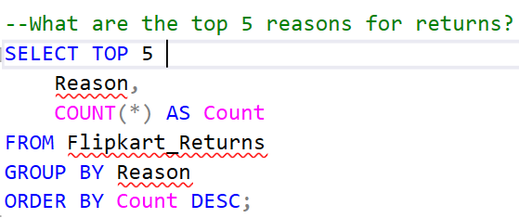
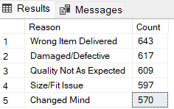
16.What are the top 5 reasons for returns?
Explanation:
Summarizes return reasons from the Returns table.
Recommendation:
Address top reasons via better product descriptions, sizing guides, packaging improvements.

Slide 21
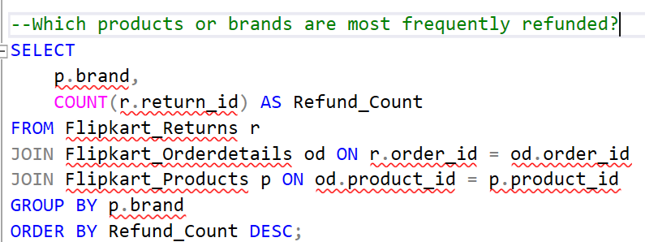
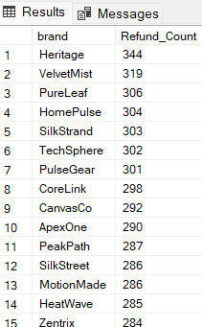
17.Which products or brands are most frequently refunded?
Explanation:
Finds products/brands with the highest refunds.
Recommendation:
Work with suppliers or manufacturers to reduce defect rates in these products.

Slide 22
Payment & Order Behavior

Slide 23
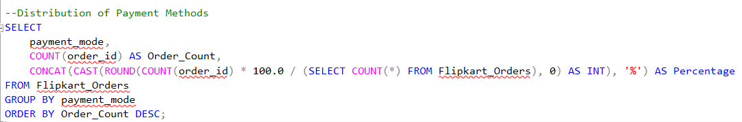
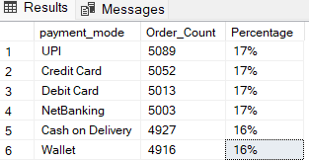
18.Distribution of Payment Methods
Explanation -
Shows how customers pay (Credit Card, UPI, COD).
Recommendations:
Maintain all options - customers value choice
Optimize checkout flow - all methods equally popular
Slight UPI promotion - already leading (17%)
Monitor digital shift - 84% prefer digital over cash

Slide 24
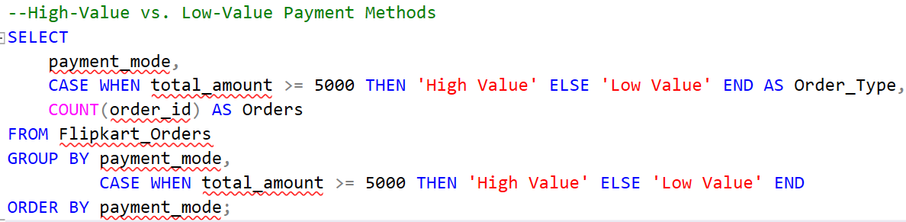
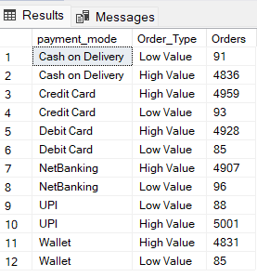
19.High-Value vs. Low-Value Payment Methods
Explanation -
Shows how customers pay (Credit Card, UPI, COD).
Recommendations:
Promote high-value payments - Customers already trust all methods for big purchases
Encourage wallet/UPI - Top performers for high-value orders
Review low-value strategy - Minimal small transactions across all methods
Maintain all options - All payment methods work well for premium purchases
Strong position: Customers confidently use all payment methods for high-value orders!

Slide 25
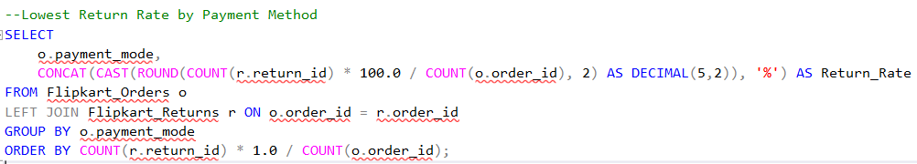
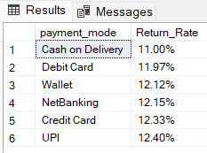
20.Lowest Return Rate by Payment Method
Explanation -
Cash on Delivery has the lowest return rate (11%), while UPI has the highest (12.4%)
Recommendations:
Promote Cash on Delivery - Lowest return rate means happier customers.
Incentivize COD for high-risk products - Reduce returns and costs.
Analyze UPI return reasons - Highest return rate needs investigation.
Maintain payment diversity - All methods within acceptable return range (11-12.4%).
Opportunity: Use Cash on Delivery strategically to minimize returns and increase customer satisfaction!

Slide 26
Regional / Location-Based Insights

Slide 27
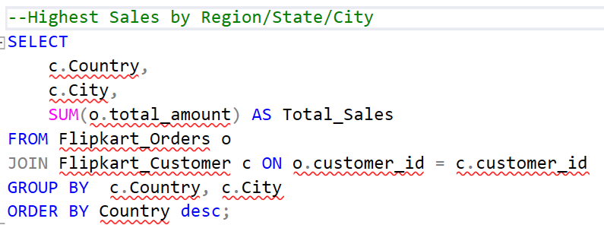
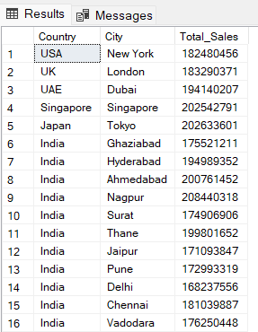
21.Highest Sales by Region/State/City
Explanation -
Identifies strongest revenue states.
Recommendation -
Top 3 states → invest more in ads, warehouses.

Slide 28
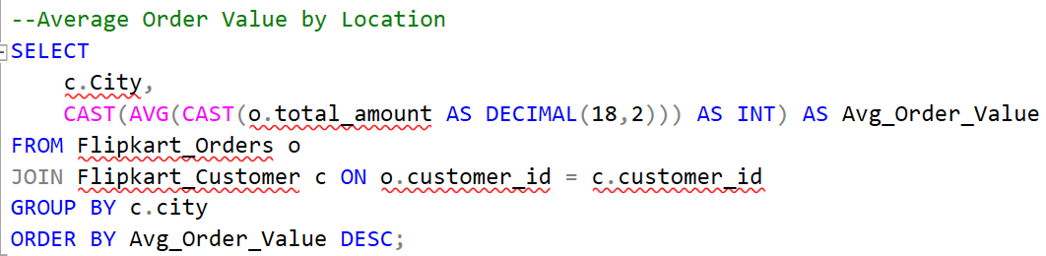
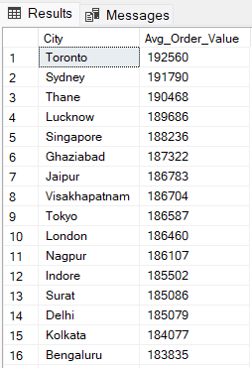
22.Average Order Value by Location
Explanation -
Compares city-level spending power.
Recommendation -
Highlight high-AOV cities → target with premium products.

Slide 29
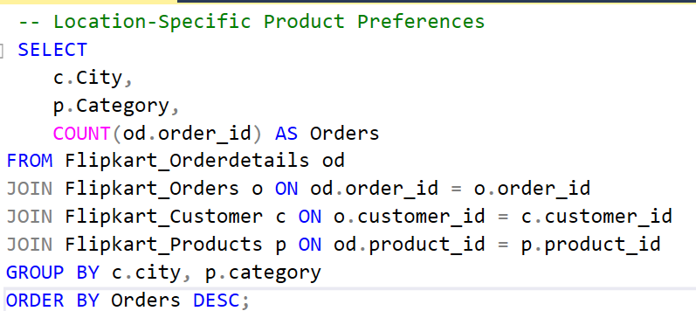
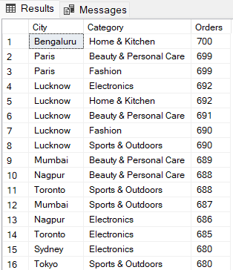
23.Location-Specific Product Preferences
Explanation -
Eg. “Mumbai → Electronics, Jaipur → Fashion”.
Recommendation -
Suggest location-based personalization in app.

Slide 30
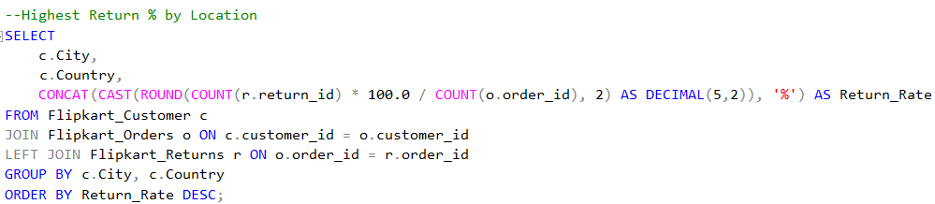
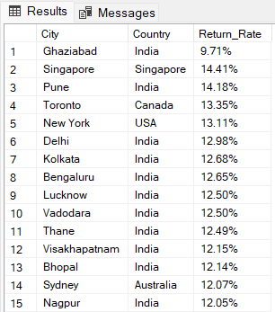
24.Highest Return % by Location
Explanation -
Some regions may show more return-prone behavior.
Recommendation -
Review product quality/logistics partners in high-return states.
Priority: Singapore's 14.41% return rate requires urgent quality/logistics review!

Slide 31
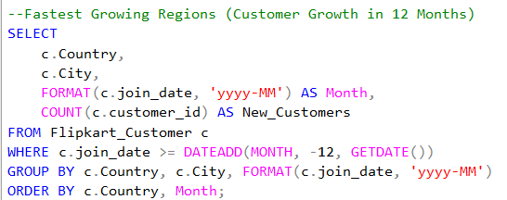
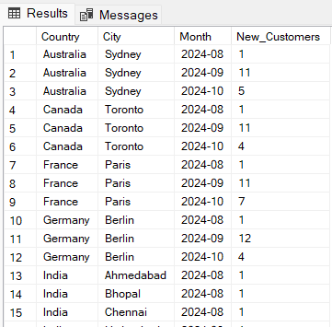
25.Fastest Growing Regions (Customer Growth in 12 Months)
Explanation -
Tracks where new customers are joining fastest.
Recommendation -
Double down on marketing in fast-growing regions.

Slide 32
Overall Benefit for Business:
Using MS SQL, I transformed raw data into actionable insights that help in:
Boosting sales & revenue
Improving customer loyalty
Optimizing inventory & payments
Reducing returns & cancellations
Supporting regional growth strategies

Slide 33
Thank You

