Slide 1
Unlocking Business Insights: The Power of Market Basket Analysis
AI driven solution for Market Basket Insights

Slide 2
Project Idea
Objective: Optimize retail operations by analyzing customer purchase behavior.
Data-Driven Insights: Utilize transaction data to uncover hidden patterns and associations.
Cross-Selling: Identify opportunities for cross-selling through product associations.
Algorithm: Implement the Apriori algorithm for efficient association rule mining.
Impact: Enhance revenue, customer satisfaction, and inventory management.
Outcome: Data-driven decision-making for retail business optimization.

Slide 3
Technology Stack
Programming Language: Python
Development Environment: Jupyter Notebook
Data Manipulation: Pandas, NumPy
Machine Learning (Optional): Scikit-Learn
Data Visualization: Matplotlib
Apriori Algorithm: mlxtend library
Database: BangDB
Version Control: Git
Cloud Services: AWS, Azure, Google Cloud

Slide 4
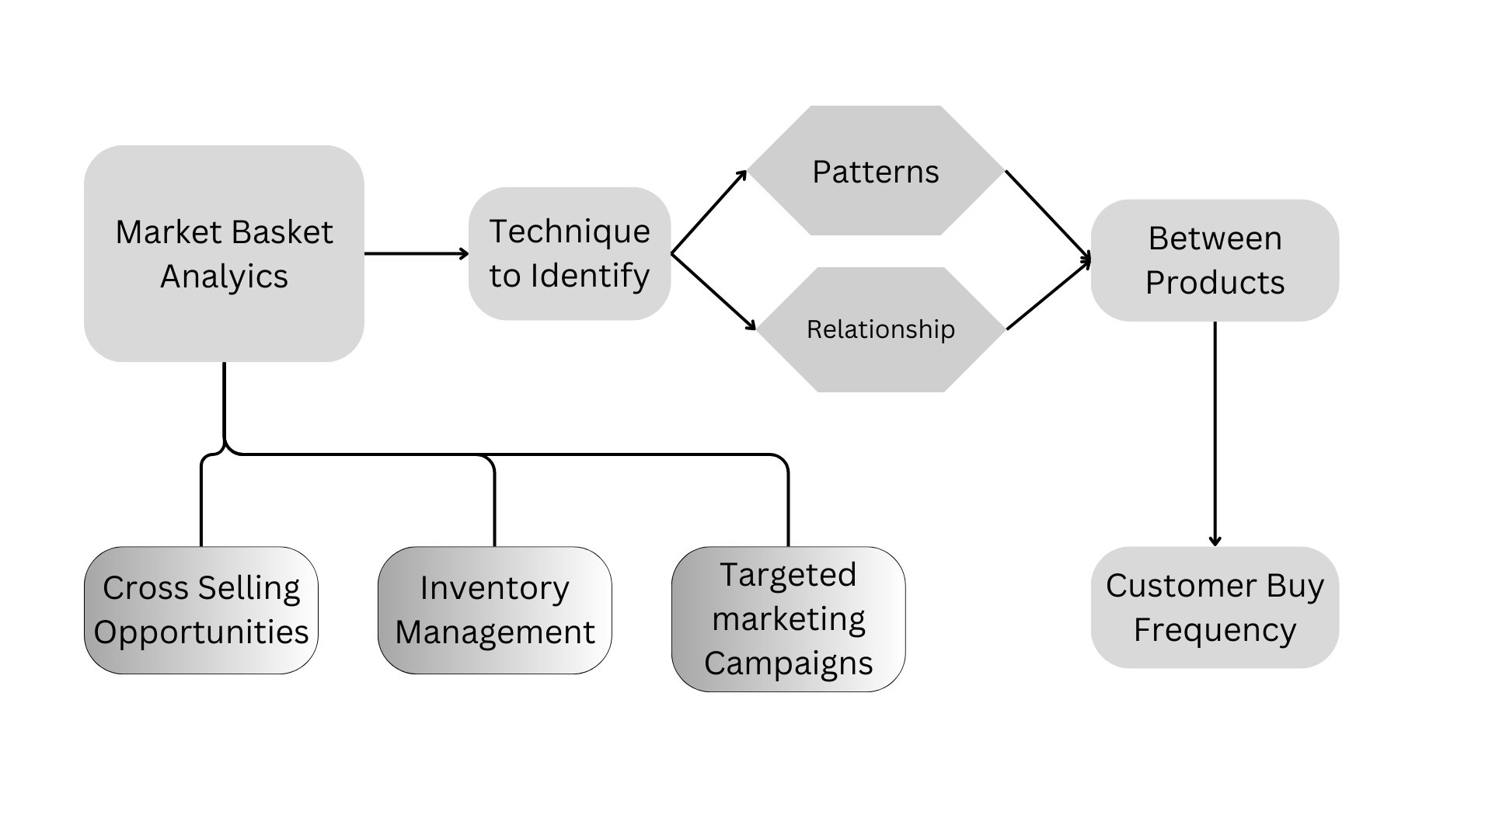
Flow Diagram

Slide 5
Use Cases
Retail Cross-Selling: Identify product combinations frequently purchased together, allowing retailers to create targeted promotions, bundles, or recommendations to increase sales.
Inventory Management: Improve stock replenishment strategies by understanding which products tend to run out together, optimizing inventory levels, and reducing carrying costs.
Upselling: Suggest complementary or higher-value products to customers during the checkout process, increasing the average transaction value.
Supply Chain Optimization: Optimize the supply chain by identifying dependencies between products and ensuring efficient production and distribution.
Grocery Store Layout: Improve store layouts by placing related products in close proximity to encourage additional purchases.
Restaurant Menu Optimization: In the restaurant industry, identify popular dish combinations to optimize menu offerings and pricing.

Slide 6
Conclusion
Market Basket Analysis (MBA) is a powerful data analysis technique with wide-ranging applications across industries. By uncovering hidden patterns and associations between products or items in transactional data, MBA empowers businesses to make data-driven decisions that can enhance customer satisfaction, increase revenue, and optimize operations.

