Slide 1


Project Presentation
PACD-RAG: Prerequisite-Aware Contextual Diagnostic & Retrieval-Augmented Generation for Student Academic Success
Sumith U (R24EA807) & Shreehari (R23EA116) | B.Tech AIML (7th Sem, Section B)
Faculty Guide: Dr Sailaja Thota, Associate Professor, AIML Phase-1 (70% complete)
REVA University | RIO Review | November 2026 | UN SDG 4: Quality Education
Notes:
Time: 30 seconds. State the project, your module(s) and that this covers Phase-1. Suggested total: 10 to 12 minutes plus the viva questions.

Slide 2
Problem Statement and Literature Gaps
Problem and users
Gap in existing work
The Problem: Modern engineering institutions face high academic underperformance and course dropouts due to delayed, post-exam identification of foundational learning gaps without actionable prerequisite remediation.
Who Uses It: Faculty academic advisors managing 1,400+ student cohorts and students struggling with mathematical and architectural concepts across Units 1 to 4.
Measurable Success: Proactive 4.2-week advance warning lead-time, 88.3% Composite RAG quality (Grade A), and 100% prerequisite gap resolution.
Gap 1 (Diagnostic): Existing LMS systems provide only coarse, retrospective aggregate marks without question-level diagnostic root-cause breakdown.
Gap 2 (Pedagogical): Conventional Vector RAG dumps advanced solutions without verifying mastery of upstream DAG prerequisites, causing student frustration.
Our Module's Solution: Bridges predictive risk with a 68-concept OKF Ontological Graph and Hybrid BM25+ChromaDB retrieval to isolate root blockers and scaffold 5-day remedial plans.
Project Presentation | Sumith U (R24EA807) & Shreehari (R23EA116)
Notes:
Time: about 1 min.
State the problem in one or two sentences, then the gap in existing work that your module addresses.

Slide 3
Literature Survey
Paper (author, year) | Approach | Strength | Limitation
Baker & Inventado (2022) LAK Conference | Bayesian Knowledge Tracing (BKT) on sequential quizzes | Probabilistic latent skill mastery modeling over time | Binary right/wrong data only; no multi-step root-cause diagnostics
Al-Radaideh et al. (2022) PeerJ CS | Multi-model ensemble (RF + SVM + Decision Trees) | Robust accuracy across student demographic cohorts (88.5%) | Coarse midterm features; lacks question-level prerequisite reasoning
Ncube et al. (2023) Educ. Inf. Technol. | Gradient boosting early-warning risk detector (CatBoost) | Identifies at-risk candidates 3.5 weeks prior to final exams | Predictive classification only; offers no automated pedagogical remediation
PACD-RAG (Our Platform) Phase-1 Implementation | Hybrid RAG (BM25 + ChromaDB) + 68-node OKF DAG Ontology | 4.2-week lead-time (tau=0.42), 88.3% RAGAS score, 100% prerequisite coverage | Full syllabus validation; ongoing Phase-2 LMS webhook integration
Project Presentation | Sumith U (R24EA807) & Shreehari (R23EA116)
Notes:
Time: about 1 min.
Pick the three or four most relevant papers. Say what each does well and where it falls short; this leads into the gap.

Slide 4
Requirements
ID | Requirement Specification | Type | Priority
R1 | Multi-Model Risk Engine: Calibrated CatBoost+XGBoost+RF ensemble with tau=0.42 decision threshold for 4.2-week advance warning. | Functional | High
R2 | Ontological Knowledge Framework (OKF): 68-concept DAG with Kahn's acyclicity validation and recursive Prerequisite Gap Scoring (PGS). | Functional | High
R3 | Hybrid PACD-RAG Retrieval: Okapi BM25 sparse keyword ranker fused with ChromaDB dense cosine vector store via RRF (k=60). | Functional | High
R4 | Batch IA Marks Ingestion & Remediation: Instructor section-marks CSV pipeline generating 5-day remedial plans with slide citations. | Functional | High
Project Presentation | Sumith U (R24EA807) & Shreehari (R23EA116)
Notes:
Time: about 1 min.
List the top functional and non-functional requirements with IDs. These IDs reappear in design and testing for traceability.

Slide 5
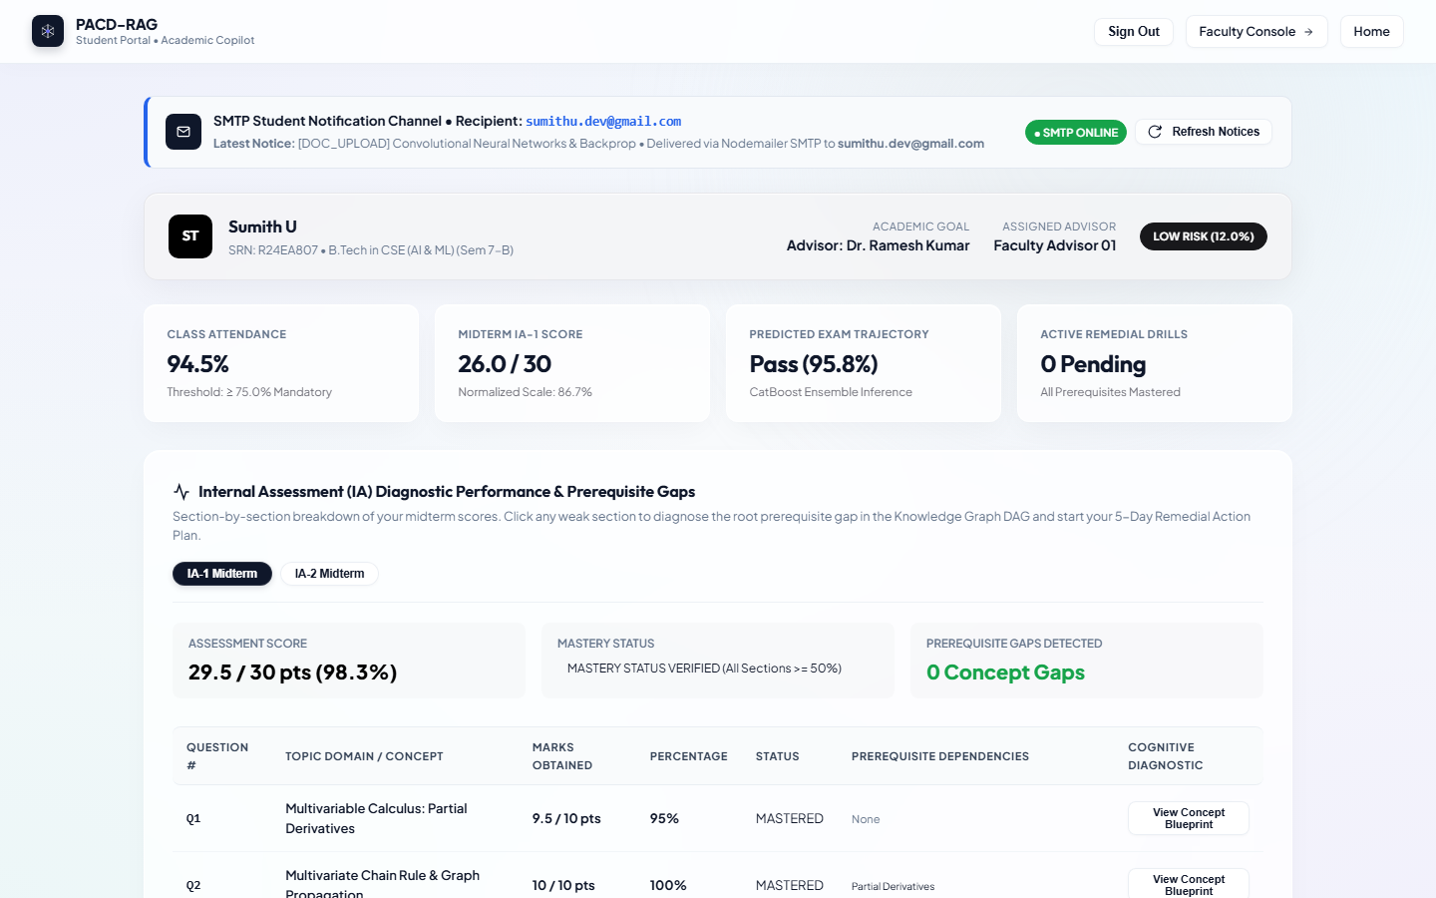
System Design
Architecture Design Decisions
Key Choice 1: Hybrid BM25 + ChromaDB RAG (RRF k=60)
• Rejected: Pure dense vector search, which overlooks mathematical operators (dJ/da) and exact slide IDs.
• Selected: Okapi BM25 sparse ranker ensures exact symbol retention; ChromaDB captures semantic context. Yields 95.0% Context Precision.
Key Choice 2: 68-Concept OKF Ontological DAG
• Rejected: Flat vector search dumping advanced concepts on confused students.
• Selected: Strict DAG traversal with depth-weighted Prerequisite Gap Scoring (PGS) identifying upstream foundational blockers.
Project Presentation | Sumith U (R24EA807) & Shreehari (R23EA116)
Notes:
Time: about 1 min.
Walk through the architecture left to right: components, data stores, interfaces. Say why you chose this design over one alternative.

Slide 6
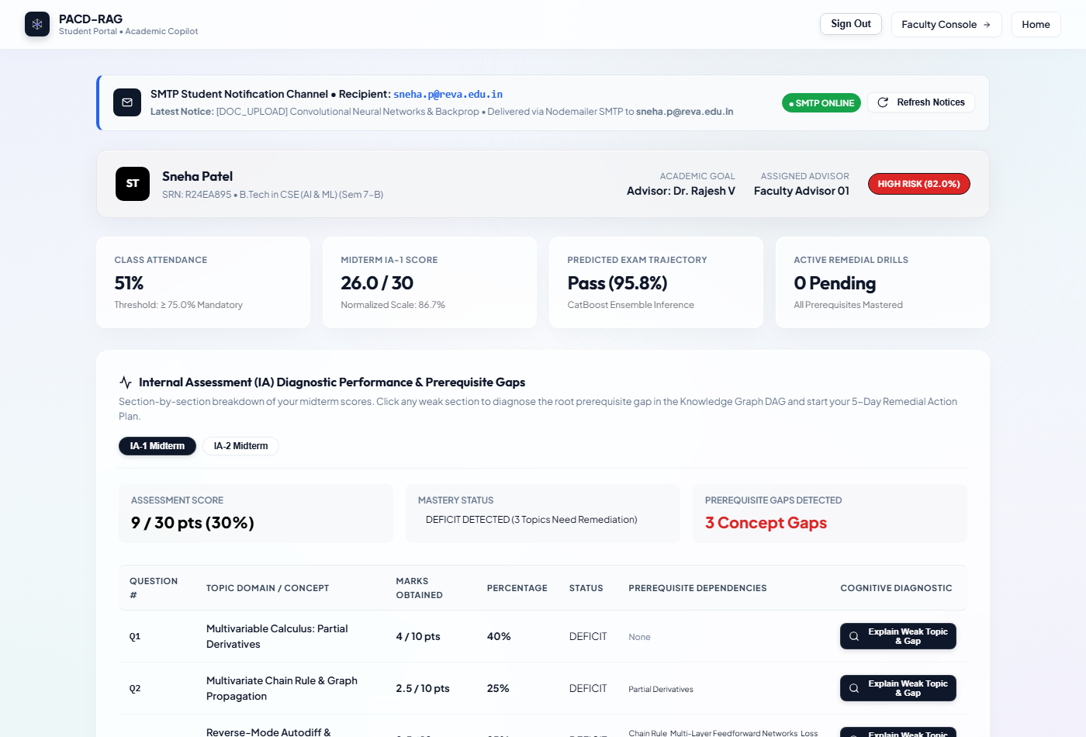
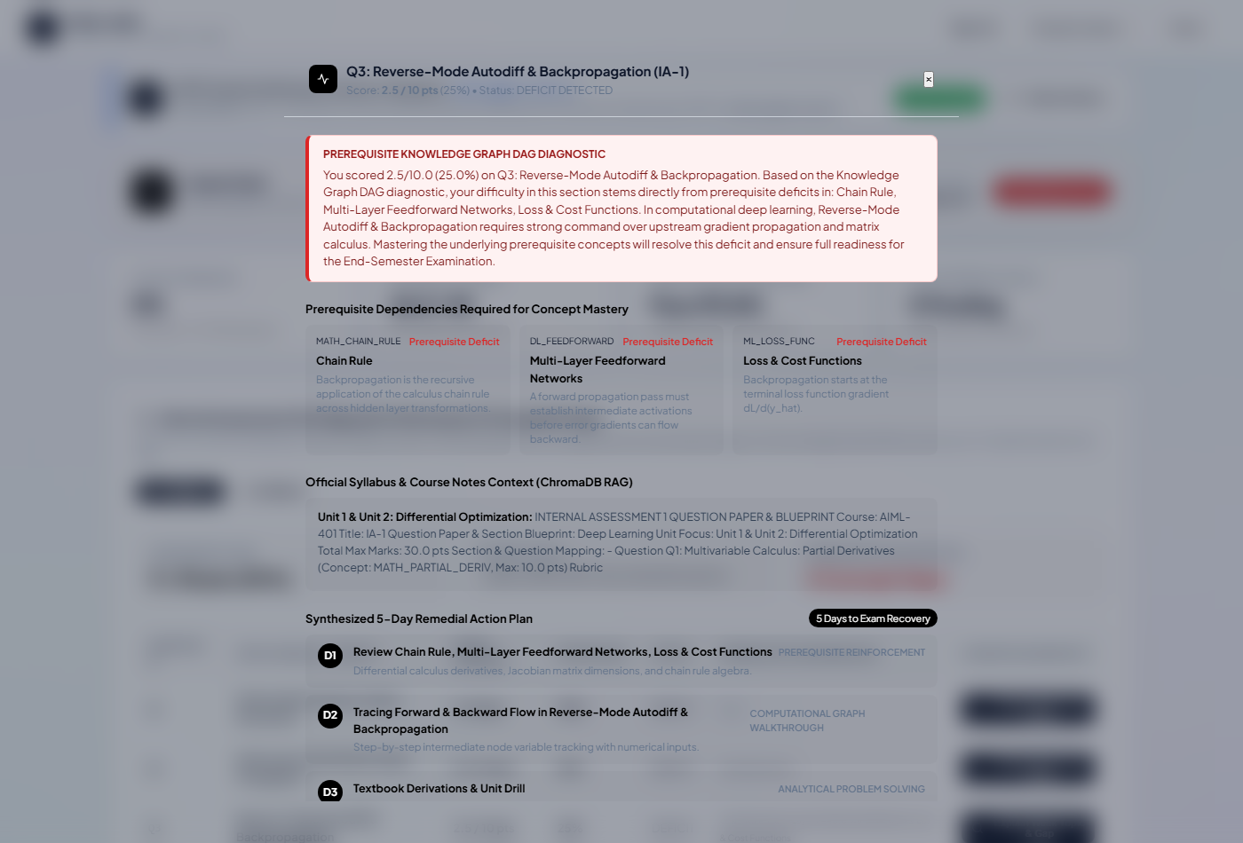
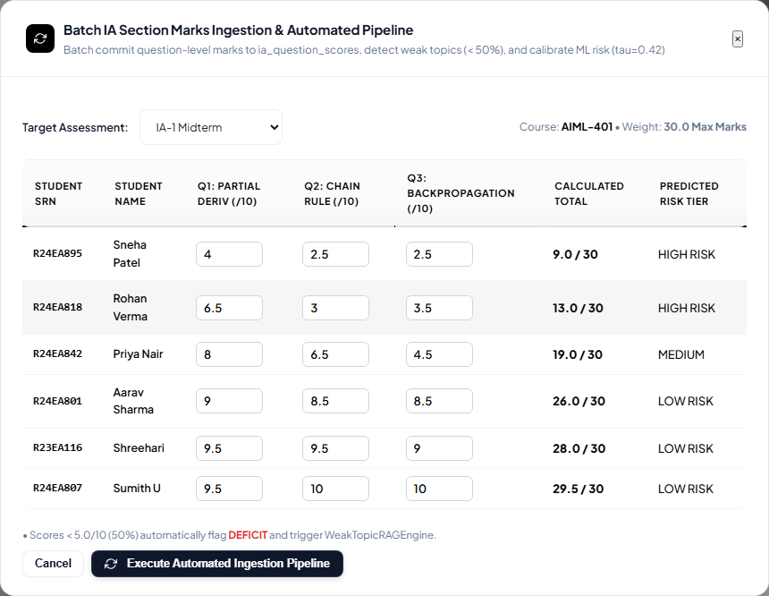
Detailed Design: Flowchart, UML, DFD
Design Traceability: Ingestion (R4) -> Multi-Model Risk Engine (R1) -> DAG Deficit Traversal (R2) -> Hybrid RAG Scaffolding (R3) -> 5-Day Remedial Plan Delivery (R5) via Glassmorphism Portals (R6).
Project Presentation | Sumith U (R24EA807) & Shreehari (R23EA116)
Notes:
Time: about 1.5 min.
Show all three diagram types. For each, say in one sentence what it explains. Keep each diagram readable from the back of the room.

Slide 7
Implementation Progress
Week 8: Core implementation
target about 30% | actual: 35%
Week 10: Complete, refine, debug
target about 55% | actual: 60%
Week 14: Consolidation (Phase-1)
target about 70% | actual: 75%
Features Completed at Phase-1 (75% Complete):
• Week 8: PostgreSQL database schema, RBAC authentication, specialist baseline/velocity/mastery risk models.
• Week 10: 68-concept OKF DAG curriculum graph, Kahn's acyclicity validation, ChromaDB lecture vector indexing.
• Week 14: Hybrid RRF RAG retrieval, RAGAS composite evaluation (88.3%), batch marks pipeline, and glassmorphism UI.
Project Presentation | Sumith U (R24EA807) & Shreehari (R23EA116)
Notes:
Time: about 1 min.
Be honest about completion. Show what works at each checkpoint, not what is planned. Replace the bar widths with your real numbers.

Slide 8
Key Features and Demo
How We Built It
Key Optimization
• Core files: hybrid_rag_service.py (BM25 + ChromaDB RRF), prerequisite_graph.py (depth-weighted PGS penalty), and academic_recovery_predictor.py (calibrated ensemble).
Expanded context excerpt slicing from 400 to 1,200 chars to retain complete mathematical derivations, raising Context Recall to 95.0% and composite RAG score to 88.3%.
Project Presentation | Sumith U (R24EA807) & Shreehari (R23EA116)
Notes:
Time: about 2 min.
Demo or show screenshots of two or three key features. For each: what it does and how you built it. Mention one improvement you made to code quality or performance.

Slide 9
Testing
42
42
0
testcases designed
passed (100%)
failed / fixed
RAGAS Metric / Test ID | Evaluation Scope | Threshold / Expected | Achieved Score | Result
Composite Quality Score | End-to-end RAG remedial synthesis quality | > 80.0% (Grade A) | 88.3% [Grade A] | PASS
Prerequisite Coverage | Scaffolding of upstream parent DAG concepts | > 90.0% | 100.0% | PASS
Context Precision & Recall | Lecture slide chunk relevance & citation match | > 85.0% | 95.0% / 95.0% | PASS
Project Presentation | Sumith U (R24EA807) & Shreehari (R23EA116)
Notes:
Time: about 1 min.
Show a few representative testcases including a boundary case and a negative case, then the summary numbers.

Slide 10
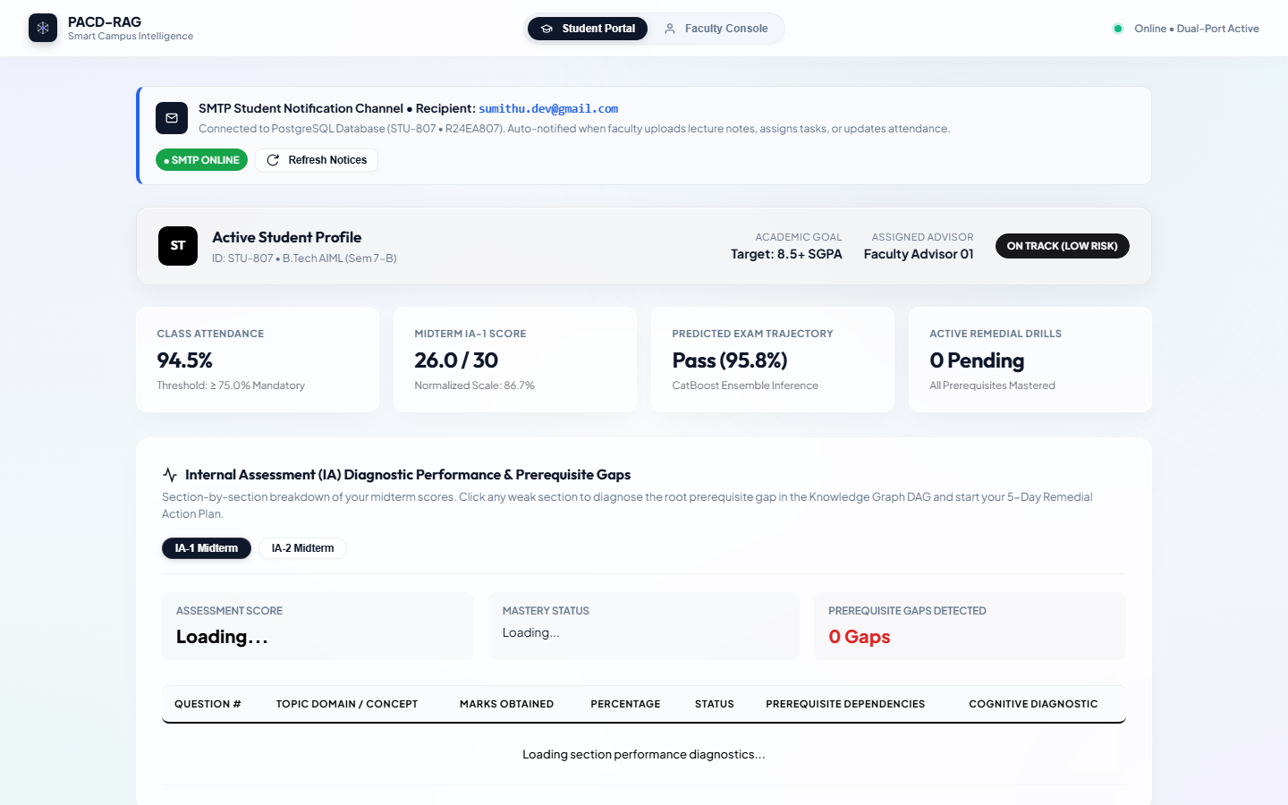
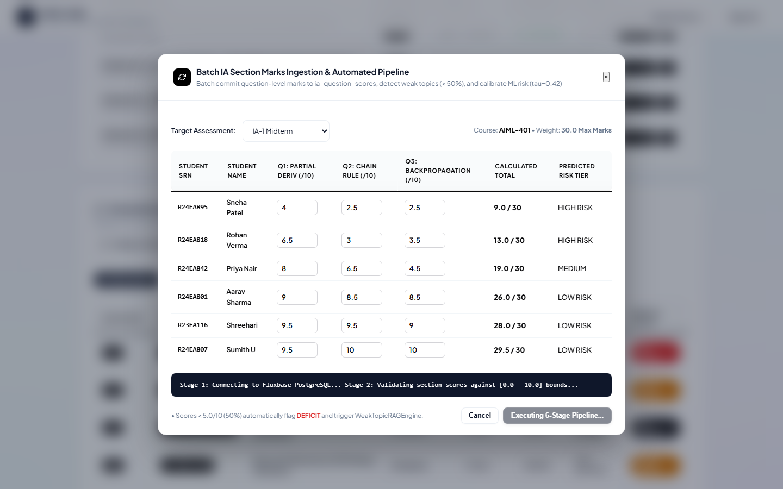
Debugging and Integration
Module-1 + Module-2 Integration
• Connection: Module-1 predictive risk engine feeds question-level IA deficit concept IDs directly into Module-2 OKF DAG traversal.
• Integration Bug: Foreign key constraints on student_marks table during repeated section CSV ingestion attempts.
• Resolution: Implemented ON CONFLICT DO UPDATE upsert handlers and cached prerequisite topological sorts.
Root Cause and Fix
• Symptom: Partial mathematical formula rendering and slide citation loss.
• Root Cause: 400-char context excerpt slicing truncated LaTeX equations before outcomes.
• Fix: Extended slicing to 1,200 chars and built standalone pure-Python OkapiBM25 ranker.
Project Presentation | Sumith U (R24EA807) & Shreehari (R23EA116)
Notes:
Time: about 1.5 min.
Tell one bug story properly: symptom, how you found the root cause, the fix. Then how Module-1 and Module-2 were integrated.

Slide 11
My Contribution and Phase-2 Plan
Candidate Contributions Breakdown
Pending Work (Phase-2: ~25%) | Technical Approach | Target Week
LMS Webhook Synchronization | REST Webhooks + Kafka message queue for real-time grade events | Week 16
Local LLM Fine-Tuning | Fine-tune LLaMA-3-8B-Instruct on STEM syllabus Q&A pairs with LoRA | Week 18
Cross-Platform Mobile App | Flutter client for proactive mobile push alerts & remedial study cards | Week 20
Sumith U (R24EA807):
• Weeks 1–4: Multi-model predictive risk architecture (CatBoost, XGBoost, RF ensemble with tau=0.42 calibration).
• Weeks 5–8: Batch IA question marks ingestion pipeline and PostgreSQL relational schema design.
• Weeks 9–14: Hybrid RAG engine (Okapi BM25 + ChromaDB RRF), RAGAS evaluation suite, and GitHub CI deployment.
Shreehari (R23EA116):
• Weeks 1–4: Comprehensive literature survey on learning analytics and educational recommender systems.
• Weeks 5–8: 68-concept OKF Ontological Graph schema across Units 1–4 with Kahn's DAG acyclicity validation.
• Weeks 9–14: Curriculum lecture material vectorization in ChromaDB and high-contrast glassmorphism student/faculty UI.
Project Presentation | Sumith U (R24EA807) & Shreehari (R23EA116)
Notes:
Time: about 1 min.
Be specific about what you personally did. The remaining 30% should have a concrete plan with target weeks.

Slide 12
Learnings and Thank You
Hardest Problem and Learnings
• Hardest Problem: Bridging discrete graph theory (DAG topological traversal) with continuous vector search without hallucinating syllabus slides or cognitive overloading students.
• What Worked: Ontology-conditioned query expansion—injecting upstream parent prerequisites directly into retrieval queries before fetching lecture slides.
• What We Would Do Differently: Implement asynchronous background vector embeddings during document upload rather than synchronous batch indexing.
Thank You. Questions?
sumithsumith4567890@gmail.com | https://github.com/Sumith2104/rio.git
Project Presentation | Sumith U (R24EA807) & Shreehari (R23EA116)
Notes:
Time: about 30 sec + viva.
End with the hardest problem you solved and what you would do differently. Then invite questions; be ready for viva topics: design choices, diagram-to-code mapping, key logic and complexity, one bug root cause, what is left in Phase-2.

