Slide 1
Bug Duplicates & Bug Hops
Using Machine Learning for Intelligent Defect Creation

Slide 2
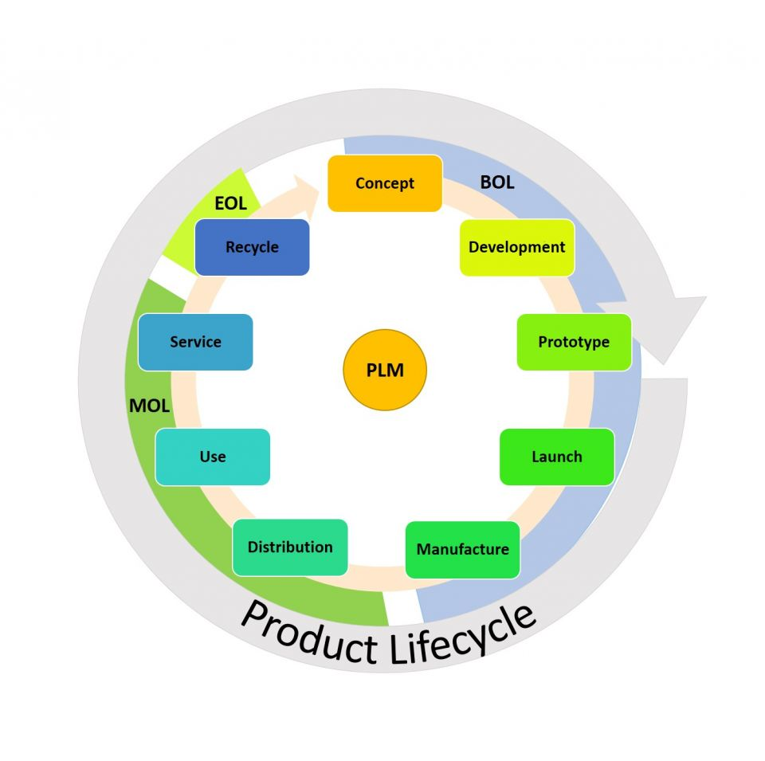
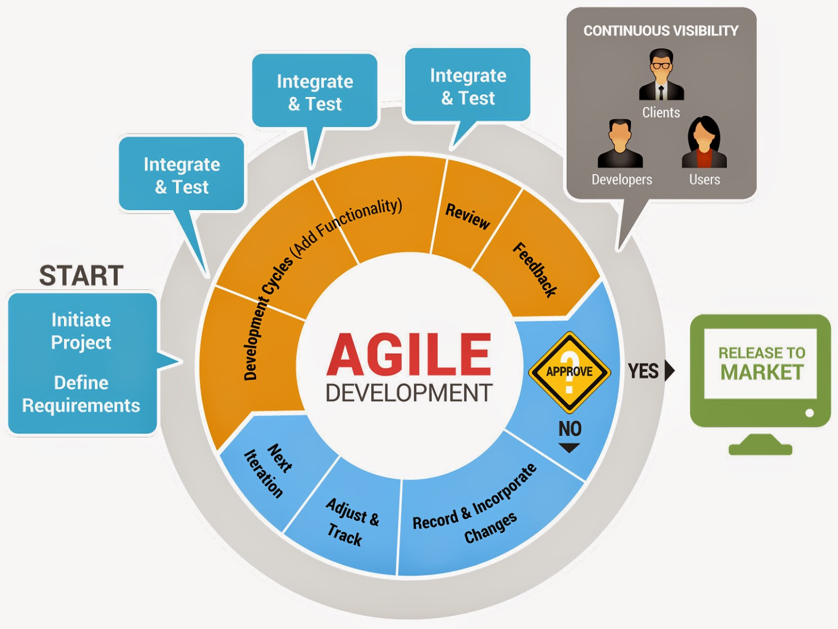
Product Life Cycle
Notes:
Any product development either waterfall or agile had various stages of development and personas. At each stage of the development the product undergoes testing and defects are reported at each stage by different people. We have amazing tools like bugZilla, JIRA etc that are used for quality issues and lot of quality metrics are derived from these tools to track the health of a product. But these systems inherently do not have intelligence to address quality of data that is being entered into them. Given the asynchronous testing that happens by different people lot of these tools suffer from duplicate defects reported and incomplete information captured.

Slide 3
Case Study
15% of the defects reported were duplicates
20-35% of defects hop between owners
Mean time to resolve a defect spikes from 10 to 250 days
On on average 2 hrs is spent on each defect

Slide 4
Problem at hand
Quality of Defect of Reporting Data
Duplication
Incompleteness
Ownership
Sufficiency

Slide 5
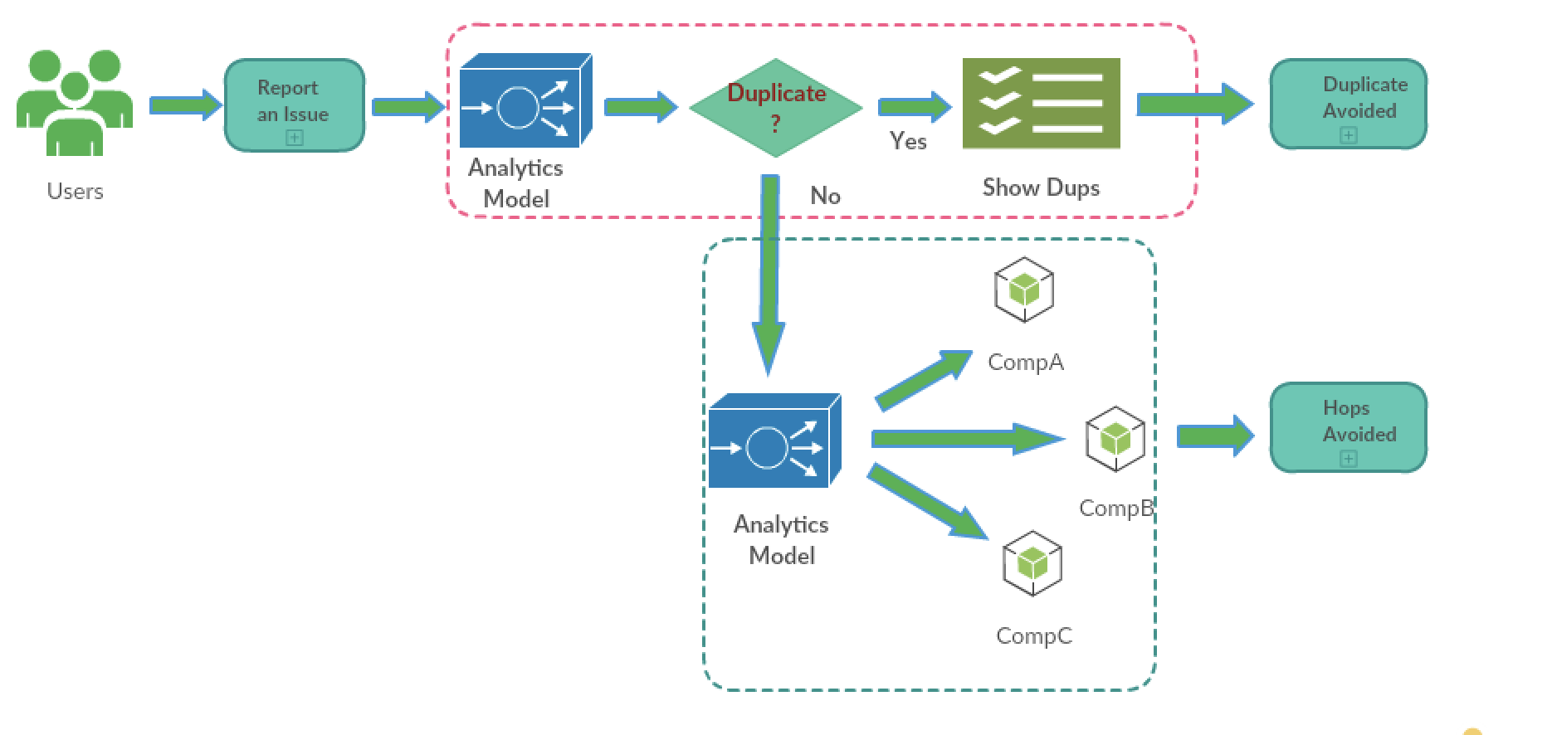
Defect Creation Process

Slide 6
Business Value
On an average 25% of the time is spent in Defect scrubbing, Defect analysis
30%(70k) of Cisco workforce are engineers
Assuming the annual cost of an engineer to be $US 200,000, this gives of a whopping estimate of (70k*0.3*200k*0.25) = US$ 1.05B as the annual cost of managing quality debt in Cisco.

Slide 7
Duplicate Bug Detection
Duplicate Bug Detection is the problem of identifying whether a newly reported bug is a duplicate of an existing bug in the system and retrieving the original or similar bugs from the past.
In typical software projects, the number of duplicate bugs reported may run into the order of thousands, making it expensive in terms of cost and time for manual intervention.
There are several methods proposed but those automated solutions are not accurate yet in practice.
We propose a method with accuracy close to 90%.

Slide 8
Data
Cisco Defect Tracking System captures the bugs along with it’s 170+ properties including textual descriptions, chat conversations and email attachments.
Dataset has categorical fields to
describe bug properties like
severity, status, version, product,
component, etc.
Bug id | 12345
Product | Router AS1000
Project | Asa
Component | LED
Severity | 2
Priority | 1
Category | Power
Version | 2.1
Status | Open
Short description | LED has stopped working
Long description | <Anything from Error log to Email conversations >
Duplicate bug id | 98765
Submitted on | 25th Feb, 2018

Slide 9
Training data preparation
For supervised model, we need to create a dataset that has Bug1 data and Bug2 data and duplicate indicator.
Status field in the defect tracking systems helps us identify existing duplicates in the dataset. (D - Duplicate)
Build a duplicate bugs list
Choose first bug from that list and it’s corresponding duplicate and create a row in the training dataset with duplicate indicator as 1
For the same first bug, choose a random bug that’s not duplicate and create a new row in the training dataset with duplicate indicator as 0
Continue this for all bugs in duplicate list
Bug_id1 | Bug_id2 | Description for b1 | Description for b1 | Duplicate label
12345 | 98765 | LED has stopped working | Light on LED is not switching on | 1
12345 | 65432 | LED has stopped working | Memory overload has led to reboot | 0

Slide 10
Feature processing
Data exploration has helped us identify patterns that bug duplicates exist only across same Products and Components.
So we used these as filters when trying to predict a duplicate for a bug.
Bug in the defect tracking system has 2 main components, short description, which is at most two sentences and long description which can be anything from error logs to email conversations
Basic preprocessing was performed on these descriptions like removing junk characters.
The sentences were passed through Stanford’s Named Entity Recognition (NER) to remove Person, Organization, Date, Location fields.
The words were then stemmed and lemmatized.
A dictionary was created for all the unique words occurring in the dataset. These words were then converted to embeddings using Word2Vec.

Slide 11
Algorithm
We process these descriptions separately using different neural network architectures, making the model learn pertinent features from them.
The word2Vec Embeddings are encoded using a Siamese LSTM network.
The purpose of encoding the bugs is to identify similar bugs.
The encoding should be learnt (trained) in such a way that it produces high similarity for similar bugs and low similarity for dissimilar bugs.
Max margin loss:
Max{0, M – Cosine(b, b+) + Cosine(b, b-)}
M is a hyper parameter, b is bug, b+ is duplicate, b- non duplicate

Slide 12
Algorithm (contd.)
The model is trained for minimizing the loss averaged across the samples, using back propagation algorithm and stochastic gradient descent.
When a new bug is created in the defect tracking system, its categorical fields, Product and Component are used to identify the subset of data that we should be looking for duplicates.
Bug is encoded using trained encoding model and then the similarity check using Siamese networked LSTM is computed among the subset.
Duplicate bugs are then reported based on the similarity score and top n basis.
Notes:
In simple terms, we can say that the model is trying to place the bugs in latent feature space so that the duplicate bugs will have high similarity score. The discriminative features which facilitate it are learned for the encodings automatically from the supervised training using max margin loss.

Slide 13
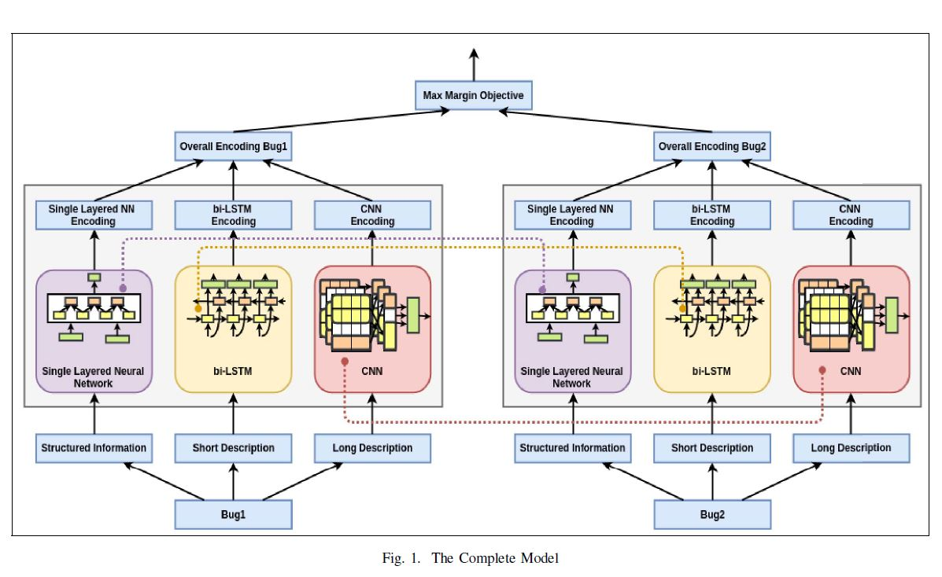

Slide 14
Evaluation
Model is evaluated across 11 projects distributed over 2 Million bugs.
We have considered ROC threshold mechanism to filter out the similar bugs.
Different thresholds were used for different projects.
We achieved an average prediction accuracy of 87% when tested against 2M bugs.

Slide 15
Q&A

