Slide 1

MBA Viva
Name:
Enrollment No:
Year of Admission:
Project Title:
Industry Mentor:
Date of Viva:
SR University, Warangal
School Name:
Specialization: (Marketing / HR / Finance / Operations / Business Analytics)
Company / Industry Name (if internship-based) :

Slide 2
Viva Panel Members
Supervisor:
Industry Mentor:
Department Internal Member:
External Member:

Slide 3
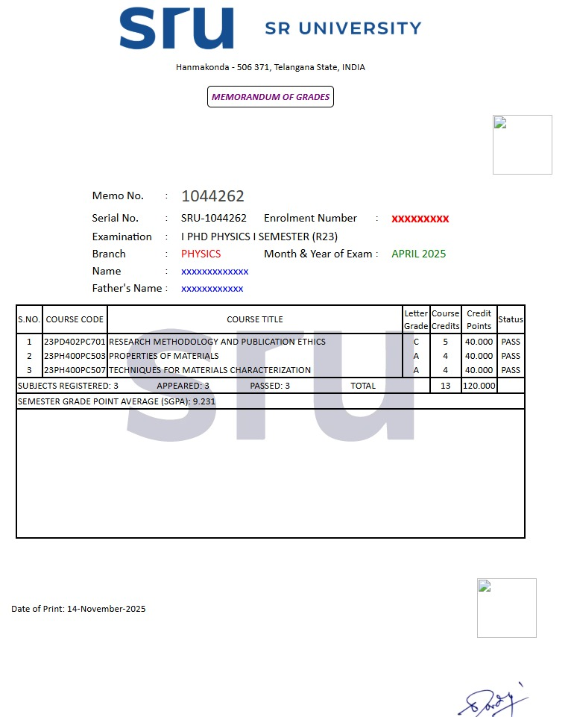
Marks Memo of Grades by Exam Section (Semester-1)

Slide 4
Marks Memo of Grades by Exam Section (Semester-2)

Slide 5
Marks Memo of Grades by Exam Section (Semester-3)

Slide 6
Internship Offer Letter
(Add the screenshot of Internship Offer Letter)

Slide 7
Receipt of Internship Payment
(Can include the screenshot of payment received proof like Check or bank statement or online transfer for one month)

Slide 8
Outcome/Impact of the Project

Slide 9
Chapter Wise Plan of the Project Report
Chapter 1 | Background/ Introduction of Project
Chapter 2 | Comparison with Similar Products/Projects/Services in the Market
Chapter 3 | Problem Statement, Problem Solutions & Proposed Methodology
Chapter 4 | Working Chapter Title based on the project/Research
Chapter 5 | Conclusion & Future Scope

Slide 10
Chapter-1: Background/ Introduction of Project
Explains the broader field or area in which your project is situated.
Helps the reader understand why the topic is important.
Applications to be focus for thesis
Use as many slides as required.

Slide 11
Chapter-2: Comparison with Similar Products/Projects/Services in the Market
Note: Reference can be publications or Website Links
Products/Projects/Services | Key Features | Ref #
Notes:
Note: Keep/remove

Slide 12
Chapter-3: Problem Statement
Discuss the problem statement identified through Literature Survey

Slide 13
Chapter-3: Problem Solutions & Proposed Methodology
Discuss the various solutions and proposed methodology

Slide 14
Chapter-4: Title
Key project works carried out during Internship
Project done (flow chart of project or calculation Schematic diagram/Algorithm/Method etc
Use As many slides as required

Slide 15
Chapter-5: Conclusion & Future Scope
Performance comparison with existing works & Future directions for further improvement

Slide 16
References
Minimum 80% references should be SCI/SSCI/AHCI Q1 (Not ESCI). Mention Quartile with every paper as per latest JCR List shared by Dean Research, SRU. (At least 20 Papers in Reference List). Follow the following style
Ghosh, A.,Yadav, S.N.S.,Tsai, M.-H., Dubey, A., Lin, C.-T., Gwo, S., Yen, T.-J. (2024): Superior visible photoelectric response with Au/Cu₂NiSnS₄ core-shell nanocrystal, ACS Applied Materials & Interfaces (SCI Q1), 16, 12033-12041.
Ghosh, D., Ghosh, A., Ali, M. Y., Bhattacharyya, S. (2018): Photoactive core-shell nanorods as bifunctional electrodes for boosting the performance of quantum dot sensitized solar cells and photoelectrochemical cells, Chemistry of Materials (SCI Q1), 30, 6071-6081.

Slide 17
References

Slide 18
THANK YOU.
Panel Members are requested to ask questions. I understand that this interaction may be recorded for the quality purpose.

