Slide 1

MBA Viva
Name:
Enrollment No:
Year of Admission:
Thesis/Project Title:
Supervisor:
Date of Viva:
SR University, Warangal
School Name:
Specialization: (Marketing / HR / Finance / Operations / Business Analytics)

Slide 2
Viva Panel Members
Supervisor:
Department Internal Member:
External Member:

Slide 3
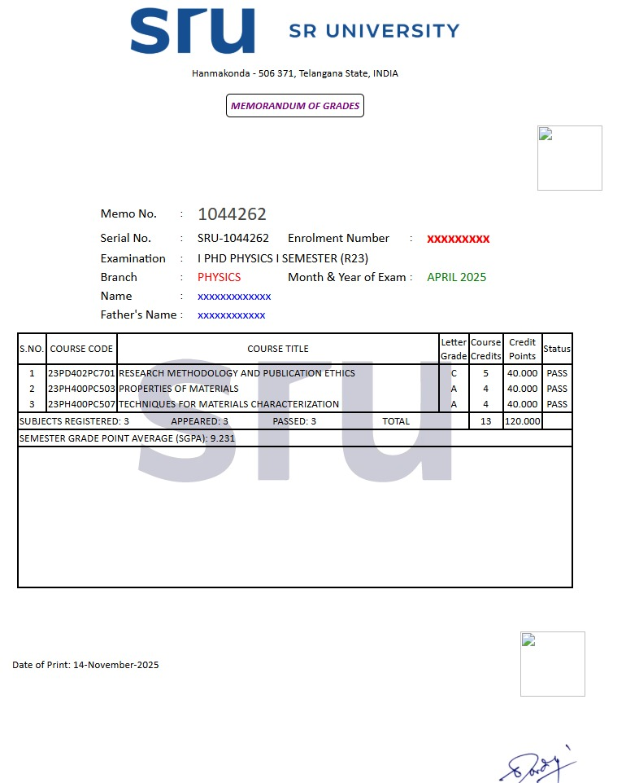
Marks Memo of Grades by Exam Section (Semester-1)

Slide 4
Marks Memo of Grades by Exam Section (Semester-2)

Slide 5
Marks Memo of Grades by Exam Section (Semester-3)

Slide 6
Objectives of the Study
Note: A Minimum of one objective and a maximum of three objectives can be entered
Objective 1
Objective 2

Slide 7
Chapter Wise Plan of the Thesis
Chapter 1 | Background/ Introduction of Study
Chapter 2 | Literature Review
Chapter 3 | Problem Statement, Problem Solutions & Proposed Methodology
Chapter 4 | Working Chapter Title based on the project/Research
Chapter 5 | Conclusion & Future Scope

Slide 8
Chapter-1: Background/ Introduction of Study
Explains the broader field or area in which your project is situated.
Helps the reader understand why the topic is important.
Applications to be focus for thesis
Use as many slides as required.

Slide 9
Chapter-2: Literature Review
Summarize the literature review by consolidating key findings, insights, and interpretations.
From the <682> research papers available in the Scopus database on <natural fibre composites in the automotive industry (2013–2025)> selected the <10> most relevant papers published in top journals for an in-depth analysis.
Article Details (Article Title, Journal Name, Lead Author, Volume No. Issue No. Page No, Year of Publication) | Key Findings | Ref #
Notes:
Note: Keep/remove

Slide 10
Chapter-2: Literature Review
Summarize the literature review by consolidating key findings, insights, and interpretations.
From the <682> research papers available in the Scopus database on <natural fibre composites in the automotive industry (2013–2025)> selected the <10> most relevant papers published in top journals for an in-depth analysis.
Article Details (Article Title, Journal Name, Lead Author, Volume No. Issue No. Page No, Year of Publication) | Key Findings | Ref #
Notes:
Note: Keep/remove

Slide 11
Chapter-3: Problem Statement
Discuss the problem statement identified through Literature Survey

Slide 12
Chapter-3: Problem Solutions & Proposed Methodology
Discuss the various solutions and proposed methodology

Slide 13
Chapter-4: Title
Work done (Data Analysis Key results and findings)
Study done (flow chart of study or calculation Schematic diagram/Algorithm/Method etc
Use As many slides as required

Slide 14
Chapter-5: Conclusion & Future Scope
Performance comparison with existing works & Future directions for further improvement

Slide 15
Workshops / Webinars/Conferences - Attended
Sl. | Name of the Event | Organisation/Venue | Dates
1
2
3
4
5

Slide 16
Journal Paper/Conf Paper/Book chapter/Patents
Sl. | Title of paper | Journal/Conference/Book name [for Indexed/published give doi] | Indexed/ Published/ Accepted/ In review | SCI/Scopus [Q1/Q2/Q3/Q4]
1
2
3
4

Slide 17
References
Minimum 80% references should be SCI/SSCI/AHCI Q1 (Not ESCI). Mention Quartile with every paper as per latest JCR List shared by Dean Research, SRU. (At least 20 Papers in Reference List). Follow the following style
Ghosh, A.,Yadav, S.N.S.,Tsai, M.-H., Dubey, A., Lin, C.-T., Gwo, S., Yen, T.-J. (2024): Superior visible photoelectric response with Au/Cu₂NiSnS₄ core-shell nanocrystal, ACS Applied Materials & Interfaces (SCI Q1), 16, 12033-12041.
Ghosh, D., Ghosh, A., Ali, M. Y., Bhattacharyya, S. (2018): Photoactive core-shell nanorods as bifunctional electrodes for boosting the performance of quantum dot sensitized solar cells and photoelectrochemical cells, Chemistry of Materials (SCI Q1), 30, 6071-6081.

Slide 18
References

Slide 19
References

Slide 20
THANK YOU.
Panel Members are requested to ask questions. I understand that this interaction may be recorded for the quality purpose.

