Slide 1
TEAM DENOVO · IBAB
THE DEMONSTRATION MODEL, END TO END
BIET
8,000,000
covered lives, Germany
↓
181,764
Budget Impact Estimation Tool
eligible patients, year 1
Five-year payer budget forecasts for early-stage drug programmes.
↓
€296.6M
net budget impact, 5 years
early-stage-bia.onrender.com
Notes:
15 seconds. Say the name and the one-line claim, then move. "We are Team Denovo from IBAB. BIET is a budget impact estimation tool: it takes a covered population and a new drug, and returns what reimbursing that drug does to a payer's budget over five years. This chain is the demonstration model you are about to see run live." Do not read the three figures out one by one. Point at the last one.

Slide 2
01 · THE PROBLEM
“What will this do to my budget?”
It is the first question a payer asks, and the one an early-stage team is least equipped to answer. Answering it once takes weeks of bespoke spreadsheet work. Answering it again takes another few weeks.
How it is answered today
Who carries the cost of that
Built from scratch in Excel, for every product and every market.
HEOR & market access
Defend every assumption to a payer with no audit trail to point at.
Formulas sit in cells no reviewer can trace, so the answer is accepted or rejected whole.
Payers & insurers
Receive a single number they cannot interrogate before committing budget.
Changing one assumption means rebuilding, so the alternatives never get tested.
Patients
Wait while the same analysis is rebuilt market by market.
Budget impact answers affordability: what it costs the budget. Cost-effectiveness asks a different question, whether the drug is good value. BIET answers the first, and says so.
BIET · Team Denovo · IBAB
02
Notes:
60 seconds. Open with the payer's question, not with the tool. "Before a price is agreed, an insurer wants one number: what does saying yes to this drug do to my budget over three to five years." Then the three failures on the left, quickly. The point is not that Excel is bad. The point is that the model is unauditable and too slow to explore. Close on the dark bar. Say it out loud: budget impact is affordability, not cost-effectiveness. A judge with an HEOR background will check that you know the difference in the first minute.

Slide 3
02 · THE SOLUTION
Six inputs in. A five-year payer forecast out.
One guided flow holds the whole model. Change any input and every figure moves with it, so the analysis is something you interrogate during the meeting rather than after it.
AFFORDABILITY
1
The engine runs in the browser
€0.13
No network call sits between an input and its result. A five-year model takes minutes to build and seconds to re-run, against weeks of spreadsheet work.
per covered member per month. The same fact as €296.6M over five years, in the unit a payer negotiates on.
2
Evidence sits beside the model
PubMed, ClinicalTrials.gov, openFDA, WHO GHO and the World Bank are searched inside the same tool, so an assumption and its source stay together.
WHAT DECIDES IT
Every figure traces back
New drug annual price
3
A methodology view follows the calculation from covered population to headline without anyone opening the code.
Ranked first of ten assumptions, each moved ±20%. Evidence spend goes where it changes the answer.
BIET · Team Denovo · IBAB
03
Notes:
60 seconds. This is the pivot from problem to product. Lead with the left card, and lead with the second figure not the first. "A budget impact analysis returns two things. First, what it costs: €296.6 million over five years, which is thirteen cents per covered member per month. Quote both, in that order, because the second is the unit the payer negotiates on." Then the lower half, which is the part that matters for an early-stage asset: "Second, it tells you which assumption the answer actually turns on. Here it is the new drug's annual price, ranked first of ten. That is where the next evidence spend goes." At this stage every input is an estimate, so knowing which estimate to go and firm up is worth more than the point figure. "BIET turns population data into a five-year payer forecast in a single sitting, with the scenarios, the sensitivity and the audit trail attached." Take the three points in order, one sentence each. Point 1 is the engineering decision that makes the demo work. Point 3 is the one that makes the answer defensible. Do not oversell. The claim is 10 minutes to a defensible early-stage estimate, not a validated HTA submission.

Slide 4
03 · LIVE DEMONSTRATION
Drug X, an early-stage GLP-1, in Germany
Type 2 diabetes. A statutory health insurer's view, over five years, 2026 to 2030.
1
2
3
4
5
6
Results
Therapy area
Population
Current care
Intervention
Uptake
Outcomes
7 views over one calculation
THREE THINGS TO WATCH
The funnel
One answer, two units
What would change it
8,000,000 covered lives narrow to 181,764 eligible patients. Every currency figure in the tool hangs off that number.
€296.6M over five years is €0.13 per member per month. The second is the one a payer negotiates on.
Ten assumptions moved ±20% and ranked by how far the answer swings. It says where to spend the evidence budget.
All figures in the demonstration scenario are illustrative. They are plausible for a walkthrough, not drawn from a validated published source.
BIET · Team Denovo · IBAB
04
Notes:
20 seconds on this slide, then switch to the browser. Budget about 4 minutes for the demo itself. BEFORE THE SESSION: open the app and click through it once. The free Render instance sleeps after 15 minutes idle and the first request takes roughly 50 seconds to wake it. Waking it during the demo costs you most of your slot. DEMO ROUTE, and say the value of each screen before you click it: 1. Load demo. "Drug X, a GLP-1, in Germany. Five years, insurer's view." It stays on tab one, it does not jump to the answer. 2. Population. "8 million lives down to 181,764 eligible. Prevalence and incidence are separate inputs, because the pool grows." 3. Uptake. "4% to 28%. This curve moves the answer more than price does." 4. Results. "€296.6 million over five years, which is 13 cents per member per month." Change one input live and let them watch every figure move. That is the whole pitch in one gesture. 5. Sensitivity. "And this is what would change that answer." If the live app fails, go to the backup slides at the end. Do not debug on the call.

Slide 5
03 · WHAT THE MODEL RETURNS
One answer, in the unit that decides it
€296.6M
€0.13
Net budget impact over five years, against current care
Per covered member per month in year 1, the negotiating unit
181,764
67,083
€2,527
eligible patients, year 1
patients treated at peak, year 5
cost per treated patient-year, on a €3,200 list price
€613
2,480
€148.3M – €444.9M
annual price at which net impact reaches zero
clinical events avoided, worth €17.96M
five-year impact at half and 1.5× uptake
Demonstration values. Plausible for a walkthrough but not drawn from a validated published source, and every PDF the tool exports says so.
BIET · Team Denovo · IBAB
05
Notes:
45 seconds, straight after the demo. This slide exists so the numbers survive the moment the browser closes. Lead with the pair. "€296.6 million sounds alarming. Thirteen cents per member per month is the same fact in the unit a payer actually negotiates on. Quote both, in that order." The break-even price is the figure that usually draws the follow-up question: €613 a year is the price at which this drug costs the insurer nothing net. It reframes the pricing conversation. Say the disclaimer line yourself rather than letting someone find it. Volunteering the limits of your own data buys credibility for everything else.

Slide 6
04 · TECH STACK
The calculation runs in the browser
One React app holds the entire engine. A thin Express service does only what a browser cannot: reach evidence APIs that block cross-origin calls, hold an LLM key it must not leak, and persist a run.
BROWSER · REACT 18 + VITE · NO NETWORK CALL IN THE CALCULATION PATH
6 input tabs
biaEngine.js
7 result views
PDF + Excel
one model object in React state
11 functions, all the arithmetic
rendered, never recalculated per tab
generated client-side
↓ HTTPS, same origin
RENDER WEB SERVICE · EXPRESS 4 · ONE ORIGIN, NO CALCULATION
Static host
Evidence API
LLM proxy
Run history
serves the built React bundle
/api/v1/evitrack
/api/chat, key stays server-side
/api/model/runs
Optional and external: PostgreSQL 16, 14 tables · PubMed, ClinicalTrials.gov, openFDA, WHO GHO, World Bank · Groq, Gemini
67 tests passing · four published analyses reproduced within 0.02% · one engine. A second copy on the server disagreed by 16% on identical inputs, so we deleted it.
BIET · Team Denovo · IBAB
06
Notes:
60 seconds. Lead with the decision, not the logo list. "The whole engine runs client-side. That was not the first design: the model started on the server behind an API call. We moved it because the free Render instance sleeps and takes about 50 seconds to wake, and because round-tripping every keystroke makes a sensitivity tool feel broken." The server still earns its place. Say what for: evidence APIs that block cross-origin requests, an LLM key that must not reach the browser, optional persistence. The bottom line is the one to land with an engineering judge. We had two copies of the engine, they had drifted to a 16% disagreement on identical inputs, and we deleted the server copy rather than keep an endpoint that quietly returned a different answer. If asked: EUR 296.6M in the browser against EUR 249.9M through the API.

Slide 7
05 · WHERE IT GOES NEXT
What we would build next, and why
Framed by what the tool does not do today. These are the four limitations we would remove first, in that order.
1
Probabilistic sensitivity
2
Multi-country roll-up
Today: a one-way tornado, ten parameters moved ±20% one at a time.
Today: one country per run, one currency, one set of prices.
Next: Monte Carlo over correlated parameters, so the headline carries a confidence interval instead of a point.
Next: several markets aggregated into a regional total, which is how global teams actually plan.
3
Subgroups with their own parameters
4
Learned uptake curves
Today: a subgroup narrows the population but inherits the parent's costs and outcomes.
Today: the uptake curve is typed in year by year.
Next: independent cost and outcome parameters, so subgroup economics stop being an approximation.
Next: curves fitted from comparable launches, because uptake moves the answer more than price does.
BIET · Team Denovo · IBAB
07
Notes:
45 seconds. Do not read all eight lines. Frame it once: "Every one of these is a limitation we can name in the tool today, which is why they are the roadmap rather than a wish list." Then take two, not four. Probabilistic sensitivity is the one an HEOR judge cares about, because a one-way tornado is the honest but limited version. Multi-country is the one a commercial judge cares about, because that is how global teams plan. Leave the other two on the slide for them to read.

Slide 8
06 · THE TEAM
Team Denovo
Institute of Bioinformatics and Applied Biotechnology.
AK
NA
NK
SR
VD
Atharva Kadam
Nakulan Anandhan
Nilesh Kamble
Sumithra Raju
Vineeth Devadiga
Model & calculation engine
Interface & experience
Evidence module
Backend & data
Validation & deployment
The funnel, cost build-up, projection and break-even search.
The six guided input tabs and the seven result views over them.
EviTrack: five external sources behind one search and one workspace.
Express API, the 14-table PostgreSQL schema and Excel import.
The test suite, the Render deployment and the PDF and Excel exports.
BIET · Team Denovo · IBAB
08
Notes:
30 seconds, and no longer. Names and one workstream each. Cards run alphabetically by first name, so nobody reads as ranked above anyone else. Two of the five are confirmed: Nilesh owns the evidence module, Sumithra owns the backend and the database. The other three titles were split across the remaining workstreams in the repository rather than from who actually did what, so check them. Each person should own the area they can answer questions about, because that is the only reason this slide is here. To drop in photographs: click a circle, Format Shape, Fill, Picture, then delete the initials text box sitting over it. If everyone is on camera, let each person say their own name and line. It is faster than one person reading five cards, and it puts a face against the workstream the judges may want to question.

Slide 9
Questions
TEAM DENOVO · IBAB
Live
early-stage-bia.onrender.com
Thank you.
Code
github.com/Sumithraju/early_stage_bia_react_node_postgres
Backup slides follow: the result as rendered, the sensitivity tornado, the audit trail, how it is tested, and what it does not do.
BIET · Team Denovo · IBAB
09
Notes:
5 minutes of Q&A. Hand to the person who owns the area rather than answering everything yourself. Likely questions and where the answer lives: • "Where do the numbers come from?" → backup slide 10 and 12, and say plainly that the demonstration values are illustrative. • "How do you know it is right?" → backup slide 13. 38 unit tests, and the negative cases matter more than the positive ones. • "What is it missing?" → backup slide 14. Answer it straight; the limitations are already written down. • "Is this an HTA model?" → No. Early-stage estimation, and it should be reviewed by HEOR before any decision relies on it. If you do not know an answer, say so and say who would find out. Do not invent a number in a room of people who model for a living.

Slide 10
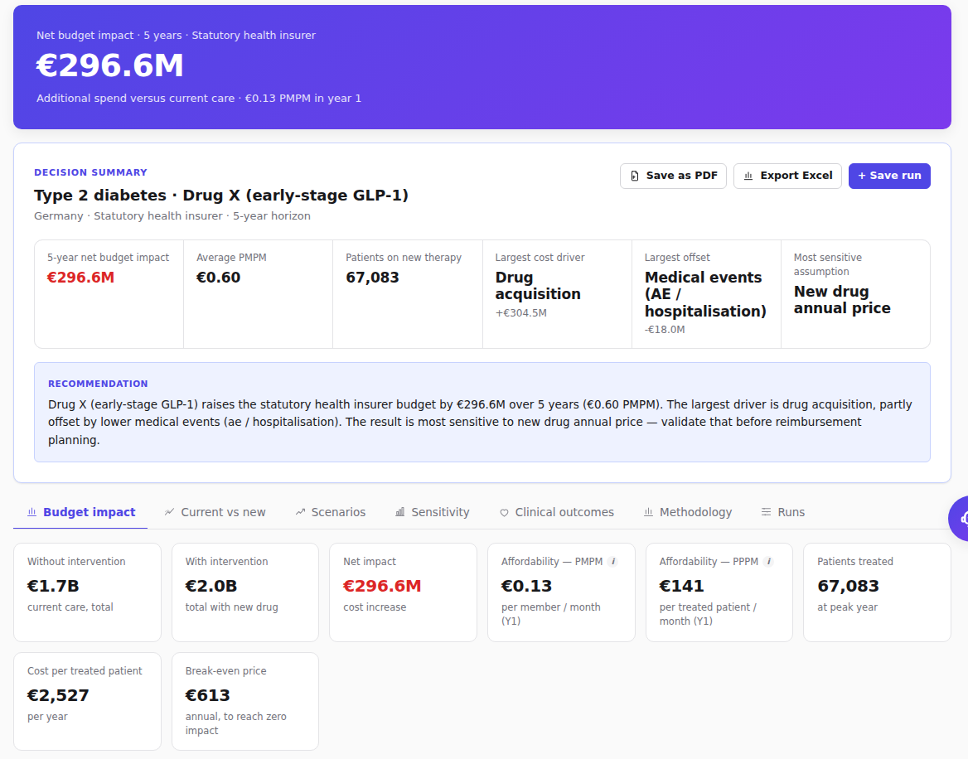
BACKUP · THE RESULT
Results, as the tool renders them
The headline
€296.6M over five years, with €0.13 PMPM stated beside it.
A decision summary
Largest cost driver, largest offset and the most sensitive assumption, above every tab.
Affordability, two ways
€0.13 per covered member per month; €141 per treated patient per month.
The negotiating figure
€613 is the annual price at which net impact reaches zero.
BIET · Team Denovo · IBAB
10
Notes:
Backup. Use this if the live app will not load, or if a judge asks to see the output again during Q&A. The recommendation paragraph under the summary is generated from the model's own results, not written by hand. It names the largest driver and the most sensitive assumption every time.

Slide 11
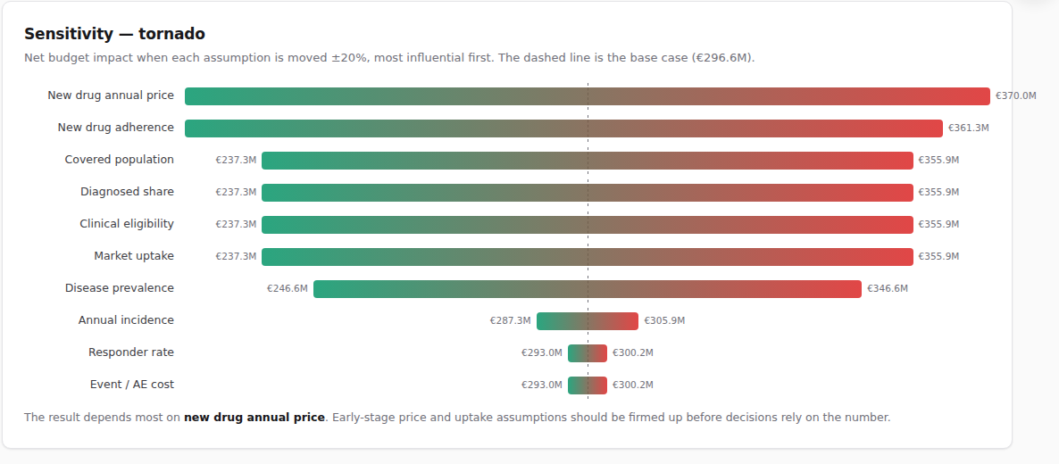
BACKUP · SENSITIVITY
What would change the answer
Each assumption moved ±20% on its own, sorted by how far the five-year answer swings. The dashed line is the base case.
How to read it
Ten parameters, one at a time, re-running the whole engine for each.
New drug annual price ranks first, so that is where the evidence budget goes.
Price and uptake dominate. Event costs barely move the answer.
It answers a reviewer's real question: what would change your mind?
One-way sensitivity only. There is no probabilistic analysis today, which is the first item on the roadmap.
BIET · Team Denovo · IBAB
11
Notes:
Backup. This is the slide that answers "how confident are you in that number". Be honest about the limit: a one-way tornado moves one parameter at a time and ignores correlation between them. That is exactly why probabilistic sensitivity is first on the roadmap.

Slide 12
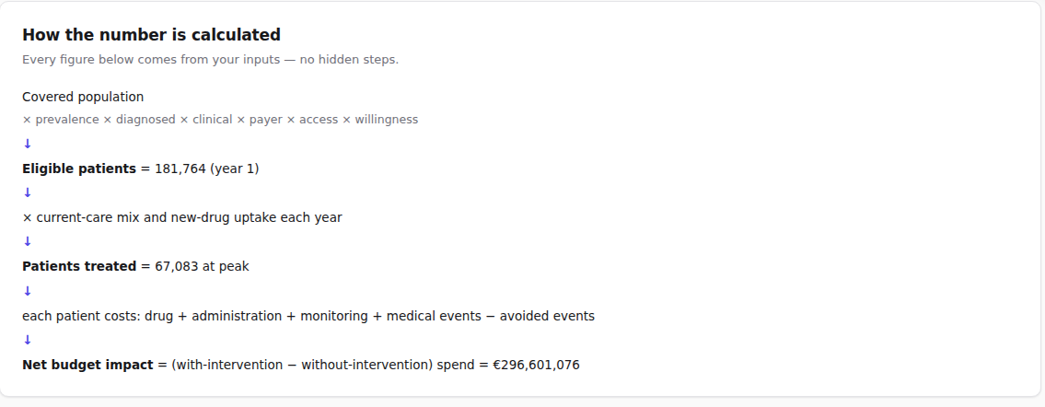
BACKUP · THE AUDIT TRAIL
Every figure traces back to an input
The methodology view inside the app, rendered from the same result object as the headline. No reviewer has to open the code.
Parameter provenance
The database records where each value came from, when it was retrieved, its bounds and whether a user overrode it.
Precedence, in order
User override, then scenario, then country-specific, then default assumption.
Reconciled, not approximated
Cost components sum exactly to the scenario totals. The split is the same arithmetic, not a second estimate.
Covered population → eligible patients → patients treated → cost per patient → net budget impact. Five steps, no hidden ones.
BIET · Team Denovo · IBAB
12
Notes:
Backup. This is the answer to "why should we believe this number". The point to make is that auditability was a design constraint, not a feature added afterwards. Economic arithmetic lives in one module. An earlier version had cost formulas duplicated across three components and they drifted, which is exactly the Excel failure the tool exists to fix.

Slide 13
BACKUP · VALIDATION
How we test a number nobody can eyeball
67 tests run against the engine and the importer, plus browser checks against the built bundle and endpoint probes against a running server.
The answer is arithmetically right
It fails loudly rather than quietly
Funnel
8,000,000 covered lives resolve to 181,764 eligible in year 1.
Shares ≠ 1.0
Throws and names the total, rather than modelling 90% of a market.
Components
Category costs sum to the scenario total exactly, not approximately.
No comparator
Throws. There is nothing to compare the intervention against.
Break-even
Net impact is zero at €613, found by binary search.
Negative rate
Clamped to zero. No NaN propagates into a currency figure.
Monotonic
€148.3M at half uptake, €296.6M at base, €444.9M at 1.5×.
Zero population
Net impact is zero, with no division by zero.
PMPM
€12,269,434 in year 1 over 8,000,000 lives over 12 is €0.13.
No database
The server boots, health reports it, and the tool still works.
Stated plainly: the browser checks are run per change rather than committed to CI, no test covers the PostgreSQL-backed paths end to end, and live third-party calls are stubbed.
BIET · Team Denovo · IBAB
13
Notes:
Backup, and the strongest slide in the deck if an engineering judge is in the room. The argument: for a budget impact model, a wrong answer that looks plausible is worse than an error. That is why the negative cases are the ones we care about. Market shares summing to 0.9 throws and names the total, rather than quietly modelling 90% of a market. Volunteer the coverage gaps on the bottom line. Naming them is worth more than implying coverage we do not have, and a judge who finds one you hid will discount everything else.

Slide 14
BACKUP · LITERATURE VALIDATION
Checked against four published analyses
Each case is a published paper rebuilt as a workbook and imported through the same path a user drives, not a model assembled inside the test. No published figure is written into the engine.
SOURCE
BENCHMARK
PUBLISHED
BIET
DEVIATION
ISPOR Europe 2025
Semaglutide, 5 years
₹3,447,884,379
₹3,447,884,379
0.00%
GLP-1 RAs in type 2 diabetes, India
JAMA Health Forum 2025
Medication budget, 5 years
$32.0B
$32.0B
0.00%
Medicare GLP-1 coverage, US
ISPOR 2026
Pharmacy budget, 1 year
$2,498,114,254
$2,497,728,240
-0.02%
Medicare GLP-1 pharmacy budget
PharmacoEconomics 2021
Incremental impact, 5 years
$4,620,201
$4,620,519
+0.01%
Oral semaglutide vs sitagliptin, US
Each workbook is imported onto a deliberately mismatched disease, so a value inherited from the previous model fails the test rather than passing quietly. The published figures come from each workbook's evidence sheet and have not been re-checked against the papers.
BIET · Team Denovo · IBAB
14
Notes:
Backup, and the one to reach for when someone asks whether the tool can be trusted outside its own demo. The claim is narrow and worth stating precisely: four published budget impact analyses, rebuilt as input workbooks, imported through the same code path a user drives, and reproduced to within two hundredths of a percent. Nothing is hard-coded; every figure is computed from the workbook's own inputs. The two exact matches are the strong ones. The ISPOR 2026 case is 0.015% low because our blended GLP-1 price sits a fraction under the poster's, and the PharmacoEconomics case is 0.007% high for the same kind of rounding reason. Say that rather than rounding both to zero. Volunteer the limit as well: these check the engine against each workbook's stated benchmark. They do not re-verify the papers themselves. If a judge wants to open the source and check, that is exactly the right thing to do and the workbook carries the DOI.

Slide 15
BACKUP · LIMITATIONS
What this is not
An early-stage estimation tool, not a validated HTA submission model. Clinical, payer, epidemiological and price assumptions should be reviewed by HEOR specialists before any decision relies on them.
Single country
Subgroups are partial
Proportional displacement
One market, one currency and one price set per run. Multi-country aggregation is not implemented.
Selecting a subgroup narrows the population but inherits the parent's cost and outcome parameters.
When the new drug takes share it is drawn evenly from comparators. Real displacement rarely is.
One-way sensitivity
Illustrative demo values
Free-tier hosting
No probabilistic analysis and no correlated parameter sampling.
The built-in scenario is plausible but not drawn from a validated published source.
The instance sleeps after 15 minutes and the free database expires after 30 days, which is why the tool runs without one.
BIET · Team Denovo · IBAB
15
Notes:
Backup. Reach for this the moment someone asks what is missing, and answer without hedging. Every one of these is already written down in the repository's architecture document under known limitations. Being able to name your own gaps in a Q&A is the difference between a demo and a project. Pair it with the roadmap slide: the first four limitations here are the first four things we would build.

