Slide 1
IBAB · TEAM DENOVO
early-stage-bia.onrender.com
BIET
Budget Impact Estimation Tool
Early-stage budget impact analysis for pharmaceutical decision support
THE PROBLEM
Early-stage drug teams cannot answer a payer's first question — what will this cost my budget? — without weeks of bespoke spreadsheet work.
HEADLINE OUTCOME
A five-year model in under 10 minutes instead of weeks, every figure traceable to the input behind it.
Notes:
BIET, from Team Denovo at IBAB. It answers the affordability question a payer asks before any reimbursement decision.

Slide 2
WHAT THIS DECK COVERS
Contents
01
The problem
What payers ask, and why it is slow to answer
3
02
Our innovation
What is original in the approach
4
03
The solution
One guided flow, six inputs, seven views
5–6
04
Technical build
Architecture, model, data, evaluation
7–8
05
Results & evidence
Live output, validation, EviTrack
9–11
06
Where it stands
Current work, scalability, roadmap
12–14
07
Why it matters
Benefits, adoption, takeaways
15
BIET · Team Denovo · IBAB
02

Slide 3
01 · THE PROBLEM
The question every payer asks first
Before a price is agreed, a health insurer wants one number: what does saying yes to this drug do to my budget over the next three to five years?
Who is affected
Why it is hard today
The model is built from scratch in Excel for every product and market
Formulas sit in cells no reviewer can trace, so the answer is trusted or rejected whole
Changing one assumption means rebuilding, so alternatives go untested
HEOR & market access
Must defend every assumption to a payer, with no audit trail to point at
Payers & insurers
Receive a number they cannot interrogate before committing budget
Patients
Access is delayed while the analysis is rebuilt for each market
A budget impact analysis answers affordability — what it costs the budget. That is a different question from cost-effectiveness, which asks whether it is good value. BIET does the first, deliberately.
BIET · Team Denovo · IBAB
03
Notes:
Frame the distinction early: BIA is affordability, CEA is efficiency. Judges from a health-economics background will check you know the difference.

Slide 4
02 · OUR INNOVATION
What is original here
Not a new economic method — a new way of working with one, so the analysis is fast enough to explore and transparent enough to defend.
01
02
03
Instant, not re-run
Evidence beside the model
Auditable by construction
The whole model recomputes in the browser as you type. Zero API calls in the calculation path, so sensitivity is something you feel rather than a job you queue.
EviTrack searches PubMed, ClinicalTrials.gov, openFDA, WHO GHO and the World Bank inside the same tool, so an assumption and its source live together.
Cost components reconcile exactly to scenario totals, and a Methodology view traces every headline figure back to the inputs that produced it.
Why this combination is new
Commercial BIA tools are enterprise licences priced out of early-stage work; academic models are spreadsheets with no interface. BIET puts a live model, its evidence and its audit trail in one browser tab that runs on free infrastructure.
BIET · Team Denovo · IBAB
04

Slide 5
03 · THE SOLUTION
One guided flow, population to decision
Six input tabs become a five-year payer forecast with scenarios, sensitivity and an audit trail — in a single sitting.
01
02
03
04
05
06
07
Therapy
area
Population
Current
care
Intervention
Uptake
Outcomes
Results
Validation runs between every edit and the result: a model that cannot produce a meaningful answer is blocked, with the reason and the field named.
Target users
Key scenario
Expected benefit
HEOR and market-access teams in pharma
Health-economics researchers and students
Anyone pricing a therapy before a formal dossier
Pricing a new GLP-1 for a German statutory insurer
8 million covered lives, five-year horizon
Compared against metformin, basal insulin, DPP-4
Time — weeks of model building down to minutes
Quality — validation blocks silent-zero errors
Outcomes — cost offsets modelled, not omitted
BIET · Team Denovo · IBAB
05

Slide 6
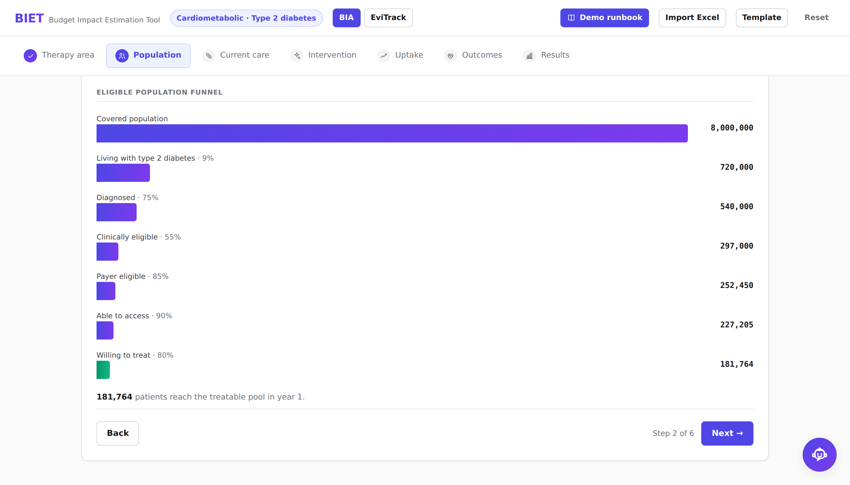
03 · THE SOLUTION
How the number is built
Every currency figure traces back to one funnel: a covered population narrowed step by step to the patients who are actually treated.
Worked example — year 1
Covered population
8,000,000
Living with type 2 diabetes
9%
720,000
Diagnosed
75%
540,000
Clinically eligible
55%
297,000
Payer eligible
85%
252,450
Able to access
90%
227,205
Willing to treat
80%
181,764
Population tab — each rate is an input; the funnel updates as you type.
A 44-fold reduction. Prevalence and incidence are separate inputs, because a prevalence-only model understates a growing disease.
BIET · Team Denovo · IBAB
06
Notes:
The funnel is the heart of a BIA and where most reviewer questions land. Eight million lives become 181,764 treatable patients.

Slide 7
04 · TECHNICAL BUILD
System architecture
BROWSER · REACT SPA — THE MODEL RUNS HERE, WITH NO NETWORK CALL
Input tabs
Calculation engine
Results
Exports
6 guided steps
biaEngine.js · 11 functions
7 views
PDF · Excel
sessionStorage
EviTrack UI
HTTPS · same origin
RENDER WEB SERVICE · EXPRESS — ONE ORIGIN, NO CALCULATION
Static host
REST API
Evidence API
LLM proxy
serves the built app
/api/model/runs
/api/v1/evitrack
/api/chat · /api/v1/llm
EXTERNAL · OPTIONAL STORE
PostgreSQL 16
Evidence sources
LLM providers
optional — run history
PubMed · trials · FDA · WHO
Groq · Gemini
Dashed = optional: with no database the app still runs.
BIET · Team Denovo · IBAB
07
Notes:
The decision that matters: the engine is client-side, so there is no request between changing an input and seeing a new number. That is what makes live sensitivity possible on free hosting.

Slide 8
04 · TECHNICAL BUILD
Model, data and how we check it
1
Algorithms & model
2
Data sources
3
Evaluation approach
Deterministic cohort projection over the horizon
Adherence- and persistence-weighted treatment cost
Relative-risk event offsets, damped by a regain rate
Binary search for the break-even drug price
One-way tornado: 10 parameters at ±20%
Undiscounted costs — ISPOR practice for BIA, not CEA
PubMed, ClinicalTrials.gov, openFDA — evidence
WHO GHO, World Bank — epidemiology and expenditure
Excel import for a team's own parameters
Every parameter overridable; provenance columns in schema
38 automated tests — 14 economics, 24 validation
Engine pinned to hand-calculable cases, not snapshots
Cost components reconcile exactly to scenario totals
Break-even re-solves to a net impact of zero
28 invalid inputs probed: 12 blocked, 10 flagged
ALIGNED WITH ISPOR BIA GOOD PRACTICE
Budget-holder perspective · 3–5 year horizon · current vs new treatment mix · undiscounted costs · total and PMPM reporting · scenario analysis
BIET · Team Denovo · IBAB
08

Slide 9
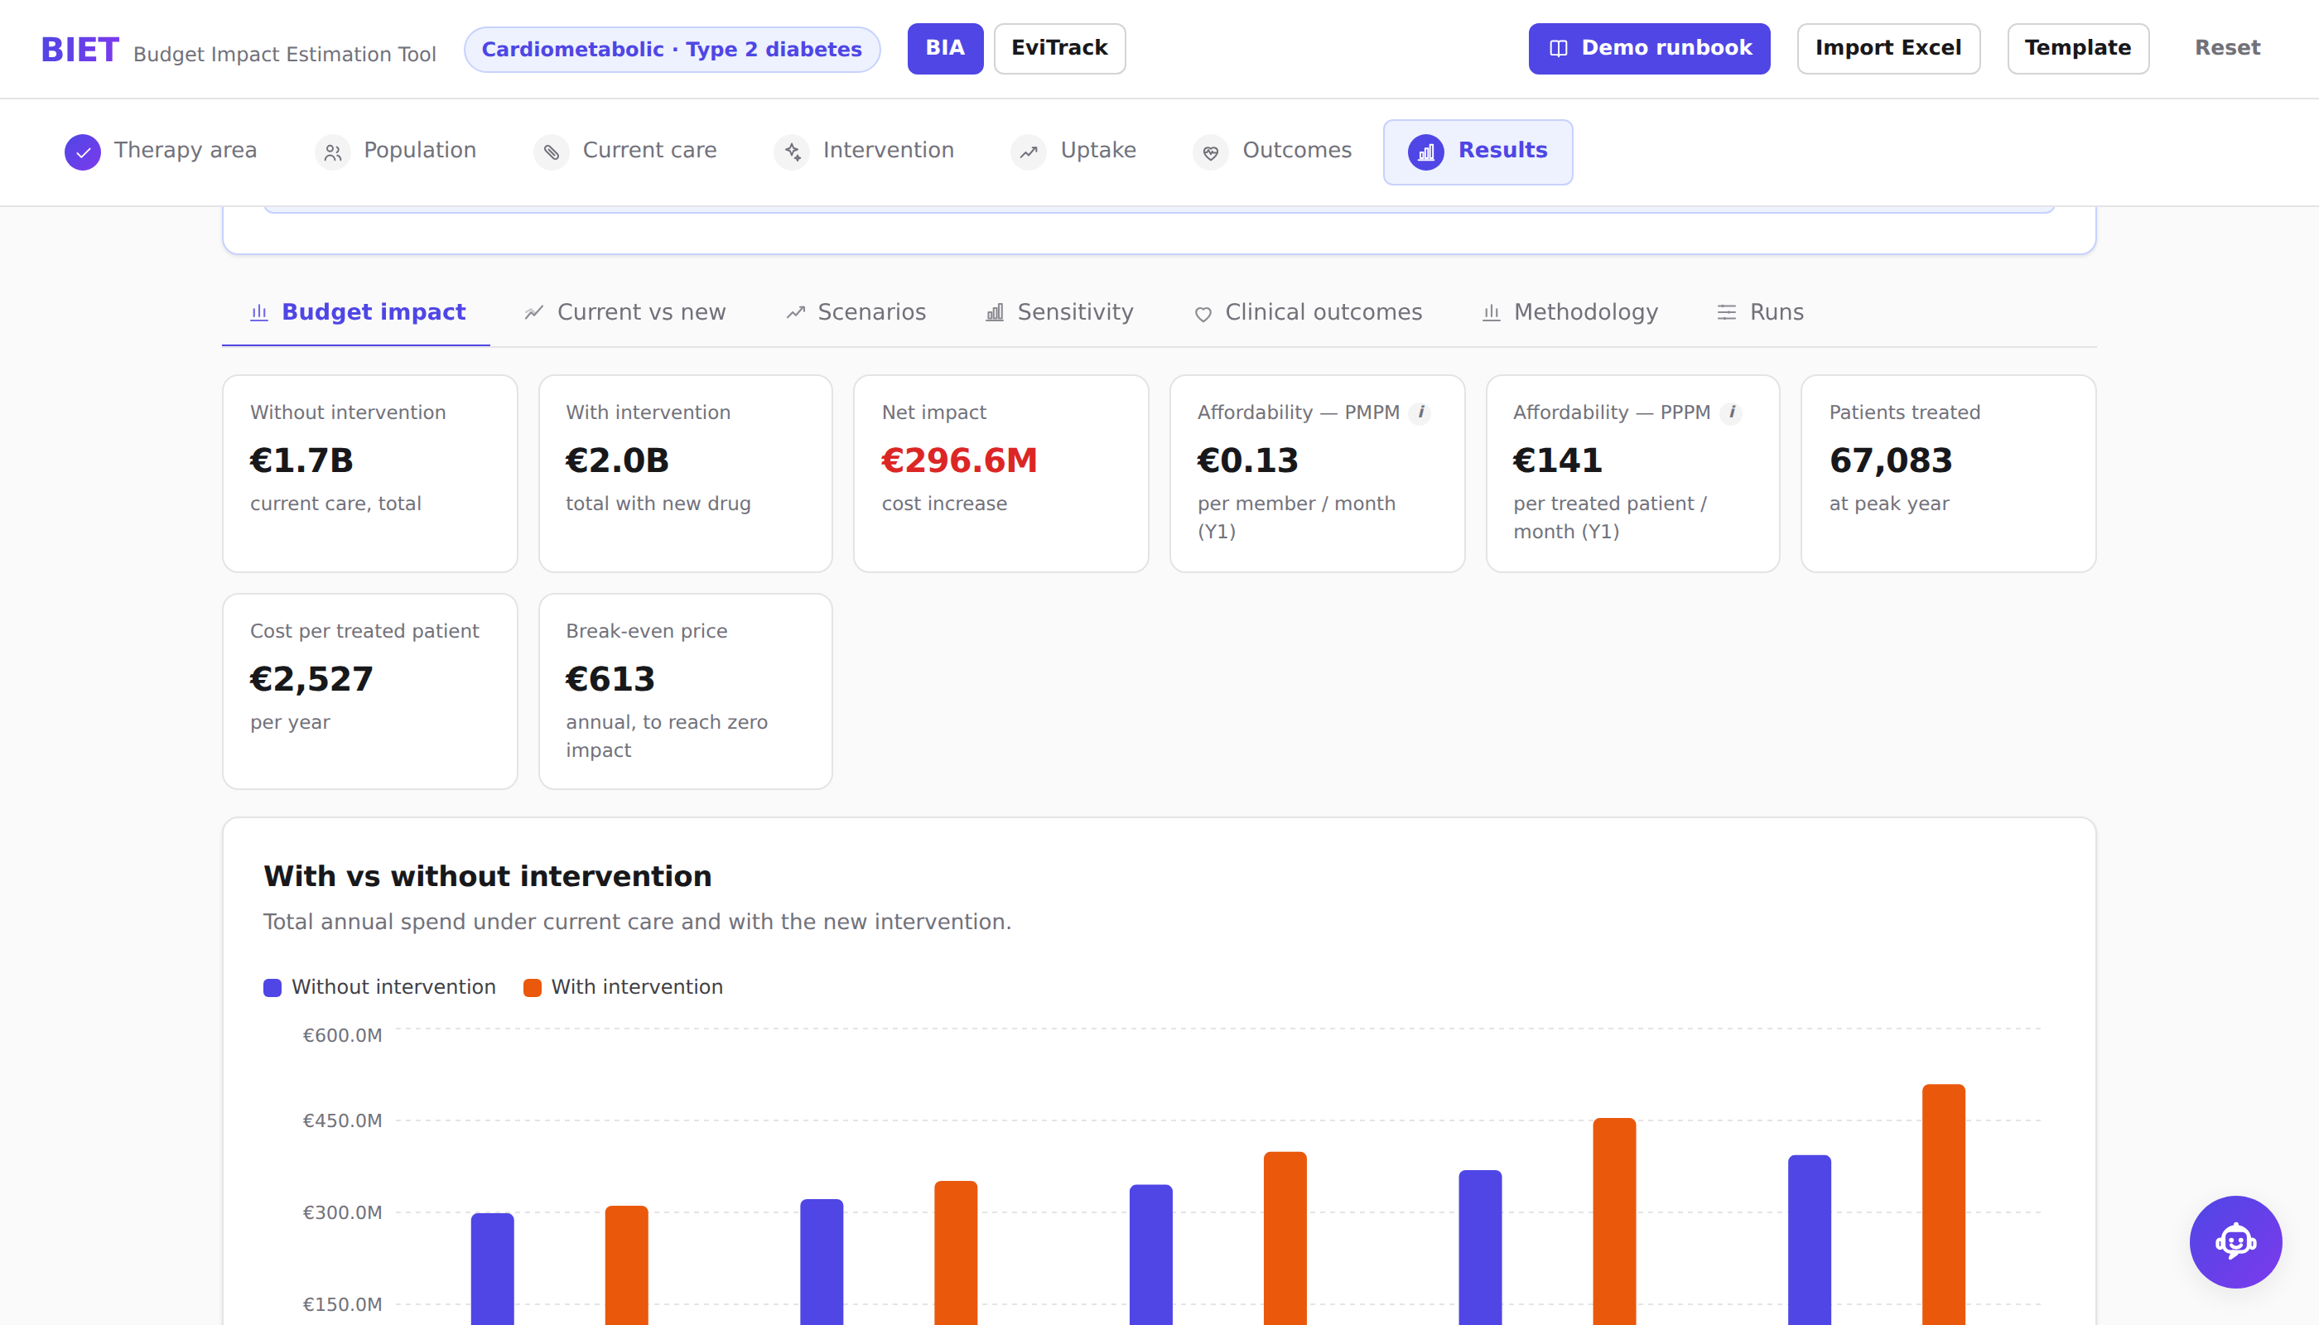
05 · RESULTS & EVIDENCE
What the tool returns
€296.6M
€0.13
net budget impact, 5 years
per member per month, year 1
67,083
€613
patients treated at peak
break-even annual price
One walkthrough
IN
8,000,000 lives · 9% prevalence · 4→28% uptake · €3,200 drug
OUT
181,764 eligible → 67,083 treated → €296.6M = €0.13 PMPM · 2,480 events avoided
Live output — Drug X, a GLP-1, in Germany. Demonstration values, not real product data.
BIET · Team Denovo · IBAB
09
Notes:
Say both numbers. €296.6 million sounds alarming; 13 cents per member per month is the same fact in the unit a payer actually negotiates on.

Slide 10
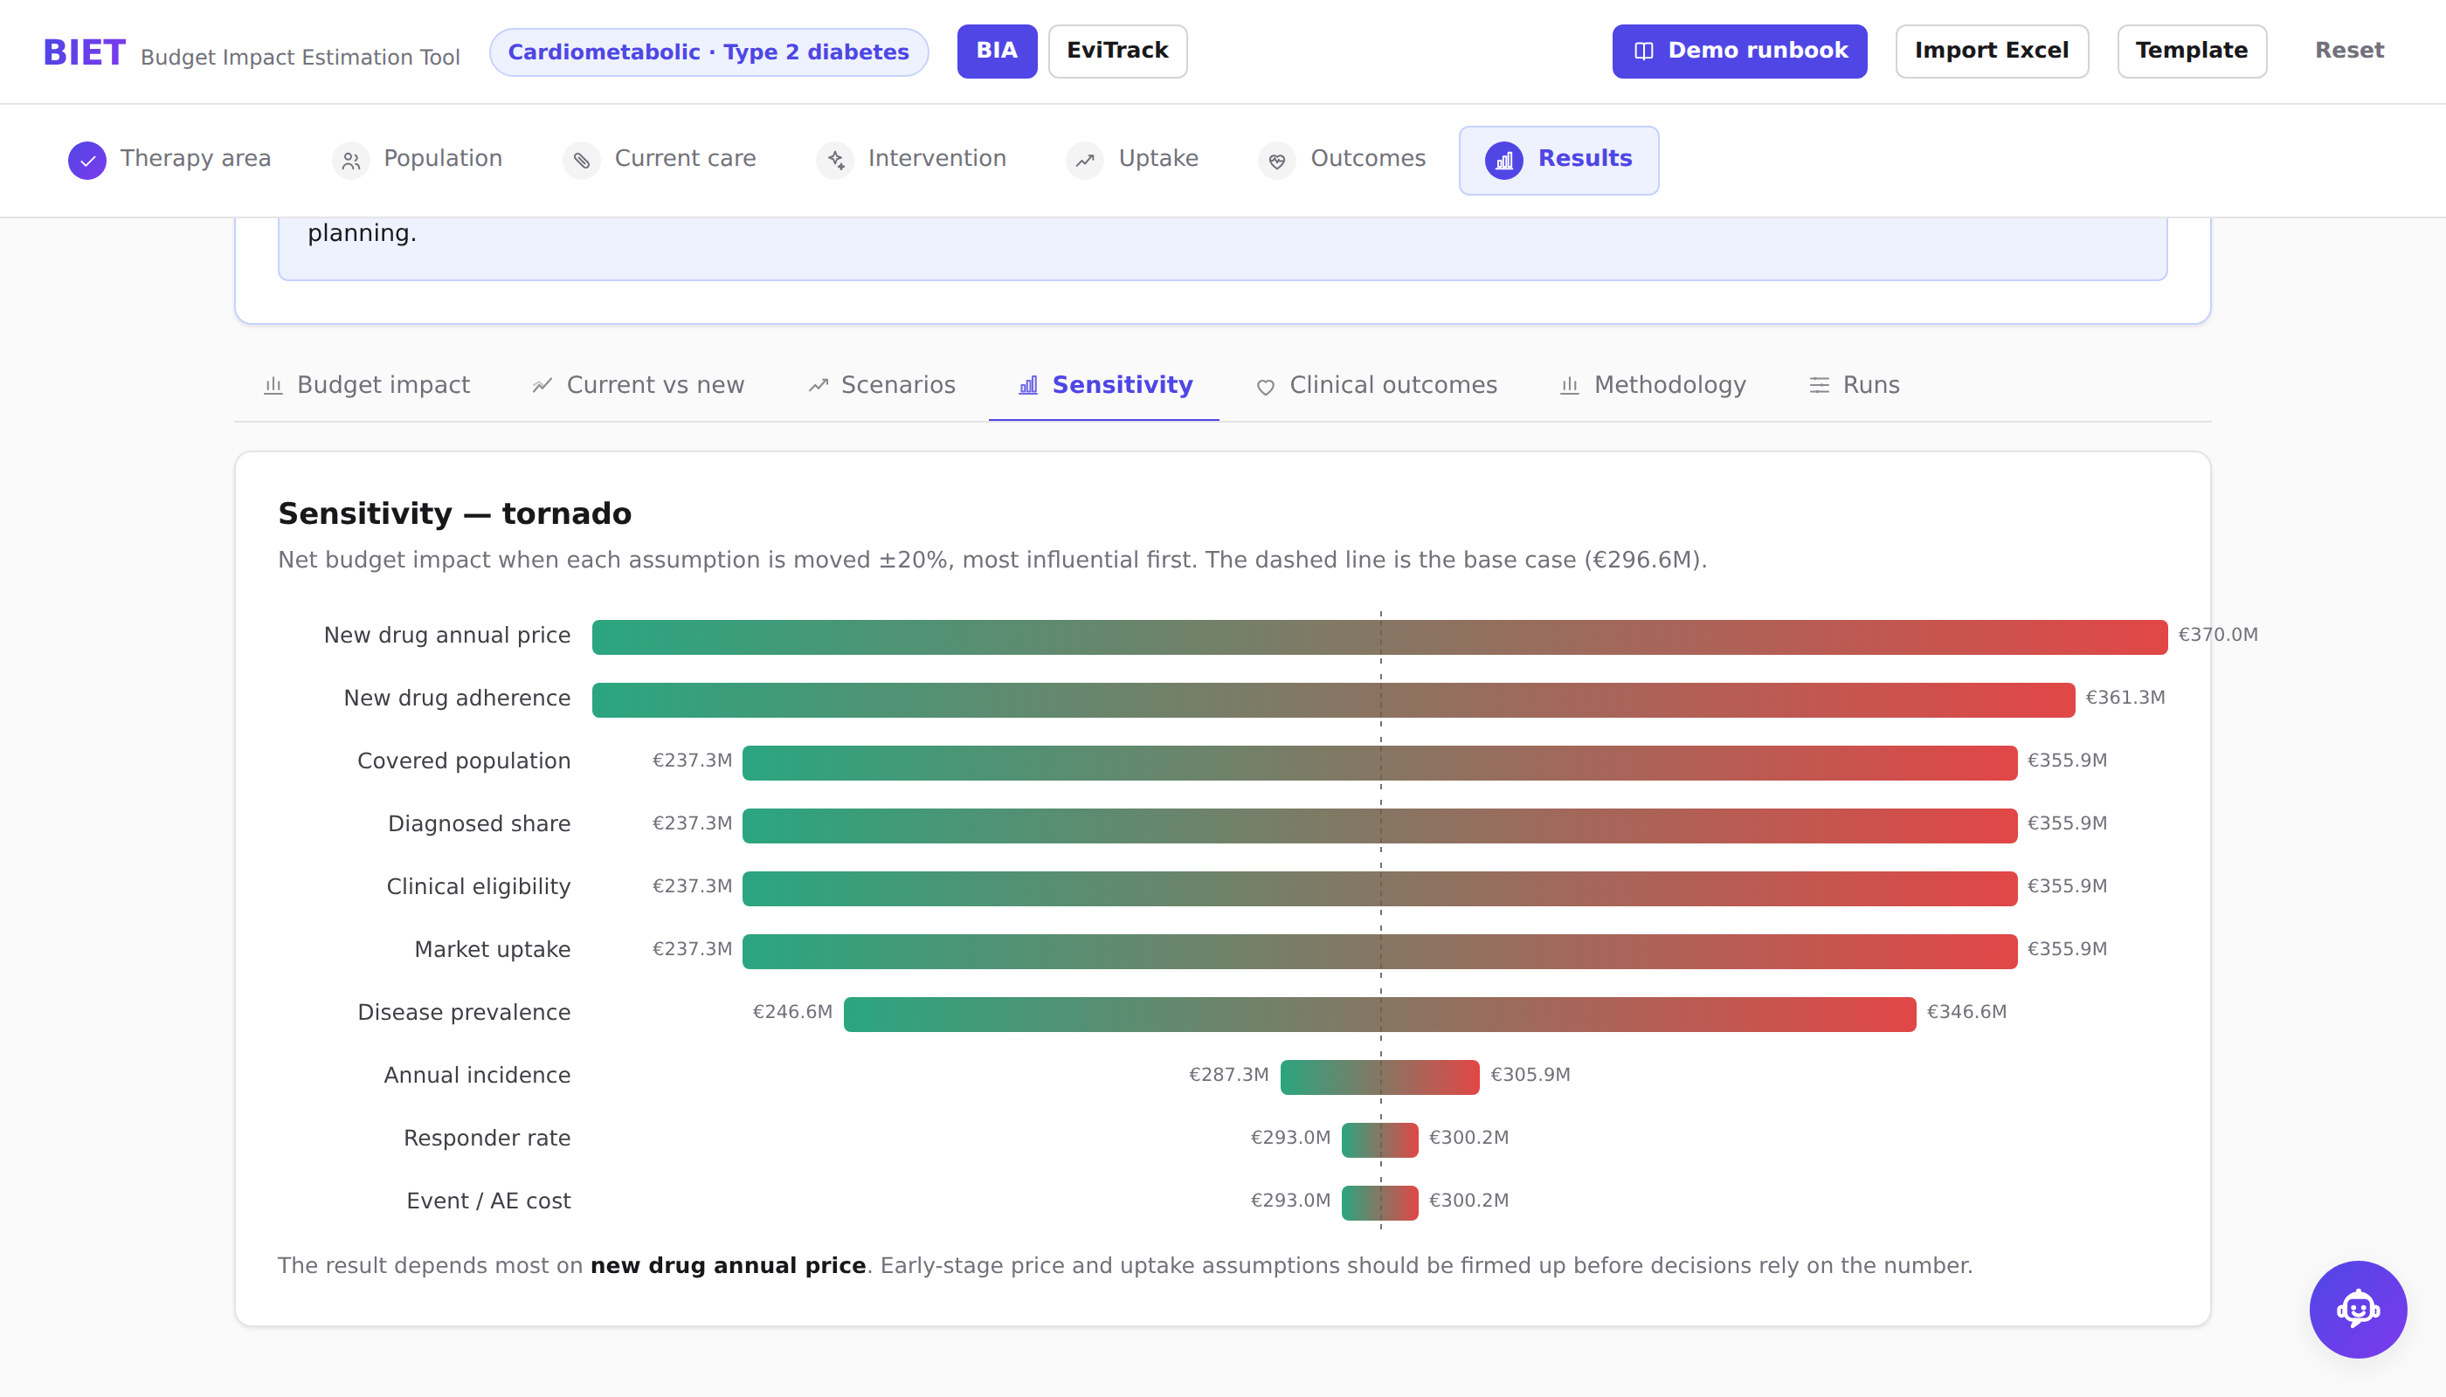
05 · RESULTS & EVIDENCE
Does it hold up when pushed?
A tool that returns a confident wrong number is worse than one that refuses. We check the arithmetic against a case anyone can verify by hand.
VALIDATION AGAINST A REFERENCE CASE
Covered lives
1,000,000
× prevalence 10%
100,000
× diagnosed 50%
50,000 eligible
× uptake 100%, 1 year
50,000 treated
× new drug ₹100/yr
₹5,000,000
Engine returns
₹5,000,000 ✓
Robustness to changing assumptions
28 invalid inputs probed — 12 blocked, 10 flagged, none produce NaN
Cost components reconcile exactly to scenario totals
Break-even price re-solves to a net impact of zero
Sensitivity — each parameter moved ±20% alone, sorted by how far the answer swings.
<100ms
38
0
recalculation
automated tests
network calls
BIET · Team Denovo · IBAB
10
Notes:
The reference case is the strongest thing on this slide: a reviewer can do the multiplication in their head and check our engine agrees.

Slide 11
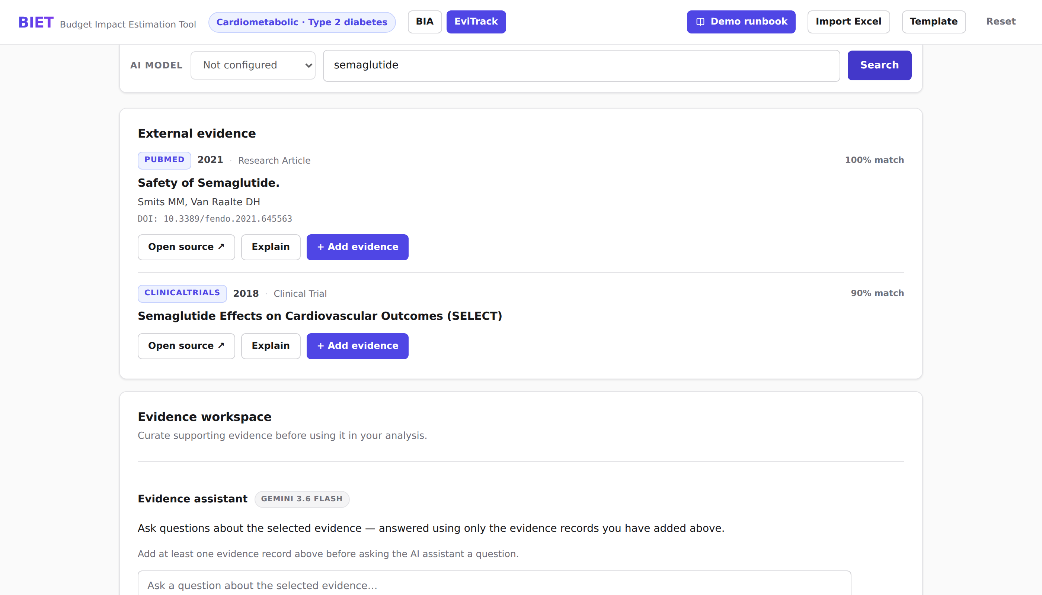
05 · RESULTS & EVIDENCE
Where the assumptions come from
The usual challenge to any model is “where did that number come from?” EviTrack is our answer, inside the same tool.
Five public sources
PubMed
Published literature
ClinicalTrials.gov
Trial registrations & results
openFDA
Label and adverse-event data
WHO GHO
Country epidemiology
World Bank
Population & health expenditure
AI summaries are constrained to the retrieved text and cannot alter any model input.
BIET · Team Denovo · IBAB
11

Slide 12
06 · WHERE IT STANDS
Current work — what is actually done
Stated honestly, so a reviewer does not have to find the edges themselves.
Working today
Built but not proven
Known limits & data gaps
3 diseases with subgroups (obesity, T2D, MASH)
Comparators added or removed as whole columns
7 result views incl. tornado and audit trail
PDF report and 6-sheet Excel export, in-browser
EviTrack search across 5 public sources
Run history — compare two models side by side
Deployed and publicly reachable on Render
Parameter provenance schema — 14 tables exist, UI not wired
Public-data sync — implemented, off by default on free hosting
AI assistant — works with a key, local answers without one
Single country per model — no multi-market roll-up yet
Subgroups inherit parent parameters rather than their own
Market share redistributes proportionally, not by displacement
One-way sensitivity only, no probabilistic run
Data gap: no validated country cost set — demo values are illustrative
Data gap: clinical parameters not yet expert-reviewed
BIET · Team Denovo · IBAB
12
Notes:
Naming the limits is deliberate. A reviewer who finds an unstated limit stops trusting everything else on the slide.

Slide 13
06 · WHERE IT STANDS
Scalability
Three directions, each with the property that already makes it possible.
Scales because it does not centralise
Computation
The model runs on the user's own machine, so a thousand analysts cost the same server capacity as one. The API is only touched for evidence search and persistence.
Scales by data, not by code
Disease & market
Adding a disease is one registry entry with its subgroups and defaults — no engine change. The same is true of a new comparator or outcome. Multi-country roll-up is the next structural step.
Scales because there is nothing to install
Organisation
It is a browser tab, holds no patient-level data, and degrades gracefully with no database and no API key — so a pilot needs no procurement or infrastructure review.
BIET · Team Denovo · IBAB
13

Slide 14
06 · WHERE IT STANDS
Future enhancement plan
M1
M2
M3
M4
2 weeks
4 weeks
6 weeks
8 weeks
Validate against a published model
Multi-country aggregation
Subgroup-level parameters
Probabilistic sensitivity
Reproduce a peer-reviewed BIA end to end and publish the variance. This is what turns a prototype into something defensible.
Run several markets in one model and roll them up to a regional total.
Independent costs and outcomes per subgroup instead of inherited ones.
Monte Carlo over correlated parameters, beyond the current one-way tornado.
Dependencies, risks and how we reduce them
Published parameters are paywalled or country-specific
Free hosting sleeps; free database expires at 30 days
Start from open sources; every parameter is overridable and carries its origin.
Already runs with no database at all — search and calculation degrade gracefully.
Clinical assumptions need expert review
Compliance if real patient data is ever involved
The Methodology view exposes every assumption for an HEOR reviewer to challenge.
Cohort-level by design; no patient-level data is stored anywhere.
BIET · Team Denovo · IBAB
14

Slide 15
07 · WHY IT MATTERS
Who benefits, and how soon
HEOR & market access
A defensible first-pass model in minutes, with sensitivity and an audit trail included rather than added later.
Immediately
Payers & insurers
A number they can interrogate — components reconcile, assumptions are visible, limits are stated.
At pilot
Patients
Faster affordability answers mean less delay between approval and access.
Downstream
Adoption pathway
Pilot inside one therapy-area team on a live pricing question · stakeholders are the HEOR lead, market access and medical affairs · integration effort is low because it is a browser tab with no patient data
€0.13 PMPM
Minutes, not weeks
Shows its working
the unit a payer decides on
live recalculation, zero API calls
reconciles exactly · 38 tests · limits stated
Notes:
Close on the three takeaways. Middle card is the differentiator; the third is what makes it credible.

