Slide 1
SCREENING GENDER: A CLOSER LOOK AT REPRESENTATION IN MOVIES
Sumit Hotchandani, Pratik Jadhav, Manpreet Kaur, Poulami Das Ghosh

Slide 2
OBJECTIVE
Primary Goal: Building a classification model that predicts the gender of a movie character based on their dialogues.
Secondary Goal: Exploring correlation between female-centric films and their IMDB rating
Stretch Goal: Examining gender bias in socio-economic status, equal opportunities, and harassment among movie characters.

Slide 3
MOTIVATION
Understanding Bias: Analysis of movie dialogues can reveal gender bias in the film industry.
Promoting Equality: Findings can initiate discussions and actions for gender equality in films.
Influence on Society: Fair representation in movies can contribute to societal perceptions and attitudes.

Slide 4
Data Overview
Cornell Movie Dialog Corpus:
Movie Characters Metadata: contains information about each movie character
Movie Conversations: the structure of the conversations
Movie Lines: contains the actual text of each utterance
Movie Titles Metadata: contains information about each movie title
IMDB Non Commercial Data:
IMDB Titles: contains details about titles e.g. release year, runtime, genres
Title Crew: contains metadata of the crew of a movie (connecting data set with movie and crew IDs)
Crew Name: contains details about the crew e,g, name, year, primary profession

Slide 5
Data Cleaning and Preprocessing
Missing Values
Data Standardization
Additional features
character_gender, critical for analysis, had 67% missing values. Due to the lack of viable inference methods, they were dropped
Insignificant missing values in ‘movie_id’, ‘character_id’, ‘dialog’ and were identified and dropped from the primary dataset.
Addressed appended strings in movie_year e.g. 2004/I by extracting numeric values for enhanced comparability.
Ensured consistency in gender representations ('m', 'M', 'f', 'F') by standardizing to 'M' and 'F'.
Handled position credits ambiguities by replacing '?' with -1 for clarity.
character_dialog_count to represent the number of unique dialogues spoken by each character.
dialog_word_count which quantifies the number of words per dialogue, providing insights into communication patterns.
dialog_length capturing the length of each dialogue in terms of character count.

Slide 6
Gender Inference of Movie Directors
Efficiently assesses text for male and female pronoun frequency.
Provides a clear gender inference ('M', 'F', or 'Unknown') based on pronoun analysis.
Gender Identification Function
Iterates through director entries, constructing and accessing Wikipedia URLs.
Adapts to special cases by modifying URLs for entries with a single paragraph, ensuring accurate data retrieval.
Web Scraping
Manages 'Unknown' gender instances by either removing or retaining them.
Incorporates inferred genders into the dataframe under the 'director_gender' column, ensuring completeness.
Data Refinement
Designed to scale for the entire dataset, ensuring a comprehensive gender analysis of movie directors.
Provides flexibility for handling diverse Wikipedia page structures, making it robust for large-scale applications.
Scalability

Slide 7
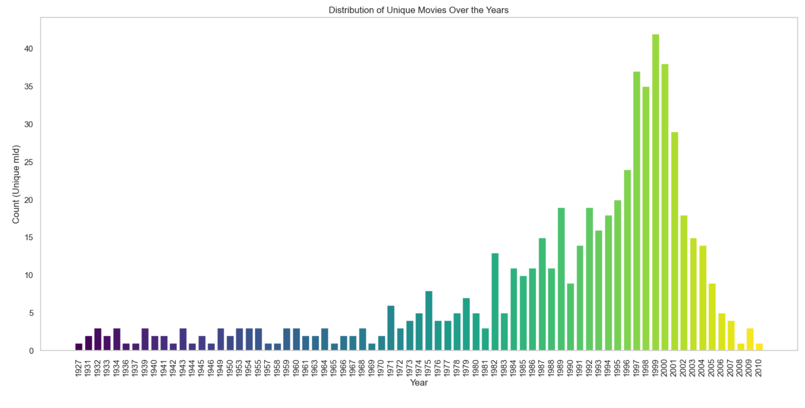
Distribution of movies over the years
Notes:
MANPREET:​
A bar plot showcased the distribution of unique movies over the years, revealing a substantial concentration in the 1980s, 1990s, and 2000s.​
​
The data ranges from the year 1926 all the way upto 2010. While we have wide-ranging data, the majority of it lies in the 3 decades of the 1980s, 1990s and 2000s, with 490 of the 617 i.e., ∼79% of the movies in that period. This sample space has enough of a time-spread for us to analyze how representation of women and the general attitude towards them in movies has changed over time.​
​
On this slide, we have the frequency of movies by year ranging from 1926 to 2015, with most of movies lying in the 1980-2000s range , it can help us analyze how representation of women have evolved over this time.​
​

Slide 8
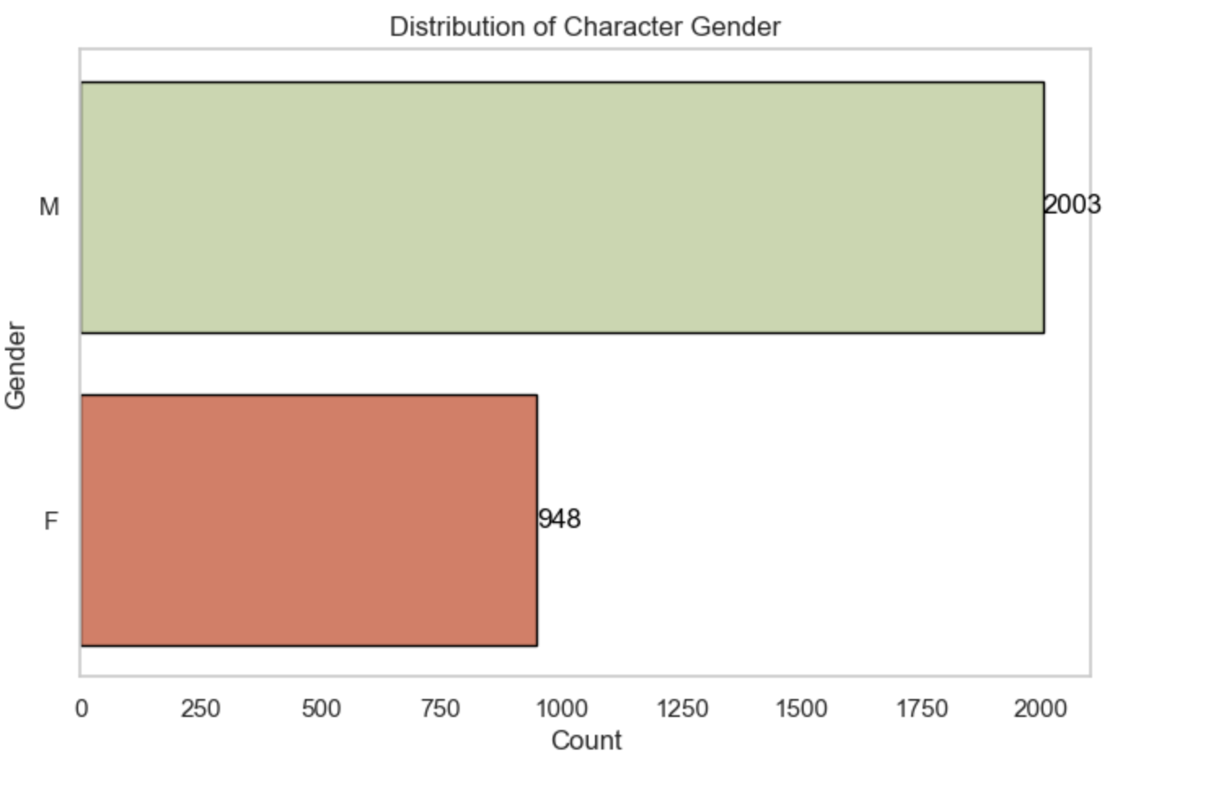
Gender Distribution in movies
Notes:
MANPREET: ​
The distribution of genders across 2951 unique characters showed that 2003 characters were male ('M'), and 948 were female ('F').​
​
We have total of 2951 Characters across 588 Movies.​
Out of these 2003 Characters are of Male Gender and 948 Female.​
​
This visual data indicates a disparity in the representation of genders, with ‘Male’ characters being more prevalent.​
This aligns well with what we want to analyze from the data and build our model accordingly ​
​
​

Slide 9
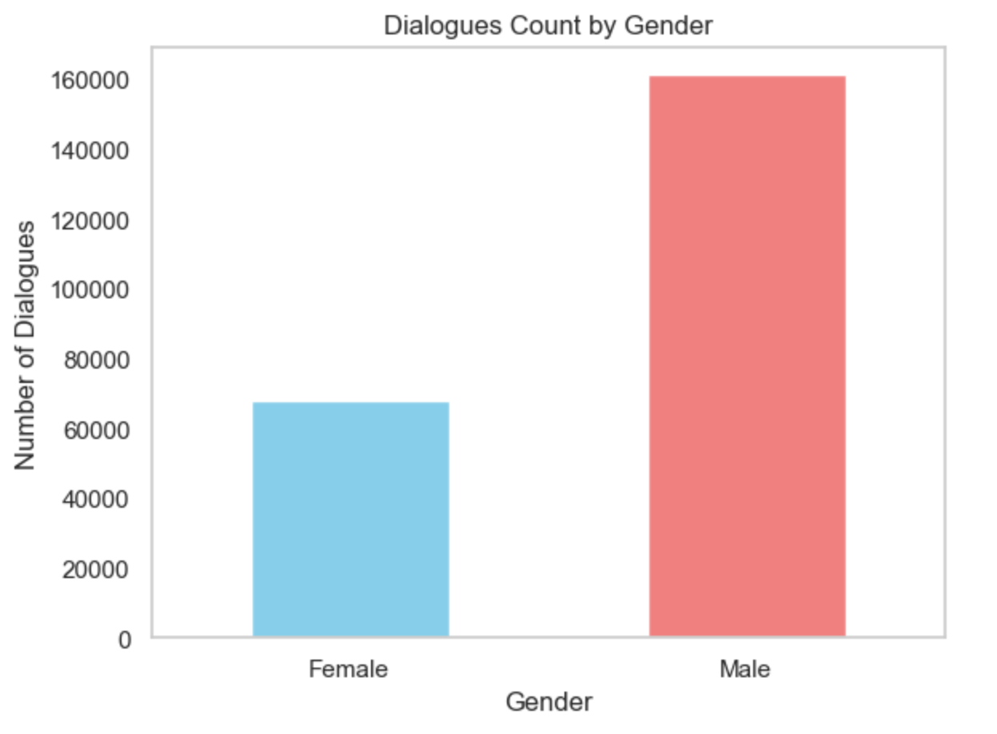
Dialogue Count per Gender
Notes:
The bar graph illustrates the distribution of dialogues between female and male characters.The data indicates that male characters have significantly more dialogues **(161244)** compared to female characters **(67862)**. This suggests a potential gender imbalance in the dataset or narrative focus.​
​
The substantial difference in dialogue counts raises questions about the representation of female characters in the context of the dataset. The analysis may prompt further investigation into the storyline, genre, or specific characters contributing to these numbers.​

Slide 10
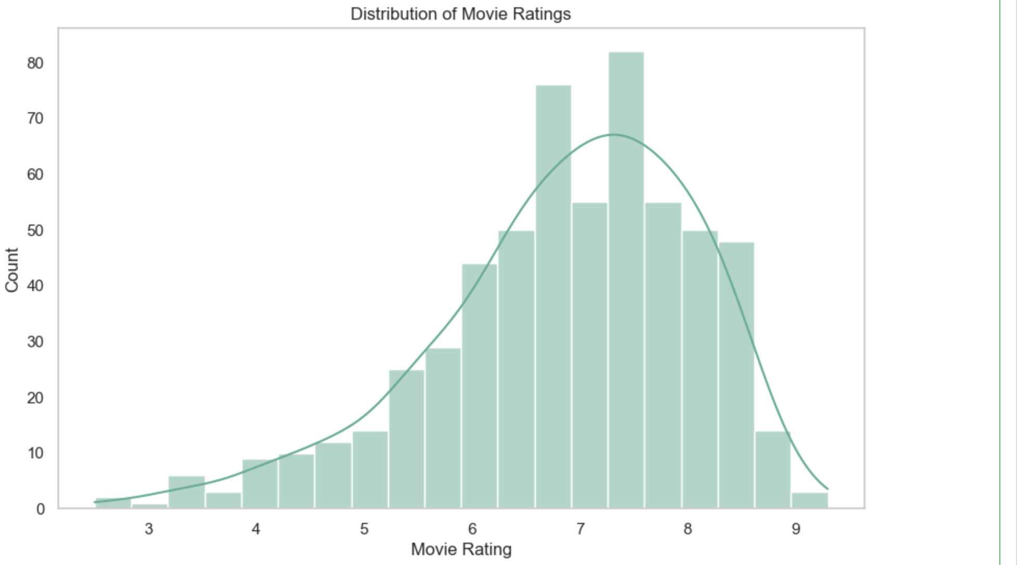
Distribution of movie ratings
Notes:
Manpreet: ​
​
A histogram illustrated the distribution of movie ratings, indicating the highest-rated movie with a rating of 9.5.​
Based on the graph, we can conclude that the majority of the movies have a rating between 6 and 8. The highest number of ratings is around 7.5. This suggests that most movies are rated between 6 and 8, with a few outliers on either end​

Slide 11
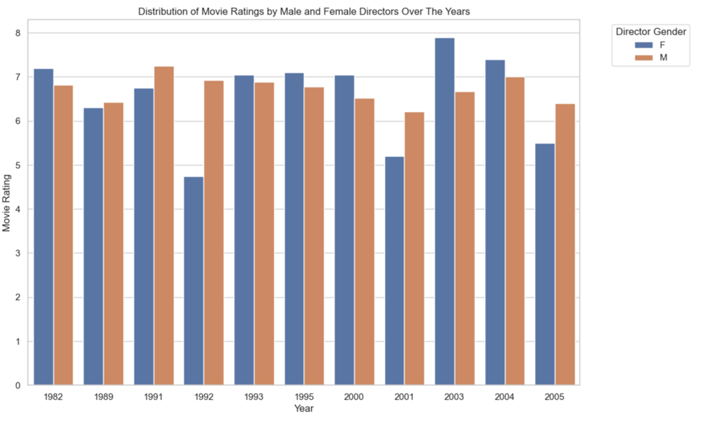
IMDB ratings based on Director Gender
Notes:
​
Number of unique movies made by female directors: 98​
Number of unique movies made by male directors: 458​
​
The bar plot showcases the distribution of movie ratings for common years, providing insights into potential trends and variations.​
The visual comparison allows for the identification of patterns or shifts in audience reception based on the gender of directors.​
​
Despite a detailed analysis, no discernible trend in movie ratings emerged over the years based on the gender of the director. The inconclusiveness is attributed to the insufficient data available for films directed by females.​
​
​

Slide 12
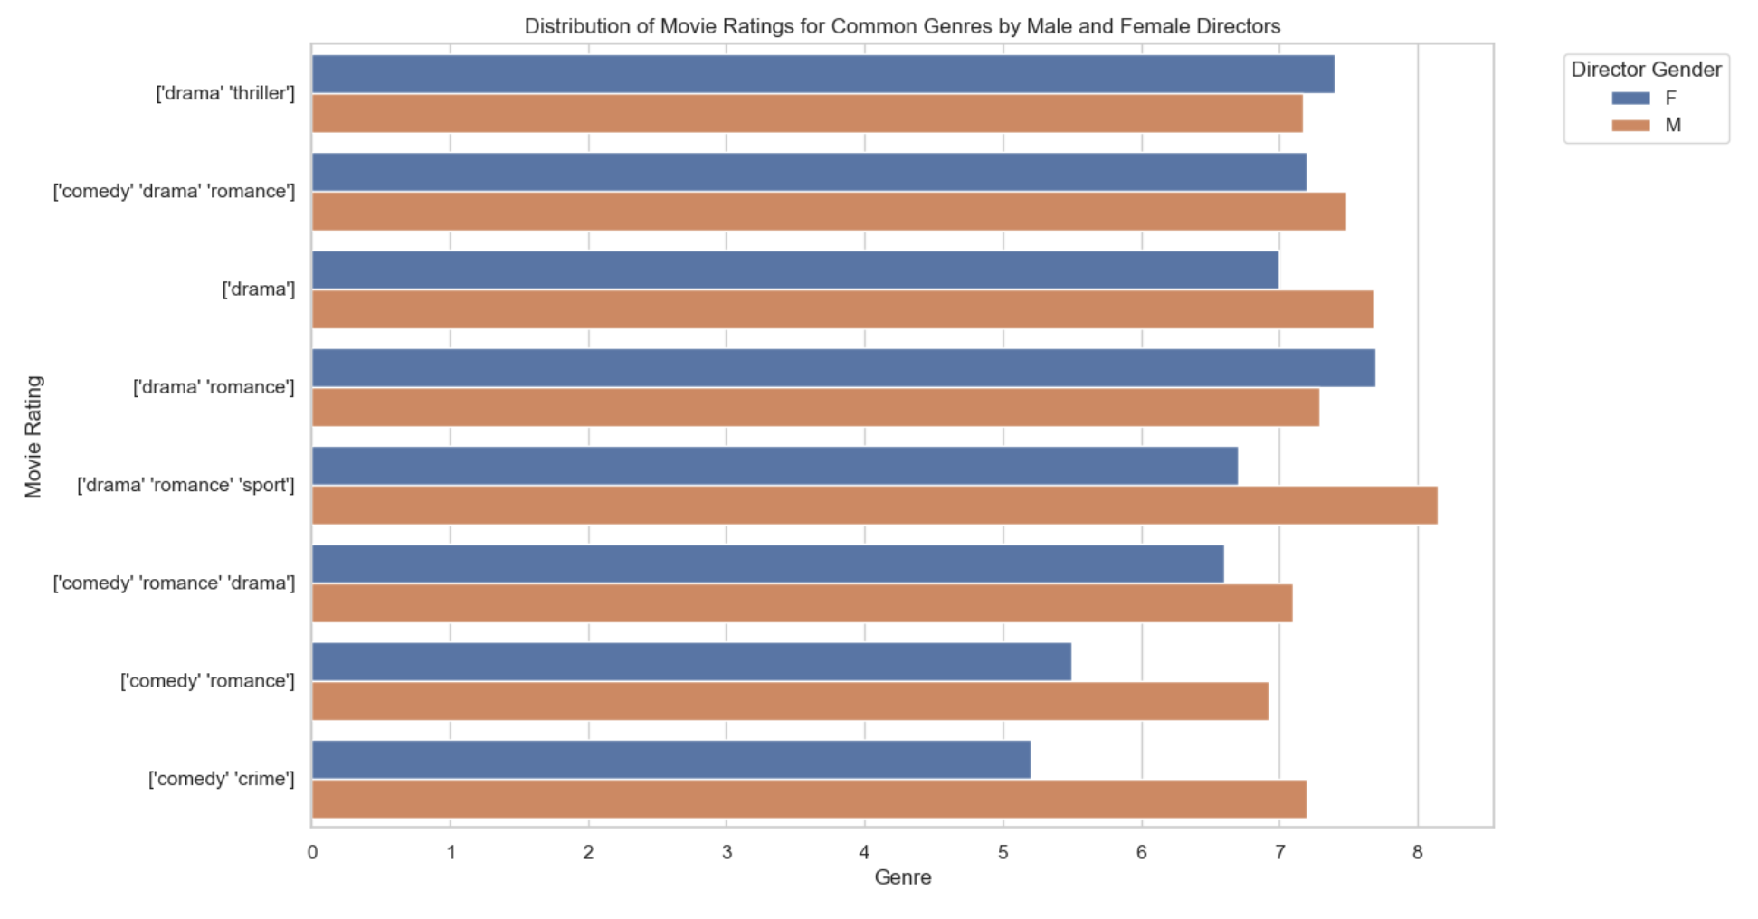
IMDB ratings based on Director Gender
Notes:
Genre Performance​
Drama and Drama-Thriller​
Female directors exhibited superior performance in genres such as Drama and Drama-Thriller, showcasing their proficiency in nuanced storytelling.​
Action Genre​
Notably, there was a striking absence of female directors in the action genre. This aligns with societal gender norms and prevalent audience preferences.​
Other Genres​
In other common genres, male directors tended to outperform their female counterparts. This outcome could be influenced by perceived differences in work quality or existing biases, particularly evident in genres like sports and crime.​
​

Slide 13
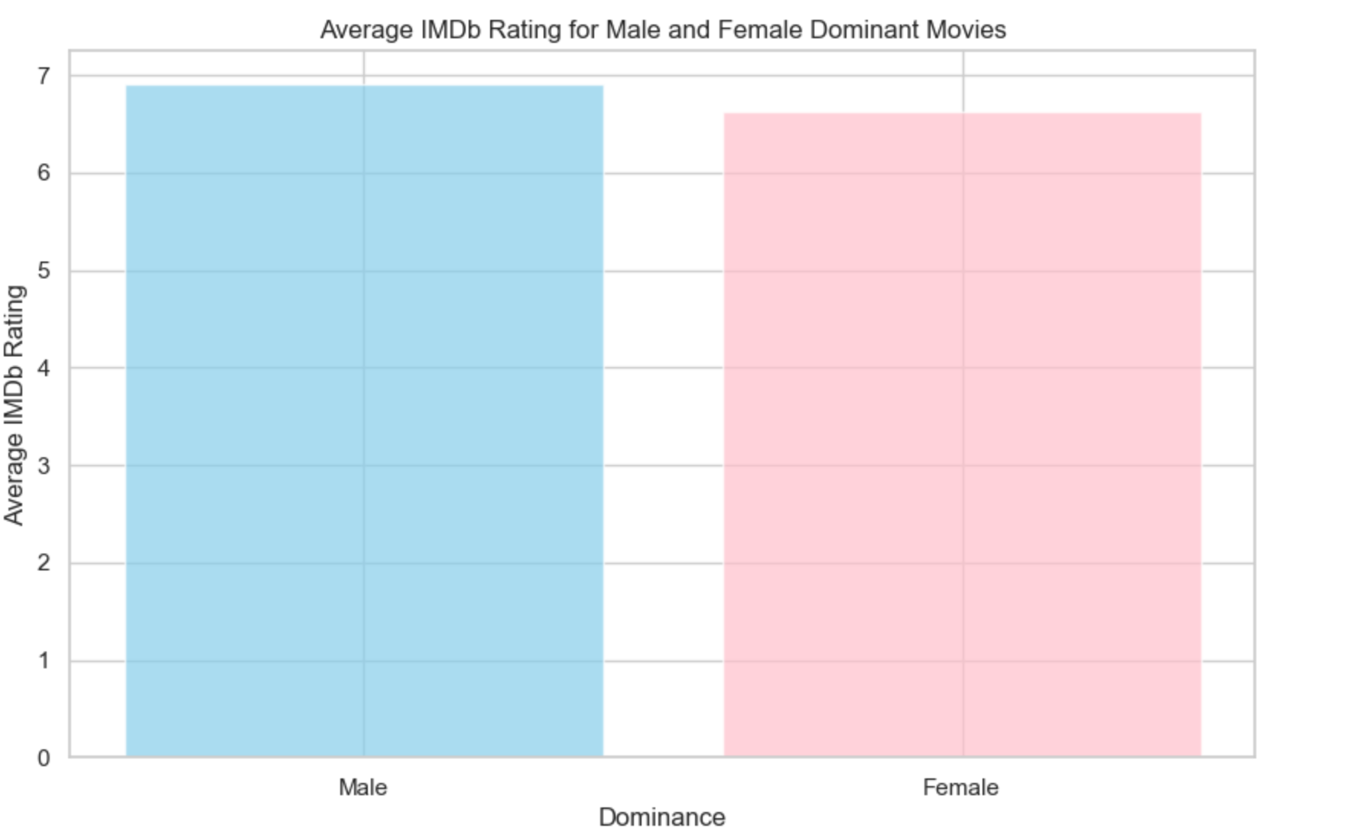
Average IMDb Rating for Male and Female Dominant Movies
Average IMDb Rating for Male Dominant Movies: 6.90
Average IMDb Rating for Female Dominant Movies: 6.62
Notes:
Average IMDb Rating for Male Dominant Movies: 6.90​ Average IMDb Rating for Female Dominant Movies: 6.62​ ​
Male Dominant Movies: The average IMDb rating for male-dominant movies is represented by the sky-blue bar. Male-dominant movies, where male characters have a higher dialogue word count, tend to have an average IMDb rating around 6.9​
Female Dominant Movies: The pink bar depicts the average IMDb rating for female-dominant movies. Female-dominant movies, characterized by a higher dialogue word count for female characters, show an average IMDb rating around 6.62​
​

Slide 14
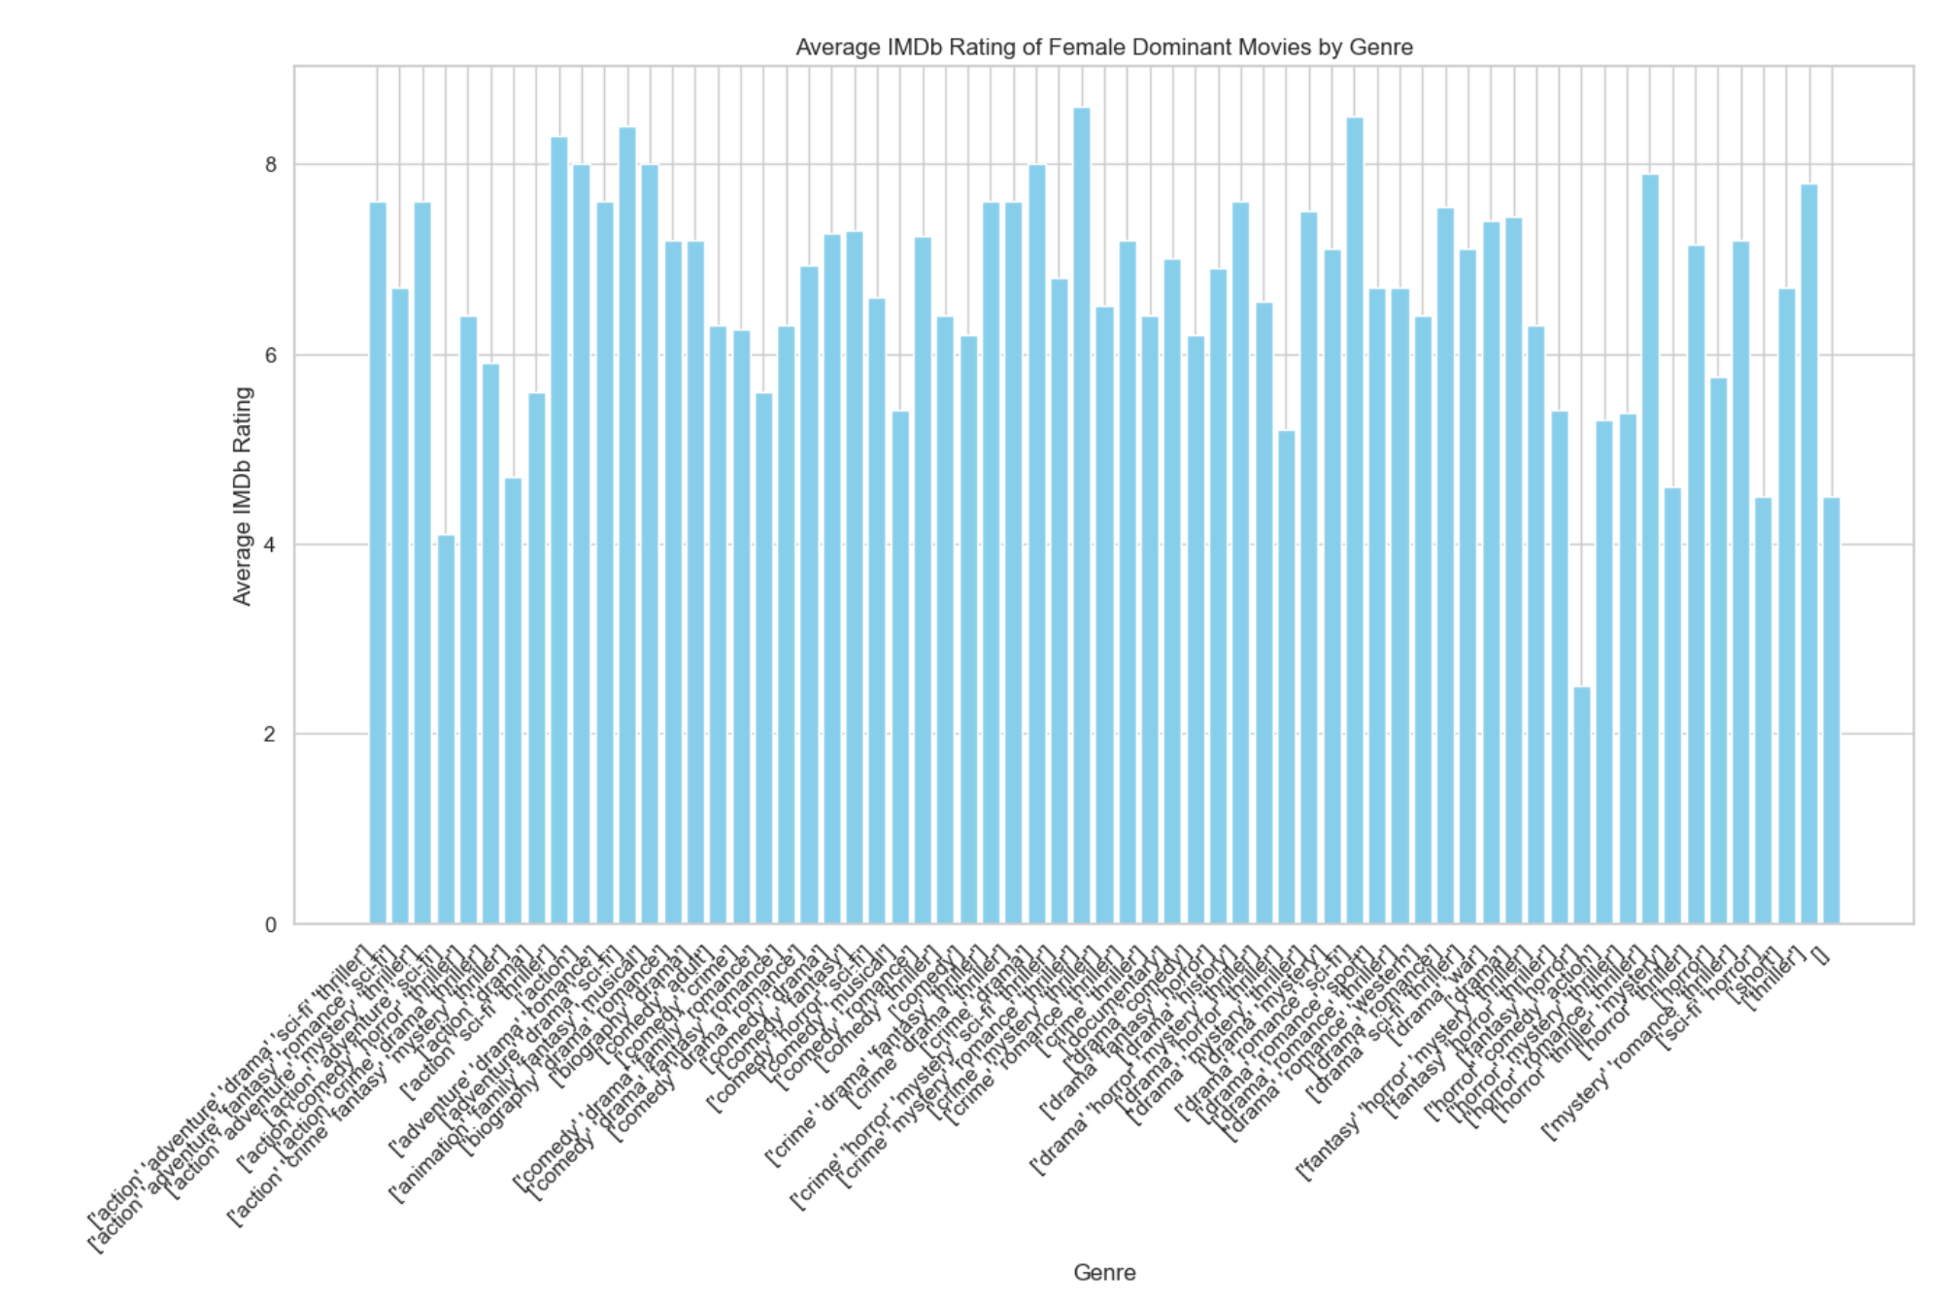
Average IMDb Rating of Female Dominant Movies by Genre
Notes:
Female Dominant Movies:​
Genres like Romance, Comedy, and Drama exhibit higher average IMDb ratings for female-dominant movies. This suggests that movies dominated by female characters, often associated with emotionally engaging storylines, receive positive audience feedback in these genres.​
​

Slide 15
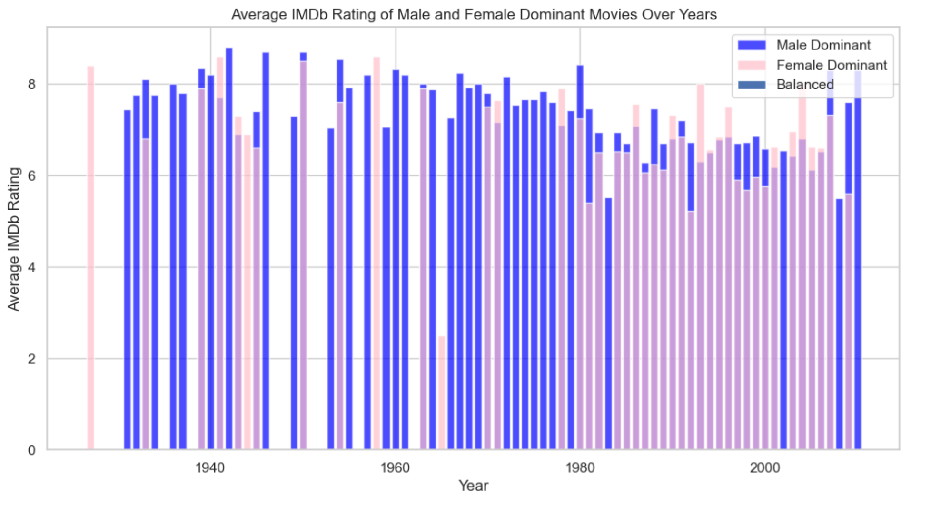
Average IMDb Rating of Male and Female Dominant Movies Over Years
Notes:
The bar graph illustrates the average IMDb ratings of movies categorized as Male Dominant, Female Dominant, and Balanced (with equal representation of male and female dialogue) over the years.​
​
​
Male Dominant Movies:​
​
Male-dominant movies consistently maintain a relatively stable average IMDb rating across the years.​
This suggests that the dominance of male characters in dialogue does not strongly correlate with fluctuations in IMDb ratings over time.​
​
Female Dominant Movies:​
​
Female-dominant movies show a fluctuating pattern in average IMDb ratings over the years.​
Peaks and troughs in ratings indicate that the success of female-dominant movies may be influenced by various factors, such as evolving audience preferences or trends.​
​
There is no clear pattern indicating that movies with a particular gender dominance consistently outperform others.​

Slide 16
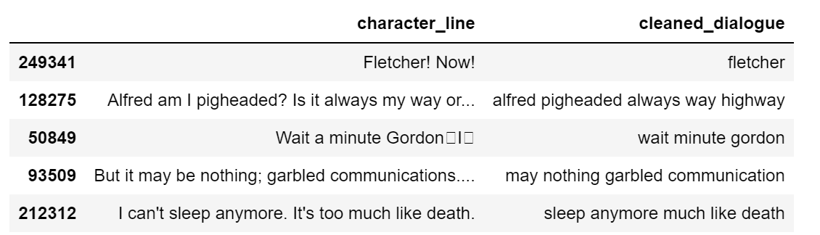
Dialogue Tokenization and Feature Engineering
> Objective: Transform dialogues into clean tokens for enhanced analysis
> Benefits: Enhances text data quality, aids in meaningful analysis, and prepares the dataset for advanced modeling.
> Implementation: Utilize natural language processing techniques for efficient feature engineering
Remove Stopwords: Eliminate common, non-informative words (e.g., is, am, are, the).
Eliminate common, non-informative words (e.g., is, am, are, the).
Case Standardization: Convert all words to lowercase for uniformity.
Lemmatization: Simplify words to their base form (e.g., walks to walk, geographical to geographic).
Notes:
Eliminate common, non-informative words (e.g., is, am, are, the).
Simplify words to their base form (e.g., walks to walk, geographical to geographic).
Simplify words to their base form (e.g., walks to walk, geographical to geographic).

Slide 17
Methodology Overview
Preprocessing Pipeline
Utilized MinMaxScaler in a pipeline for numeric data scaling.
Ordinal Encoder applied ordinal categorical data.
One-Hot Encoding used to handle nominal categorical data.
Vectorizer processes each word, generating TF-IDF distributions for efficient text data representation.
Hyper -parameter Tuning
Efficiently explores hyperparameter space through RandomSearchCV.
Particularly beneficial for models like Random Forest and SVC.
Enhances model efficiency and fine-tuning.
Model Training
80-20 training-test split. ‘stratify = y’ to ensures the same proportion of samples are maintained across sets
Multinomial NB, Random Forest, Linear SVC and Logistic Regression models were used
Models were trained with unbalanced data as baseline, and with undersampled as well as oversampled data
Reporting Metrics
Classification Metrics: Precision, Recall(Sensitivity), F1-Score, Support and Accuracy
AUC (Area Under the ROC Curve): Measures the model's ability to distinguish between positive and negative instances
Confusion Matrix: Summarizes model performance with counts of true positives, true negatives, false positives, and false negatives.

Slide 18
Performance Analysis
Naive Bayes
Logistic Regression
Random Forest
SVM
Balanced precision, recall, and F1-scores for both genders
Achieving an accuracy of 0.689.
Top-performing model with balanced metrics and the highest accuracy at 0.748
Excelled in identifying males but struggled with female identification
Recognized males well but exhibited a limitation in identifying females
Yielding an accuracy of 0.679
Challenges and Limitations:
> Significant class imbalance impacted precision and recall for female characters across all models.
> Random Forest excelled in male identification but struggled with females.
> SVM exhibited a limitation in recognizing females, highlighting a clear constraint.

Slide 19
Performance Analysis - Random Under Sampler
Naive Bayes
Logistic Regression
Random Forest
SVM
Achieved accuracy of 65%, demonstrating balanced precision, recall, and F1-scores.
Highest accuracy of 70.0%, with a marginal dip in female precision.
Attained 69.7% accuracy, showing similar trends in precision values.
Reasonable performance with balanced metrics, achieving an accuracy score of 57.1%.
Evaluation of Overall Model Performance:
> Logistic Regression stands out with the highest accuracy (70.0%) and AUC (77.9%), indicating good discrimination between classes.

Slide 20
Performance Analysis - Random Over Sampler and SMOTE
Naive Bayes
Logistic Regression
Random Forest
SVM
Significant improvement in accuracy (0.832) with heightened precision, recall, and F1-scores for both genders.
Maintains reliability with an accuracy of 0.768 on the rebalanced data.
Excels further with an impressive accuracy of 0.936 and a high AUC.
SVM exhibits improvement but persists in grappling with achieving balanced performance metrics.
Evaluation of Overall Model Performance:
> Random Forest stands out with the highest accuracy (93.6%) and high AUC

Slide 21
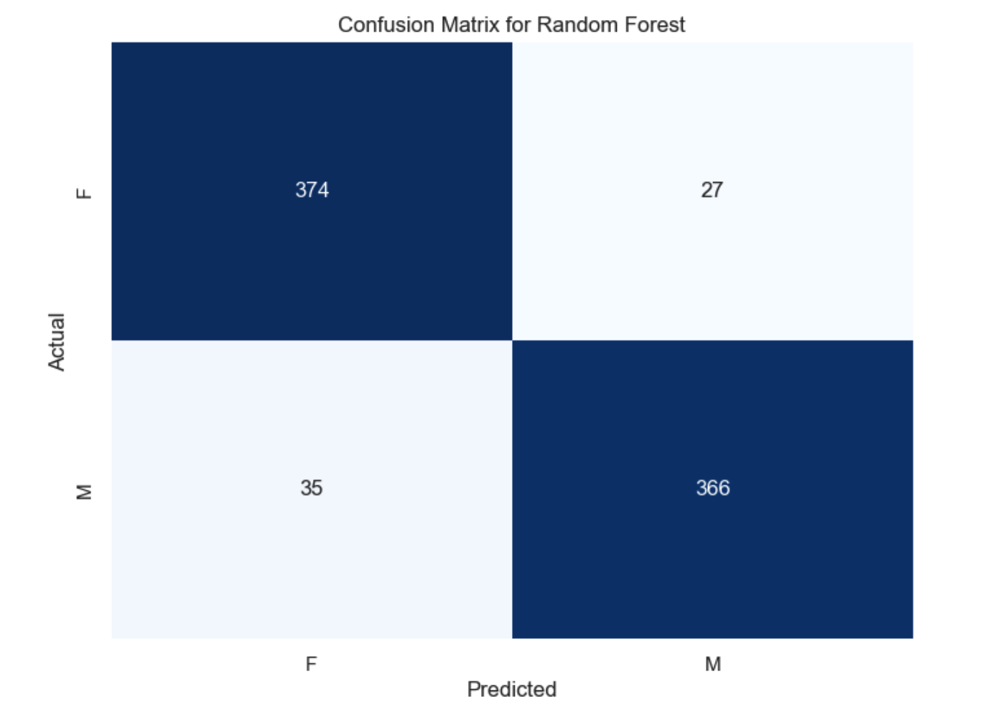
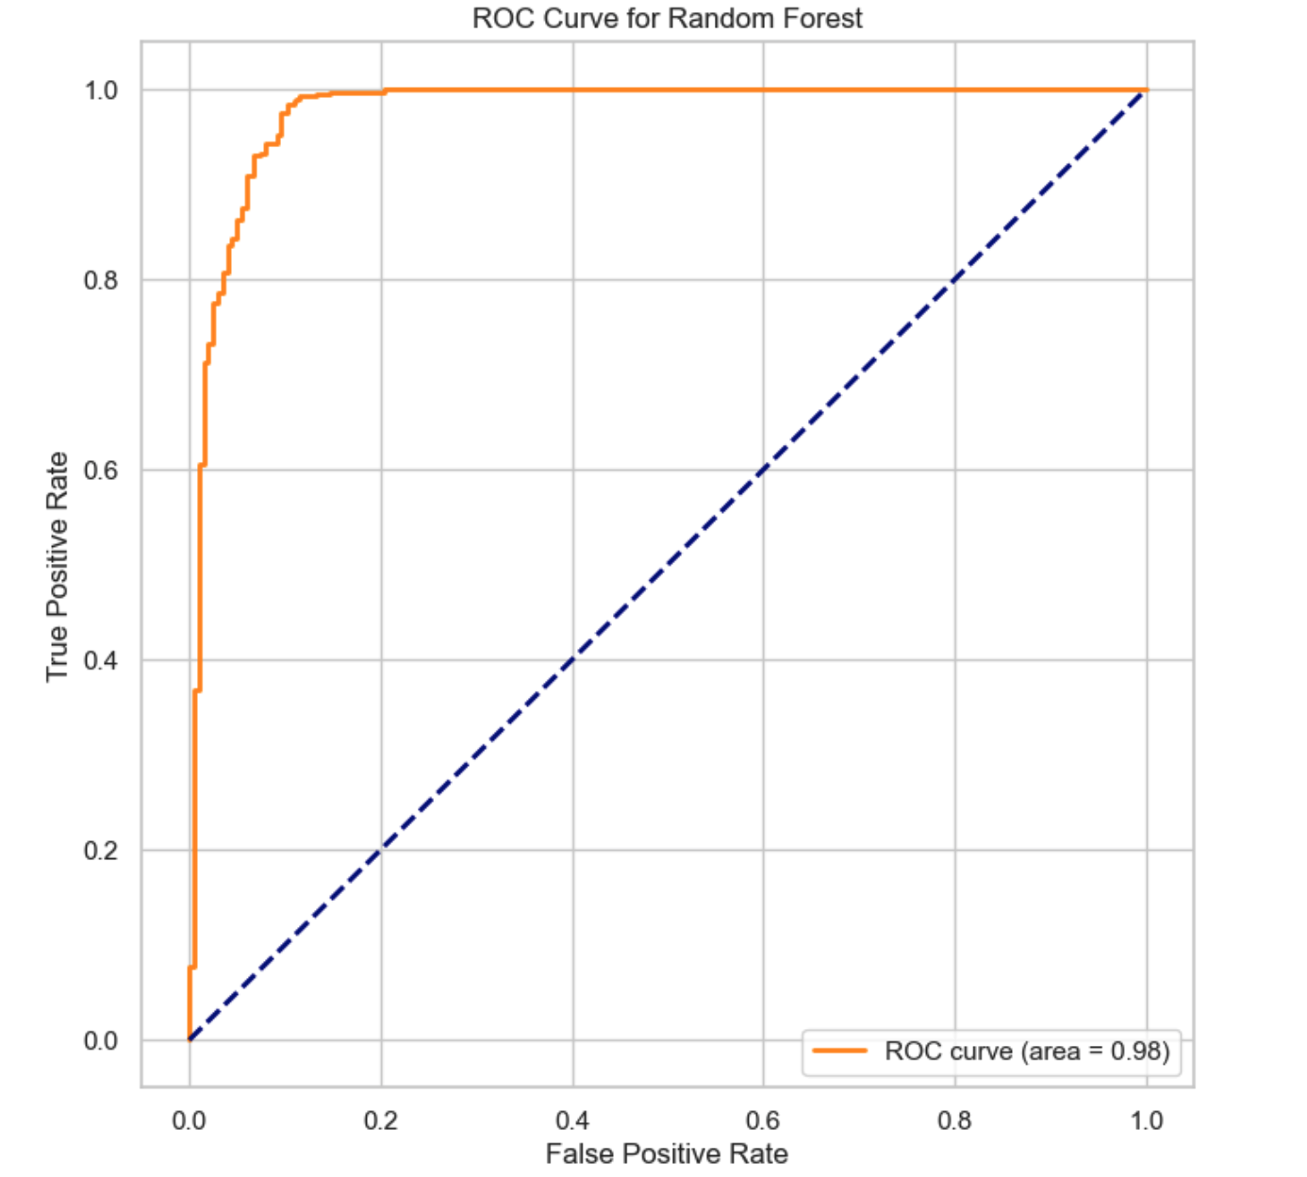
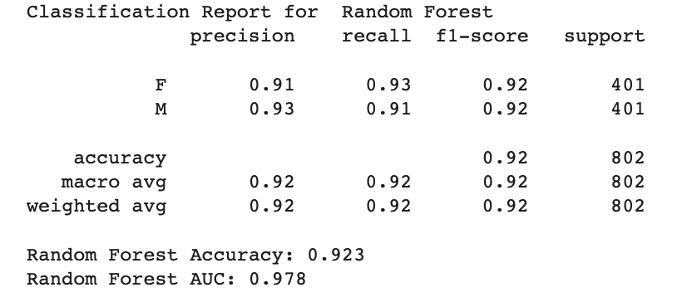
Best Model – Random Forest (Random OverSampler)

Slide 22
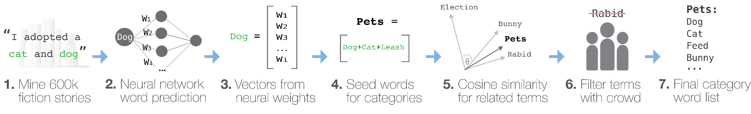
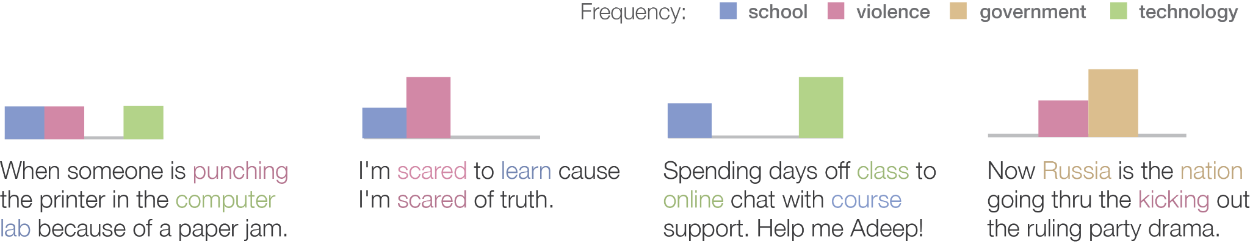
Text Analysis with Empath

Slide 23
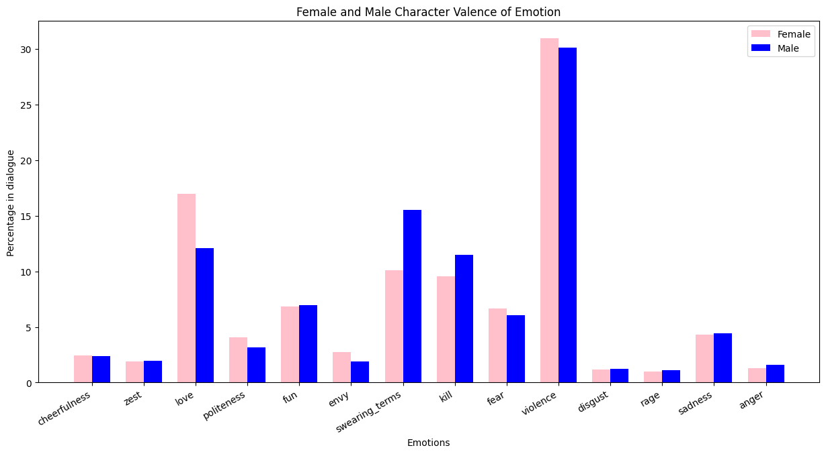
A Comparative Analysis of Valence of Emotions in Male and Female Experiences

Slide 24
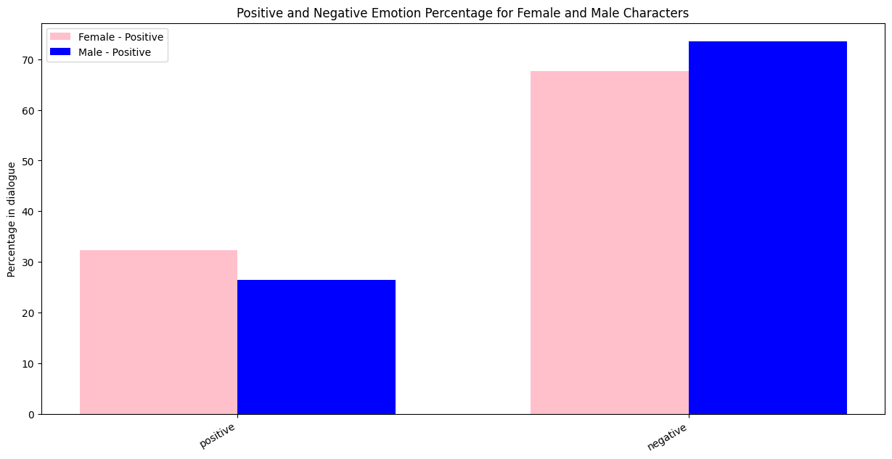
A Comparative Analysis of Valence of Emotions in Male and Female Experiences

Slide 25
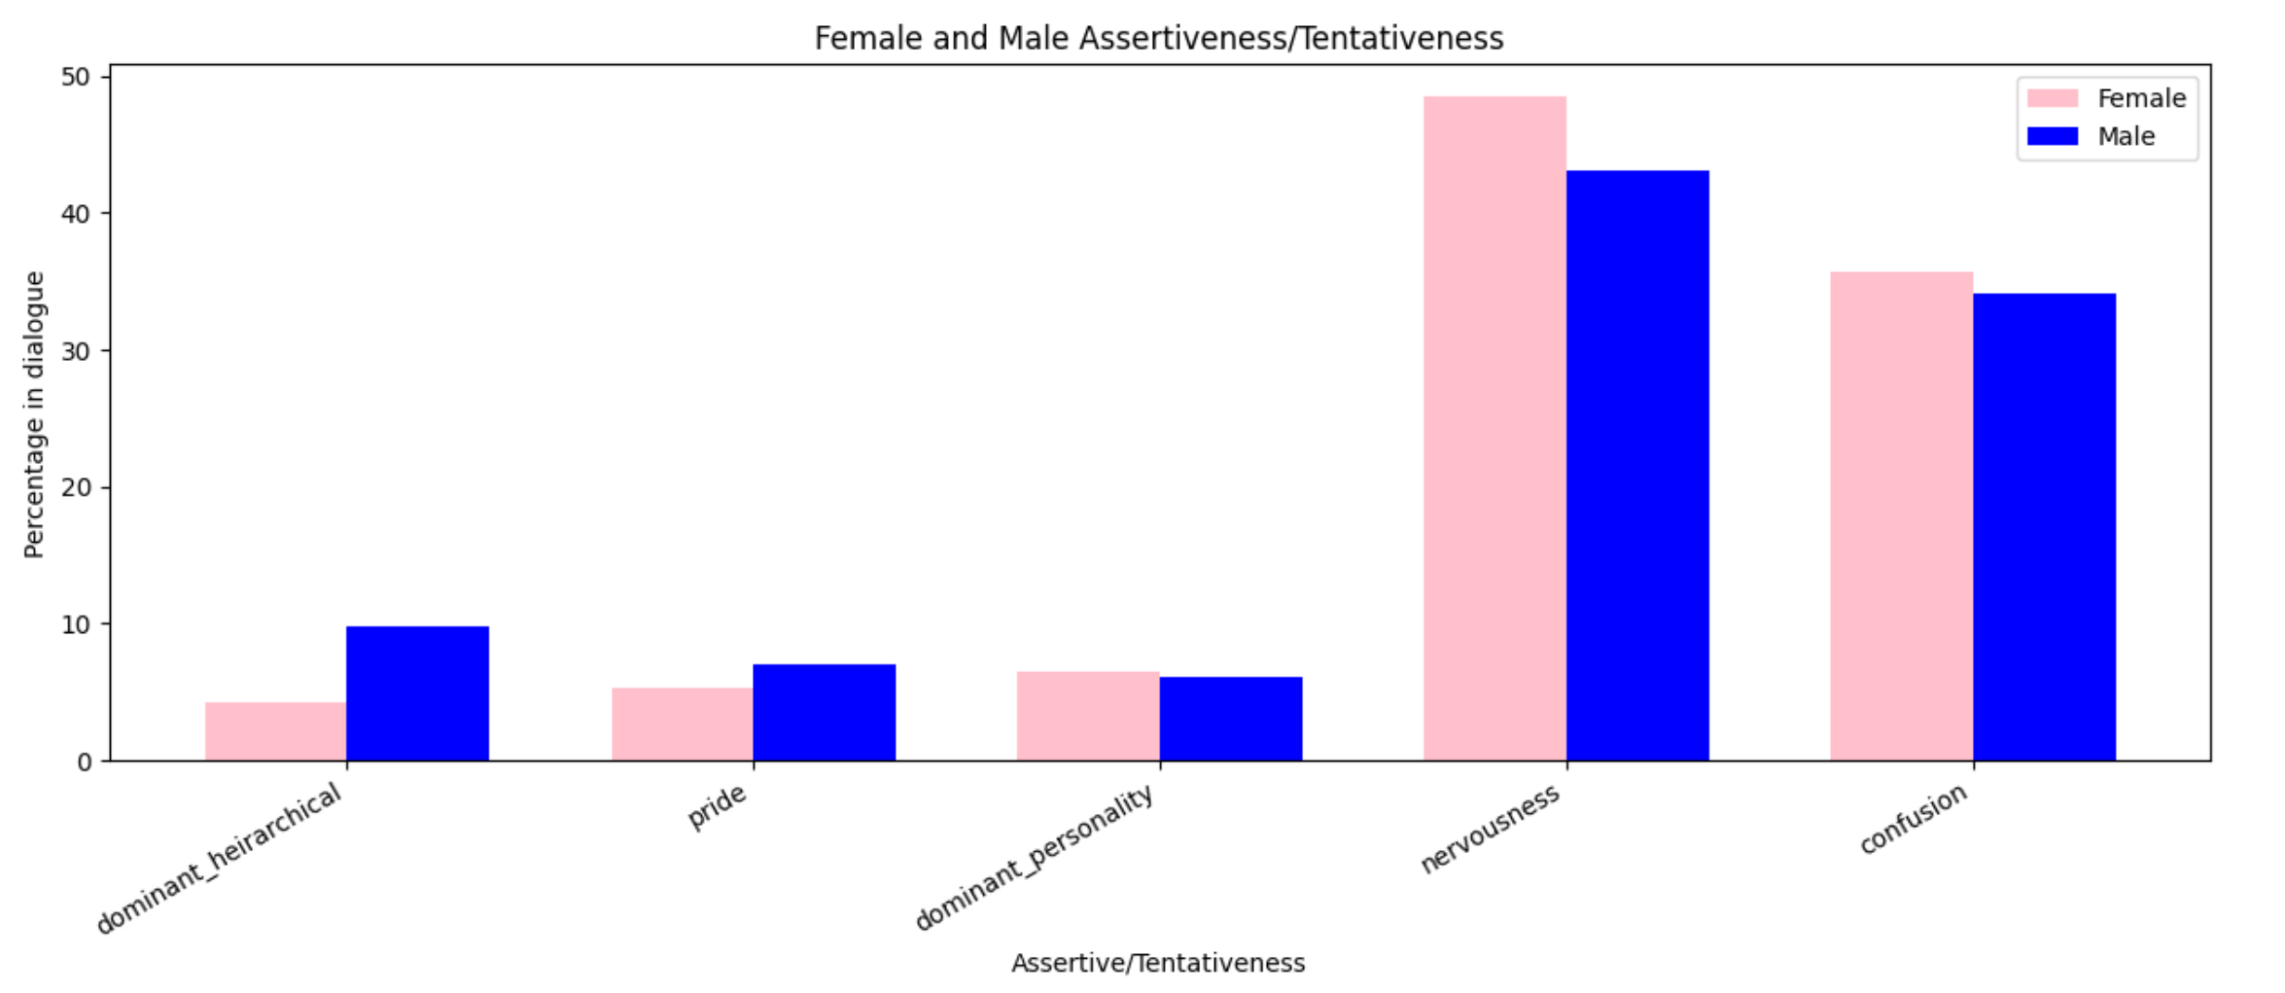
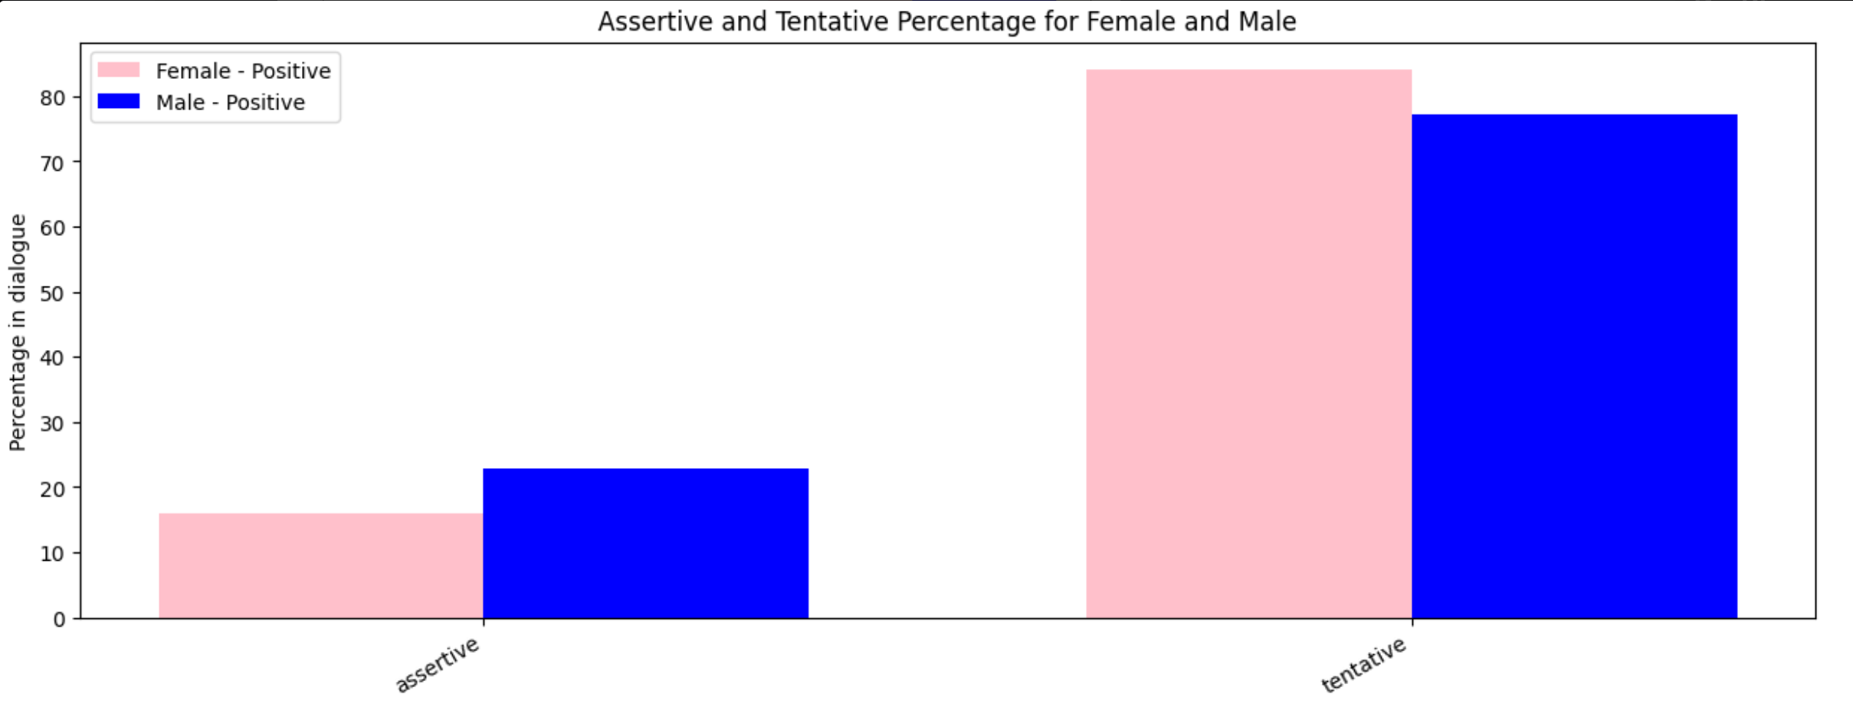
Gender Dynamics in Communication: Exploring Assertiveness and Tentativeness Patterns

Slide 26
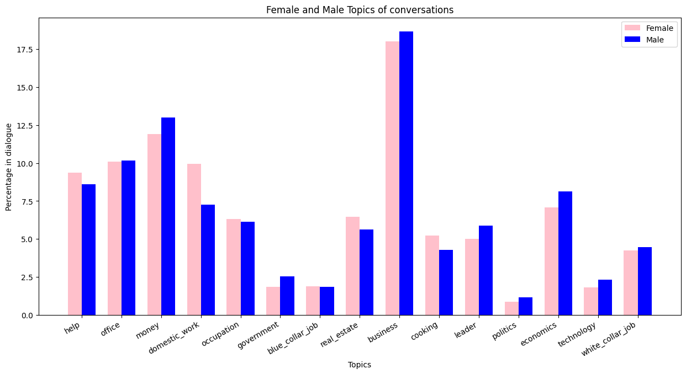
Male vs Female Conversation Topics

Slide 27
CONCLUSION & FUTURE WORK
Broadened scope of NLP: Extend analysis beyond the speaker to understand the impact on both the speaker and listener, while pinpointing the conversation's subject.
Redefine female centric: Expand the definition by including metrics like the Bechdel Test, ensuring a more comprehensive understanding of female-centric work.
Exploration across domains: Investigate the applicability of current NLP work in uncovering gender bias in diverse fields such as academia, workplace, healthcare, finance, HR, etc.

Slide 28
REFERENCES
> K. Khadilkar, A. R. KhudaBukhsh, and T. M. Mitchell, "Gender bias, social bias, and representation in Bollywood and Hollywood," Patterns, vol. 3, no. 2, 2022, doi: 10.1016/j.patter.2021.100409.
> J. Devlin, M.-W. Chang, K. Lee, and K. Toutanova, "BERT: Pre-training of Deep Bidirectional Transformers for Language Understanding," in Proceedings of the 2019 Conference of the North American Chapter of the Association for Computational Linguistics: Human Language Technologies, Volume 1 (Long and Short Papers), Minneapolis, Minnesota, 2019, pp. 4171–4186, doi: 10.18653/v1/N19-1423.
> Haris, M.J., Upreti, A., Kurtaran, M. et al. Identifying gender bias in blockbuster movies through the lens of machine learning. Humanit Soc Sci Commun 10, 94 (2023). https://doi.org/10.1057/s41599-023-01576-3
> Fast, E., Chen, B., \& Bernstein, M. S. (n.d.). Empath: Understanding Topic Signals in Large-Scale Text. Stanford University.
> Yu, Yulin \& Hao, Yucong \& Dhillon, Paramveer. (2022). Unpacking Gender Stereotypes in Film Dialogue. 10.1007/978-3-031-19097-1\_26.

Slide 29
Questions ?
Thank you for listening !

