Slide 1

SMART INDIA HACKATHON’18
TEAM TYROS

Slide 2

Problem Statement (#MSP8)
Engagement Management System (EMS) through an Application for Desktop as well as Mobile-phones.
Ministry of Statistics and Programme Implementation

Slide 3

Idea/ Prototype/ Solution
We are developing a Web application for engagements of Hon’ble Minister, Chairman, National Statistical Commission (NSC), Secretary, M/o Statistics etc.
By using this application they can track each others schedules and arrange meetings accordingly.
Every officer first signup in this web app and after that by logging in can manage himself.

Slide 4


E.g.. Suppose Hon’ble minister wanted to have meeting with chairman then he will be logged in in this web app and after that he will send the date-time of meetings and subject and send request to chairman. Then chairman will be notified by this web app and meeting will be arranged
.
But if chairman wants meeting with minister then the app will show both the meetings and minister can accept the schedules accordingly by sending may be his secretary, PA etc to attend the meeting.

Slide 5

Technology Stack
PHP Framework (yii2)
Database
Web Server
Operating System
Bootstrap, HTML, CSS Javascript, Java, Jquery,Ajax
Webview
Operating System
MYSQL engagement database
Authentication
Operating System
Internet
Internet
BOOTSTRAP
CSS
CLIENT
DATABASE
PHP
SERVER
Why yii2 ?
MYSQL
More functionalities
Saves time
Most importantly ... SECURE !!
ANDROID

Slide 6
Basic functionalities
Create a Program
Notifications and access rights
BASIC OPERATIONS
View programs and schedules
Cancel a program

Slide 7
App that can run on both PC as well as android phones
Complete abstraction of schedules from the users we do not wish to show our schedule
In case of collision between two schedules minister get the choice to decide which meeting to attend
Report generation for weekly,monthly,yearly schedules and personal schedules as well.
Notifications after every new schedule is arranged
E-mail module for new schedules
Admin module to add new user or remove him/her
Features

Slide 8
We can add navigation facilities for correct routing to destinations of meetings
We can integrate aadhar card for verification purpose.
Future Scope

Slide 9
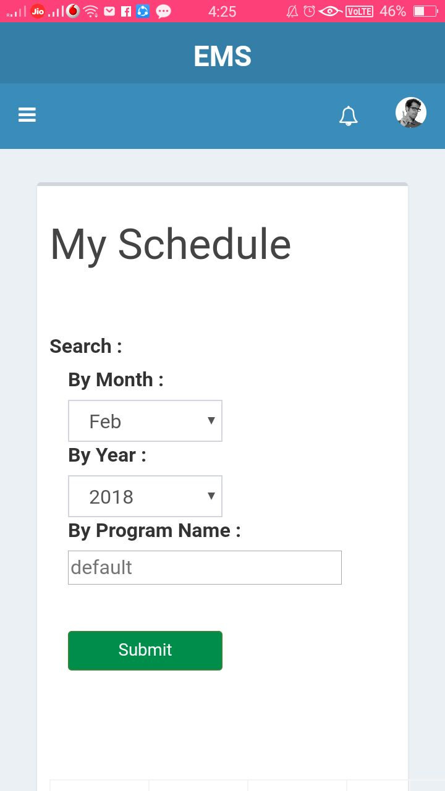
Place your screenshot here

Slide 10
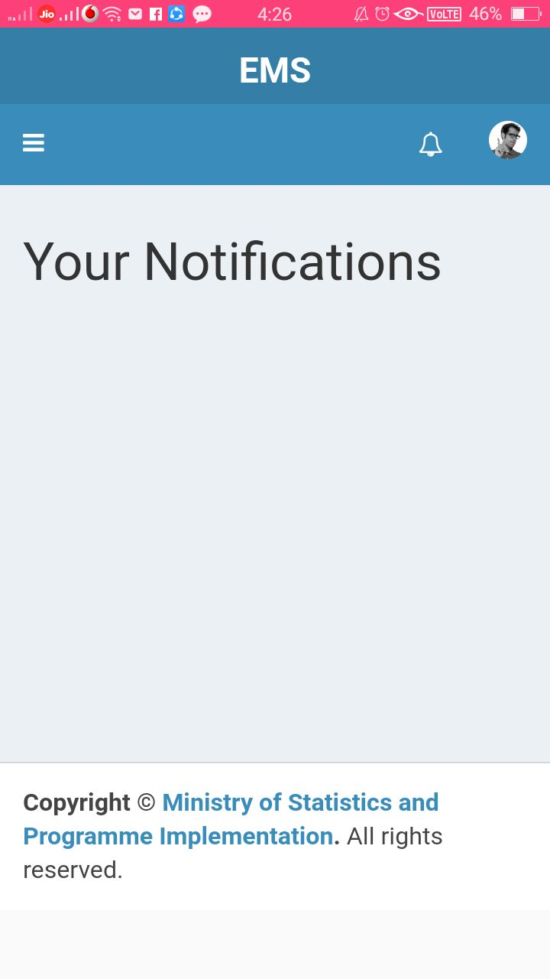
Place your screenshot here

Slide 11
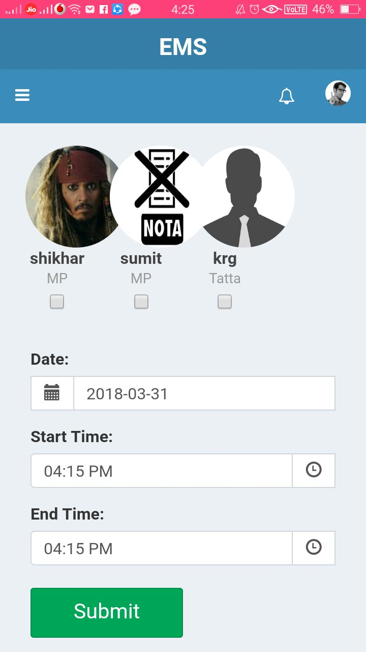
Place your screenshot here

Slide 12
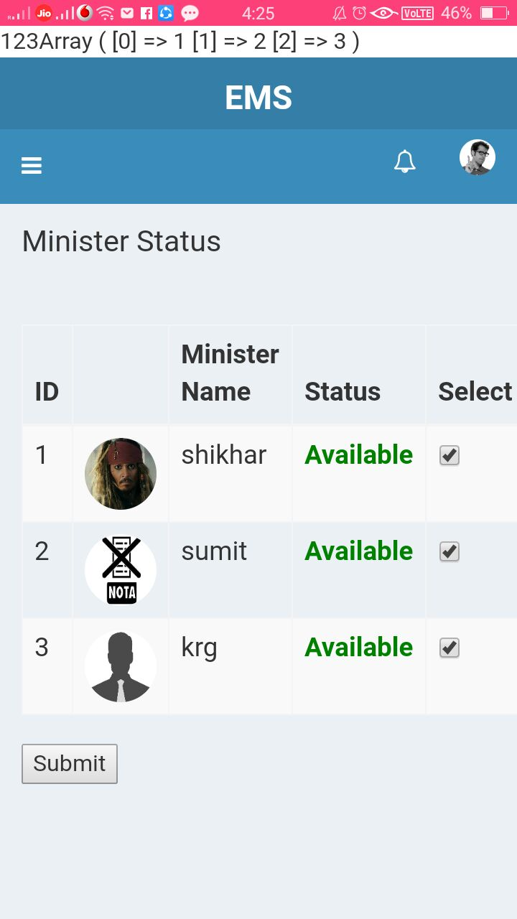
Place your screenshot here

Slide 13
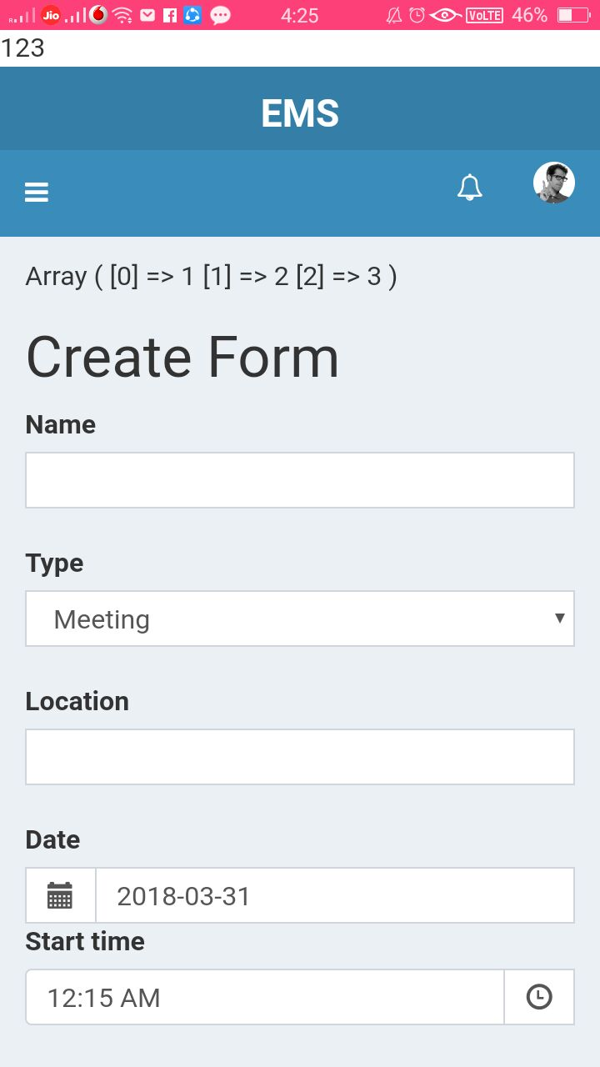
Place your screenshot here

Slide 14
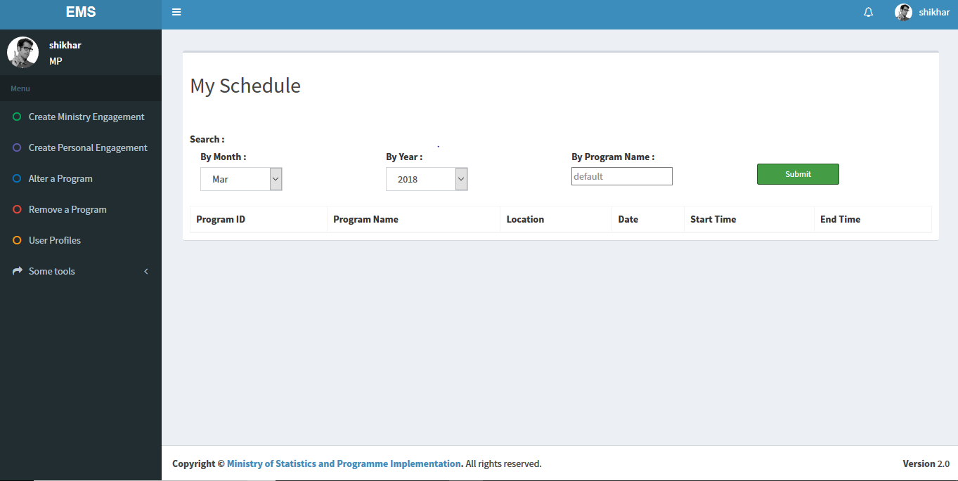
Place your screenshot here

Slide 15
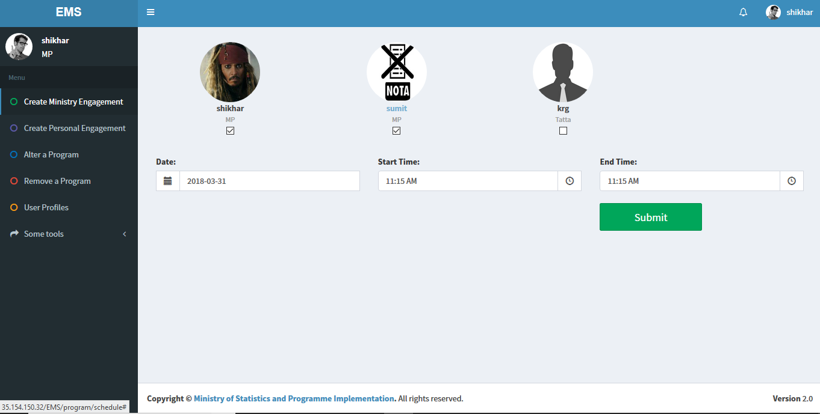
Place your screenshot here

Slide 16
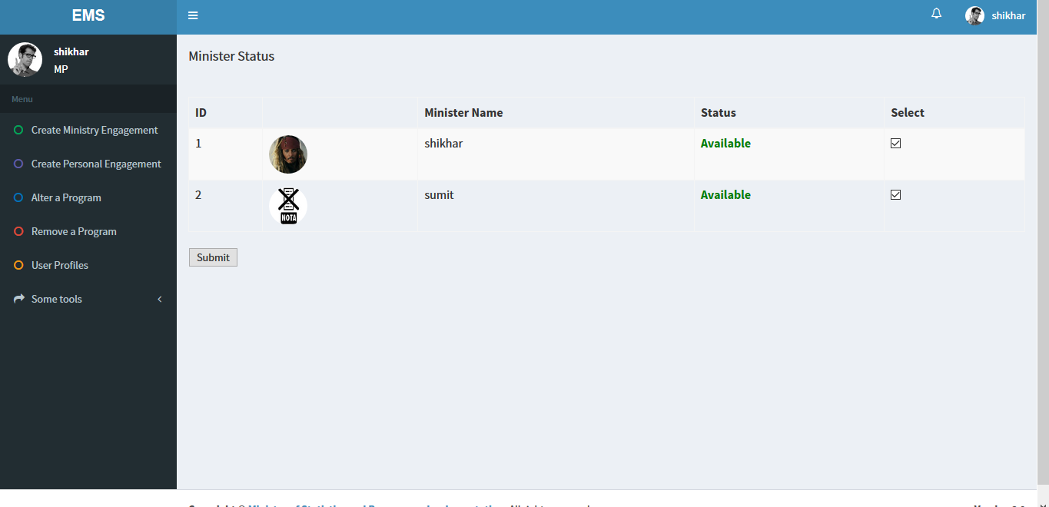
Place your screenshot here

Slide 17
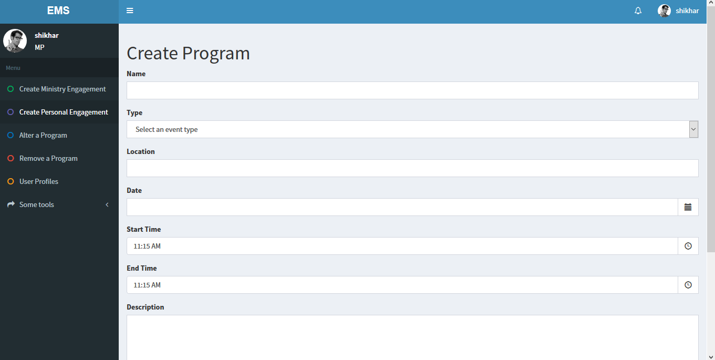
Place your screenshot here

Slide 18
😉
THANK YOU!!

