Slide 1

STYLE ADVISOR CX PROGRAM • OCTOBER 2022
Evaluation of Style Advisor
Performance
Comprehensive Analysis and Insights
61 mystery-shopper evaluations | 58 style advisors | 4 zones nationwide

Slide 2

INTRODUCTION
Overview & Objectives
THE PROGRAM
OBJECTIVES OF THE ANALYSIS
Sunglass Hut ran an independent mystery-shopper audit of its style advisors across October 2022. Trained auditors visited stores nationwide and scored each visit against a standard rubric covering store environment, greeting, needs discovery, product knowledge, and sales closure.
1
Grade every style advisor on a consistent A-D performance scale
2
Compare average evaluation scores across the four sales zones
The result is a dataset of 61 evaluations covering 58 named style advisors in 22 cities across the East, North, South, and West zones — scored, graded, and rolled up into the pivot views used throughout this deck.
3
Identify which regions produce the highest share of top performers
4
Break performance down by individual evaluation criteria
5
Track how scores moved over the course of the audit period
6
Turn findings into concrete coaching and staffing recommendations
Style Advisor Performance Evaluation
2

Slide 3





THE DATASET
Data Overview
Every evaluation is a single mystery-shop visit, captured in the raw response sheet (61 rows x 84 columns) and rolled up into grading and pivot sheets used for reporting.
Identifiers & Location
Scores
Visit Details
Survey Responses
Evaluation_ID, Evaluation_Date, Location_City/State, Zone (East / North / South / West), Country
Evaluation_Score (overall) plus 8 criteria sub-scores: Store Ambiance, First Impressions, Discovery, Recommendations, Trial Experience & Upsell, Objection Handling, Closure & Care, Overall Experience
Time of entry/exit, duration of visit, advisors present, customers present, and the named Style Advisor who attended the shopper
~30 structured Yes/No and free-text questions across Store Environment, Greeting & First Impression, and Needs Discovery sections, plus auditor demographics
Style Advisor Performance Evaluation
3

Slide 4

METHODOLOGY
Performance Grading
GRADING SCALE
Grade | Score Range
A - High Performer | 90 - 100
B - Average Performer | 70 - 89
C - Low Performer | 50 - 69
D - Bottom Performer | Below 50
HOW GRADES WERE ASSIGNED
Each evaluation's overall score maps directly to a grade. A few worked examples from the dataset:
Fariz
100
A - High Performer
Santosh
94
A - High Performer
Sanket Patel
86
B - Average Performer
Yasin Kaif
61
C - Low Performer*
Mr. Girish
33
D - Bottom Performer*
*Per-evaluation grading (used in the pivot views on the following slides). Advisors with multiple visits also get a smoothed average-based grade in the master roster.
Style Advisor Performance Evaluation
4

Slide 5
PIVOT ANALYSIS
Average Evaluation Score by Zone
Zone | Avg. Evaluation Score
North | 76.7
West | 71.8
East | 71.6
South | 66.6
Grand Total | 71.8
KEY OBSERVATIONS
North leads all zones at 76.7 — a broad-based result driven by a strong base of B-grade advisors and very few bottom performers.
South lags noticeably at 66.6, roughly 10 points behind North, with the heaviest mix of C and D grades in the dataset.
East and West sit close together in the middle (71.6 and 71.8) — near the 71.8 company-wide average.
Style Advisor Performance Evaluation
5

Slide 6

PIVOT ANALYSIS
High Performer Analysis by Region
HIGHEST SHARE OF TOP TALENT
North
40.6% of all High Performer evaluations — more than double any other zone.
SHARE OF HIGH-PERFORMER EVALUATIONS
North
40.6%
East
20.2%
South
19.6%
West
19.6%
Style Advisor Performance Evaluation
6

Slide 7
VISUALIZATIONS 1 / 5
Average Evaluation Scores by Zone
Style Advisor Performance Evaluation
7

Slide 8

VISUALIZATIONS 2 / 5
Percentage of High Performers by Region
Style Advisor Performance Evaluation
8

Slide 9

VISUALIZATIONS 3 / 5
Performance Trends Over Time
Style Advisor Performance Evaluation
9

Slide 10

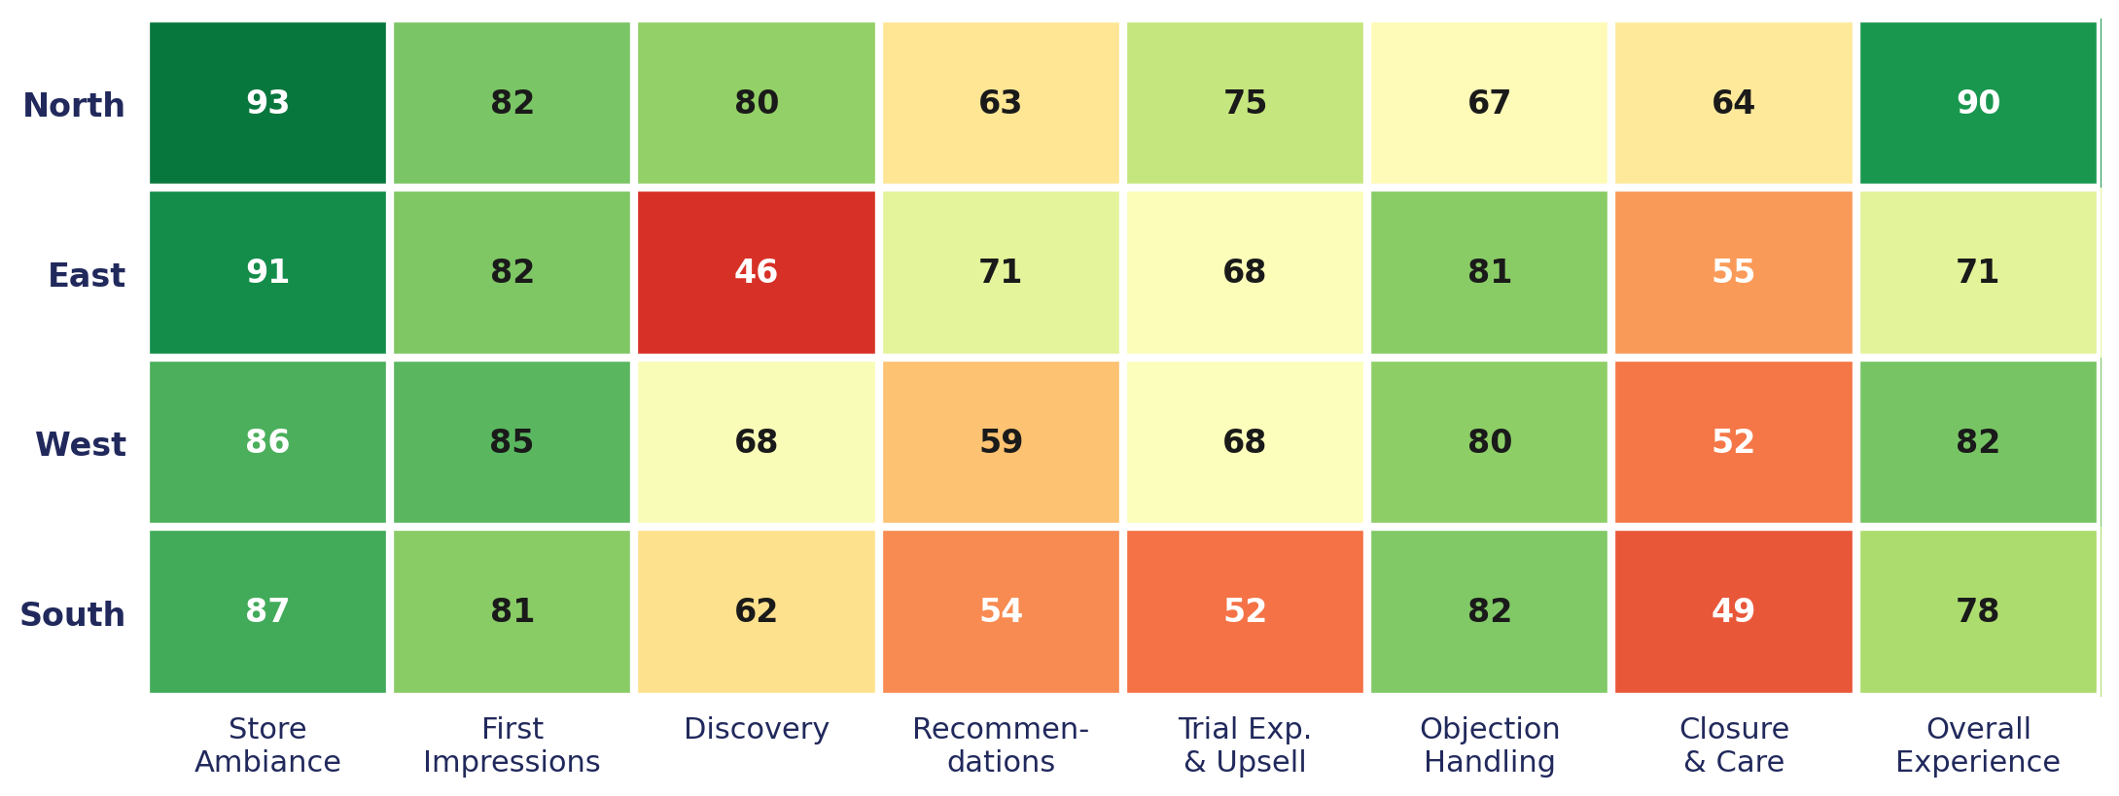
VISUALIZATIONS 4 / 5
Breakdown by Evaluation Criteria & Zone
Average score per evaluation criterion, by zone. Closure & Care and Recommendations are the weakest touchpoints company-wide, while Store Ambiance is consistently the strongest.
Style Advisor Performance Evaluation
10

Slide 11
VISUALIZATIONS 5 / 5
High vs. Low Performers Comparison
Style Advisor Performance Evaluation
11

Slide 12

SYNTHESIS
Key Insights
Regional performance
Where the experience breaks down
North leads (76.7 avg, 40.6% of High Performers). South lags (66.6 avg, heaviest C/D mix). East shows the widest spread of any zone — both strong top performers and weak bottom performers — pointing to inconsistent coaching rather than a uniformly weak market.
Scores aren't low because of store environment: Store Ambiance (88.8) and First Impressions (82.6) are consistently strong. The weak points cluster at the two ends of the human interaction — Closure & Care (55.2) and Recommendations (60.1) are the lowest-scoring touchpoints by a wide margin.
Trends over time
Performance distribution
Daily average scores swing widely across the audit window, from a low of 48.3 (Oct 30) to a high of 94 (Oct 27), with no clear upward or downward trend — day-to-day variation looks more like inconsistent execution than a seasonal pattern.
Of 61 evaluations, 10 scored A, 27 scored B, 16 scored C, and 8 scored D. The bulk of advisors cluster in the Average band — meaningful upside exists in moving the 24-evaluation C/D tail toward B.
Style Advisor Performance Evaluation
12

Slide 13

NEXT STEPS
Recommendations
01
02
03
Standardize the greeting protocol
Build a structured closing routine
Coach proactive recommendations
The single highest-leverage, lowest-cost fix: train and audit the smile + eye-contact + verbal-greeting-within-15-seconds sequence company-wide.
Closure & Care is the weakest touchpoint in every zone. A simple checklist — summarize needs, mention loyalty offers, thank and invite back — would lift this fast.
Many advisors show product but don't actively recommend complementary items or alternatives. This is a revenue opportunity as much as a CX one.
04
05
06
Review staffing during peak periods
Investigate South, root-cause East
Target the bottom-performer cohort
Shorter visits correlate with lower scores, suggesting advisors are rushed when stores are busy. Check staffing ratios during high-footfall hours.
South needs a broad coaching push given its consistently low scores; East's wide spread points to store-by-store inconsistency worth a targeted review.
Concentrate retraining effort on the 8 D-grade evaluations rather than spreading training thin across everyone — the score gap is largest there.
Style Advisor Performance Evaluation
13

