Slide 1
Data Science
Sumitra Mukherjee
sumitra@nova.edu

Slide 2
What does a data scientist do?
Data scientists use data and models to help make good decisions and gain insights into problem domains.
Example of application areas:
Product development and improvement
Autonomous vehicles, automated translation.
Customer retention and customer base expansion
Sentiment analysis, smart ad placement.
Business process improvement:
Scheduling, routing, resource allocation

Slide 3
Modeling a Problem
Data: Uncontrollable inputs
(Environmental Factors)
Models:
Statistics
Machine learning
Data mining
Operations research
Management science
Outputs
(Projected results)
Data: Controllable inputs
(Decision Variables)

Slide 4
Skills required
Data management
Mathematics
Statistics
Data mining
Machine learning
Computing
Ability to locate and use the abundance of free resources available.

Slide 5
Career Prospects
Increasing number of well-paying jobs.
Interesting work, if you enjoy mathematics, statistics, and computing.
Related fields:
Analytics
Business intelligence
S. Ransbotham, D. Kiron and P.K. Prentice, “The Talent Dividend: Analytics talent is driving competitive advantage at data-oriented companies,” MIT Sloan Management Review, April 2015 (http://sloanreview.mit.edu/projects/analytics-talent-dividend/).

Slide 6
Our focus today
Analytics
Predictive analytics
Prescriptive analytics
Supervised learning
Unsupervised learning

Slide 7
Here’s what we are going to do today:
Briefly discuss some fundamental concepts in machine learning
Develop and test models to predict hand written digits using the MNIST data set: https://en.wikipedia.org/wiki/MNIST_database
Develop and test a simple app to predict the polarity (positive or negative) of sentiments expressed in any language using pre-trained models.
Develop these applications using Python in a Jupyter notebook envirorment: Google Colaboratory
In the process we are going to see how we can use available resources to accomplish tasks in machine learning.

Slide 8
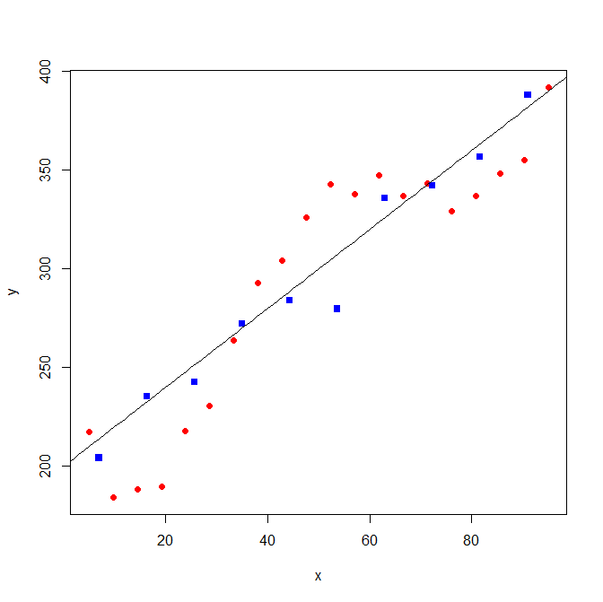
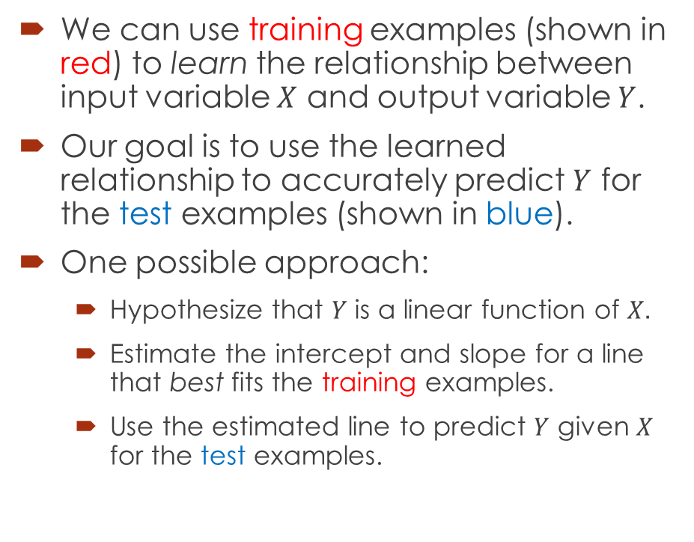
Supervised Learning: Predict output based on inputs
obs. | X | Y
1 | 5.0 | 217.4
2 | 9.7 | 184.2
3 | 14.5 | 188.3
4 | 19.2 | 189.5
5 | 23.9 | 218.0
6 | 28.7 | 230.8
7 | 33.4 | 263.9
8 | 38.2 | 293.0
9 | 42.9 | 304.2
10 | 47.6 | 325.9
11 | 52.4 | 343.0
12 | 57.1 | 337.8
13 | 61.8 | 347.2
14 | 66.6 | 336.9
15 | 71.3 | 343.3
16 | 76.1 | 329.3
17 | 80.8 | 337.1
18 | 85.5 | 348.3
19 | 90.3 | 355.2
20 | 95.0 | 392.1
21 | 7.0 | 204.3
22 | 16.3 | 235.5
23 | 25.7 | 242.5
24 | 35.0 | 272.4
25 | 44.3 | 283.8
26 | 53.7 | 279.7
27 | 63.0 | 335.8
28 | 72.3 | 342.0
29 | 81.7 | 356.8
30 | 91.0 | 388.2
We can use training examples (shown in red) to learn the relationship between input variable $X$ and output variable $Y$.
Our goal is to use the learned relationship to accurately predict $Y$ for the test examples (shown in blue).
One possible approach:
Hypothesize that $Y$ is a linear function of $X.$
Estimate the intercept and slope for a line that best fits the training examples.
Use the estimated line to predict $Y$ given $X$ for the test examples.
Training examples
Test examples

Slide 9
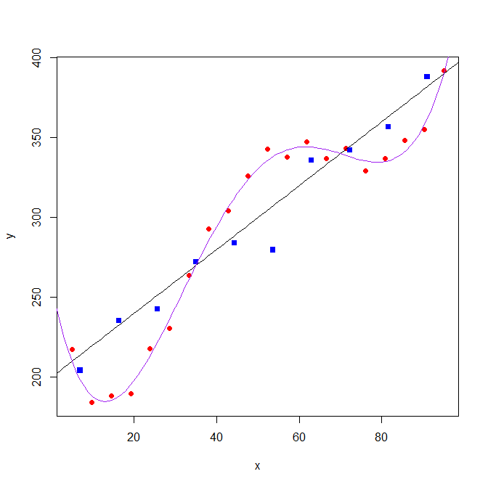
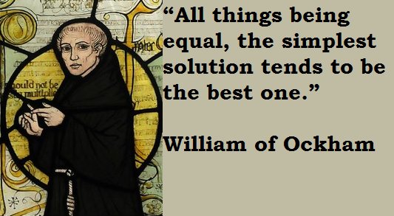
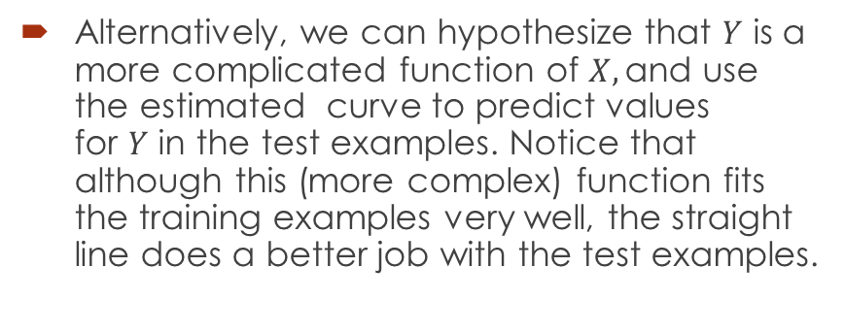
Caution!!! Overfitting
Alternatively, we can hypothesize that $Y$ is a more complicated function of $X,\text{and} \text{use} \text{the} \text{estimate}\text{d} \text{curve} \text{to} \text{predict} \text{values} \text{for} Y \text{in} \text{the} \text{test} \text{examples}\text{.}$ Notice that although this (more complex) function fits the training examples very well, the straight line does a better job with the test examples.
Occam’s razor

Slide 10
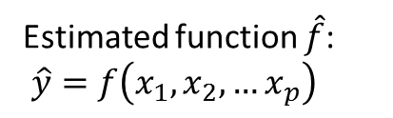

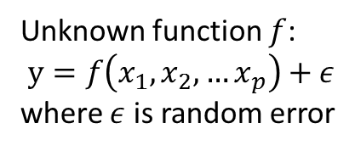
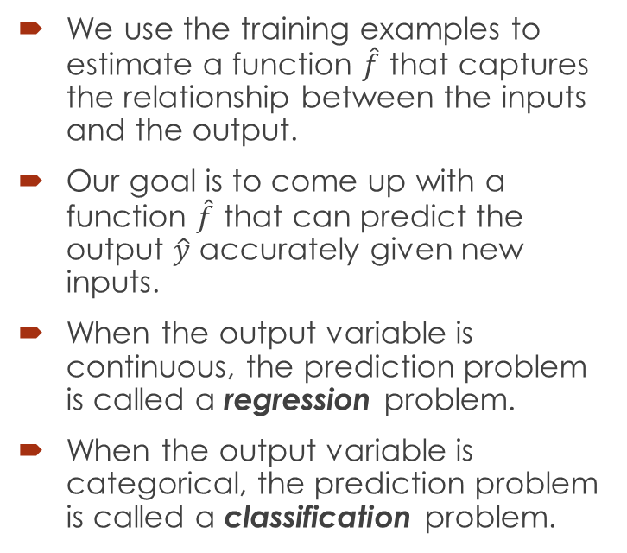




Supervised Learning
$$x_{1}$$
Unknown function $f$:
$y=f\left(x_{1},x_{2},…x_{p}\right)+ε$
where $ε$ is random error
We use the training examples to estimate a function $\hat{f}$ that captures the relationship between the inputs and the output.
Our goal is to come up with a function $\hat{f}$ that can predict the output $\hat{y}$ accurately given new inputs.
When the output variable is continuous, the prediction problem is called a regression problem.
When the output variable is categorical, the prediction problem is called a classification problem.
$$x_{2}$$
Input variables
.
.
.
Observed: $y$
Estimated function $\hat{f}$:
$\hat{y}=f\left(x_{1},x_{2},…x_{p}\right)$
Predicted: $\hat{y}$
$$x_{p}$$
Evaluation should be based on test samples that were not used for training.

Slide 11
Common supervised learning methods:
Linear Regression
Logistic Regression
K Nearest Neighbors
Classification and Regression Trees
Random Forests
Support Vector Machines
Naïve Bayes classifier
Artificial Neural Networks

Slide 12
Resources
Open source software:
Python:
scikit-learn: http://scikit-learn.org/dev/index.html
Tensorflow: https://www.tensorflow.org/
R: http://cran.r-project.org/
Java: Weka: http://www.cs.waikato.ac.nz/ml/weka/index.html
C++: MLPACK: http://www.mlpack.org/
Proprietary software: SAS, SPSS, MATLAB
Data repositories:
UC Irvine Machine Learning Repository: http://archive.ics.uci.edu/ml/
kaggle: https://www.kaggle.com/
Free courses:
EdX: https://www.edx.org/
Coursera: https://www.coursera.org/
Udacity: https://www.udacity.com/
Books:
The Elements of Statistical Learning: http://statweb.stanford.edu/~tibs/ElemStatLearn/
An Introduction to Statistical Learning: http://www-bcf.usc.edu/~gareth/ISL/

Slide 13
Getting started:
Create a folder on your computer and download into it all the files from my GitHub folder:
https://github.com/SumitraMukherjee/DataScience
Open your browser and visit to Google Colaboratory:
https://colab.research.google.com/notebooks/welcome.ipynb
Sign in with your google userid and password
Follow my instructions and let me know any time you need help

