Slide 1
AI-Powered E-Commerce
Customer Churn Analytics &
Retention Decision Support System
Eligible customers
1,765
Future inactive
490
Predicting 90-Day Customer Inactivity Risk Using Transactional Analytics and Machine Learning
High-risk tier
353
IBM SkillsBuild Data Analytics & AI Internship 2026
Prepared by Tanmay Chawhan
24 September 2026

Slide 2
Project at a Glance
Validated end-to-end workflow from transaction data to customer-level decision support.
Raw transactions
Qualified transactions
Eligible customers
Future inactivity
High-risk customers
541,909
392,692
1,765
27.76%
353
490 / 1,765
20% of eligible
Workflow
What makes the project reproducible
01
Audit & clean
Validate source, duplicates, cancellations, missing customers
Fixed 31-Aug-2011 snapshot and 90-day future window.
Explicit qualifying-purchase and eligibility rules.
Customer-level 80/20 stratified split with random_state=42.
Preprocessing contained inside the scikit-learn Pipeline.
141 automated tests and four executable notebooks.
02
Build customer view
Snapshot features + RFM + eligibility
03
Predict inactivity
Leakage-safe Logistic Regression
04
Prioritize review
Probability → risk tier → retention context
IBM SkillsBuild Data Analytics & AI Internship 2026 • Tanmay Chawhan
2

Slide 3
Business Problem & Objectives
Turn historical purchase activity into structured evidence for customer retention review.
Problem statement
Objectives
Which eligible customers show historical patterns associated with a higher likelihood of future inactivity, and how can that risk be presented in a usable decision-support workflow?
Validate and clean the UCI Online Retail transaction data without altering the raw source.
Construct a snapshot-based customer analytical dataset using information available on or before 31-Aug-2011.
Perform RFM and supporting behavioral analysis.
Define Churn_90D as a project-specific 90-day future-inactivity proxy.
Train and evaluate an interpretable Logistic Regression classifier.
Generate continuous inactivity probabilities and operational risk tiers.
Provide customer- and segment-level retention decision support in Streamlit.
The project is observational: the model estimates risk and does not establish why a customer becomes inactive or guarantee that a retention action will change future behavior.
IBM SkillsBuild Data Analytics & AI Internship 2026 • Tanmay Chawhan
3

Slide 4
Dataset & Data Quality Audit
Official UCI Online Retail workbook validated before customer-level analysis.
Source: UCI Machine Learning Repository • Dataset 352 • DOI 10.24432/C5BW33
Audit check | Verified result
Raw rows | 541,909
Missing CustomerID | 135,080
Missing Description | 1,454
Exact duplicates | 5,268
Cancellation rows | 9,288
Quantity ≤ 0 | 10,624
UnitPrice ≤ 0 | 2,517
Unique invoices | 25,900
Unique products | 4,070
Unique customers | 4,372
Countries | 38
Date range | 2010-12-01 to 2011-12-09
Cleaning logic
1
Schema validation + InvoiceDate parsing
2
Normalize missing descriptions to “Unknown” for analysis
3
Remove exact duplicates from analytical data
4
Flag cancellations where InvoiceNo starts with C
5
Keep only CustomerID present, non-cancellation, Quantity > 0, UnitPrice > 0
6
Calculate Revenue = Quantity × UnitPrice
Result: 392,692 qualifying transactions retained for customer analytics. Raw workbook remains unchanged.
IBM SkillsBuild Data Analytics & AI Internship 2026 • Tanmay Chawhan
4

Slide 5
Temporal Design & Churn Definition
The target looks forward from a fixed snapshot; predictors never use post-snapshot information.
Observation period
Snapshot
Future label window
01-Dec-2010 → 31-Aug-2011
31-Aug-2011
01-Sep-2011 → 29-Nov-2011
Customer eligibility
Churn_90D target
Eligible customer = both conditions during the observation period
No qualifying purchase in the future window
At least 2 distinct qualifying invoices
At least 30 days between first and last qualifying purchase
→ Churn_90D = 1
At least one qualifying purchase
→ Churn_90D = 0
Result: 1,765 eligible customers
The UCI dataset has no native churn label. Churn_90D is a project-defined future-inactivity proxy.
IBM SkillsBuild Data Analytics & AI Internship 2026 • Tanmay Chawhan
5

Slide 6
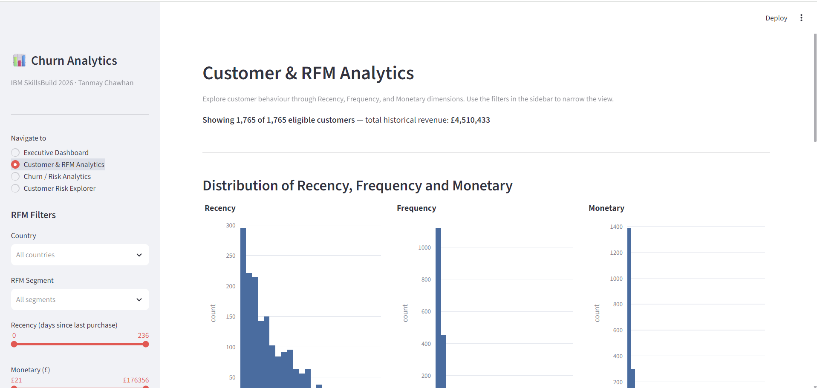
Customer Features & RFM Segmentation
Snapshot-based customer behavior is summarized through nine numeric features plus descriptive RFM scoring.
Feature set
Recency
Frequency
Monetary
AvgOrderValue
UniqueProducts
TotalItems
ActiveMonths
TenureDays
PurchaseSpanDays
RFM scoring
R: recent is higher score
F: more orders is higher score
M: higher spend is higher score
RFM_Score = R + F + M (3–15)
Segments
13–15 Very High • 10–12 High • 7–9 Medium • 3–6 Lower
IBM SkillsBuild Data Analytics & AI Internship 2026 • Tanmay Chawhan
6

Slide 7
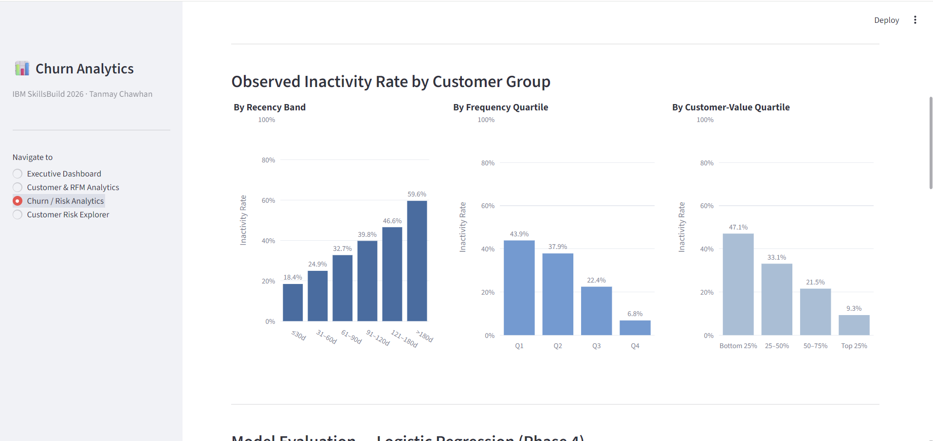
Observed Inactivity Patterns
Historical recency, frequency, and customer-value groups show distinct observed future-inactivity rates.
Observed inactivity by recency band
≤30d
18.4%
31–60d
24.9%
61–90d
32.7%
91–120d
39.8%
121–180d
46.6%
>180d
59.6%
Frequency quartiles: Q1 43.89%, Q2 37.87%, Q3 22.45%, Q4 6.80%. The quartiles are deterministic rank-based population groups to handle tied integer frequencies.
IBM SkillsBuild Data Analytics & AI Internship 2026 • Tanmay Chawhan
7

Slide 8
Machine Learning Methodology
A transparent, leakage-safe Logistic Regression pipeline predicts future inactivity risk.
Observation features
Train / test split
Preprocessing
Classifier
Outputs
9 numeric behavioral features
80 / 20 • stratified • random_state=42
StandardScaler inside Pipeline
Logistic Regression
class_weight=balanced
Probability + class
+ interpretability
Leakage controls
Why Logistic Regression?
No predictor uses information after 31-Aug-2011.
Churn_90D is generated only from 01-Sep-2011 to 29-Nov-2011.
CustomerID, Churn_90D, R/F/M labels, RFM_Score and RFM_Segment are excluded from X.
Preprocessing is fitted only on the training split.
Interpretable coefficients and probability output.
Reproducible baseline with modest complexity.
Supports threshold analysis and customer-level risk ranking.
Aligned with the project focus on explainable decision support.
IBM SkillsBuild Data Analytics & AI Internship 2026 • Tanmay Chawhan
8

Slide 9
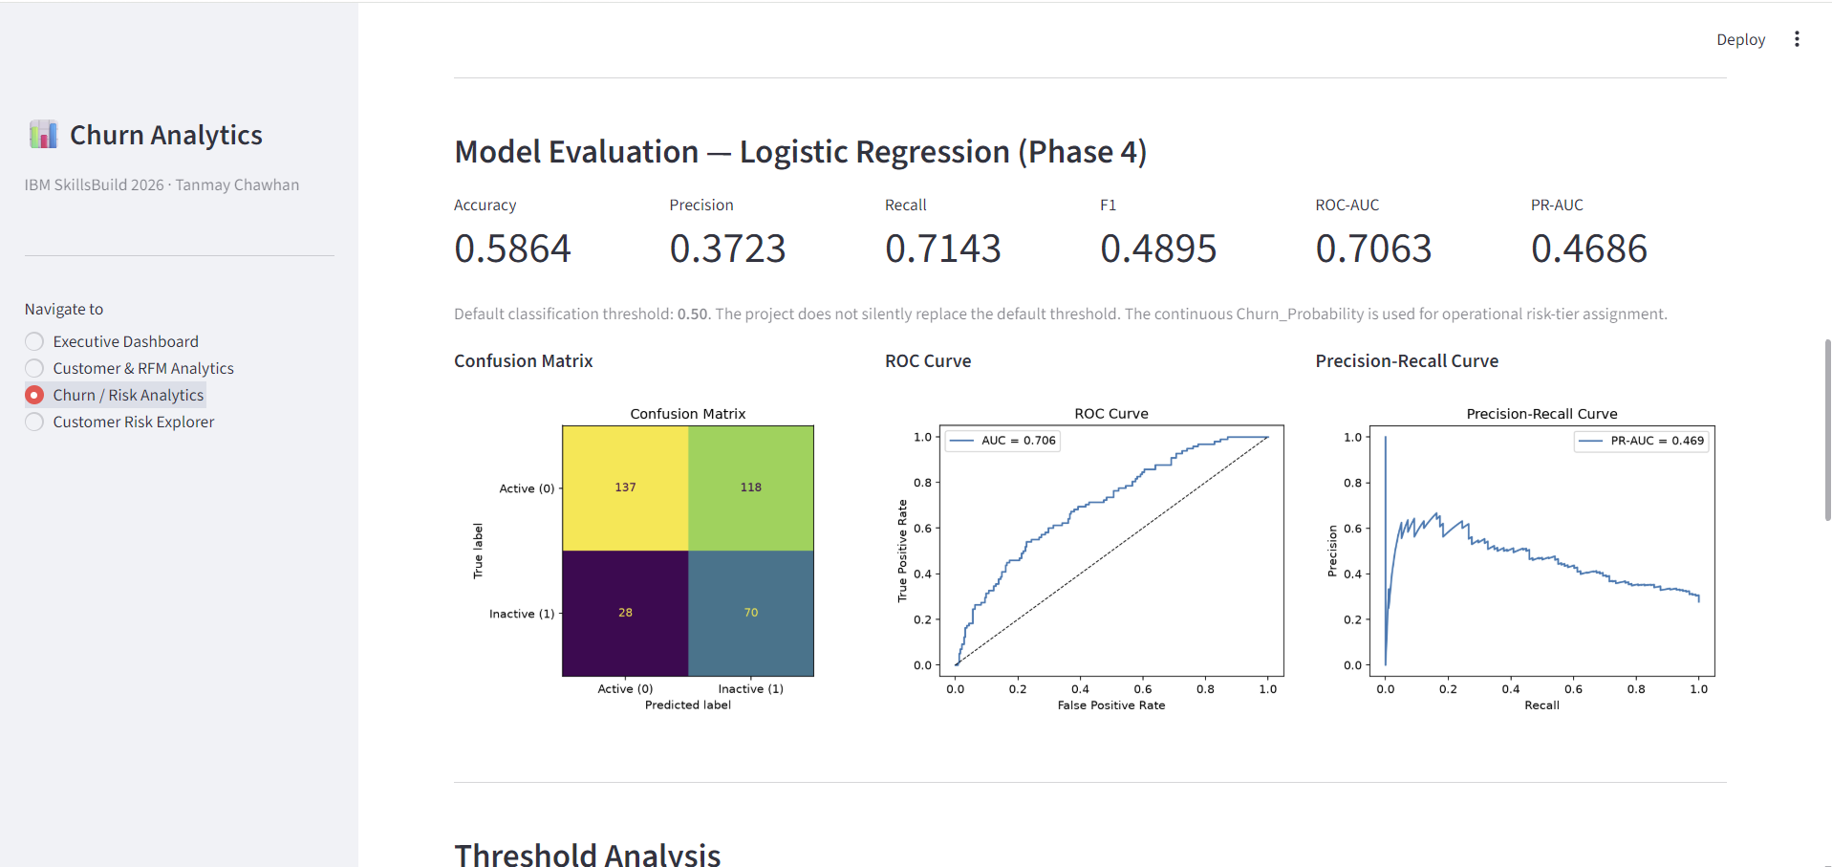
Model Performance on the Held-Out Test Set
Metrics below are calculated only on the 353-customer test set.
Accuracy
Precision
Recall
F1
ROC-AUC
PR-AUC
58.64%
37.23%
71.43%
48.95%
0.7063
0.4686
Confusion matrix counts
Pred A
Pred I
True A
137
118
True I
28
70
70 / (70 + 28) = 71.43% recall
The model shows useful discrimination while retaining substantial false positives. Accuracy alone is not sufficient on this imbalanced target.
IBM SkillsBuild Data Analytics & AI Internship 2026 • Tanmay Chawhan
9

Slide 10
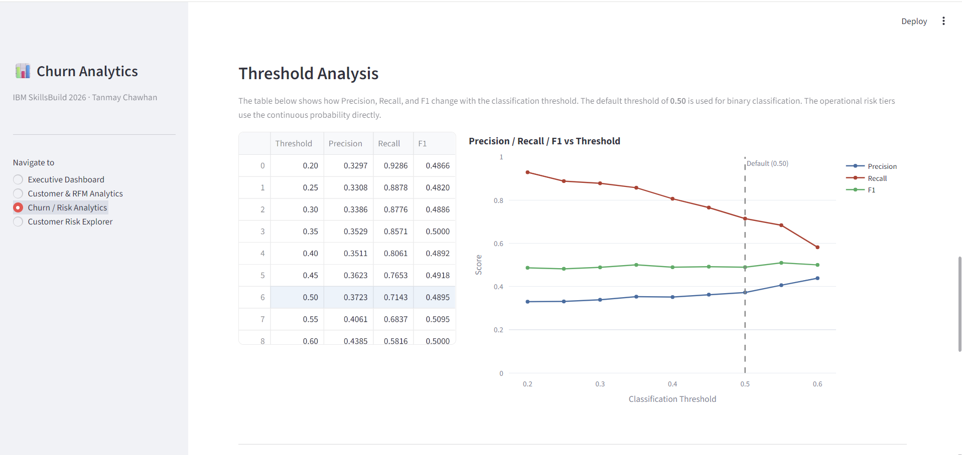
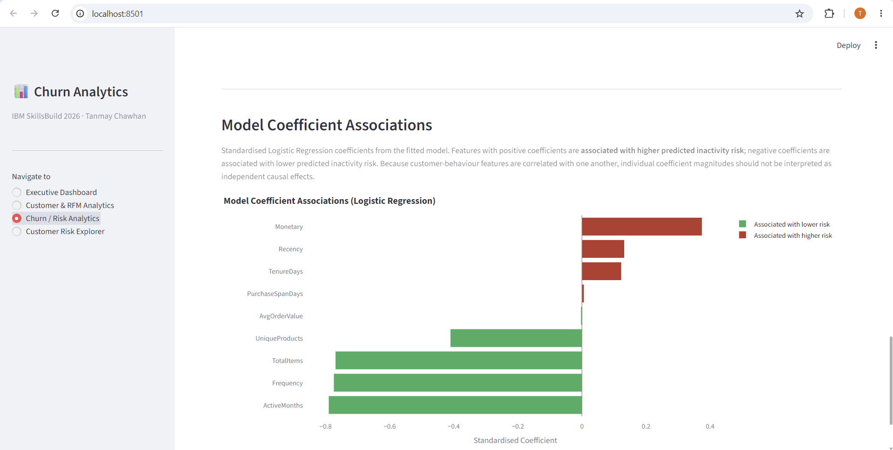
Threshold Analysis & Model Coefficient Associations
The application keeps the default 0.50 classifier threshold and uses continuous probability for operational risk tiers.
Selected threshold trade-off
Coefficient interpretation
At 0.50: Precision 0.3723 • Recall 0.7143 • F1 0.4895
Positive coefficients are associated with higher predicted inactivity risk; negative coefficients with lower predicted risk. Correlated behavior features limit causal interpretation.
IBM SkillsBuild Data Analytics & AI Internship 2026 • Tanmay Chawhan
10

Slide 11
Operational Risk Segmentation & Retention Decision Support
Continuous model probabilities are converted into population-based risk tiers, then combined with historical customer value.
Low Risk
Medium Risk
High Risk
706
706
353
706 customers • bottom 40%
706 customers • 40th–80th percentile
353 customers • top 20%
Risk × value context
Key operational metric
Risk + value context | Decision-support label
High + Very High / High | Priority retention attention
High + Medium | Targeted attention
High + Lower | Lower-cost intervention
Medium + High | Monitor / targeted engagement
Low + High | Relationship / loyalty attention
Low + Lower | Standard engagement
High-risk historical revenue
£220,990
4.9% of eligible-customer historical revenue
Risk tiers are operational segmentation rules. Retention labels are decision-support groupings, not experimentally validated intervention policies.
IBM SkillsBuild Data Analytics & AI Internship 2026 • Tanmay Chawhan
11

Slide 12
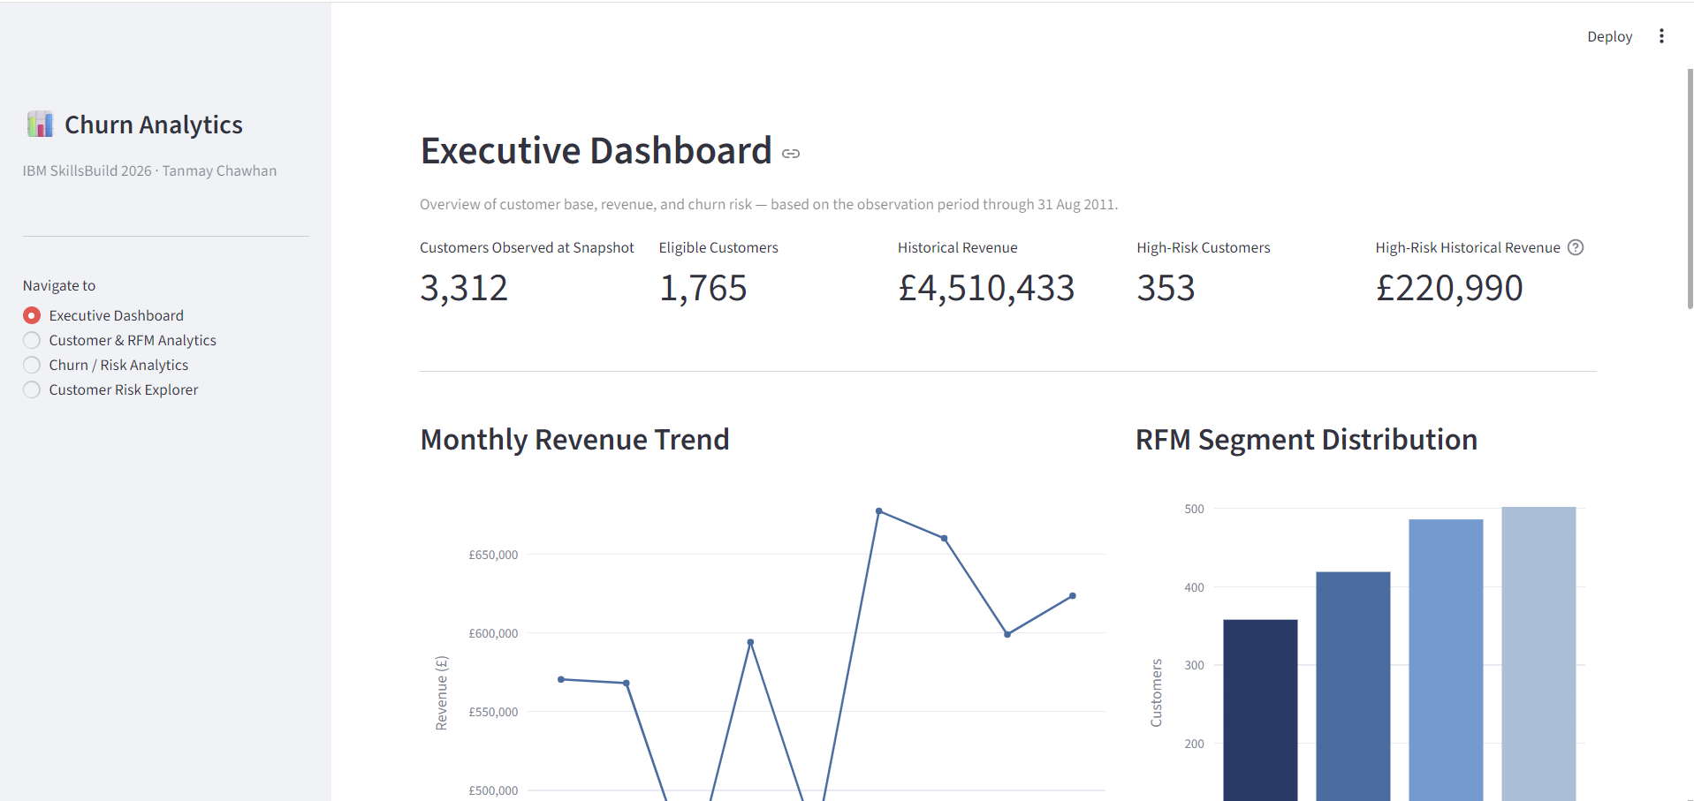
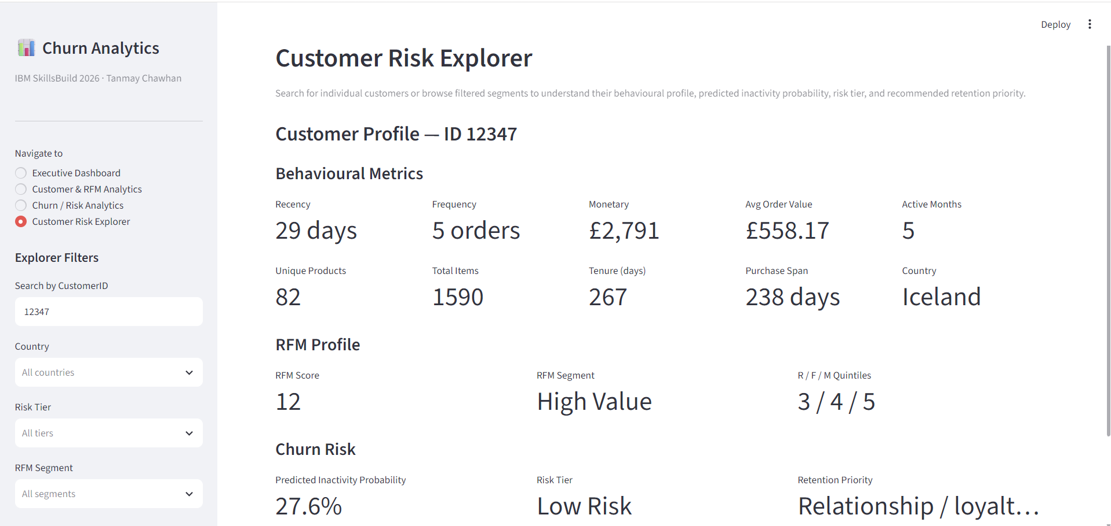
Streamlit Decision-Support Dashboard
Four sections connect executive overview, customer behavior, model evaluation, and customer-level risk review.
Executive Dashboard
Customer Risk Explorer
KPIs • monthly revenue • RFM segments • risk distribution • country revenue
Behavioral profile • RFM • probability • risk tier • retention priority
IBM SkillsBuild Data Analytics & AI Internship 2026 • Tanmay Chawhan
12

Slide 13
Key Findings, Limitations & Conclusion
The final system is a decision-support prototype built for transparent, reproducible customer-risk analysis.
Key findings
Limitations & conclusion
27.76% of eligible customers were future-inactive under the project-defined 90-day proxy.
Observed inactivity increased across higher recency bands, from 18.4% at ≤30 days to 59.6% above 180 days.
Frequency quartile inactivity ranged from 43.89% in Q1 to 6.80% in Q4.
Higher customer-value quartiles had lower observed future-inactivity rates in this population.
The Logistic Regression model achieved ROC-AUC 0.7063 and PR-AUC 0.4686 on the held-out test set.
The dashboard operationalizes risk as continuous probability → risk tier → retention context.
Churn_90D is a project-defined future-inactivity proxy, not a native churn label.
The dataset represents one retailer and a specific historical period.
Observed associations and model coefficients do not establish causation.
Risk scores are ranking aids, not guarantees of future behavior.
Retention-priority labels are decision-support rules, not causal intervention evidence.
Conclusion
The project demonstrates a complete analytics-to-action workflow: clean transactions → snapshot features → future-inactivity label → interpretable ML → risk segmentation → interactive dashboard.
Final validation: 141 automated tests passed; four notebooks validated; model artifact loads cleanly; Streamlit application is runnable.
IBM SkillsBuild Data Analytics & AI Internship 2026 • Tanmay Chawhan
13

Slide 14
References & Project Artifacts
Primary sources and implemented project materials documented in the final report.
References
Final artifacts
UCI Machine Learning Repository. Online Retail. Dataset 352. DOI: 10.24432/C5BW33.
Chen, D., Sain, S. L., & Guo, K. (2012). Data mining for the online retail industry: a case study of RFM model-based customer segmentation. Journal of Database Marketing & Customer Strategy Management, 19(3), 197–208. DOI: 10.1057/dbm.2012.17.
scikit-learn documentation: LogisticRegression, Pipeline, StandardScaler, evaluation metrics and model-selection utilities.
Streamlit documentation: multipage applications and sidebar navigation configuration.
Project report (.docx)
Four Jupyter notebooks
Validated processed datasets and audit outputs
Saved Logistic Regression pipeline (.joblib)
Model evaluation figures and metrics
Streamlit dashboard source
Automated tests (141 passed)
Git repository: initial commit 42b9259; latest verified commit 07fabd1 on main branch
Repository is published on GitHub and ready for internship submission packaging.
IBM SkillsBuild Data Analytics & AI Internship 2026 • Tanmay Chawhan
14

