Slide 1
IBM University Engagement Project Submission
“Exploring the Power of Agentic AI with IBM Granite and LangFlow”

Slide 2

Project Title – AI-Powered College Admission Agent
Domain of Project – Educational Technology & Applied AI
Student Name | Recent Passport Photo | Email ID | Mobile number [WhatsApp]
Sumit |  | s20025261@gmail.com | 7419075831

Slide 3
Problem Statement -
The Challenge:
Prospective students and their families often struggle to navigate complex, scattered institutional databases to find up-to-date information regarding admission policies, fee structures, and eligibility criteria. This data fragmentation forces a heavy reliance on manual inquiries—such as phone calls, emails, and physical campus visits. These manual processes are highly inefficient, prone to delays, and severely overwhelm university administration staff during peak admission seasons.
The Objective:
To design and deploy an Agentic AI assistant powered by Retrieval-Augmented Generation (RAG) that autonomously streamlines the student admission process. The objective is to provide a 24/7, highly accurate, conversational digital assistant that retrieves verified university data in real-time. By doing so, the system will reduce administrative bottlenecks, boost operational efficiency, and significantly enhance the accessibility and transparency of the college application experience.

Slide 4
Proposed Solution -
Proposed Solution: AI-Powered Admission Agent
The proposed solution is an AI-powered College Admission Agent built using Python Flask, LangChain, IBM watsonx.ai, and Granite Models to provide personalized, real-time academic guidance. The system addresses challenges in navigating university policies, fee structures, and eligibility criteria through an intelligent, modular architecture.
At its core, the solution uses a Retrieval-Augmented Generation (RAG) pipeline to fetch accurate institutional data from verified university datasets. This unstructured text is embedded and stored in a local FAISS vector database, enabling the system to retrieve and summarize specific admission details (such as B.Tech CSE deadlines, course matrices, and hostel fees) using Granite models.
The system consists of four key functional components:
Vector Retrieval Engine searches the FAISS index to instantly extract highly relevant contextual data from the university knowledge base.
Granite AI Generator formulates precise, natural language responses strictly based on the retrieved facts, eliminating hallucinations and ensuring trust.
Conversational Memory Pipeline maintains the context of the applicant's inquiries, allowing for natural, follow-up questions during the session.
Interactive Web Dashboard provides a responsive, dark-mode chat interface built with Flask and Bootstrap for applicants to interact with the agent intuitively.

Slide 5
Technology Used
Python Flask Framework – For designing and orchestrating the backend API and serving the web-based chat interface.
IBM Granite Model (ibm-granite-3-1-8b-base) – For natural language understanding, contextual reasoning, and generating professional, accurate responses.
IBM Cloud – Provides a reliable, secure, and scalable environment for API access to the Granite models.
RAG (Retrieval-Augmented Generation) – To fetch real institutional data first, then generate intelligent answers, making the Admission Agent trustworthy and eliminating false information.
IBM Watsonx.ai – For model deployment, API access, and AI governance.
Vector Database (FAISS CPU) – For chunking text, creating mathematical embeddings, and enabling high-speed semantic search of the admission data.

Slide 6
Core Framework Components Used -
User Interaction Interface (Chat Input & Output): A custom-built, responsive Flask web dashboard that securely captures prospective students' natural language queries and dynamically displays the AI-generated responses in an intuitive chat format.
Knowledge Ingestion Component (Document Loader): Utilizes RecursiveCharacterTextSplitter to act as the file processing module, actively reading, cleaning, and chunking the unstructured institutional data directly from university_data.txt.
Vector Retrieval Database (FAISS): Acts as the agent's long-term memory by storing mathematical embeddings (generated via HuggingFace). This allows the system to perform hyper-fast semantic similarity searches across thousands of university policies instantly.
IBM Watsonx.ai Engine (Granite LLM): The core reasoning and generation module powered by the ibm-granite-3-1-8b-base model. It processes the retrieved context alongside the user query to synthesize accurate, professional, and hallucination-free answers.
RetrievalQA Orchestration Chain: The underlying logical component that binds the entire workflow together—acting as the "Agent." It automatically routes the user's question to the vector store, retrieves the most relevant facts, applies strict guardrail prompts, and feeds everything to the Granite model for final generation.

Slide 7
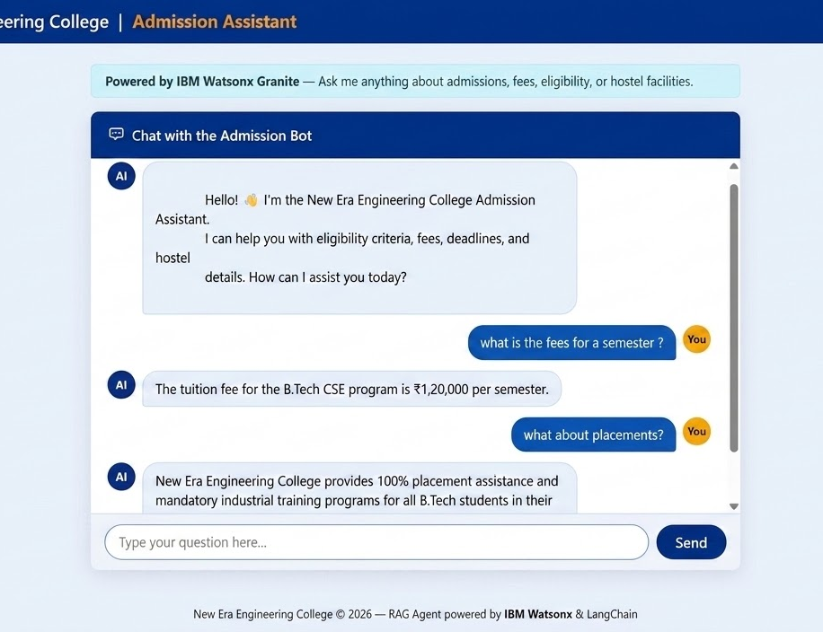
Live Demonstration: Interactive Web Interface
Intuitive User Experience: Developed a responsive, modern web dashboard using HTML, CSS (Bootstrap), and Vanilla JavaScript.
Asynchronous Communication: The frontend communicates seamlessly with the Python Flask backend via asynchronous API fetches, preventing page reloads.
Real-Time RAG Synthesis: The interface demonstrates the IBM Granite model successfully parsing user intent and synthesizing localized institutional data into a coherent response.
Professional Styling: Designed with an enterprise-grade dark mode to ensure high contrast and readability for prospective students.

Slide 8
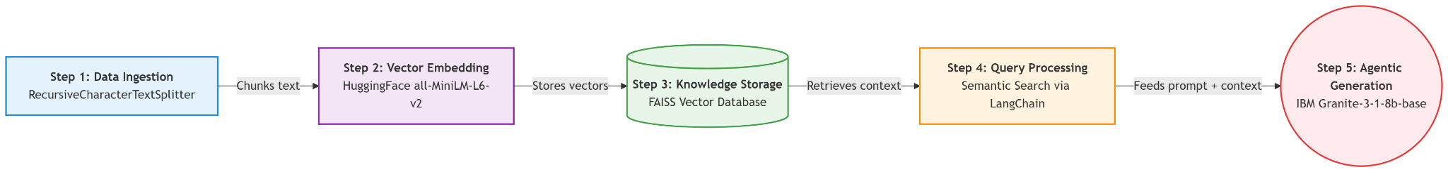
Application Execution Workflow -

Slide 9
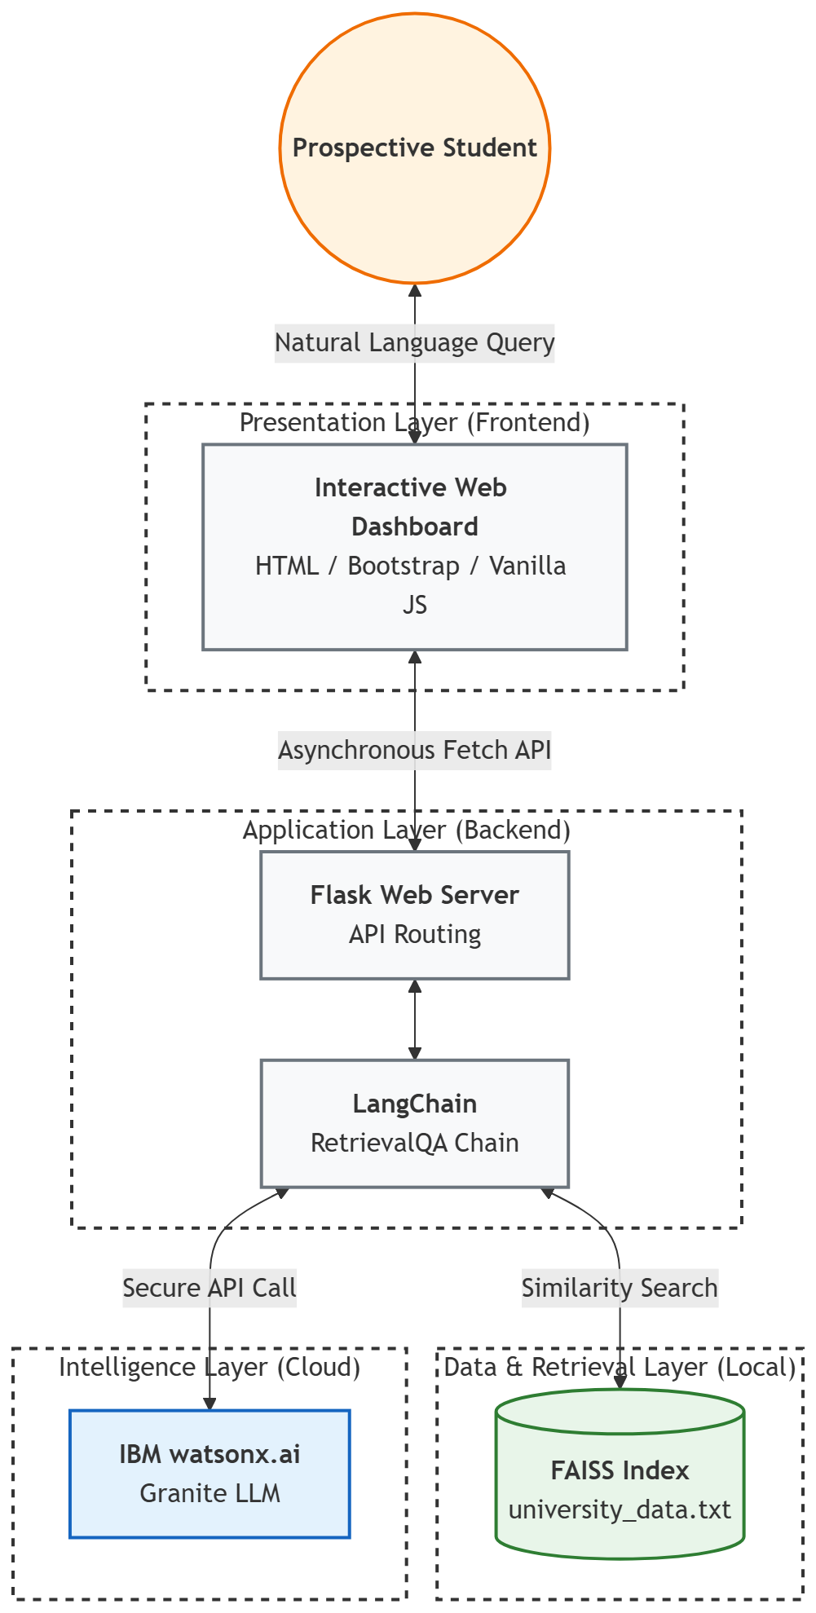
Architecture blueprint

Slide 10

Role of Agentic AI in the solution
Deterministic Fact-Checking: Unlike standard generative AI which relies on its pre-trained memory, this agentic system actively searches for the truth within the provided document before speaking.
Autonomous Synthesis: The agent intelligently combines multiple scattered facts (e.g., pulling tuition fees from paragraph A and hostel fees from paragraph B) into a single, cohesive answer.
Adaptive Fallback: The agent is programmed with specific instructions to confidently state "I don't know" when asked about data not present in the institutional database, preserving trust and accuracy.

Slide 11
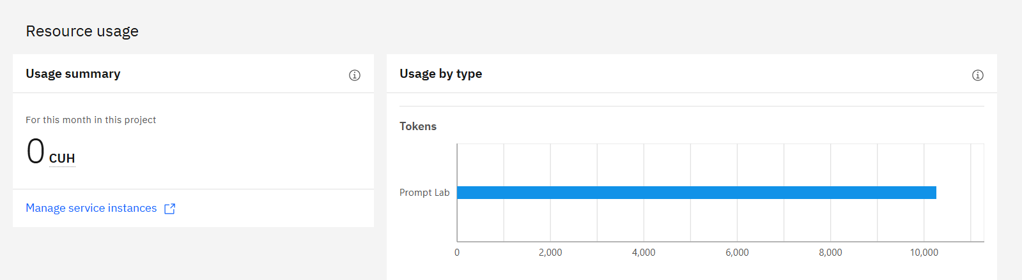
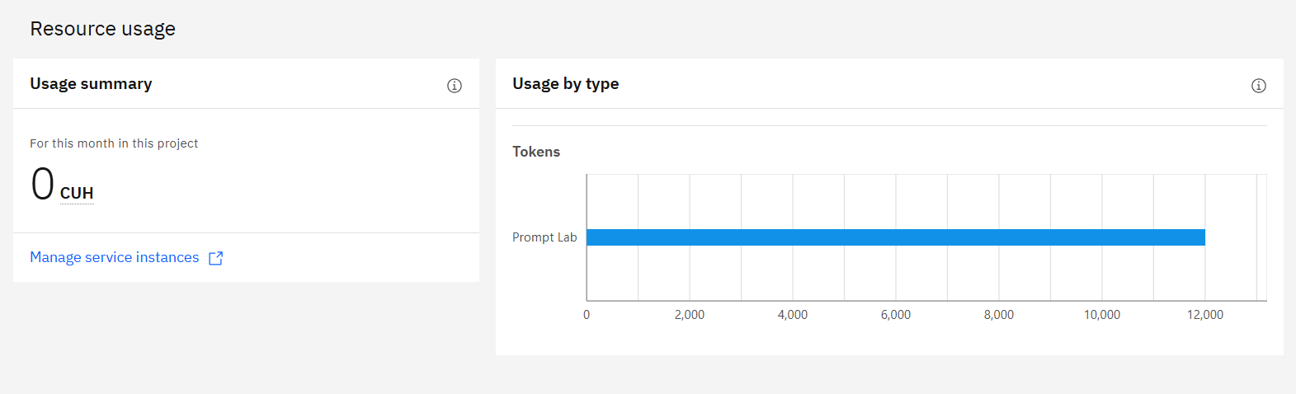
Token Usage
Before Prompt
After Prompt

Slide 12
Novelty and Uniqueness
Zero-Shot Adaptation: The system requires zero model retraining to learn new facts; updating the admission criteria is as simple as editing a text file.
Semantic Understanding: The agent understands the intent behind a question, successfully answering queries even if the student uses typos or completely different phrasing than the source document.
Enterprise-Grade Security: By utilizing IBM watsonx.ai, data is processed securely, making the architecture viable for scaling to handle sensitive student data in the future.

Slide 13
Git Hub Link
Project Repository URL: https://github.com/Sumitsaini101/College-Admission-Agent
Repository Contents & Deliverables: This public repository contains the complete source code and required documentation for the EduAI Agentic RAG system, structured for easy deployment and evaluation:
app.json – Contains project metadata, required environment variables, and execution scripts for deployment.
Problem_Statement.pdf – The official AICTE / IBM University Engagement challenge document (Problem Statement No. 4).
Project_Presentation.pptx – This complete architectural and solution overview presentation.
app.py & requirements.txt – The core Python Flask server, LangChain orchestration logic, and required dependencies.
university_data.txt – The localized, unstructured knowledge base used for the FAISS vector retrieval.
README.md – Comprehensive, enterprise-standard documentation detailing the system architecture, features, and step-by-step setup instructions.

Slide 14
Future Scope
Multi-Modal Ingestion: Upgrading the LangChain document loaders to directly parse complex PDF brochures, course matrices, and tabular fee structures.
Predictive Analytics Dashboard: Adding a backend feature to log user queries, allowing college administrators to identify the most frequently asked questions and admission trends.
Omnichannel Deployment: Porting the Flask API to a webhook, enabling the admission agent to answer queries directly via WhatsApp and the official university student portal.
·
·

Slide 15
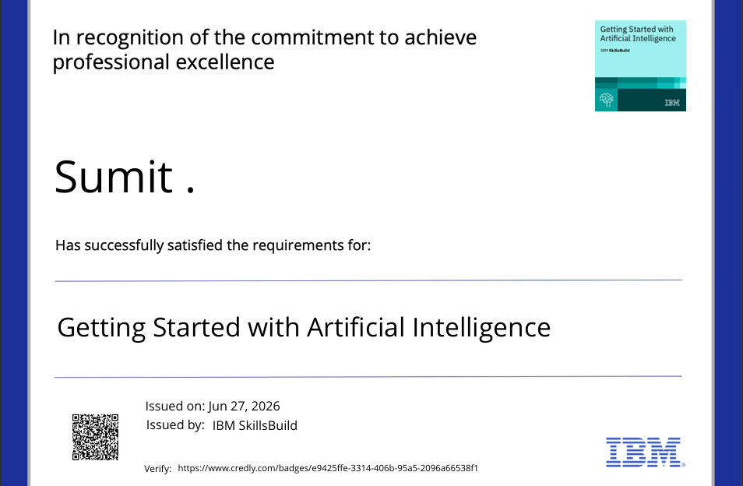
Certificates Earned:

Slide 16
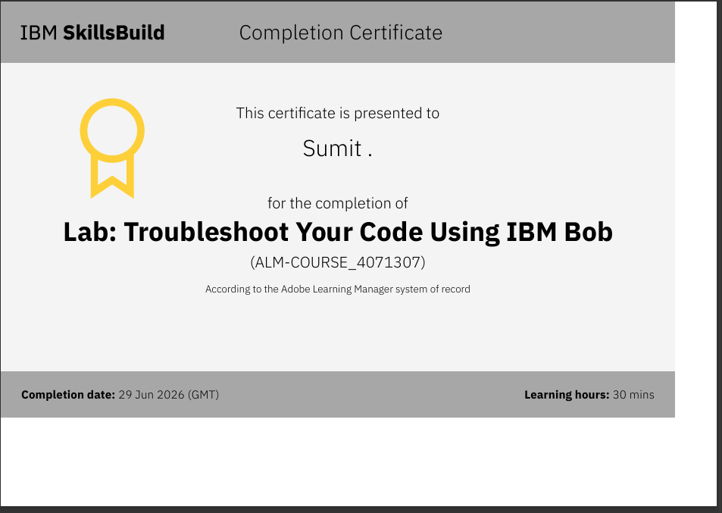
Certificates Earned:​

Slide 17


