Slide 1

Viral Video Performance Analysis
Analyzing 400 videos across 10 performance metrics to uncover what drives short-form video success

Slide 2





Dataset Overview
400 Videos Analyzed
10 Key Metrics
195 Million Total Views
Our comprehensive dataset spans various niches and formats, providing a rich foundation for analysis.
Each video was meticulously evaluated against a suite of performance indicators to ensure robust insights.
Aggregated reach across all analyzed content, demonstrating significant audience engagement.

Slide 3
Data Preparation Workflow
01
02
03
Data Loading & Exploration
Quality Verification
Feature Engineering
Imported dataset using pandas, ran initial checks on structure and statistics
Confirmed zero missing values across all 400 rows and 10 columns
Created duration categories and growth percentage calculations
04
05
Data Cleaning
Database Integration
Identified and corrected data entry errors exceeding 100% growth
Loaded cleaned dataset into MySQL for advanced analysis

Slide 4

Growth Pattern Categories
Flash Viral
Strong first hour, then gradually declines
Early Growth
Good start with moderate traction
Balanced Growth
Performs consistently over time
Late Viral
Not strong initially, goes viral later

Slide 5
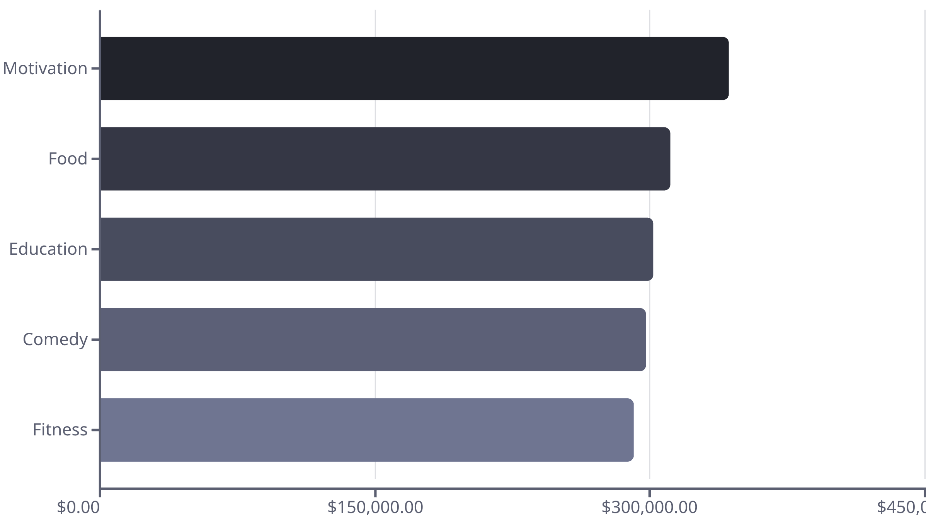
Top Revenue-Generating Niches
Weighted by views, hook strength, and retention rate

Slide 6
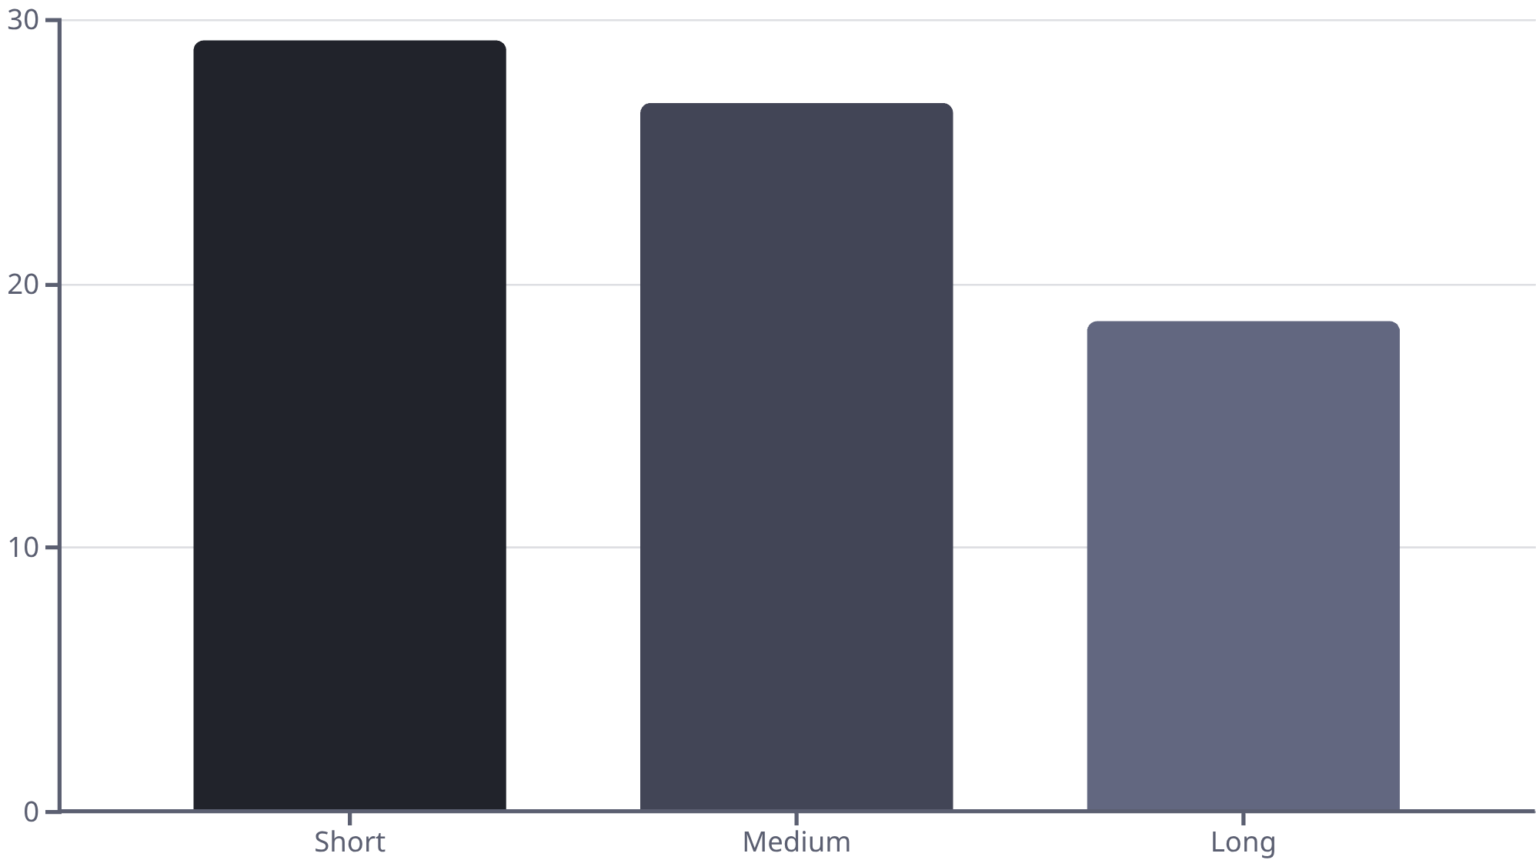

Video Duration Impact
Late Viral Performance by Length
Key Finding: Short videos (avg 11.5 sec) produce the highest percentage of late viral content at 29.2%

Slide 7



Missed Monetization Opportunities
High retention videos with below-average first hour views
94%
93%
92%
Peak Retention
Travel Content
Beauty Video
Beauty niche video with only 11.8K first hour views
Strong retention but slow initial growth at 2.6%
802K total views despite modest 21.5K start

Slide 8

Music Type Strategy
Late Viral Growth by Music
Viral Track: 13.21% avg growth, 18 late viral videos
Remix: 12.01% avg growth, 18 late viral videos
Trending: 8.55% avg growth, 19 late viral videos
No Music: 8.32% avg growth, 22 late viral videos
Original: 8.02% avg growth, 23 late viral videos

Slide 9
Upload Timing ROI
Wednesday
1
310,975 ROI
2
Sunday
302,984 ROI
Monday
3
301,135 ROI
4
Tuesday
290,659 ROI
Thursday
5
285,420 ROI
Strategic Insight: Wednesday posts generate highest ROI, followed by weekend content

Slide 10

Key Takeaways
Niche Selection
Motivation and Food content drive highest revenue potential
Duration Strategy
Short videos excel at late viral growth (29.2%)
Music Matters
Viral tracks and remixes boost growth percentage significantly
Timing Optimization
Wednesday uploads maximize ROI per video

