Slide 1
Explainable AI for Mental Health Classification
Addressing Bias and Transparency in AI-Based Mental Health Systems
Summen Zahid (B00996747) | COM772 - Emerging and Advanced Topics in AI

Slide 2
Introduction & Motivation
Building on CW1 research on ethical implications of mental health AI
Key concerns identified:
• Patient safety and reliability
• Algorithmic bias and fairness
• Lack of transparency in AI decision-making
• Data privacy and consent
This project addresses these concerns through Explainable AI (XAI) techniques

Slide 3
Research Questions
1. Can XAI techniques (SHAP, LIME) make mental health AI more transparent?
2. How can we detect and measure bias in mental health classification?
3. What mitigation strategies effectively reduce algorithmic bias?
4. How do we balance model performance with fairness requirements?
5. What ethical frameworks ensure responsible AI deployment?

Slide 4
Literature Review: XAI Techniques
SHAP (SHapley Additive exPlanations)
• Game theory-based feature attribution
• Provides global and local interpretability
• Consistent and theoretically sound
LIME (Local Interpretable Model-agnostic Explanations)
• Local approximation of black-box models
• Model-agnostic approach
• Human-interpretable explanations
Both techniques critical for clinical AI systems (Lundberg et al., 2020)

Slide 5
Literature Review: Bias in Healthcare AI
Obermeyer et al. (2019): Racial bias in healthcare algorithms
• Algorithms showed significant disparities across demographic groups
Rajkomar et al. (2018): Challenges in clinical ML
• Bias amplification in training data
• Need for fairness-aware machine learning
Mehrabi et al. (2021): Survey of fairness in ML
• Multiple fairness definitions (demographic parity, equalized odds)
• Trade-offs between accuracy and fairness

Slide 6
Methodology Overview
Dataset: Mental Health in Tech Survey (1000 samples)
• Demographics, work environment, mental health history
• Target: Treatment-seeking behavior
Approach:
1. Data preprocessing and exploratory analysis
2. Multi-model training and evaluation
3. SHAP and LIME explainability analysis
4. Bias detection across demographic groups
5. Bias mitigation through reweighting
6. Ethical implications assessment

Slide 7
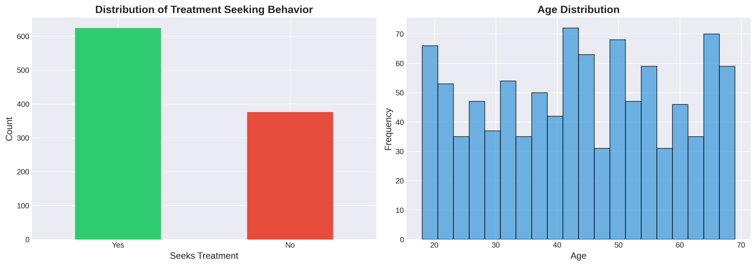
Data Exploration
Distribution of treatment-seeking behavior and age demographics

Slide 8
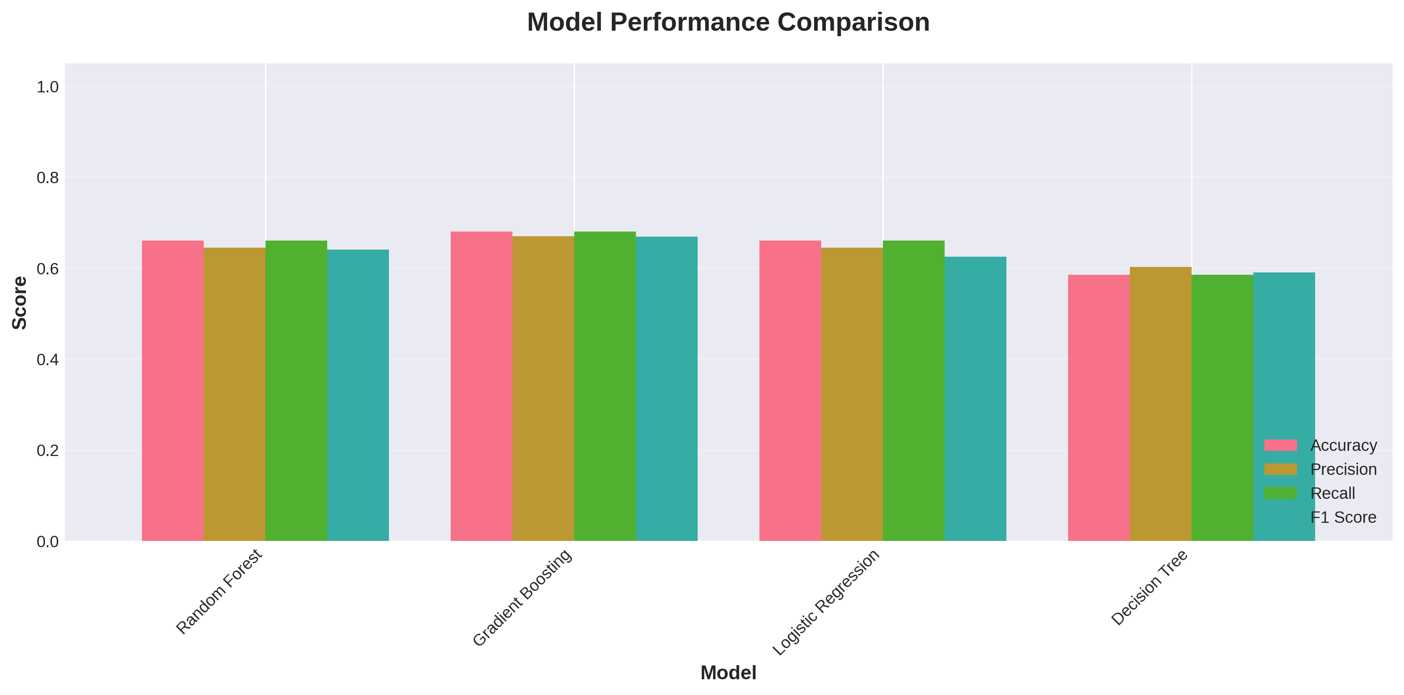
Model Performance Comparison
Gradient Boosting achieved best F1 score (0.67)

Slide 9
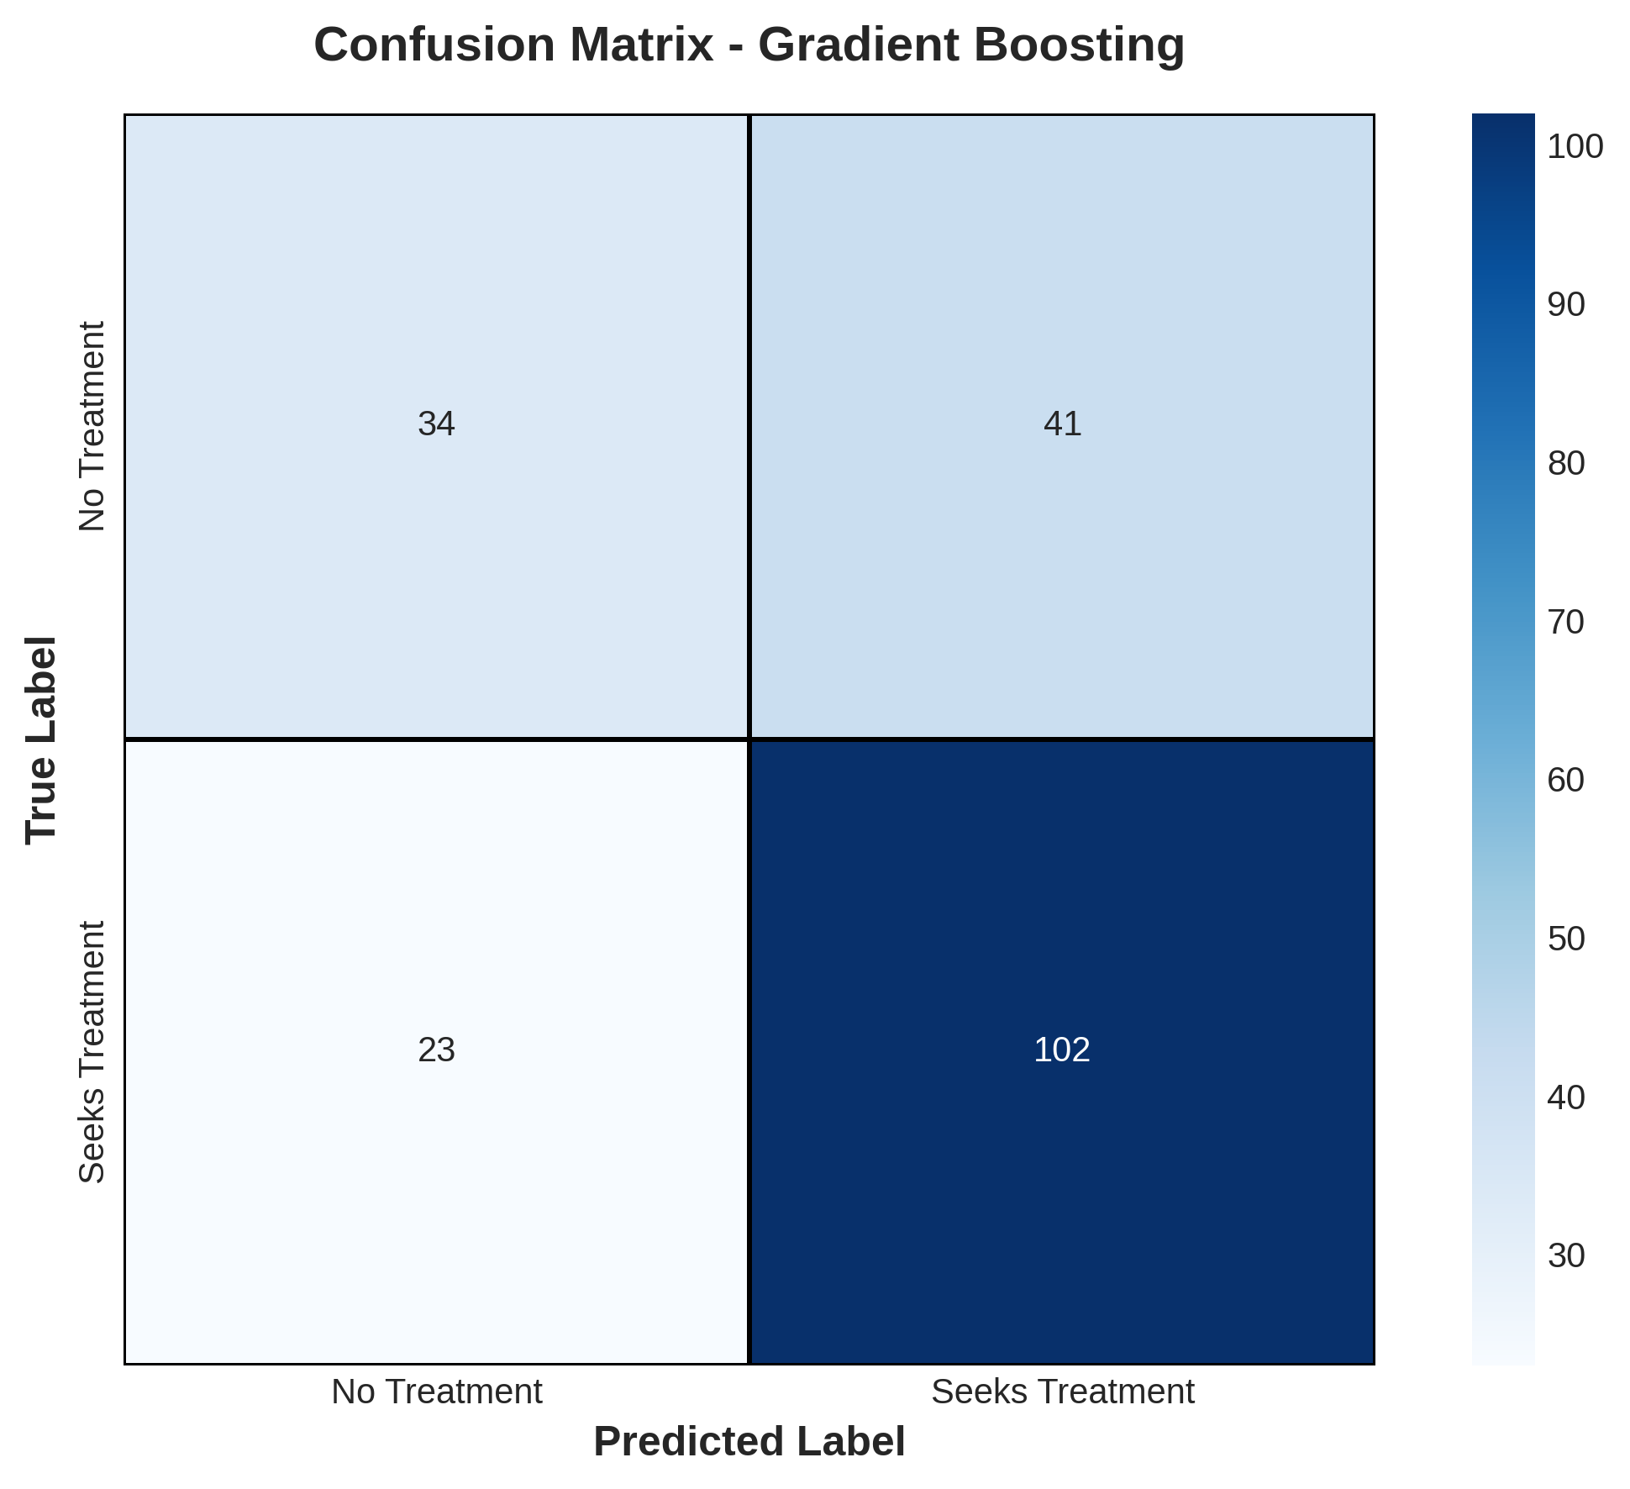
Model Evaluation - Confusion Matrix
Performance analysis of best-performing model

Slide 10
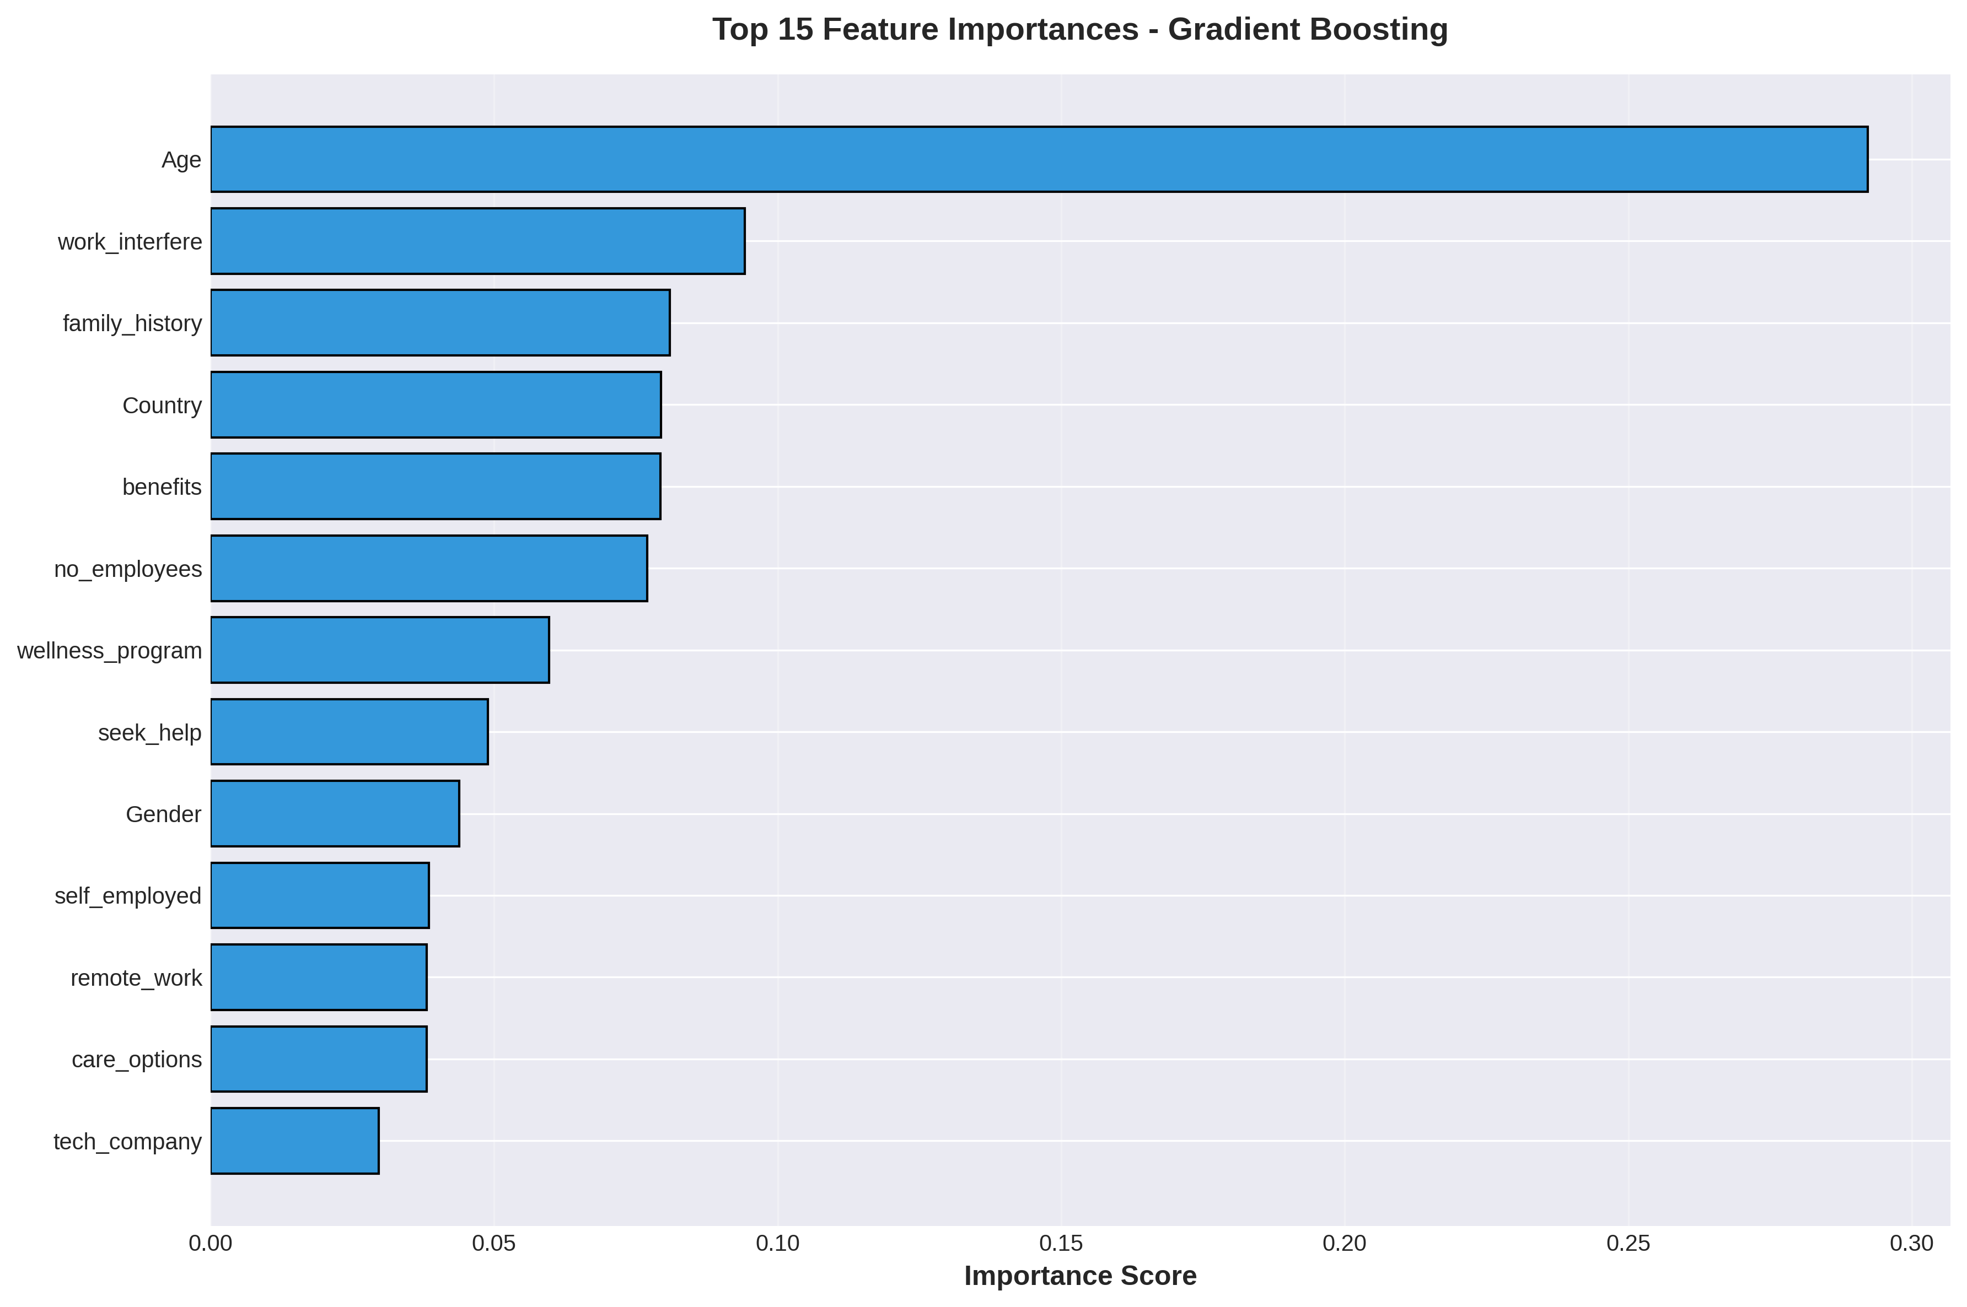
Feature Importance Analysis
Key predictors: family history, work interference, benefits

Slide 11
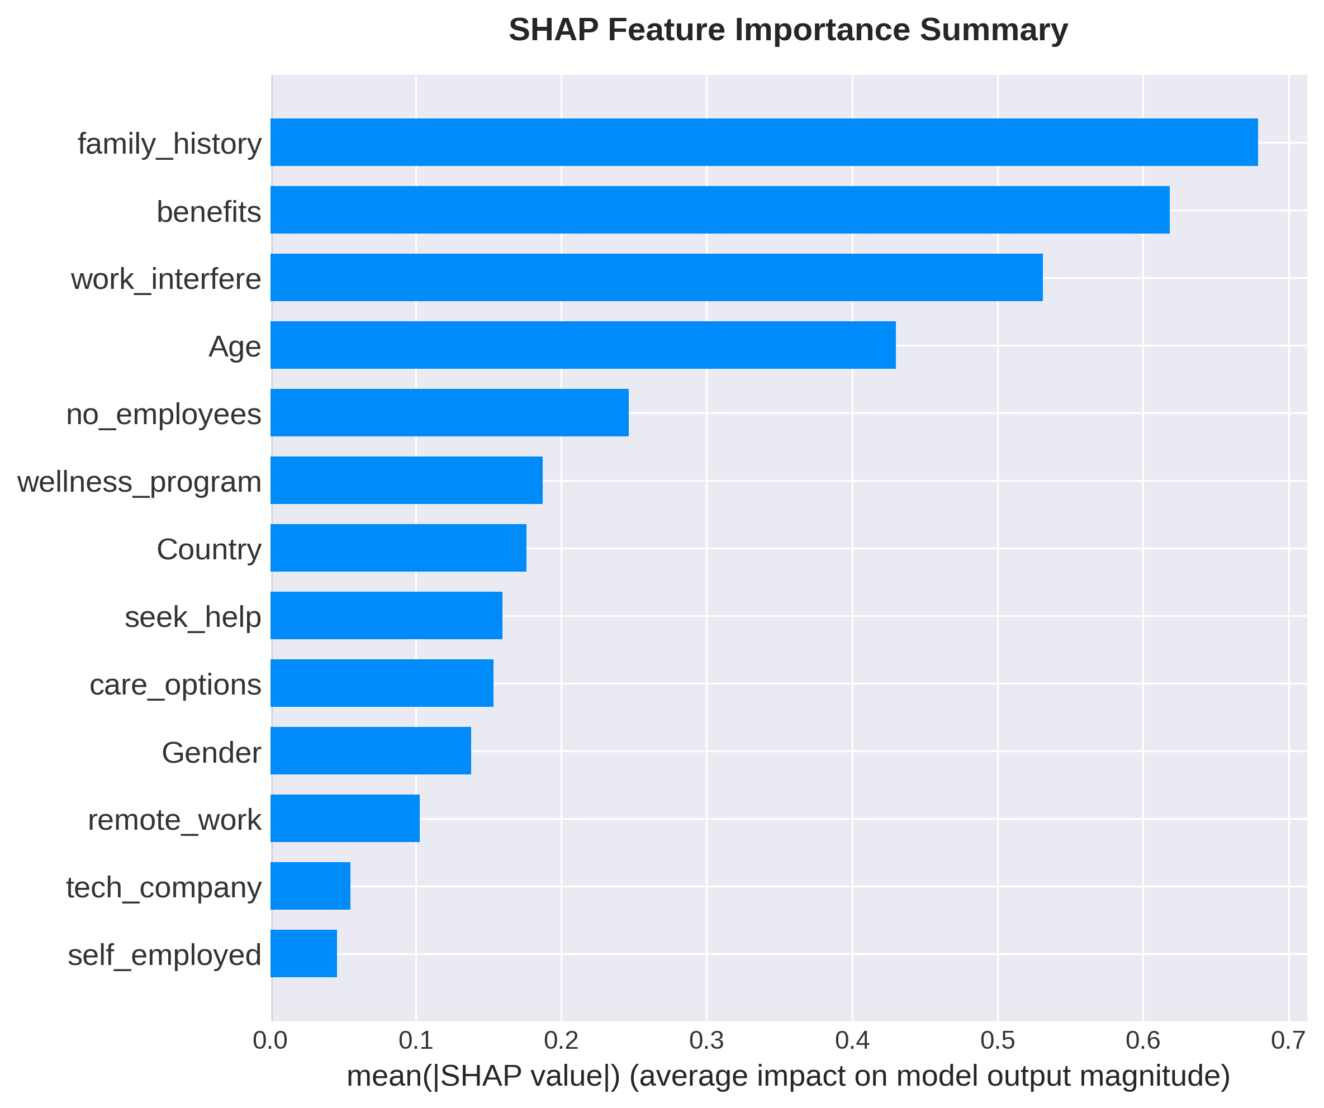
SHAP Feature Importance
Global feature importance using SHAP values

Slide 12
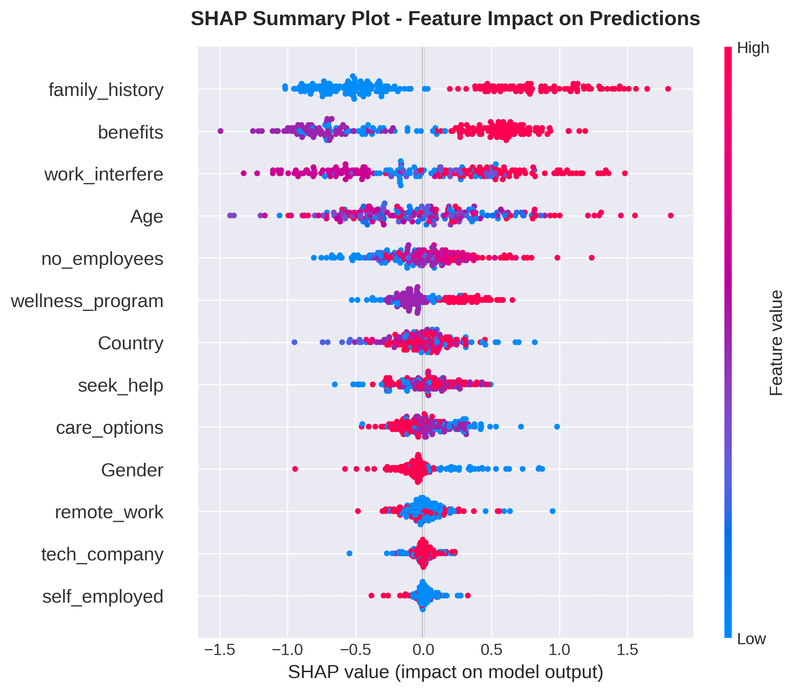
SHAP Detailed Analysis
Feature impact on individual predictions

Slide 13
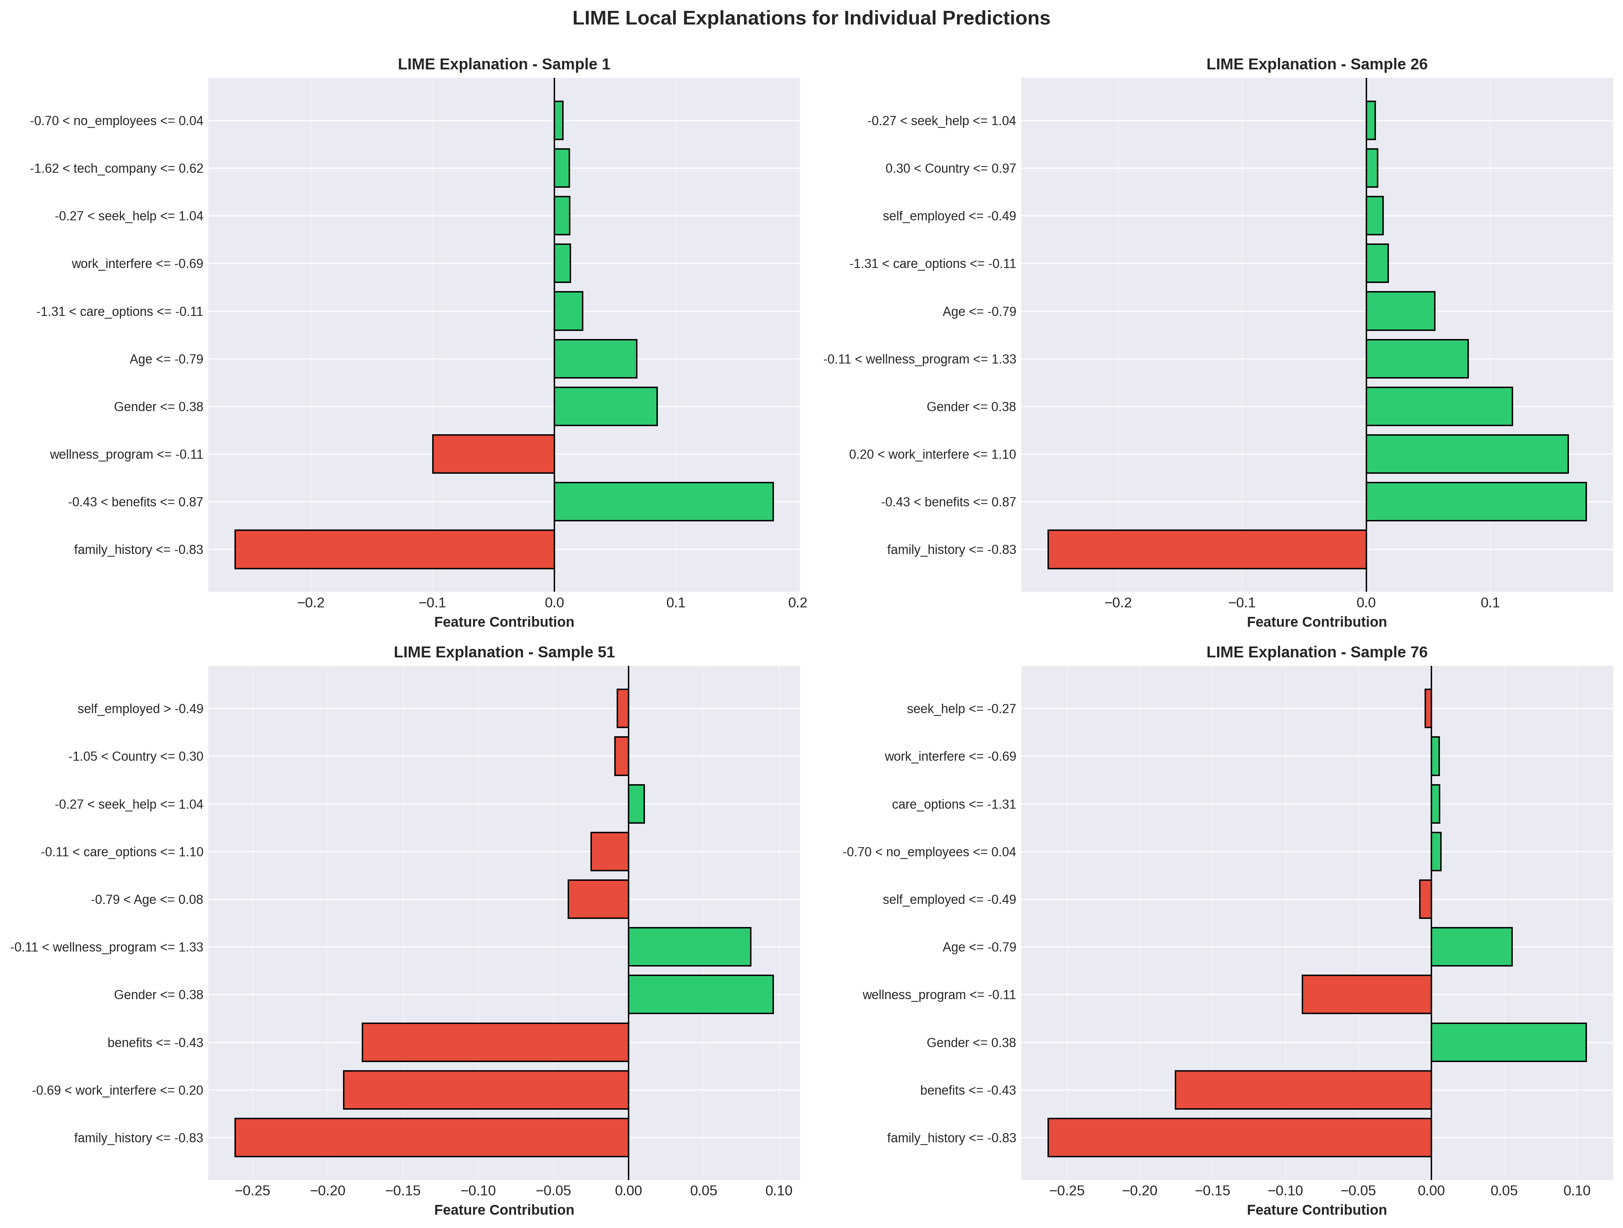
LIME Local Explanations
Human-interpretable explanations for individual predictions

Slide 14
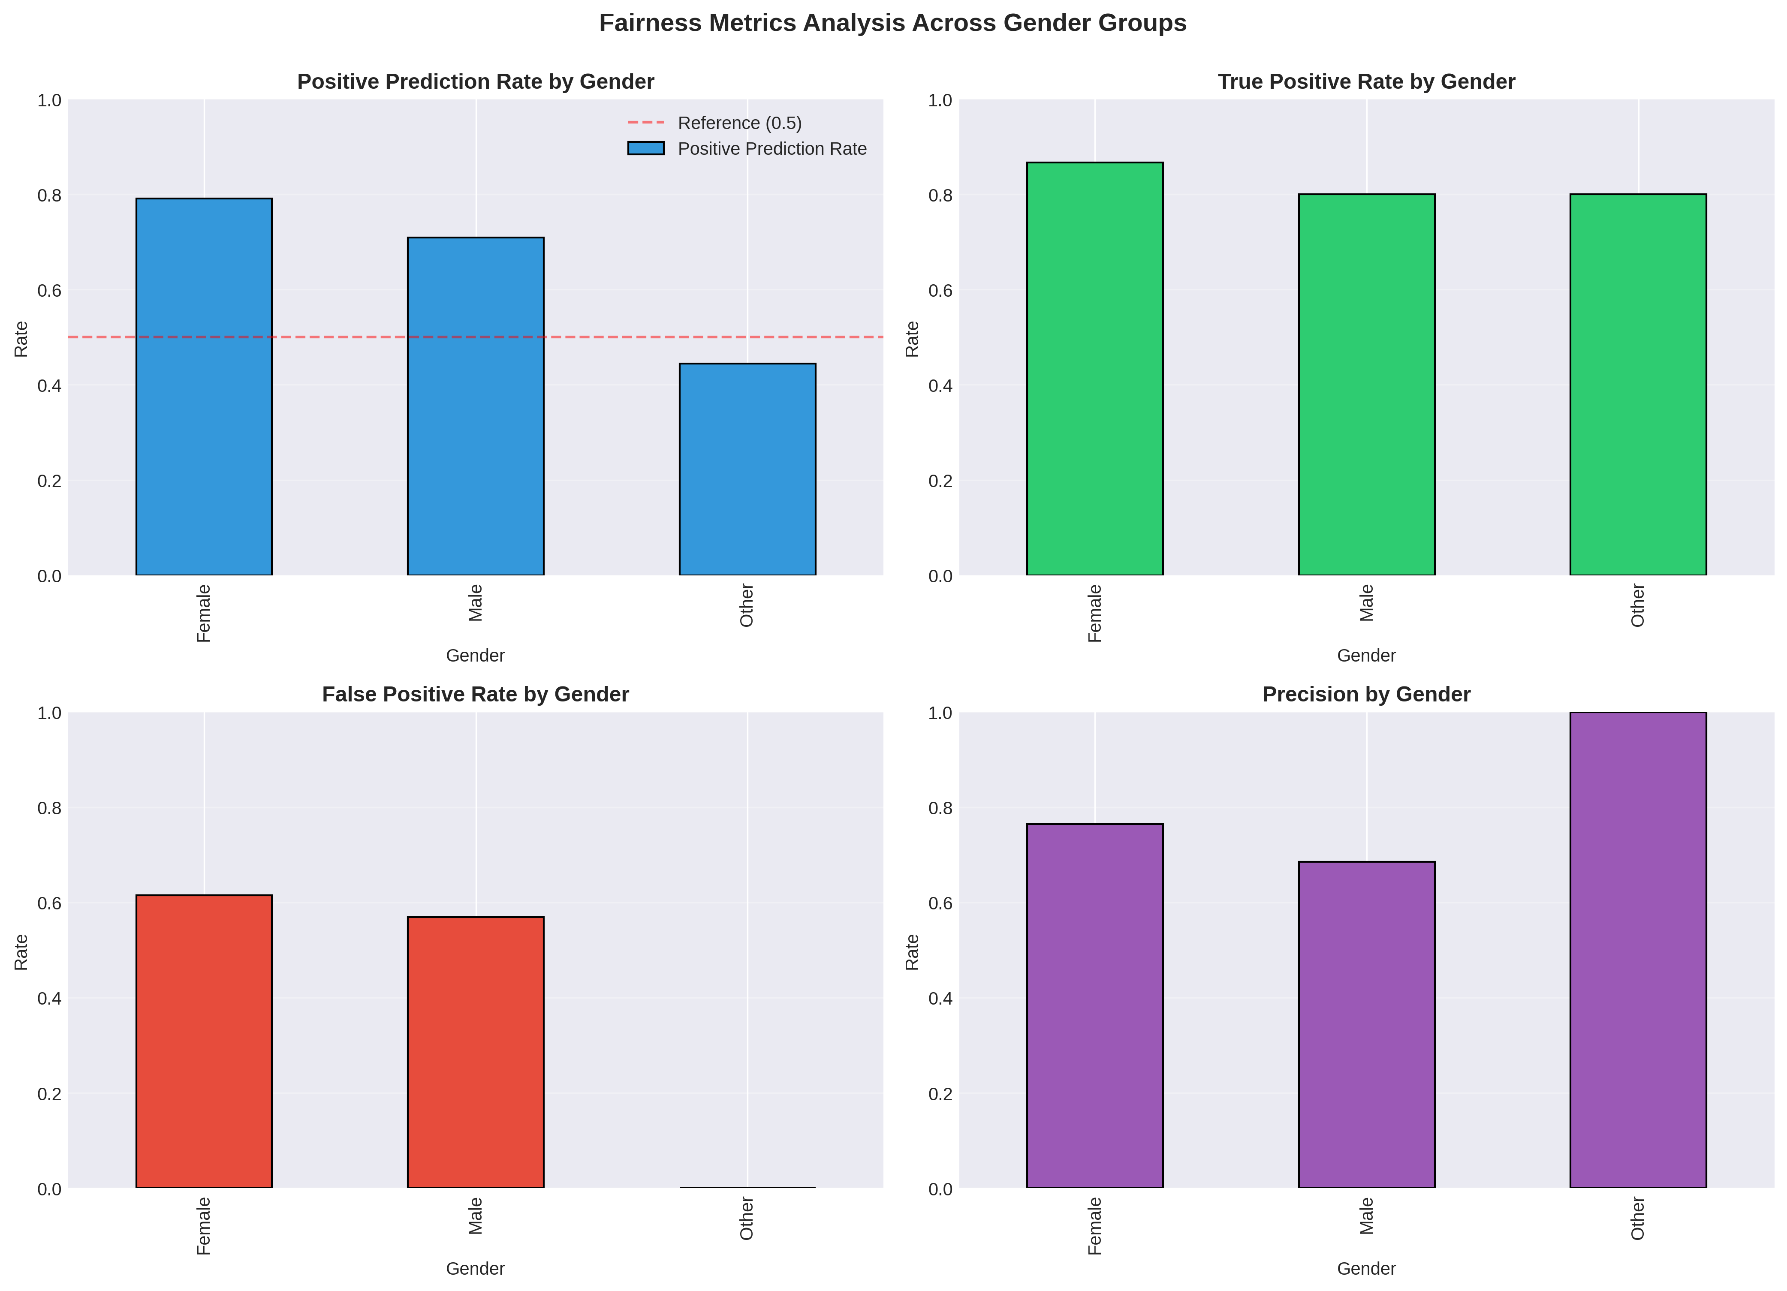
Fairness Analysis Across Demographics
Measuring bias using demographic parity and equalized odds

Slide 15
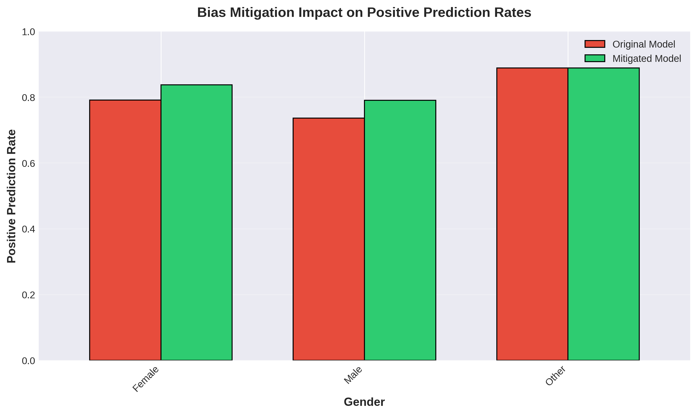
Bias Mitigation Results
Impact of reweighting on fairness metrics

Slide 16
Key Findings: Explainability
SHAP Analysis revealed:
• Family history, work interference, and benefits as top predictors
• Consistent feature importance across model types
• Individual prediction explanations align with clinical intuition
LIME Analysis showed:
• Local explanations vary significantly across individuals
• Model-agnostic approach validates SHAP findings
• Human-interpretable feature contributions
Clinical Implications:
• Enables clinician oversight and validation
• Supports informed decision-making

Slide 17
Key Findings: Bias & Fairness
Bias Detection Results:
• Disparate Impact Ratio: 1.115 (within acceptable range 0.8-1.25)
• Statistical Parity Difference: 0.346 (significant disparity detected)
• Varying True Positive Rates across gender groups
Mitigation Strategies:
• Reweighting reduced prediction rate disparities
• Trade-off: slight decrease in overall accuracy
• Improved fairness metrics across demographics
Lessons Learned:
• No single fairness metric tells the complete story
• Context-specific fairness definitions are critical

Slide 18
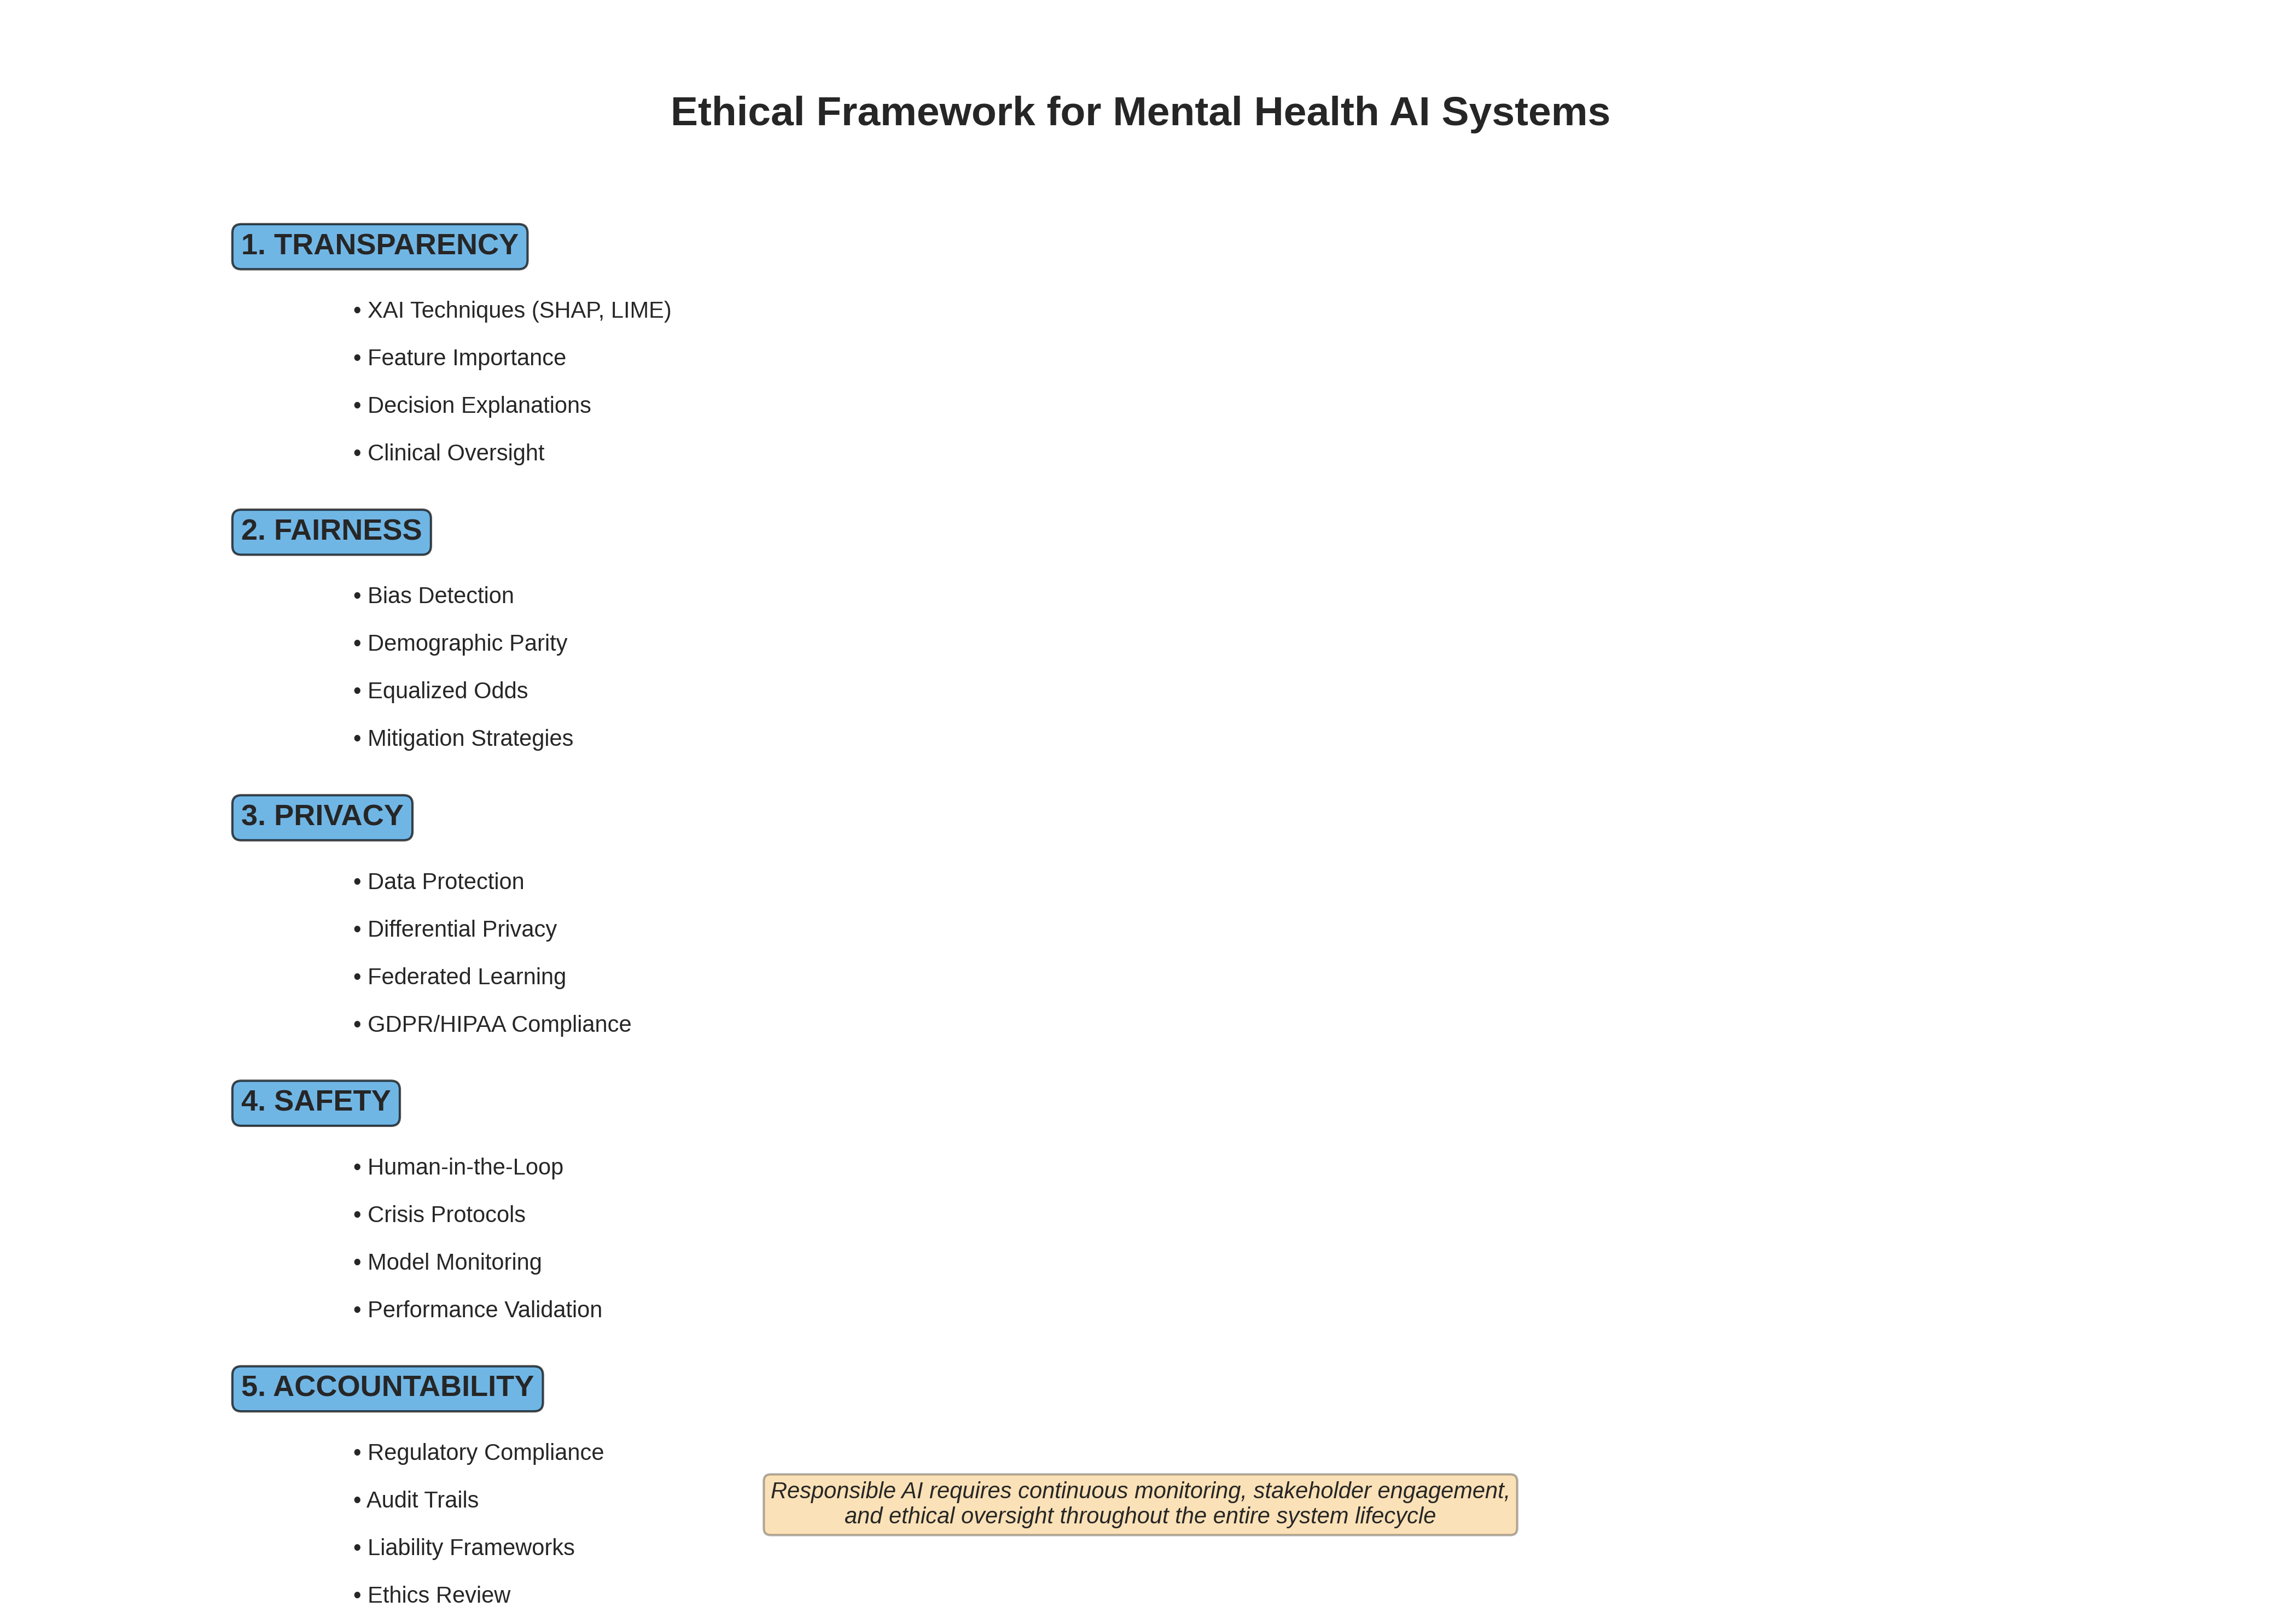
Ethical Framework for Mental Health AI
Comprehensive ethical considerations

Slide 19
Ethical Implications & Recommendations
Transparency & Explainability:
• XAI techniques enable clinical oversight
• Individual prediction explanations support informed consent
Fairness & Non-discrimination:
• Continuous monitoring across demographic groups required
• Bias mitigation must be context-appropriate
Privacy & Data Protection:
• GDPR/HIPAA compliance essential
• Differential privacy and federated learning recommended
Safety & Clinical Oversight:
• Human-in-the-loop for high-risk decisions
• Clear escalation protocols for crisis situations

Slide 20
Regulatory & Legal Considerations
Medical Device Regulation:
• FDA (US) and MHRA (UK) approval pathways
• Classification as medical device vs. wellness tool
AI-Specific Regulation:
• EU AI Act: High-risk AI system requirements
• Transparency and accountability obligations
Liability Frameworks:
• Unclear assignment of responsibility
• Need for clear contractual agreements
Data Protection:
• Cross-border data transfer challenges
• Patient consent and data rights

Slide 21
Limitations & Future Work
Current Limitations:
• Synthetic dataset for demonstration (real-world data needed)
• Limited demographic diversity
• Single point-in-time analysis (no longitudinal data)
• Cultural bias in feature selection
Future Work:
• Expand to multi-modal data (text, voice, behavioral)
• Longitudinal validation studies
• Integration with clinical workflows
• Continuous learning with clinician feedback
• Cross-cultural validation

Slide 22
Technical Implementation Highlights
Libraries & Technologies:
• scikit-learn: Model training and evaluation
• SHAP: Explainability analysis
• LIME: Local interpretability
• pandas, numpy: Data processing
• matplotlib, seaborn: Visualization
Code Quality:
• Modular, well-documented functions
• Comprehensive error handling
• Reproducible results (fixed random seeds)
• Production-ready structure
Total: ~1200 lines of documented Python code

Slide 23
Conclusions
Demonstrated successful integration of XAI in mental health AI:
✓ SHAP and LIME provide complementary explainability
✓ Bias detection reveals fairness challenges
✓ Mitigation strategies improve equity (with trade-offs)
✓ Comprehensive ethical framework guides deployment
Key Takeaways:
• Transparency is achievable through XAI techniques
• Fairness requires continuous monitoring and context-specific approaches
• Technical solutions must be coupled with ethical governance
• Multidisciplinary collaboration is essential
Mental health AI holds promise, but responsible deployment requires
ongoing commitment to transparency, fairness, and patient safety

Slide 24
References (1/2)
Lundberg, S. M., & Lee, S. I. (2017). A unified approach to interpreting model predictions. NIPS.
Ribeiro, M. T., et al. (2016). Why should I trust you? Explaining predictions of ML models. KDD.
Obermeyer, Z., et al. (2019). Dissecting racial bias in an algorithm. Science, 366(6464).
Rajkomar, A., et al. (2018). Ensuring fairness in ML to advance health equity. Annals of Internal Medicine.
Mehrabi, N., et al. (2021). A survey on bias and fairness in machine learning. ACM Computing Surveys.

Slide 25
References (2/2)
Char, D. S., et al. (2020). Implementing ML in health care. NEJM, 383(10).
Hardt, M., et al. (2016). Equality of opportunity in supervised learning. NIPS.
Wachter, S., et al. (2021). Bias preservation in ML. West Virginia Law Review.
Chen, I. Y., et al. (2019). Can AI help reduce disparities in general medical and mental health care? AMA Journal of Ethics.
Additional references available in code documentation and ethical report.

Slide 26
Thank You
Questions & Discussion
Summen Zahid (B00996747) | COM772 - Emerging and Advanced Topics in AI

